Slide 1

Communication

Slide 2
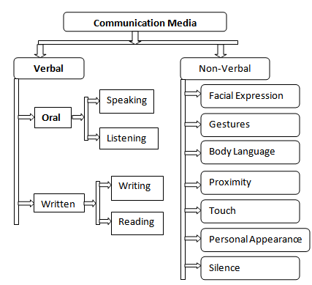
Communication-Types

Slide 3
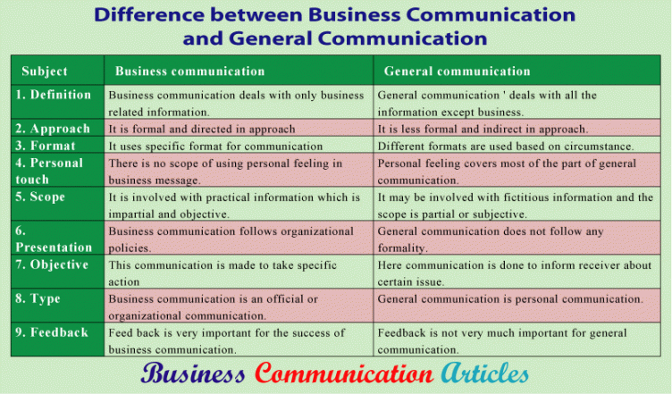
Difference between General and Business Communication

Slide 4

BARRIERS TO COMMUNICATION
Perceptual and Language Differences: Perception is generally how each individual interprets the world around him. All generally want to receive messages which are significant to them. But any message which is against their values is not accepted. A same event may be taken differently by different individuals. For example : A person is on leave for a month due to personal reasons (family member being critical). The HR Manager might be in confusion whether to retain that employee or not, the immediate manager might think of replacement because his teams productivity is being hampered, the family members might take him as an emotional support Information Overload: Managers are surrounded with a pool of information. It is essential to control this information flow else the information is likely to be misinterpreted or forgotten or overlooked. As a result communication is less effective. Inattention: At times we just not listen, but only hear. For example a traveler may pay attention to one “NO PARKING” sign, but if such sign is put all over the city, he no longer listens to it. Thus, repetitive messages should be ignored for effective communication. Similarly if a superior is engrossed in his paper work and his subordinate explains him his problem, the superior may not get what he is saying and it leads to disappointment of subordinate. Time Pressures: Often in organization the targets have to be achieved within a specified time period, the failure of which has adverse consequences. In a haste to meet deadlines, the formal channels of communication are shortened, or messages are partially given, i.e., not completely transferred. Thus sufficient time should be given for effective communication.

Slide 5
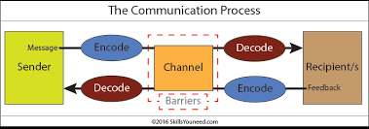
Distraction/Noise: Communication is also affected a lot by noise to distractions. Physical distractions are also there such as, poor lightning, uncomfortable sitting, unhygienic room also affects communication in a meeting. Similarly use of loud speakers interferes with communication.
Emotions: Emotional state at a particular point of time also affects communication. If the receiver feels that communicator is angry he interprets that the information being sent is very bad. While he takes it differently if the communicator is happy and jovial (in that case the message is interpreted to be good and interesting).
Complexity in Organizational Structure: Greater the hierarchy in an organization (i.e. more the number of managerial levels), more is the chances of communication getting destroyed. Only the people at the top level can see the overall picture while the people at low level just have knowledge about their own area and a little knowledge about other areas.
Poor retention: Human memory cannot function beyond a limit. One cant always retain what is being told specially if he is not interested or not attentive. This leads to communication breakdown

Slide 6
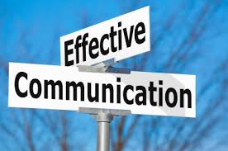
Overcoming barriers in Communication
Eliminating differences in perception: The organization should ensure that it is recruiting right individuals on the job. It’s the responsibility of the interviewer to ensure that the interviewee has command over the written and spoken language. There should be proper Induction program so that the policies of the company are clear to all the employees. There should be proper trainings conducted for required employees (for eg: Voice and Accent training).
Use of Simple Language: Use of simple and clear words should be emphasized. Use of ambiguous words and jargons should be avoided.
Reduction and elimination of noise levels: Noise is the main communication barrier which must be overcome on priority basis. It is essential to identify the source of noise and then eliminate that source.
Active Listening: Listen attentively and carefully. There is a difference between “listening” and “hearing”. Active listening means hearing with proper understanding of the message that is heard. By asking questions the speaker can ensure whether his/her message is understood or not by the receiver in the same terms as intended by the speaker.

Slide 7

Emotional State: During communication one should make effective use of body language. He/she should not show their emotions while communication as the receiver might misinterpret the message being delivered. For example, if the conveyer of the message is in a bad mood then the receiver might think that the information being delivered is not good.
Simple Organizational Structure: The organizational structure should not be complex. The number of hierarchical levels should be optimum. There should be a ideal span of control within the organization. Simpler the organizational structure, more effective will be the communication.
Avoid Information Overload: The managers should know how to prioritize their work. They should not overload themselves with the work. They should spend quality time with their subordinates and should listen to their problems and feedbacks actively.

Slide 8
Give Constructive Feedback: Avoid giving negative feedback. The contents of the feedback might be negative, but it should be delivered constructively. Constructive feedback will lead to effective communication between the superior and subordinate.
Proper Media Selection: The managers should properly select the medium of communication. Simple messages should be conveyed orally, like: face to face interaction or meetings. Use of written means of communication should be encouraged for delivering complex messages. For significant messages reminders can be given by using written means of communication such as : Memos, Notices etc.
Flexibility in meeting the targets: For effective communication in an organization the managers should ensure that the individuals are meeting their targets timely without skipping the formal channels of communication. There should not be much pressure on employees to meet their targets.

