Slide 1
Quantum Computation

Slide 2



Introduction
Qubits $: \left.|0\right\rangle$ $\left.|1\right\rangle$
Linear Combination of states / Superposition
$\left.|ψ\right\rangle$ = α $\left.|0\right\rangle$ + β $\left.|1\right\rangle$
Qubit’s state is a unit vector in a 2-D complex vector space.
$\frac{1}{\sqrt{2}}$ $\left.|0\right\rangle$ + $\frac{1}{\sqrt{2}}$ $\left.|1\right\rangle$ …………. $\left.|+\right\rangle$

Slide 3

Multiple qubits
$\left.|ψ\right\rangle$ = ${\text{α}}_{00} \left.|00\right\rangle$ + ${\text{α}}_{01} \left.|01\right\rangle$+${\text{α}}_{10} \left.|10\right\rangle$+${\text{α}}_{11} \left.|11\right\rangle$
Amplitude
Measurement of 2qubit system
Bell State or EPR pair
$\frac{\left.|00\right\rangle \text{ + }\left.|11\right\rangle }{\sqrt{2}}$

Slide 4
Condition for a Quantum Gate
Matrix representing the Gate is Unitary
X X† = I
X† is adjoint of X, obtained by transposing and then complex conjugating X

Slide 5

Single qubit gates
Classical not Gate 0 ->1 and 1-> 0
Quantum not Gate ??
$\text{α} \left.|0\right\rangle$ + $β \left.|1\right\rangle$ -----?
X = $\left[\begin{matrix}0 & 1 \\ 1 & 0\end{matrix}\right]$

Slide 6

Single qubit gates
Z Gate
Leaves $\left.|0\right\rangle$ unchanged and flips sign of$\left.|1\right\rangle$
Z = $\left[\begin{matrix}1 & 0 \\ 0 & −1\end{matrix}\right]$

Slide 7

Single qubit gates
Hadamard Gate / square root of not Gate
Turns $\left.|0\right\rangle$ to ($\left.|0\right\rangle$ + $\left.|1\right\rangle$)/ $\sqrt{2}$
Turns$\left. |1\right\rangle$ to ($\left.|0\right\rangle$ - $\left.|1\right\rangle$)/ $\sqrt{2}$
Z = $\frac{1}{\sqrt{2}}\left[\begin{matrix}1 & 1 \\ 1 & −1\end{matrix}\right]$

Slide 8
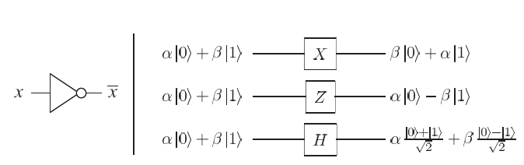
Single qubit gates

Slide 9
Multiple qubit gates
Controlled-Not or CNOT gate
2 inputs : control qubit & target qubit
If control qubit set to 0 then target left alone
If control qubit set to 1 then target qubit flipped

Slide 10
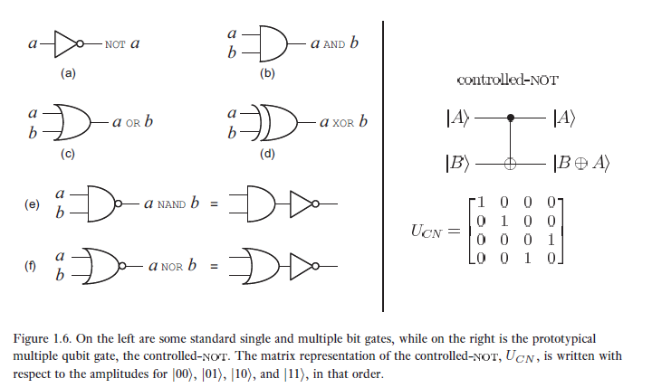
Multiple qubit gates

Slide 11

Measurement Operation
Measurement : converts the qubit to a probabilistic classical bit

Slide 12
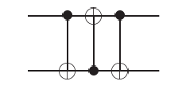

Quantum Circuit
Write the output for the input $\left.|a,b\right\rangle$

Slide 13
Quantum Circuit v/s Classical Circuit
Quantum Circuit | Classical Circuit
Loops i.e. Feedback not allowed The circuits are acyclic | Loops i.e. Feedback allowed
Doe not allow wires to be joined, an operation called as FANIN, as the operation is not reversible and therefore not unitary | Allows wires to be joined, an operation called as FANIN
Quantum mechanics forbids copying of bits and hence the FANOUT , where the several copies of bits are produced is not allowed in the circuit | FANOUT is allowed

Slide 14
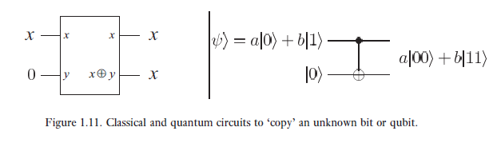
Qubit Copying State

Slide 15
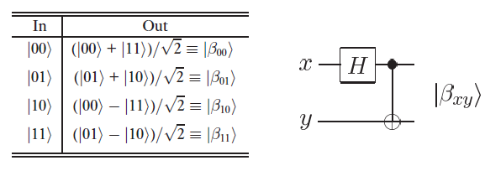
Bell States

Slide 16
References
Quantum_text_41_54 : ebook (page 41-54)
Actual Book pages 13-26

