Slide 1
Secure Hash Algorithm-512 (SHA-512)

Slide 2
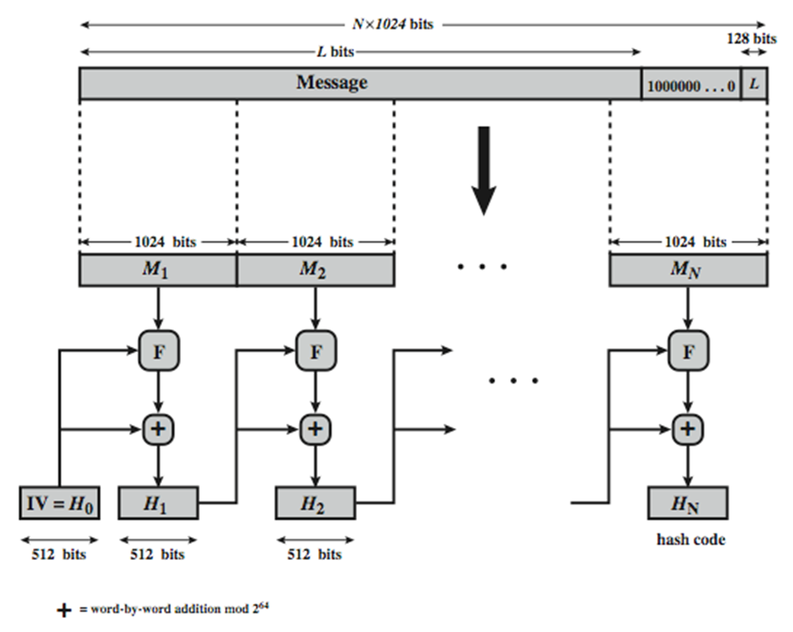
Figure: SHA-512 Processing of a Single 1024-Bit Block
Processing of SHA-512

Slide 3
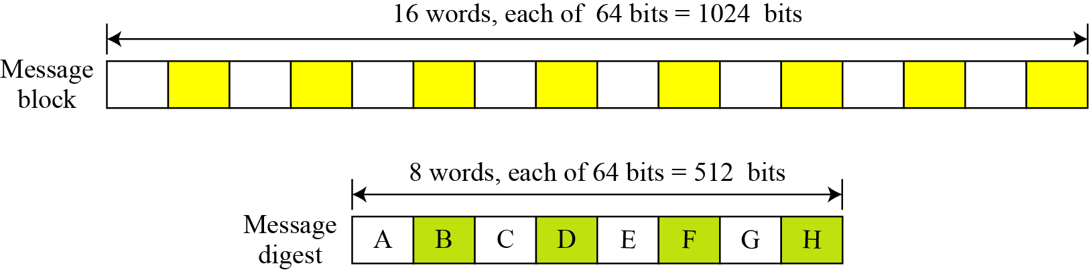
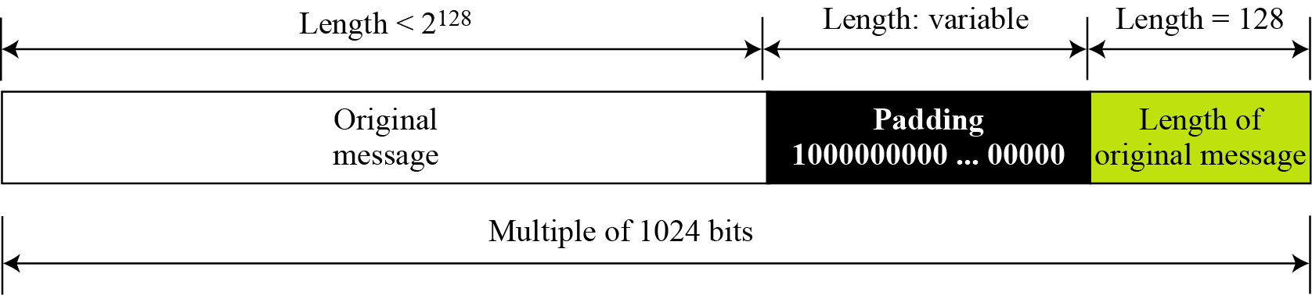
Message block and digest word
Figure: A message block and the digest as words
Figure: Padding and length field

Slide 4
12.2.1 Continued
Example 12.3
What is the number of padding bits if the length of the original message is 2590 bits?
Solution
We can calculate the number of padding bits as follows:
The padding consists of one 1 followed by 353 0’s.

Slide 5
12.2.1 Continued
Example 12.4
Do we need padding if the length of the original message is already a multiple of 1024 bits?
Solution
Yes we do, because we need to add the length field. So padding is needed to make the new block a multiple of 1024 bits.

Slide 6
Processing of SHA-512
appending padding and fixed 128 bit length field
dividing the augmented message into blocks
using a 64-bit word derived from the current message block
using 8 constants based on square root of first 8 prime numbers (2-19)
updating a 512-bit buffer
using a round constant based on cube root of first 80 prime numbers (2-409)

Slide 7
Message block and digest word
operates on words
each block consists of sixteen 64 bits(1024 bits) words
message digest has eight 64 bits (512 bits) words named A,B,C,D,E,F,G,H
expanding 80 words from sixteen 64 bits words

Slide 8
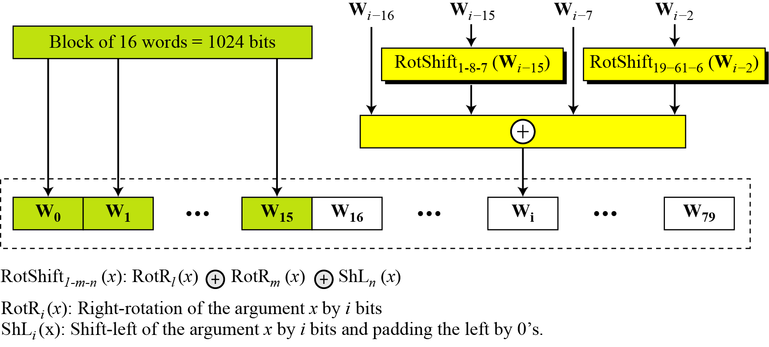
Figure: Word expansion in SHA-512
SHA-512 Initial Values & Word Expansion
Table : Values of constants in message digest initialization of SHA-512
Buffer | Value (in Hexadecimal) | Buffer | Value (in Hexadecimal)
A0 | 6A09E667F3BCC908 | E0 | 510E527FADE682D1
B0 | BB67AE8584CAA73B | F0 | 9B05688C2B3E6C1F
C0 | 3C6EF372FE94F82B | G0 | 1F83D9ABFB41BD6B
D0 | A54FF53A5F1D36F1 | H0 | 5BE0CD19137E2179

Slide 9
12.2.1 Continued
Example 12.6
Show how W60 is made.
Solution
Each word in the range W16 to W79 is made from four previously-made words. W60 is made as

Slide 10
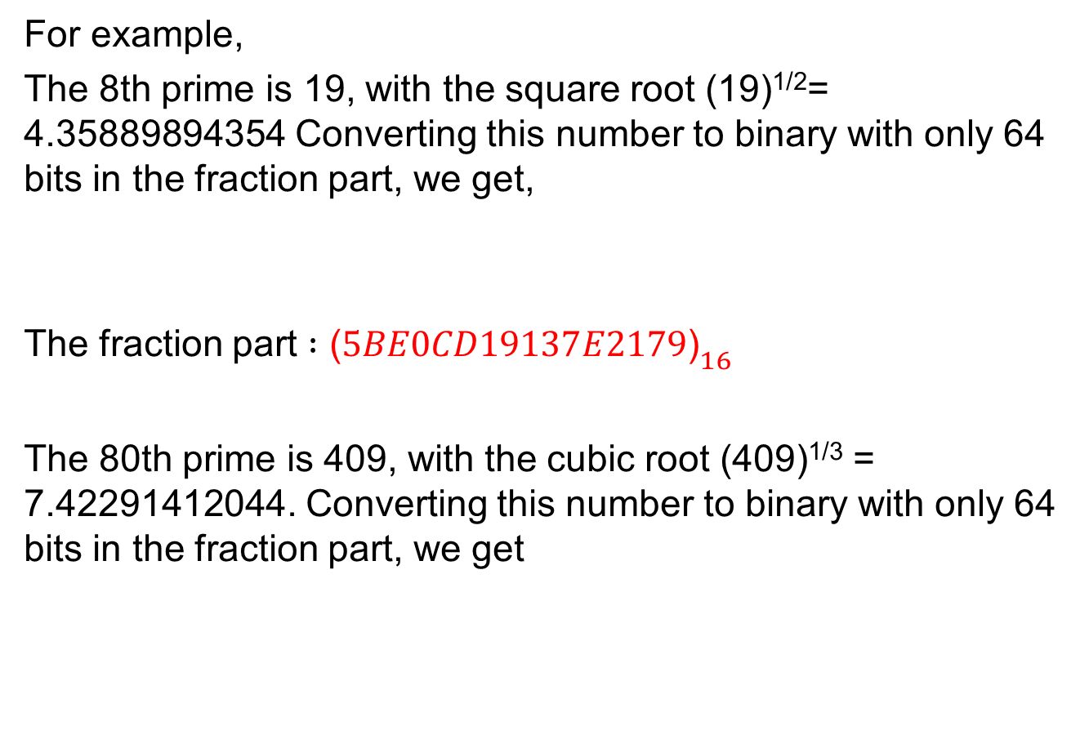
Calculation of constants
For example,
The 8th prime is 19, with the square root (19)^{1/2}= 4.35889894354 Converting this number to binary with only 64 bits in the fraction part, we get,
The fraction part $:{\text{ (}5BE0CD19137E2179\text{)}}_{16 }$
The 80th prime is 409, with the cubic root (409)^{1/3} = 7.42291412044. Converting this number to binary with only 64 bits in the fraction part, we get
${\text{ (}\text{100.0101 1011 1110 …1001})}_{2}{ \text{(}4.5BE0CD19137E2179\text{)}}_{16 }$
The fraction part: (6C44198C4A475817)₁₆

Slide 11
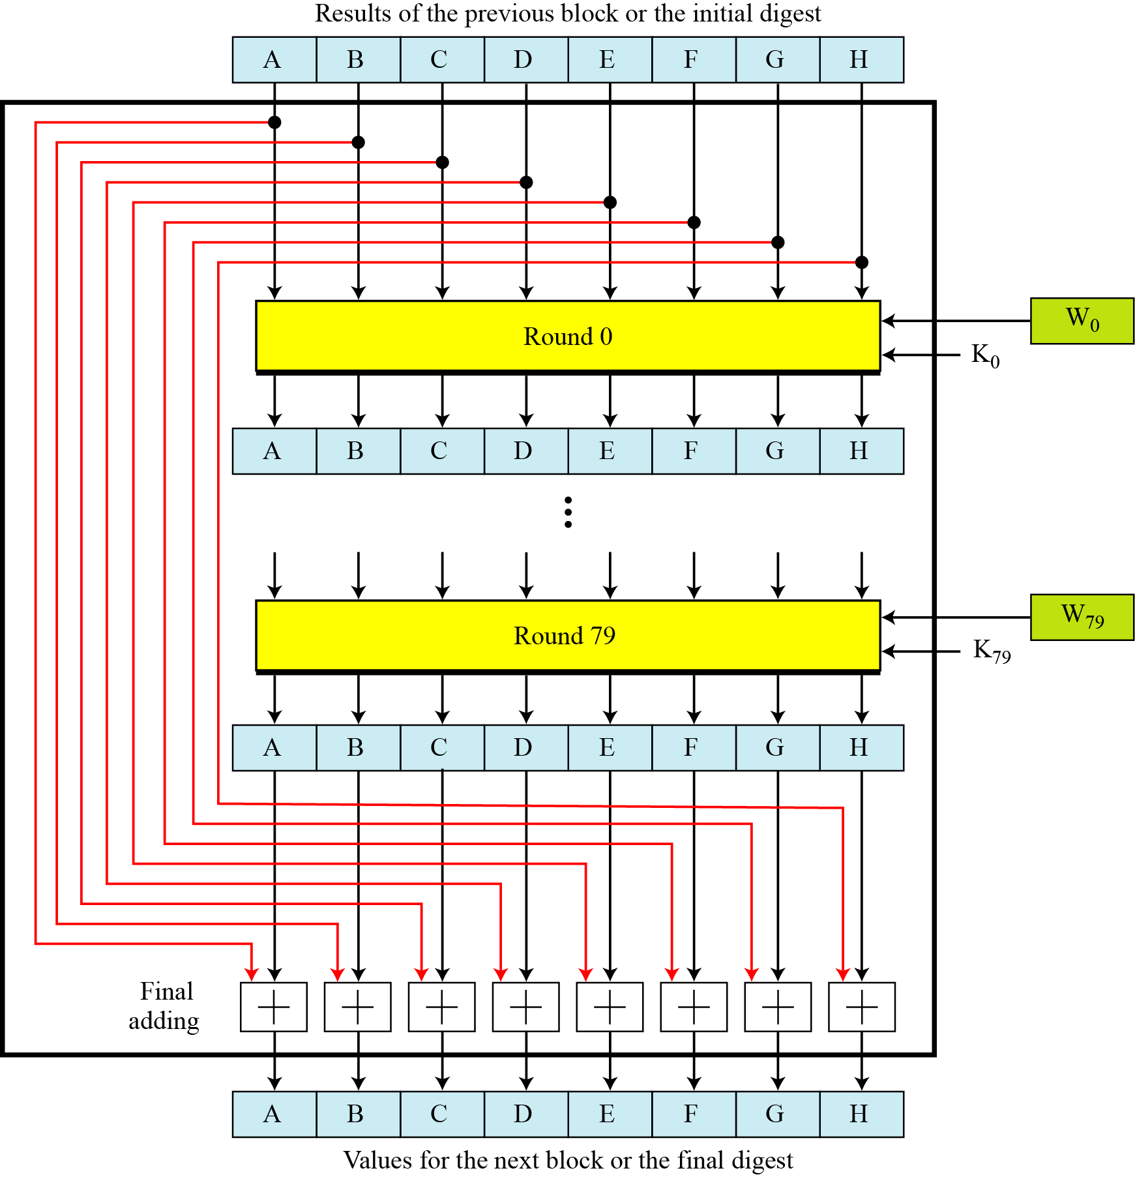
Figure: Compression Function in SHA-512
SHA-512 Compression Function

Slide 12
Figure: List of round constants used in SHA-512
SHA-512 Round constants (K)

Slide 13
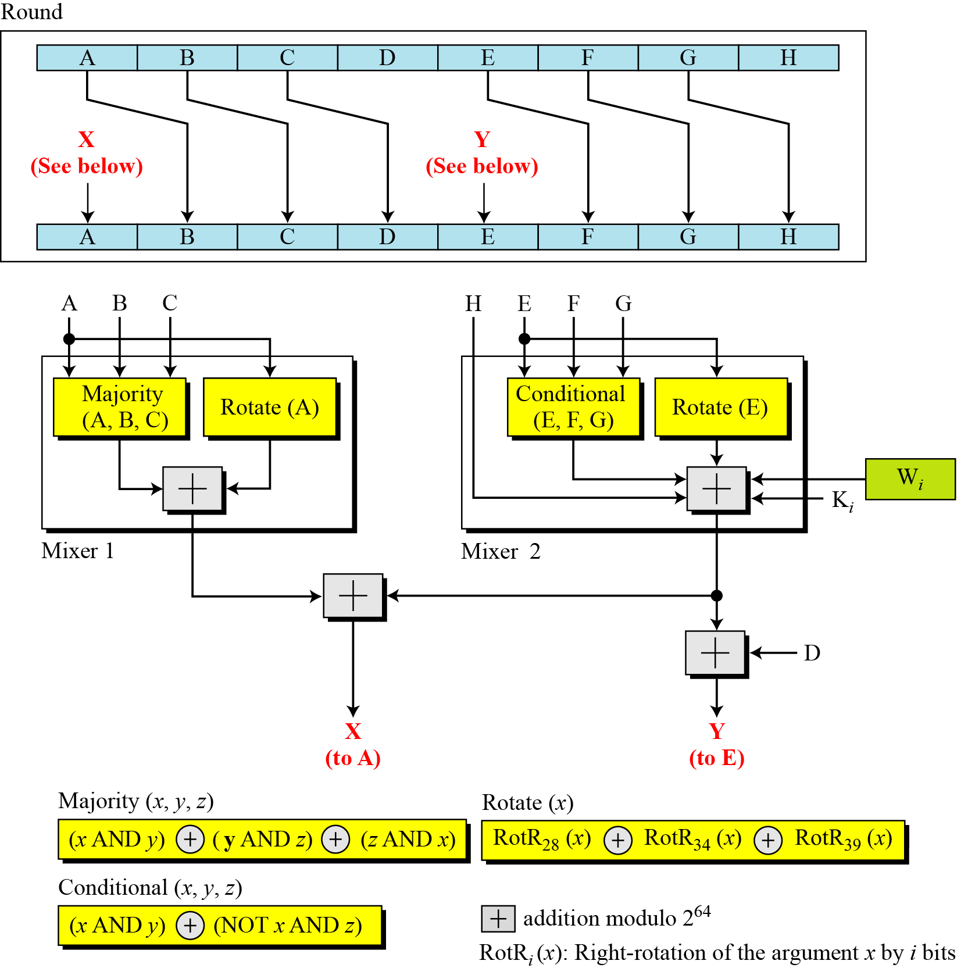
Figure: Structure of each round in SHA-512
SHA-512 Round Function

Slide 14
SHA-512 Round Function
Majority Function
Conditional Function
Rotate Functions

Slide 15

SHA-512 Majority Function calculation
We apply the Majority function on buffers A, B, and C. If the leftmost hexadecimal digits of these buffers are 0x7, 0xA, and 0xE, respectively, what is the leftmost digit of the result?
Solution
The digits in binary are 0111, 1010, and 1110.
a. The first bits are 0, 1, and 1. The majority is 1.
b. The second bits are 1, 0, and 1. The majority is 1.
c. The third bits are 1, 1, and 1. The majority is 1.
d. The fourth bits are 1, 0, and 0. The majority is 0.
The result is 1110, or 0xE in hexadecimal.

Slide 16

SHA-512 Conditional Function calculation
We apply the Conditional function on E, F, and G buffers. If the leftmost hexadecimal digits of these buffers are 0x9, 0xA, and 0xF respectively, what is the leftmost digit of the result?
Solution
The digits in binary are 1001, 1010, and 1111.
a. The first bits are 1, 1,and 1.The result is F₁, which is 1.
b. The second bits are 0,0, and 1. The result is G₂, which is 1.
c. The third bits are 0,1,and 1.The result is G₃, which is 1.
d. The fourth bits are 1,0,and 1.The result is F₄, which is 0.
The result is 1110, or 0xE in hexadecimal.

Slide 17
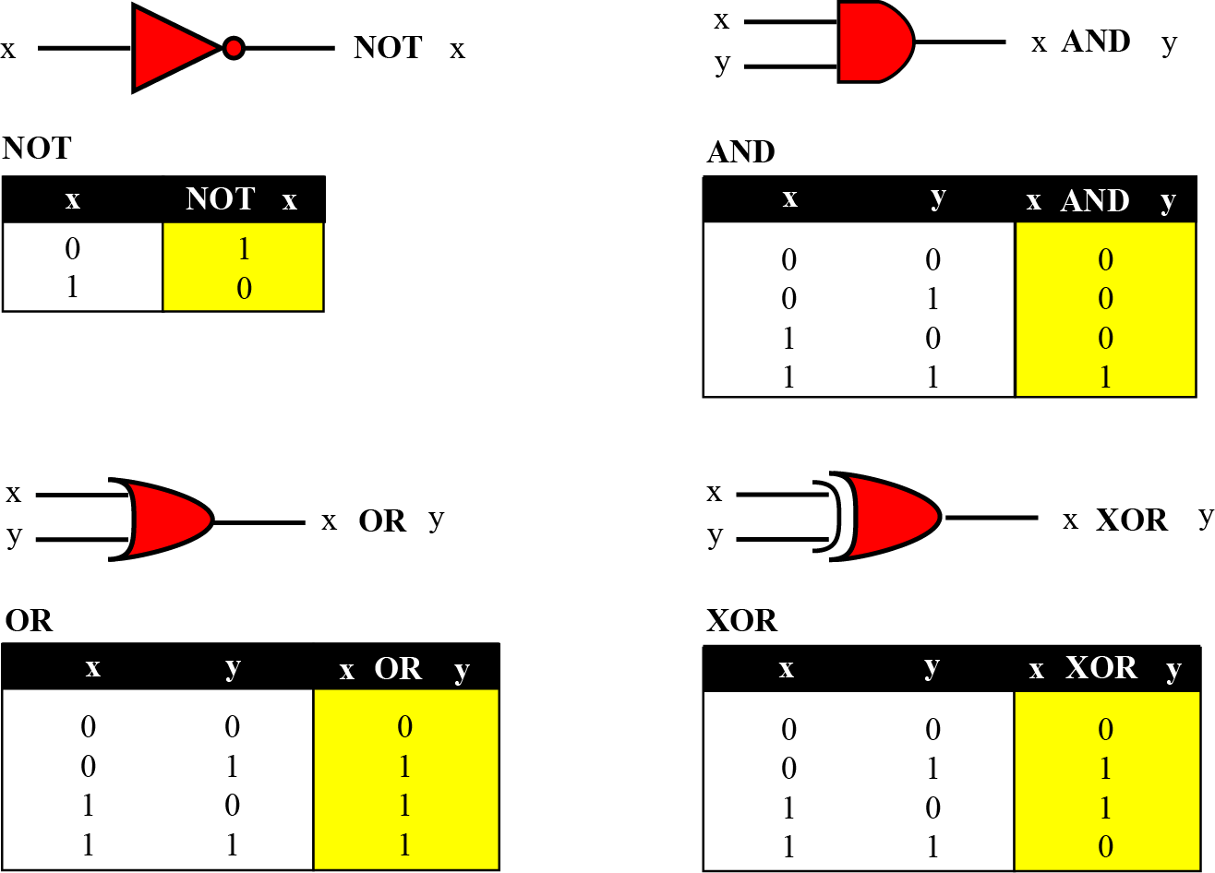
Figure 4.1 Logic operations at the bit level

Slide 18
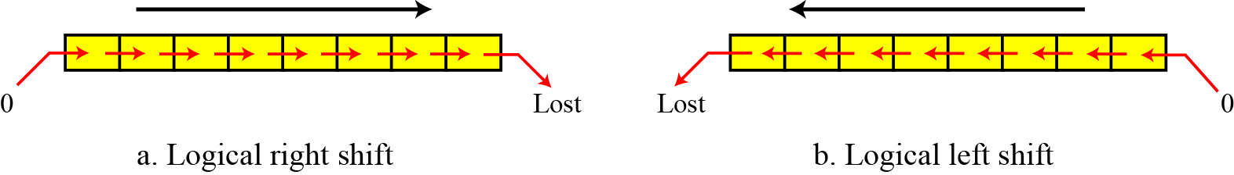
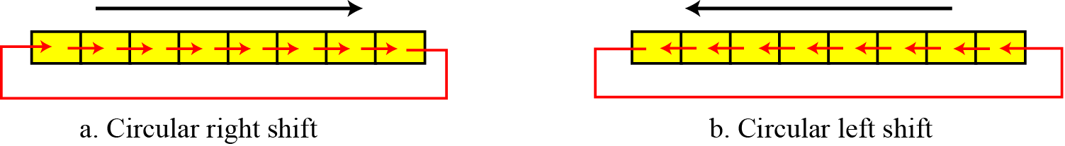
Some of the operations Done …
Logical shift operations insert zeros from the right or left; the circular shifts take whatever bits drop out of one end of the word and put them into the other end.

Slide 19
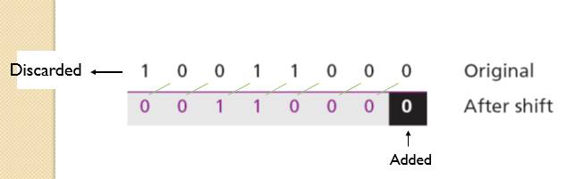
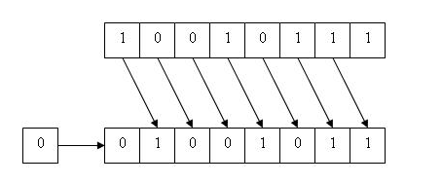
Use a logical left shift operation on the bit pattern 10011000.
Solution
The solution is shown below. The leftmost bit is lost and a 0 is inserted as the rightmost bit.
RIGHT SHIFT

Slide 20
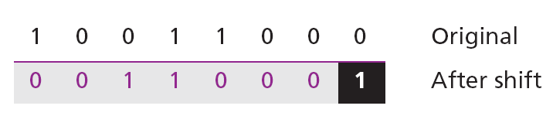
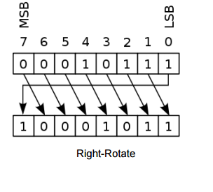
Use a circular left shift operation on the bit pattern 10011000.
Solution
The solution is shown below. The leftmost bit is circulated and becomes the rightmost bit.

Slide 21
Example using SHA-512
ASCII characters: “abc”, which is equivalent to the following 24-bit binary string:
01100001 01100010 01100011 = 616263 in Hexadecimal
The original length is 24 bits, or a hexadecimal value of 18. the 1024-bit message block, in hexadecimal, is
6162631000000000 0000000000000000 0000000000000000 0000000000000000 0000000000000000 0000000000000000 0000000000000000 0000000000000000 0000000000000000 0000000000000000 0000000000000000 0000000000000000 0000000000000000 0000000000000000 0000000000000000 0000000000000018 W0 = 6162638000000000 W5 = 0000000000000000 W1 = 0000000000000000 W6 = 0000000000000000 W2 = 0000000000000000 W7 = 0000000000000000 W3 = 0000000000000000 W8 = 0000000000000000 W4 = 0000000000000000 W9 = 0000000000000000 W10 = 0000000000000000 W13 = 0000000000000000 W11 = 0000000000000000 W14 = 0000000000000000 W12 = 0000000000000000 W15 = 0000000000000018

Slide 22
The following table shows the initial values of these variables and their values after each of the first two rounds. The process continues through 80 rounds. The output of the final round is 73a54f399fa4b1b2 10d9c4c4295599f6 d67806db8b148677 654ef9abec389ca9 d08446aa79693ed7 9bb4d39778c07f9e 25c96a7768fb2aa3 ceb9fc3691ce8326
Example using SHA-512
a | 6a09e667f3bcc908 | f6afceb8bcfcddf5 | 1320f8c9fb872cc0
b | bb67ae8584caa73b | 6a09e667f3bcc908 | f6afceb8bcfcddf5
c | 3c6ef372fe94f82b | bb67ae8584caa73b | 6a09e667f3bcc908
d | a54ff53a5f1d36f1 | 3c6ef372fe94f82b | bb67ae8584caa73b
e | 510e527fade682d1 | 58cb02347ab51f91 | c3d4ebfd48650ffa
f | 9b05688c2b3e6c1f | 510e527fade682d1 | 58cb02347ab51f91
g | 1f83d9abfb41bd6b | 9b05688c2b3e6c1f | 510e527fade682d1
h | 5be0cd19137e2179 | 1f83d9abfb41bd6b | 9b05688c2b3e6c1f

Slide 23
Example using SHA-512
The hash value is then calculated as
H1,7 = 5be0cd19137e2179 + ceb9fc3691ce8326 = 2a9ac94fa54ca49f H1,6 = 1f83d9abfb41bd6b + 25c96a7768fb2aa3 = 454d4423643ce80e H1,5 = 9b05688c2b3e6c1f + 9bb4d39778c07f9e = 36ba3c23a3feebbd H1,4 = 510e527fade682d1 + d08446aa79693ed7 = 2192992a274fc1a8 H1,3 = a54ff53a5f1d36f1 + 654ef9abec389ca9 = 0a9eeee64b55d39a H1,2 = 3c6ef372fe94f82b + d67806db8b148677 = 12e6fa4e89a97ea2 H1,1 = bb67ae8584caa73b + 10d9c4c4295599f6 = cc417349ae204131 H1,0 = 6a09e667f3bcc908 + 73a54f399fa4b1b2 = ddaf35a193617aba The resulting 512-bit message digest is
ddaf35a193617aba cc417349ae204131 12e6fa4e89a97ea2 0a9eeee64b55d39a 2192992a274fc1a8 36ba3c23a3feebbd 454d4423643ce80e 2a9ac94fa54ca49f

Slide 24
Thanks All

