Slide 1
Design of DNA Origami

Slide 2


Introduction
Origami
Using Self-Assembly (inexpensive, parallel method)
Problems with Self Assembly (Not DNA Assembly)
Example ABCD using 4 components
Advantage of DNA to create complex structures

Slide 3
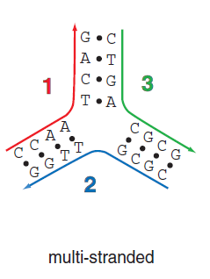
Advantage of DNA for complex components

Slide 4
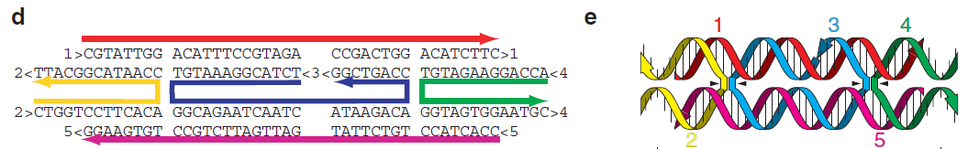
Advantage of DNA for complex components

Slide 5
Approaches to create a design
Designs Classified by how they are built from component strands
Composed of entirely of short oligonucleotides
Composed of one long scaffold strand and numerous helper strands
One long strand and few/ no helper strands
Whether DNA sequences are repeated in design

Slide 6
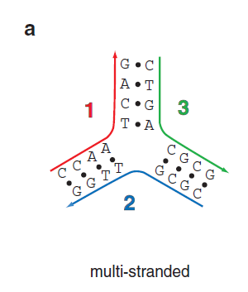
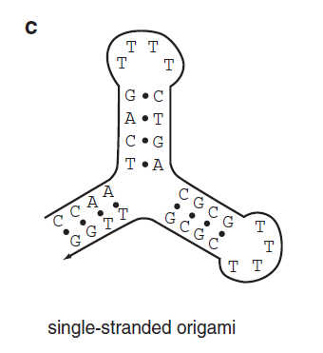
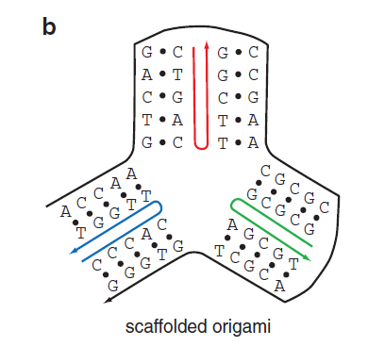
Based on Component Strands

Slide 7
Based on Strands Repeated
Structure Uniquely Addressed (one-pot reaction)
Mixture of structures formed or methods employed to break symmetries

Slide 8
Design of Scaffolded DNA Origami
Double stranded DNA can be idealized as a cylinder ~2nm in diameter and roughly 3.6 nm long for every turn of double helix.
Design of a DNA Origami performed in 5 steps:
1st two steps are manually done
last 3 are computer aided

Slide 9
Design of Scaffolded DNA Origami
Build a geometric model of a DNA structure that will approximate the desired shape
Pairs of parallel cylinders of identical length, are used to fill the shape from top to bottom.
Cylinders cut to fit shape (integral no. of DNA turns)
One DNA turn in x direction and 2 helical width in y- directions
Crossovers added to hold the cylinders together

Slide 10
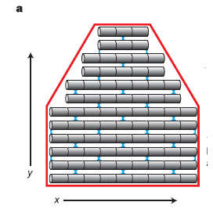
Design of Scaffolded DNA Origami
Build a geometric model of a DNA structure that will approximate the desired shape

Slide 11
Design of Scaffolded DNA Origami
Folding of the DNA Strand
Translation of geometric Model to molecular design proceeds by folding a single long scaffold strand back and forth in a raster fill pattern such that it comprises of one of 2 strand in every double helical domain.
From one helix to another and onto a third, the distance between successive scaffold crossovers must be an odd number of half turns.
Raster reverses direction vertically and returns to a previously visited helix, the distance between scaffold crossovers must be an even number of half-turns (seam)

Slide 12
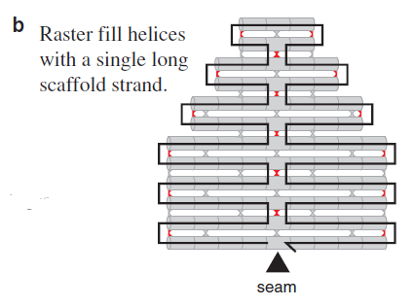
Design of Scaffolded DNA Origami
Folding of the DNA Strand

Slide 13
Design of Scaffolded DNA Origami
Design of a set of staple strands
Helper strands/ staple strands provide Watson-Crick complements for the scaffold and create the crossovers
Design is then fed into a computer program that calculates the placement of individual staple strands. Each staple binds to a specific region of the DNA template, and thus due to Watson-Crick base pairing, the necessary sequences of all staple strands are known and displayed.

Slide 14
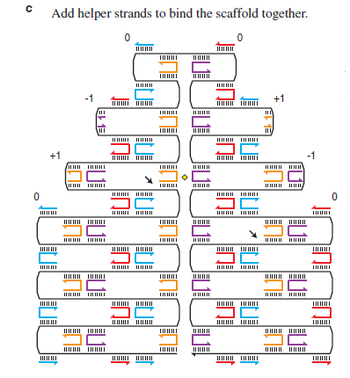
Design of Scaffolded DNA Origami
Design of a set of staple strands

Slide 15
Design of Scaffolded DNA Origami
The twist of scaffold crossovers is calculated and their position is changed (reduce strain)
The twist strain between the crossovers has to be balanced and minimized
Twist of scaffold crossover calculated & position is changed
Staple sequences are recomputed accordingly

Slide 16
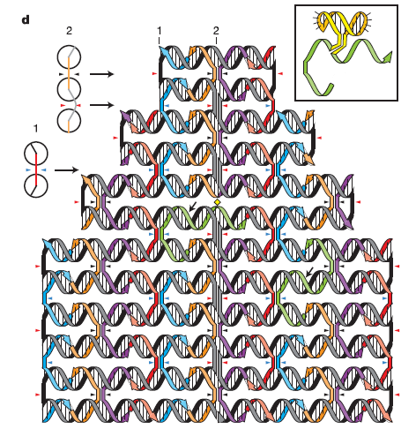
Design of Scaffolded DNA Origami
The twist of scaffold crossovers is calculated and their position is changed (reduce strain)

Slide 17
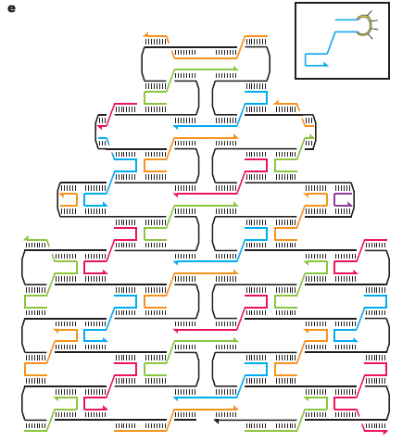
Design of Scaffolded DNA Origami
In-order to achieve higher binding specificity and higher binding energy which results in higher melting temperatures pairs of adjacent staples are merged

Slide 18
Design of 3-D Origami
Two Approaches:
Bundle neighboring DNA helices by crossovers according to the structural characteristics of DNA
Join 2D DNA origami domains into 3-D layouts by corresponding interconnection strands
A DNA box was constructed by joining 6 rectangle origami domains using interconnecting strands

Slide 19
Applications
Control of DNA Methylation and DNA Repair in the DNA Nanospace.
Investigation of interaction between target molecules
DNA targeted enzymes require bending specific DNA strands
EcoRI methyltransferase

Slide 20
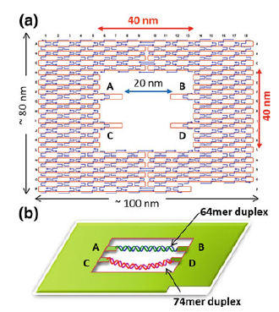
Applications

Slide 21
Applications
Visualization of DNA Structural Changes
Structural interaction between DNA Strands
G-4 DNA (G-Quadruplex)
Drug Delivery

Slide 22
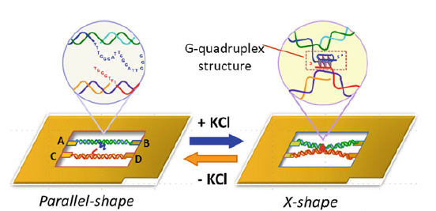
Applications

Slide 23
References
DesignofDNAOrigami (First Part)
DNA_Origami_Rothenmund (Steps of design)
DNAOrigami (3-D and Applications)

