Slide 1
Quantum Turing Machine

Slide 2

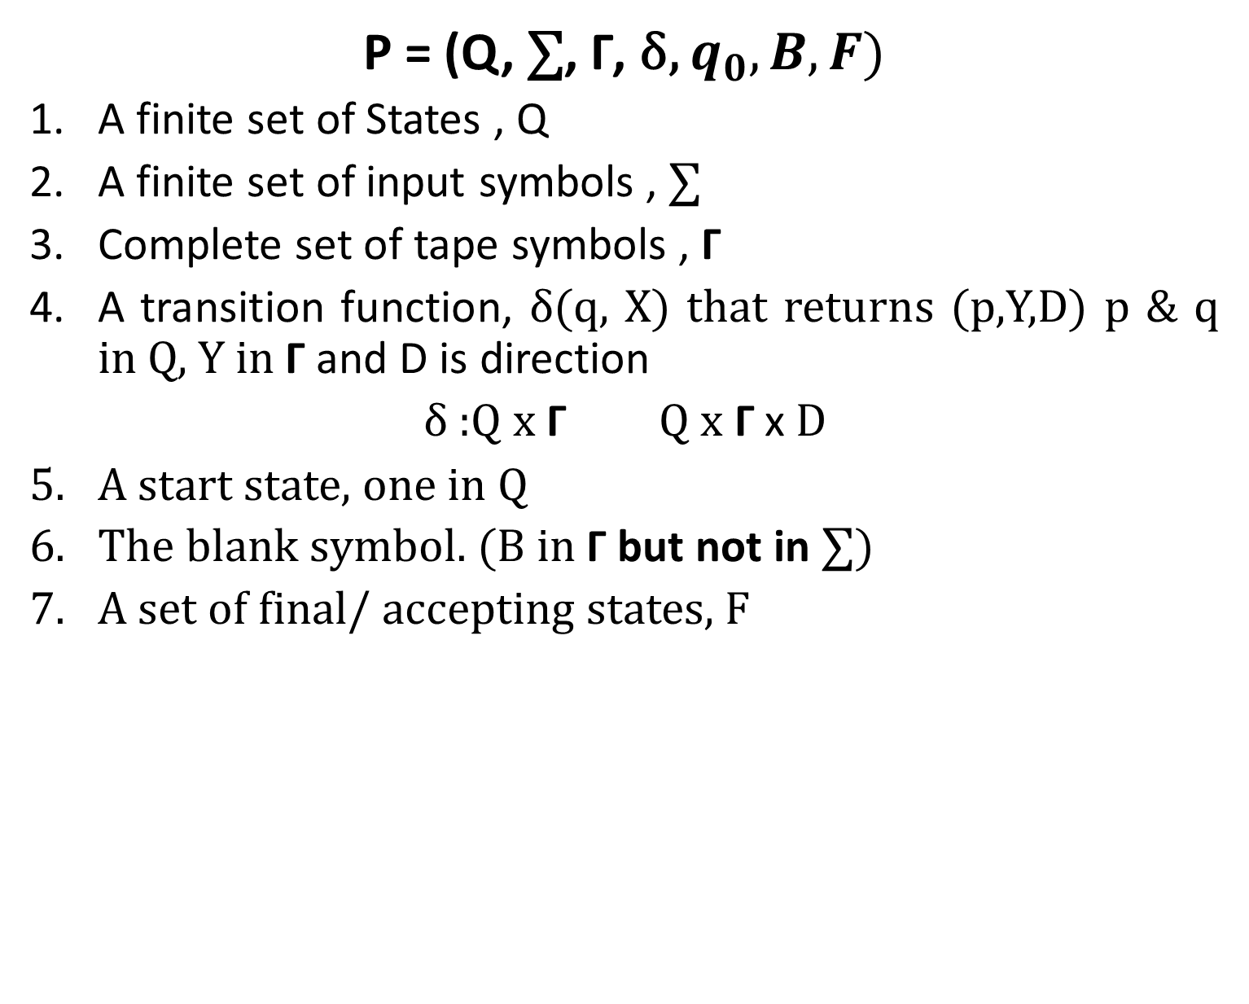

Classical Turing Machine
P = (Q, $\text{∑}$, Γ, δ, $q_{0},B,F)$
A finite set of States , Q
A finite set of input symbols , $\text{∑}$
Complete set of tape symbols , Γ
A transition function, δ(q, X) that returns (p,Y,D) p & q in Q, Y in Γ and D is direction
δ :Q x Γ Q x Γ x D
A start state, one in Q
The blank symbol. (B in Γ but not in $\text{∑}$)
A set of final/ accepting states, F

Slide 3
Classical Turing Machine
Transducer: uses the tape as an output tape
Acceptor: does not write any output on the tape, When it halts, it just accepts or rejects an input

Slide 4
Time Complexity
Time Complexity: Let T(n) be a function T: N->N and let M be a Turing Machine that on each input of length n proceeds at most T(n) steps before halting for some function T(n).
Thus , M has time complexity T(n)

Slide 5
Space Complexity
Space Complexity: Let S(n) be a function T: N->N and let M be a Turing Machine that on each input of length n uses at most S(n) cells before halting for some function S(n).
Thus , M has space complexity S(n)

Slide 6
Configuration of a Turing Machine
It is an ordered set of
The contents of the tape
The current state
The position of the head
Configuration in terms of transition matrix

Slide 7
Deterministic Turing Machine with Oracle
In addition to existing definition of Deterministic Turing Machine, 4 new symbols are added:
q_{a} ∊ Q is a special post-query state
q_{q} ∊ Q is a special query state
y is a special yes symbol
n is a special no symbol

Slide 8
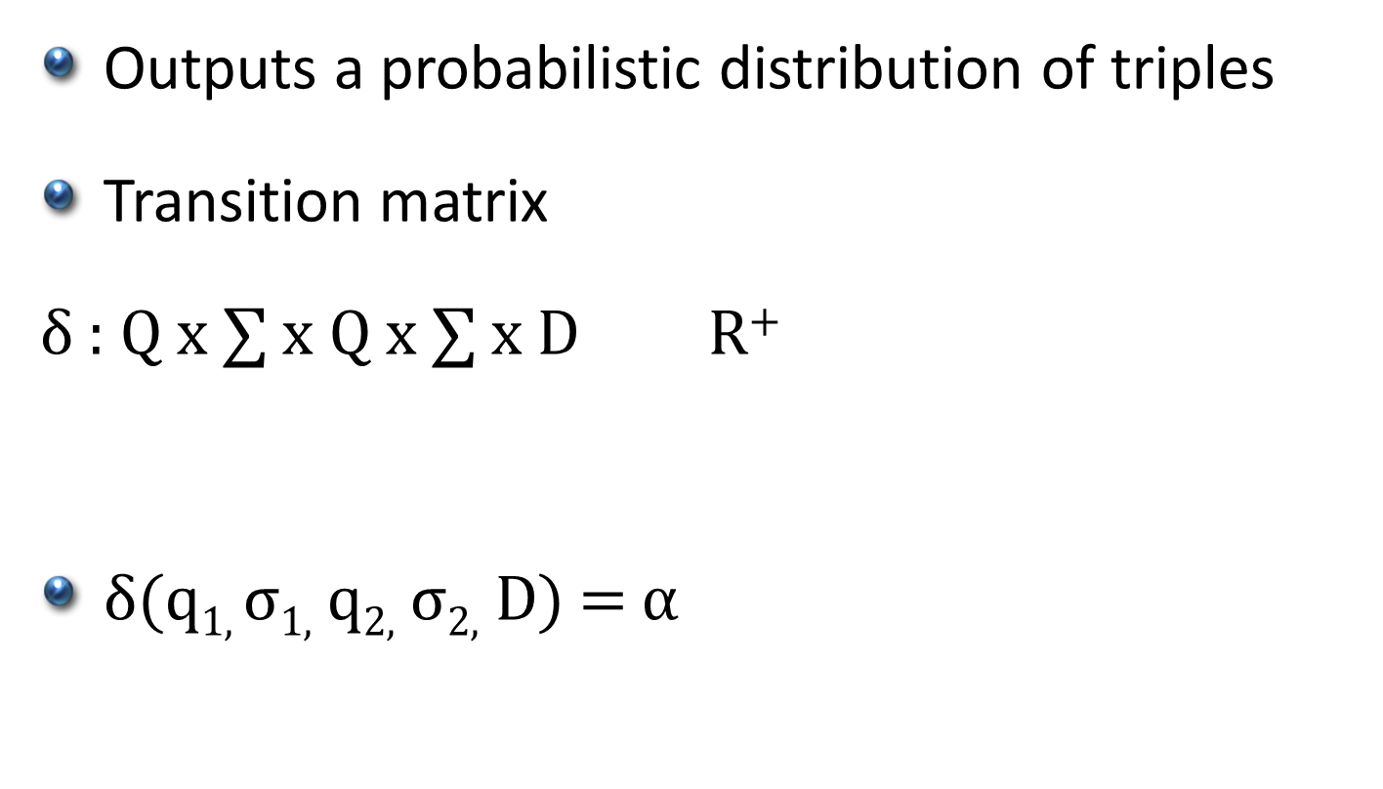
Probabilistic Turing Machine
Outputs a probabilistic distribution of triples
Transition matrix
δ : Q x $\text{∑}$ $\text{x} \text{Q} \text{x}\text{ ∑}$ x D R⁺
δ(q_{1,} σ_{1,} q_{2,} σ_{2,} D) = α

Slide 9
Probabilistic Turing Machine Acceptance
2 parameters :Completeness c and soundness s
If x ∊ L , M accepts with probability p>= c
If x ∉ L , M accepts with probability p <=s

Slide 10
Quantum Turing Machine
Similar to probabilistic Turing Machine
Transition matrix coefficients are not probabilities but complex numbers called amplitudes
Transition matrix has to be unitary

Slide 11
References
Quantum Turing Machine Chapter 2

