Slide 1
Plant Inspired Algorithms

Slide 2


Categories of Plant Inspired Algorithm
Plant propagation behavior
Light foraging behavior (branching algorithms)
Purported swarm behavior of plant root networks

Slide 3
Plant Propagation Algorithm
Inspiration for design of Optimization Algorithm
Invasive Weed Optimization (IWO)
Paddy Field Algorithm

Slide 4
Invasive Weed Optimization
Algorithm has 3 key components
Seeding
Seed Dispersal
Competition between plants

Slide 5

Seeding (Seed Production)

Slide 6

Seed Dispersal
Seeds dispersed by creating a random displacement vector of dimension n and applying it to the parent location
Random dispersal around the parent location with decreasing variance over time

Slide 7
Competition Between Plants
Initial population p_{initial} , and maximum population size limit p_{max}
Once the p_{max} population is reached , parent compete with children and based on the fitness only p_{max} plants survive the next generation

Slide 8
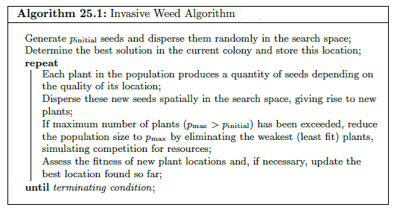
Invasive Weed Optimization

Slide 9

Paddy Field Algorithm
Algorithm has 5 stages
Sowing
Selection y = f(x)
Seeding s_{i} = q_{max} $(\frac{y_{i} − y_{t}}{y_{max} −{ y}_{t}}$ )
Pollination U_{i} = $e^{\left(v_{i}/v_{max}\right)−1}$
Dispersion s_{i}^{viable} = U_{i} s_{i}

Slide 10
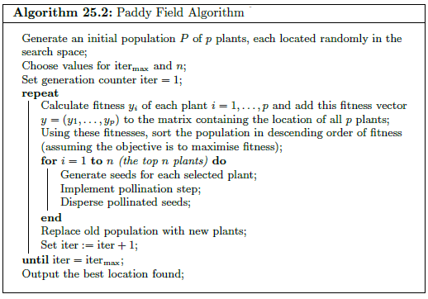
Paddy Field Algorithm

Slide 11
References
Natural_Com_Algorithm_455 (Chapter 25)

