Slide 1
DNA Computing Based Encryption & Decryption Algorithm

Slide 2


Requirement of DNA Encryption Algorithm
DNA Encoding of complete character set
Dynamic Encoding Table Generation
Unique sequence for encoding of every character of plaintext to DNA sequence
Robustness of Encoding
Biological Process Simulation
Dynamicity of Encryption Process

Slide 3
DNA Encryption-Decryption Algorithm
DNA Computing based Encoding Algorithm
DNA Computing based Encryption & Decryption Algorithm

Slide 4
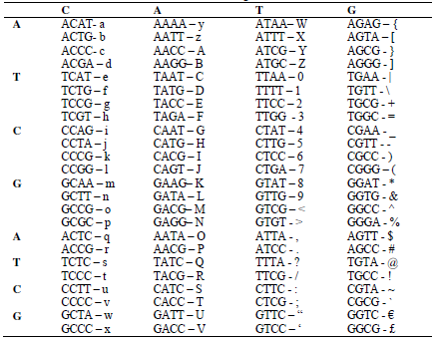
DNA Encoding Table

Slide 5
Encryption Process
Generation of encoding table 1 & 2
Plaintext converted into DNA sequence (Encoding table1 &2)
Multiple round functions are performed: (min 10 rounds)
DNA sequence XNOR with introns
DNA converted to mRNA (transcription process) T -> U
mRNA to tRNA (translation process) complement
tRNA to DNA (reverse transcription) U -> T
Right Shift the sequences
tRNA obtained is converted amino acids
The resultant protein sequence is the cipher text

Slide 6
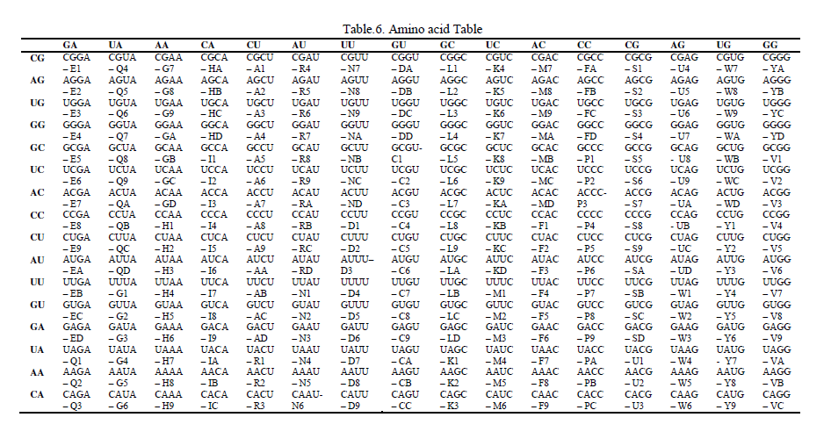
Amino Acid Table

Slide 7
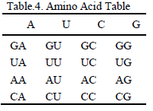
Amino-Acid Table Generation
Generation of 2 DNA sequences randomly (4 DNA alphabets) Ex: ATCG, GTAC
Converting sequences into mRNA
Assigning 2 mRNA row-wise and column-wise in 4x4 matrix
The 4x4 matrix extended to 16x16
Amino acids divided into four groups
24 possible collating sequences , Using any one of the sequence

Slide 8
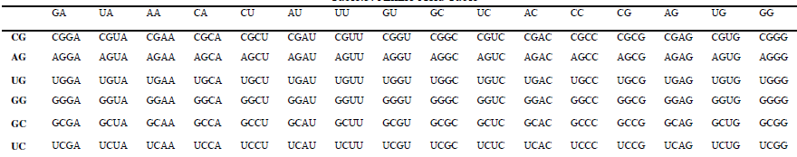
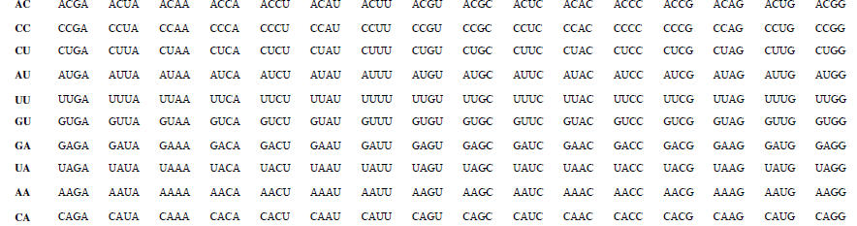
Amino-Acid Table Generation

Slide 9
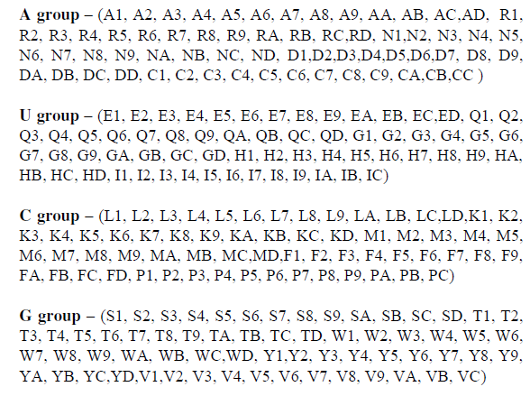
Amino-Acid Table Generation

Slide 10
Amino Acid Table

Slide 11
Decryption Process
Generation of encoding table 1 & 2
Cipher text of protein sequence divided into 2 halves
Protein sequences converted to tRNA using amino acid table
tRNA converted to mRNA (Reverse Translation) Complement
mRNA converted to DNA (Reverse Transcription) U -> T
Multiple round functions are performed:
DNA sequence XNOR with introns
Left Shift the sequences
DNA converted to mRNA (Transcription) T -> U
mRNA to tRNA (translation process) complement
tRNA to DNA (reverse transcription) U -> T
DNA transformed with introns
Transformed DNA converted to plaintext and merged

Slide 12
References
DNA_Cryptography_Encryption_Decryption

