Slide 1
DNA Based Archival-Storage System

Slide 2


Challenges :- DNA storage system
DNA Synthesis and sequencing are error prone
Random access is problematic leading to longer overall read latency
Possible ways to handle above ???

Slide 3
Background on DNA Manipulation
Selective DNA amplification with PCR
DNA synthesis
DNA Sequencing

Slide 4
DNA Storage System
System Overview
Interface and Addressing
System Operations

Slide 5
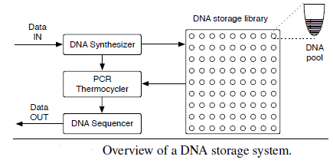
System Overview

Slide 6
Interface and Addressing
Simple key-value architecture
Random access by mapping a key to a pair of primers
Separating the DNA strands into a collection of pools: balance density and performance

Slide 7
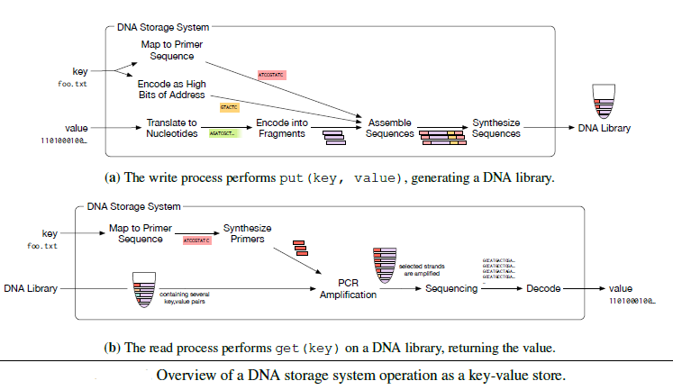
System Operation

Slide 8
Representing Data
Use of Quaternary Digits mapped to DNA Nucleotides
(0,1,2,3) -> (A,C,G,T)
Example: 01110001 to base 4 ??
Base-4: 1301 Hence DNA sequence is CTAC
More efficient is to use Base-3 to avoid sequencing errors

Slide 9
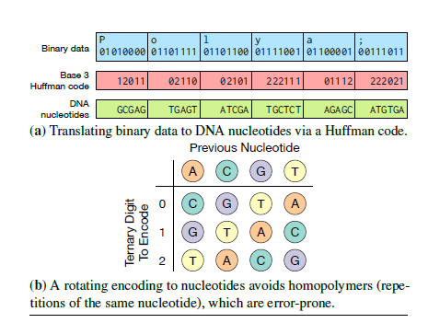
Encoding using base-3

Slide 10
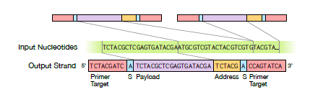
Data Format
Payload
Address
Primers
Random Access

Slide 11
References
DNA_Based_Archival_Storage

