Slide 1
KDC
Notes:
Lecture slides by Lawrie Brown for “Cryptography and Network Security”, 4/e, by William Stallings, Chapter 14 – “Authentication Applications”.

Slide 2
Key Distribution and Management
Symmetric key cryptography: fast implementations, good for encrypting large amounts of data; requires shared secret key
Asymmetric (public) key cryptography: inefficient for large data, good for authentication; no need to share a secret
How to share symmetric keys?
How to distribute public keys?

Slide 3
Symmetric Key Distribution using Symmetric Encryption
Objective: two entities share same secret key
Principle: change keys frequently
How to exchange a secret key?
A physically delivers key to B
Third party, C, can physically deliver key to A and B
If A and B already have a key, can securely transmit new key to each other, encrypted with old key
If A and B have secure connection with third party C, C can securely send keys to A and B

Slide 4
Symmetric Key Distribution using Symmetric Encryption
Option 1 and 2: manual delivery; feasible if number of entities is small (link encryption)
Option 3: requires initial distribution of key; discovery of initial key releases all subsequent keys.
Option 4: requires initial distribution of key with C; practical for large-scale systems (end-to-end encryption)
Notes:
The strength of any cryptographic system thus depends on the key distribution technique. For two parties A and B, key distribution can be achieved in a number of ways:
Physical delivery (1 & 2) is simplest - but only applicable when there is personal contact between recipient and key issuer. This is fine for link encryption where devices & keys occur in pairs, but does not scale as number of parties who wish to communicate grows. 3 is mostly based on 1 or 2 occurring first.
A third party, whom all parties trust, can be used as a trusted intermediary to mediate the establishment of secure communications between them (4). Must trust intermediary not to abuse the knowledge of all session keys. As number of parties grow, some variant of 4 is only practical solution to the huge growth in number of keys potentially needed.

Slide 5
Link Encryption vs End-to-End Encryption
Link Encryption
Encrypt data over individual links in network
Each link end-point shares a secret key
Decrypt/Encrypt at each device in path
Requires all links/devices to support encryption
End-to-End Encryption
Encrypt data at network end-points (e.g. hosts or applications)
Each pair of hosts/applications share a secret key
Does not rely on intermediate network devices

Slide 6
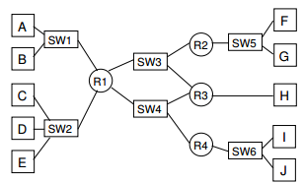
How Many Keys Need To Be Exchanged?
Link-level encryption?
End-to-end encryption between hosts?
End-to-end encryption between applications?

Slide 7
Key Hierarchy
Key Distribution Centre (KDC) is trusted third party
typically have a hierarchy of keys
Data sent between end-systems encrypted with temporary session key
Session keys obtained from KDC over network; encrypted with master key
Master keys can be distributed using manual delivery
Notes:
The use of a key distribution center is based on the use of a hierarchy of keys. At a minimum, two levels of keys are used: a session key, used for the duration of a logical connection; and a master key shared by the key distribution center and an end system or user and used to encrypt the session key.

Slide 8
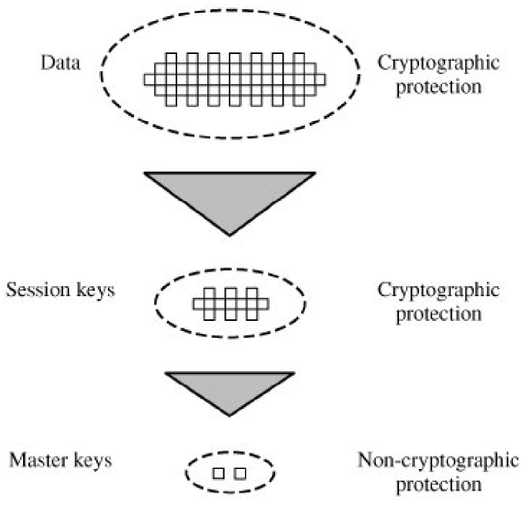
The Use of a Key Hierarchy

Slide 9
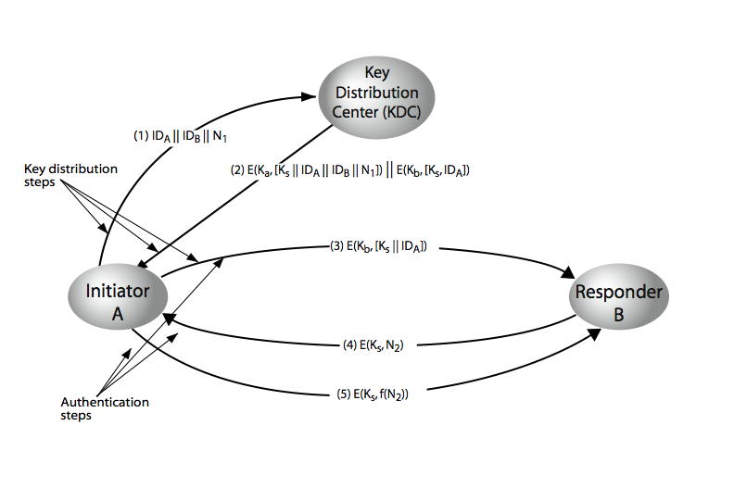
Key Distribution Scenario
Notes:
The key distribution concept can be deployed in a number of ways. A typical scenario is illustrated in Stallings Figure 7.9 above, which has a “Key Distribution Center” (KDC) which shares a unique key with each party (user). See text section 7.3 for details of the steps shown in this distribution process.

Slide 10
KDC Scenario Notation
End-systems: A and B, identified by ID_{A} and ID_{B}
Master keys: K_{a}, K_{b}
Session key (between A and B): K_{s}
Nonce values: N₁, N₂
E.g. timestamp, counter, random value
Must be different for each request
Must be difficult for attacker to guess

