Slide 1

Chapter 11
Message Integrity
and
Message Authentication
Copyright © The McGraw-Hill Companies, Inc. Permission required for reproduction or display.
11.<number>

Slide 2
Chapter 11
Objectives
❏ To define message integrity
❏ To define message authentication
❏ To define criteria for a cryptographic hash function
❏ To define the Random Oracle Model and its role in
evaluating the security of cryptographic hash
functions
❏ To distinguish between an MDC and a MAC
❏ To discuss some common MACs
11.<number>

Slide 3
11-1 MESSAGE INTEGRITY
The cryptography systems that we have studied so far provide secrecy, or confidentiality, but not integrity. However, there are occasions where we may not even need secrecy but instead must have integrity.
Topics discussed in this section:
11.1 Document and Fingerprint
11.2 Message and Message Digest
11.3 Difference
11.4 Checking Integrity
11.5 Cryptographic Hash Function Criteria
11.<number>

Slide 4
11.1.1 Document and Fingerprint
One way to preserve the integrity of a document is through the use of a fingerprint. If Alice needs to be sure that the contents of her document will not be changed, she can put her fingerprint at the bottom of the document.
11.<number>

Slide 5
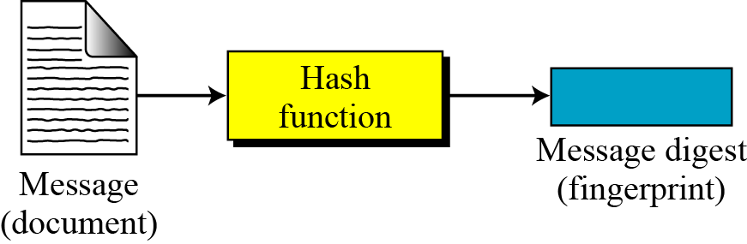
11.1.2 Message and Message Digest
The electronic equivalent of the document and fingerprint pair is the message and digest pair.
Figure 11.1 Message and digest
11.<number>

Slide 6

11.1.3 Difference
The two pairs (document / fingerprint) and (message / message digest) are similar, with some differences. The document and fingerprint are physically linked together. The message and message digest can be unlinked separately, and, most importantly, the message digest needs to be safe from change.
Note
The message digest needs to be safe from change.
11.<number>

Slide 7
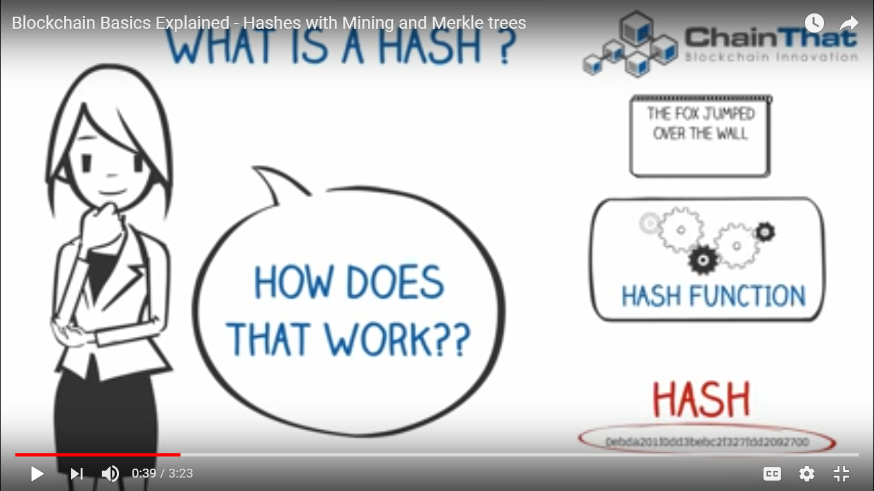
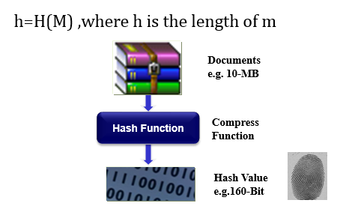
11.<number>

Slide 8
Collision Resistance
A slight change in an input string should cause the hash value of the function to change drastically. Even if 1 bit is flipped in the input string, at least half of the bits in the hash value will flip as a result. This is called an avalanche effect.
Since it is computationally infeasible to produce a document that would hash to a given value or find two documents with the same hash value.
As there is almost no chance to have the same hash value of two different messages, so it is called collision free or collision resistant.
A document's hash can serve as a cryptographic equivalent of the document. This makes a one-way hash function a central notion in public-key cryptography.

Slide 9
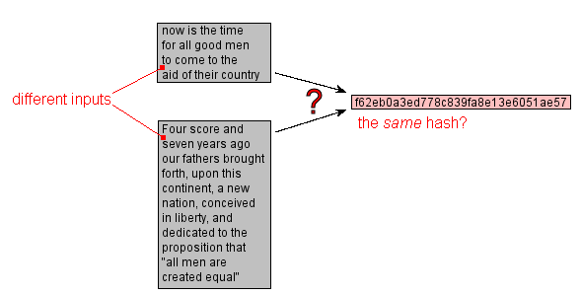
Hash Collision
When different input message results in the same hash value, then it is called hash collision.

Slide 10
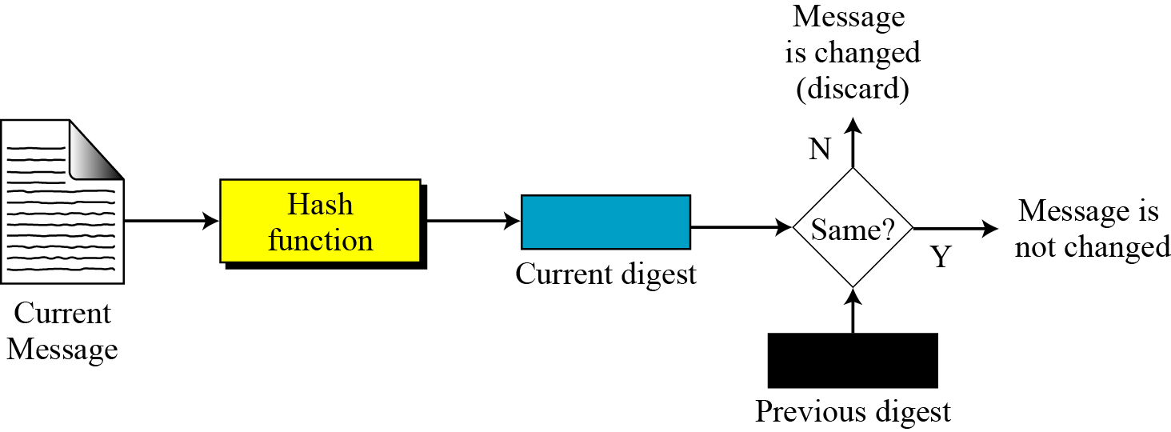
11.1.4 Checking Integrity
Figure 11.2 Checking integrity
11.<number>

Slide 11
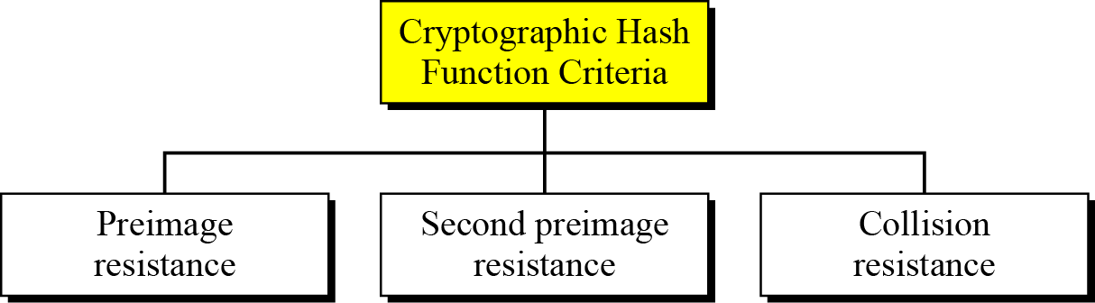
11.1.5 Cryptographic Hash Function Criteria
A cryptographic hash function must satisfy three criteria: preimage resistance, second preimage resistance, and collision resistance.
Figure 11.3 Criteria of a cryptographic hash function
11.<number>

Slide 12
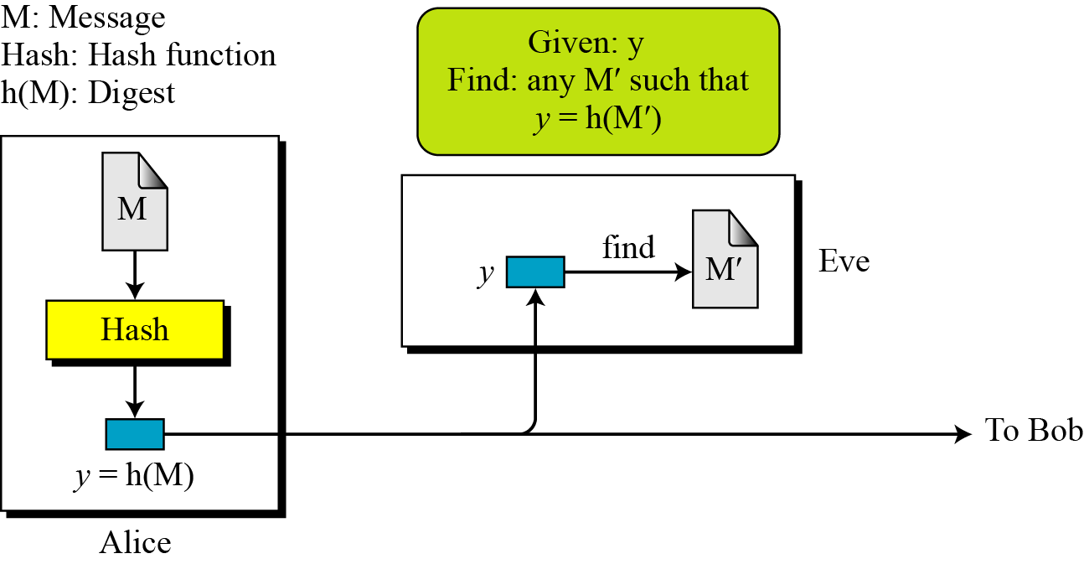
11.1.5 Continued
Preimage Resistance
Figure 11.4 Preimage
11.<number>

Slide 13
11.1.5 Continued
Example 11.1
Can we use a conventional lossless compression method such as StuffIt as a cryptographic hash function?
Solution
We cannot. A lossless compression method creates a compressed message that is reversible.
Example 11.2
Can we use a checksum function as a cryptographic hash function?
Solution
We cannot. A checksum function is not preimage resistant, Eve may find several messages whose checksum matches the given one.
11.<number>

Slide 14
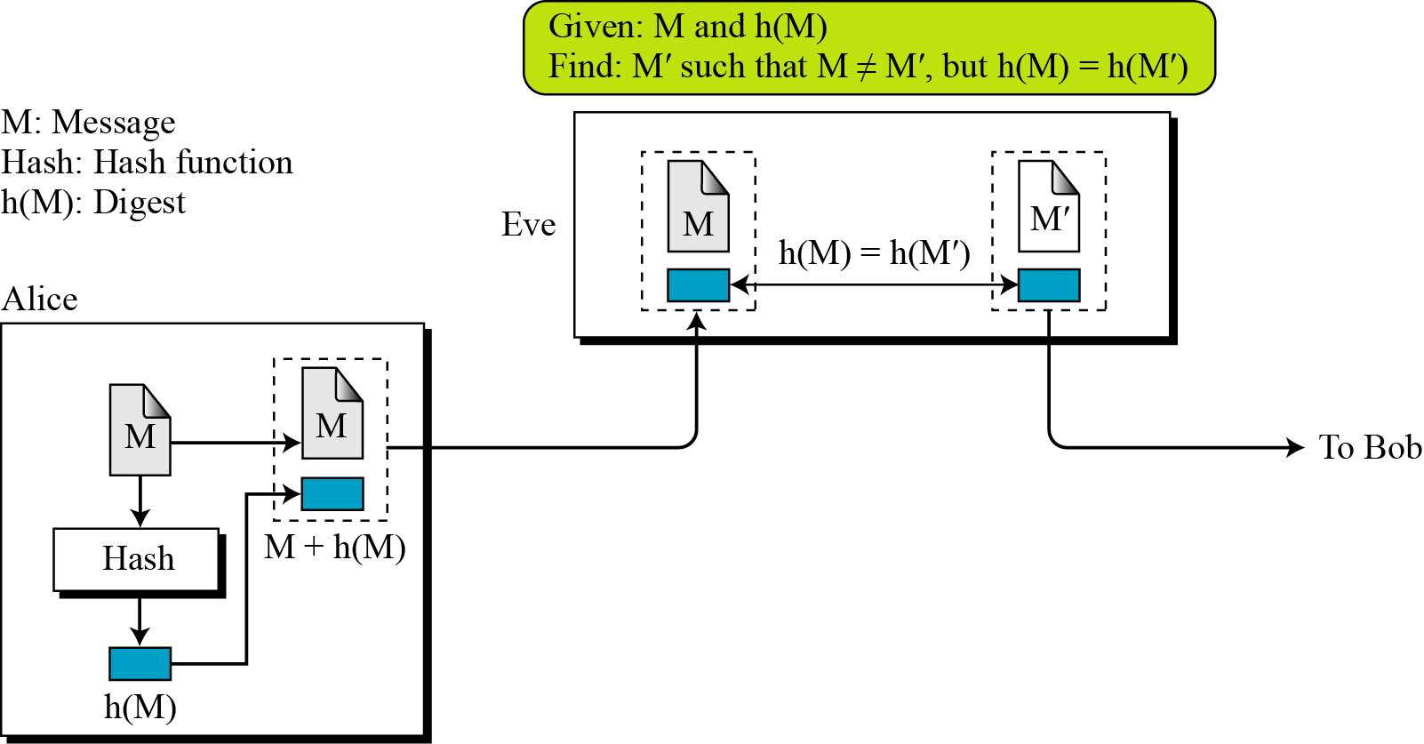
11.1.5 Continued
Second Preimage Resistance
Figure 11.5 Second preimage
11.<number>

Slide 15
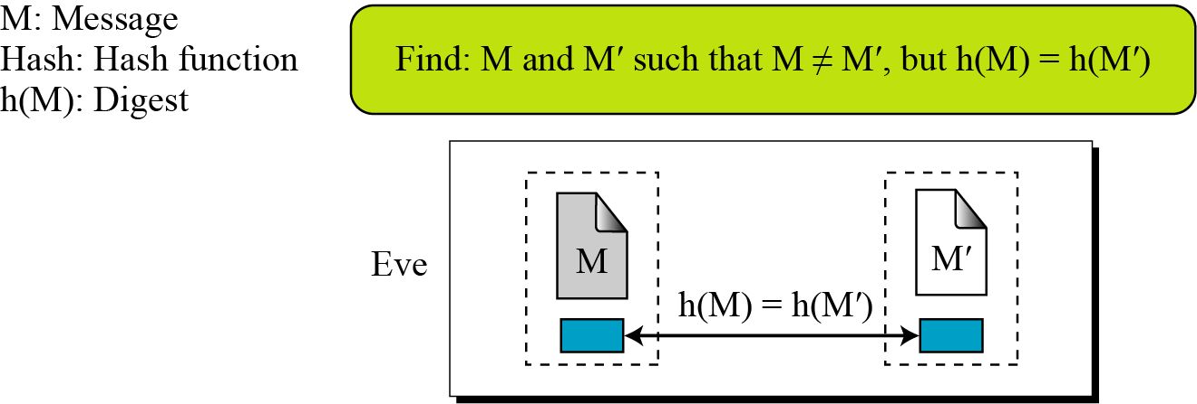
11.1.5 Continued
Collision Resistance
Figure 11.6 Collision
11.<number>

Slide 16
11-2 RANDOM ORACLE MODEL
The Random Oracle Model, which was introduced in 1993 by Bellare and Rogaway, is an ideal mathematical model for a hash function.
Topics discussed in this section:
11.2.1 Pigeonhole Principle
11.2.2 Birthday Problems
11.2.3 Attacks on Random Oracle Model
11.2.4 Attacks on the Structure
11.<number>

Slide 17
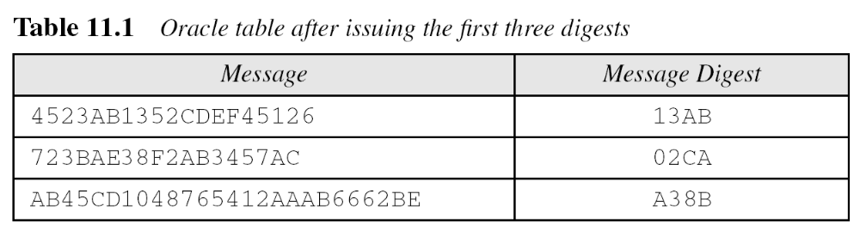
11-2 Continued
Example 11.3
Assume an oracle with a table and a fair coin. The table has two columns.
a. The message AB1234CD8765BDAD is given for digest calculation. The oracle checks its table.
11.<number>

Slide 18
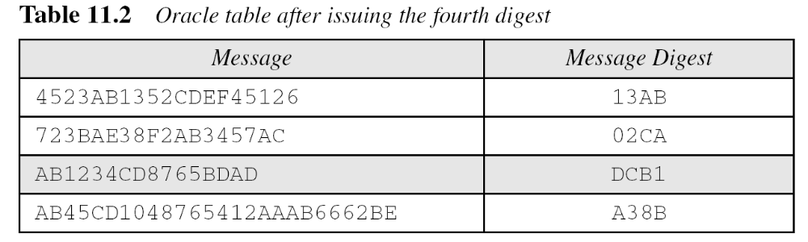
11-2 Continued
Example 11.3
Continued
b. The message 4523AB1352CDEF45126 is given for digest calculation. The oracle checks its table and finds that there is a digest for this message in the table (first row). The oracle simply gives the corresponding digest (13AB).
11.<number>

Slide 19
11-2 Continued
Example 11.4
The oracle in Example 11.3 cannot use a formula or algorithm to create the digest for a message. For example, imagine the oracle uses the formula h(M) = M mod n. Now suppose that the oracle has already given h(M1) and h(M2). If a new message is presented as M3 = M1 + M2, the oracle does not have to calculate the h(M3). The new digest is just [h(M1) + h(M2)] mod n since
This violates the third requirement that each digest must be randomly chosen based on the message given to the oracle.
11.<number>

Slide 20
11.2.1 Pigeonhole Principle
If n pigeonholes are occupied by n + 1 pigeons, then at least one pigeonhole is occupied by two pigeons. The generalized version of the pigeonhole principle is that if n pigeonholes are occupied by kn + 1 pigeons, then at least one pigeonhole is occupied by k + 1 pigeons.
11.<number>

Slide 21
11.2.1 Continued
Example 11.5
Assume that the messages in a hash function are 6 bits long and the digests are only 4 bits long. Then the possible number of digests (pigeonholes) is 24 = 16, and the possible number of messages (pigeons) is 26 = 64. This means n = 16 and kn + 1 = 64, so k is larger than 3. The conclusion is that at least one digest corresponds to four (k + 1) messages.
11.<number>

Slide 22
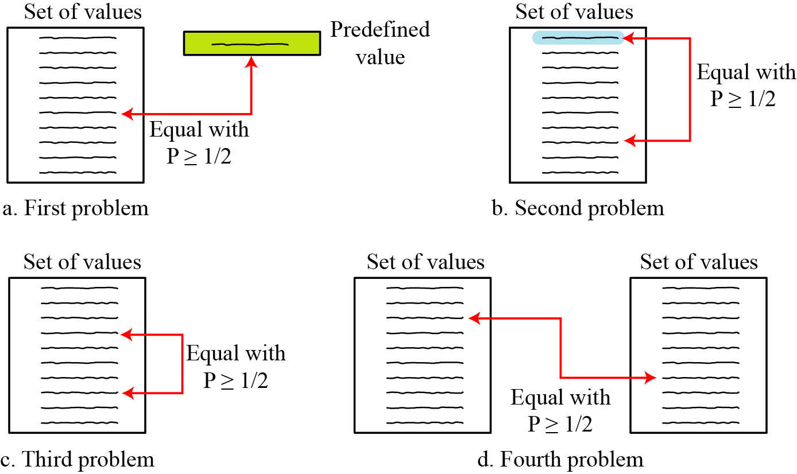
11.2.2 Birthday Problems
Figure 11.7 Four birthday problems
11.<number>

Slide 23
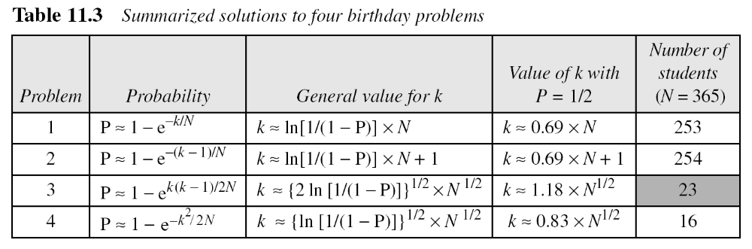
11.2.2 Continued
Summary of Solutions
Solutions to these problems are given in Appendix E for interested readers; The results are summarized in Table 11.3.
11.<number>

Slide 24
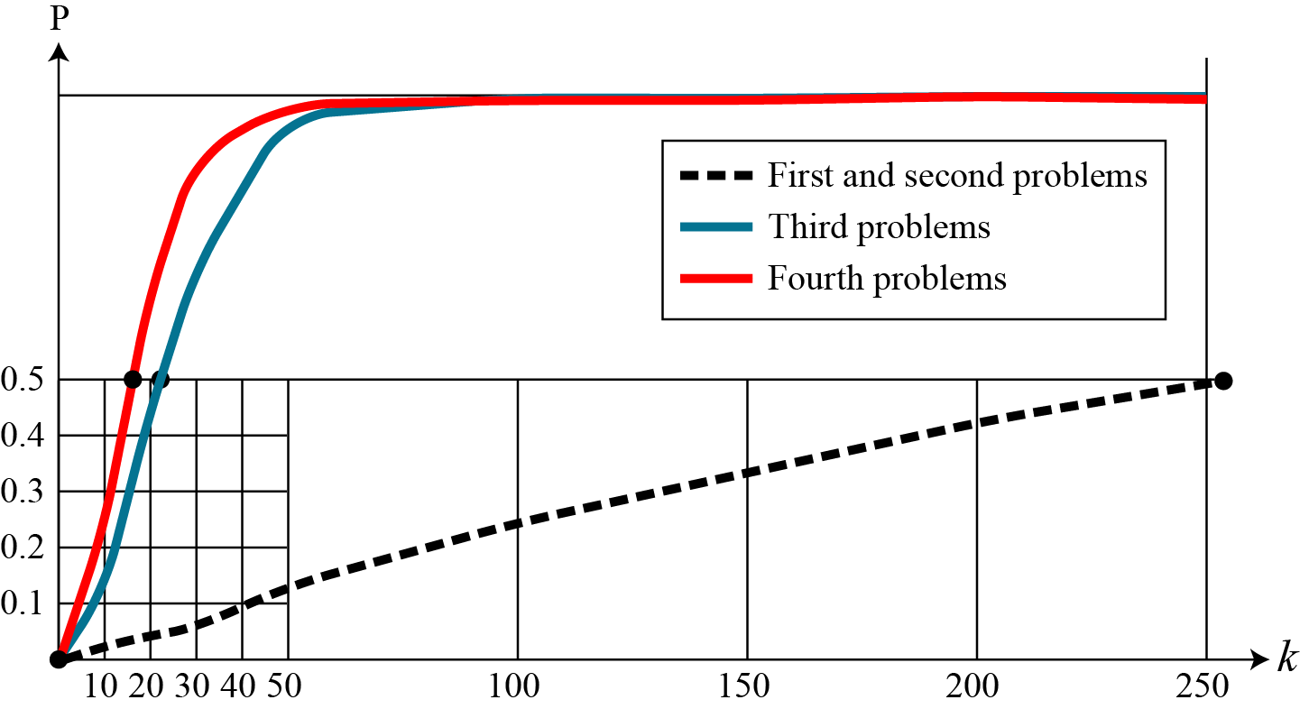
11.2.2 Continued
Comparison
Figure 11.8 Graph of four birthday problem
11.<number>

Slide 25
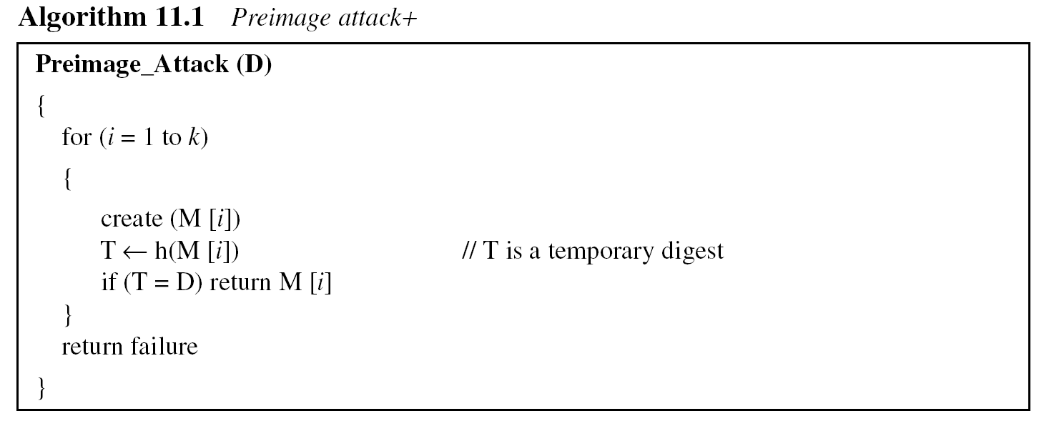
11.2.3 Attacks on Random Oracle Model
Preimage Attack
11.<number>

Slide 26
11.2.3 Continued
Example 11.6
A cryptographic hash function uses a digest of 64 bits. How many digests does Eve need to create to find the original message with the probability more than 0.5?
Solution
The number of digests to be created is k ≈ 0.69 × 2^{n} ≈ 0.69 × 2⁶⁴. This is a large number. Even if Eve can create 2³⁰ (almost one billion) messages per second, it takes 0.69 × 2³⁴ seconds or more than 500 years. This means that a message digest of size 64 bits is secure with respect to preimage attack, but, as we will see shortly, is not secured to collision attack.
11.<number>

Slide 27
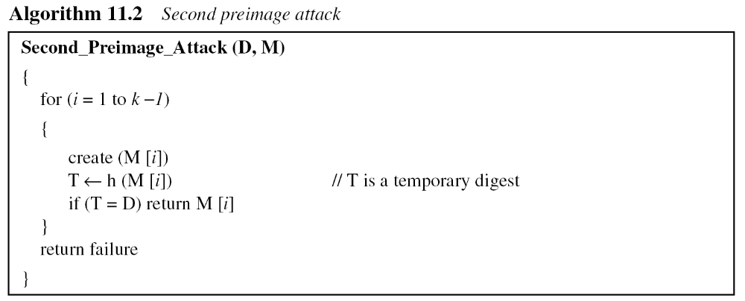
11.2.3 Continued
Second Preimage Attack.
11.<number>

Slide 28
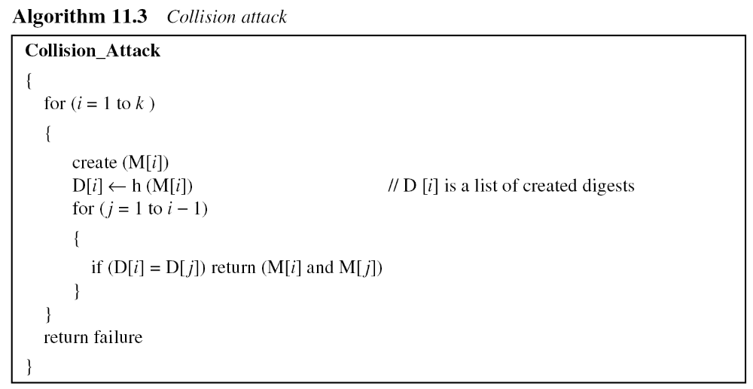
11.2.3 Continued
Collision Attack
11.<number>

Slide 29
11.2.3 Continued
Example 11.7
A cryptographic hash function uses a digest of 64 bits. How many digests does Eve need to create to find two messages with the same digest with the probability more than 0.5?
Solution
The number of digests to be created is k ≈ 1.18 × 2^{n/2} ≈ 1.18 × 232. If Eve can test 2²⁰ (almost one million) messages per second, it takes 1.18 × 2¹² seconds, or less than two hours. This means that a message digest of size 64 bits is not secure against the collision attack.
11.<number>

Slide 30
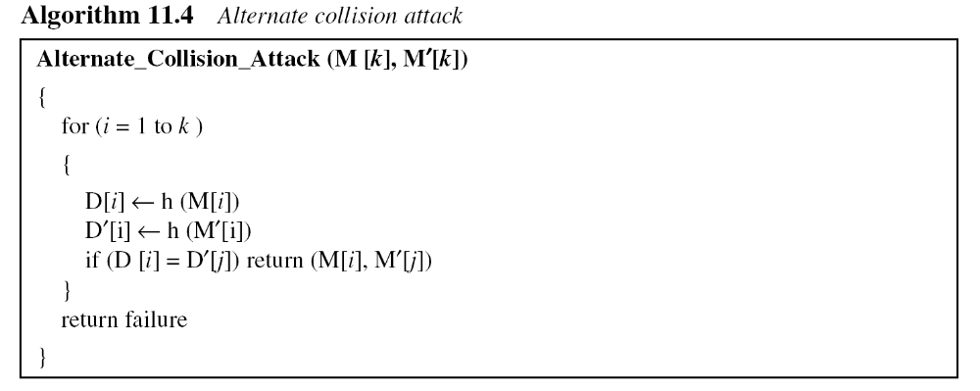
11.2.3 Continued
Alternate Collision Attack
11.<number>

Slide 31
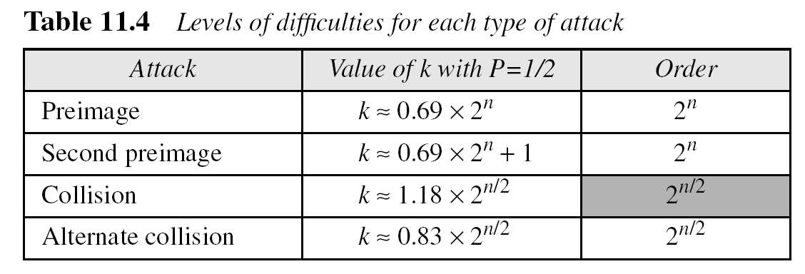
11.2.3 Continued
Summary of Attacks
Table 11.4 shows the level of difficulty for each attack if the digest is n bits.
11.<number>

Slide 32
11.2.3 Continued
Example 11.8
Originally hash functions with a 64-bit digest were believed to be immune to collision attacks. But with the increase in the processing speed, today everyone agrees that these hash functions are no longer secure. Eve needs only 2^{64/2} = 2³² tests to launch an attack with probability 1/2 or more. Assume she can perform 2²⁰ (one million) tests per second. She can launch an attack in
2³²/2²⁰ = 2¹² seconds (almost an hour).
11.<number>

Slide 33
11.2.3 Continued
Example 11.9
MD5 (see Chapter 12), which was one of the standard hash functions for a long time, creates digests of 128 bits. To launch a collision attack, the adversary needs to test 2⁶⁴ (2¹²⁸/2) tests in the collision algorithm. Even if the adversary can perform 2³⁰ (more than one billion) tests in a second, it takes 2³⁴ seconds (more than 500 years) to launch an attack. This type of attack is based on the Random Oracle Model. It has been proved that MD5 can be attacked on less than 2⁶⁴ tests because of the structure of the algorithm.
11.<number>

Slide 34
11.2.3 Continued
Example 11.10
SHA-1 (see Chapter 12), a standard hash function developed by NIST, creates digests of 160 bits. The function is attacks. To launch a collision attack, the adversary needs to test 2^{160/2} = 2⁸⁰ tests in the collision algorithm. Even if the adversary can perform 2³⁰ (more than one billion) tests in a second, it takes 2⁵⁰ seconds (more than ten thousand years) to launch an attack. However, researchers have discovered some features of the function that allow it to be attacked in less time than calculated above.
11.<number>

Slide 35
11.2.3 Continued
Example 11.11
The new hash function, that is likely to become NIST standard, is SHA-512 (see Chapter 12), which has a 512-bit digest. This function is definitely resistant to collision attacks based on the Random Oracle Model. It needs 2^{512/2} = 2²⁵⁶ tests to find a collision with the probability of 1/2.
11.<number>

Slide 36
11.2.4 Attacks on the Structure
The adversary may have other tools to attack hash function. One of these tools, for example, is the meet-in-the-middle attack that we discussed in Chapter 6 for double DES.
11.<number>

Slide 37
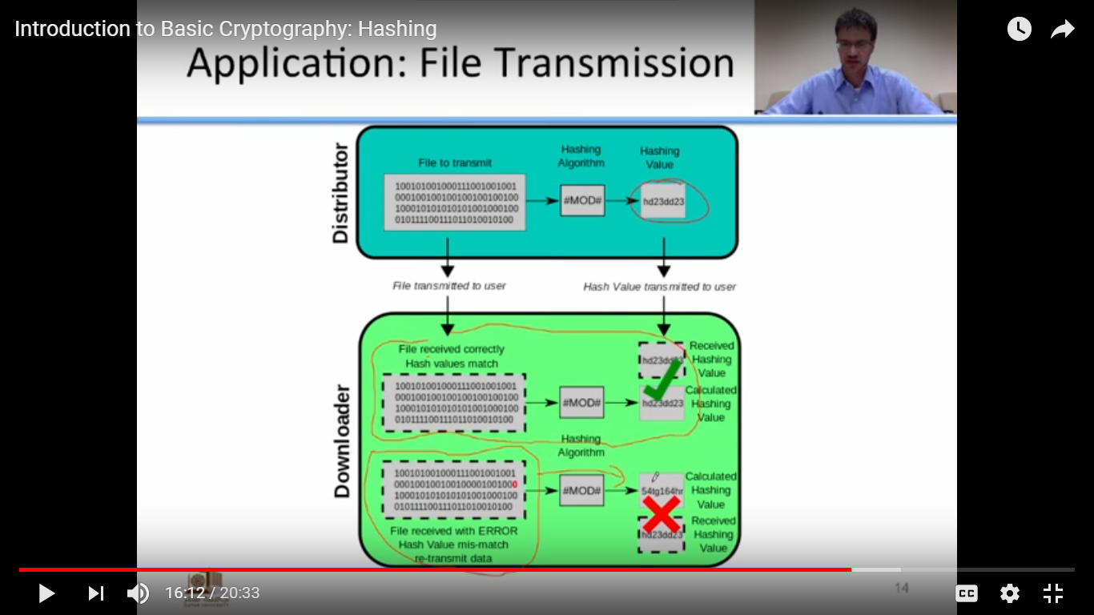
11.<number>

Slide 38
Application: Hashing Password
Original Password
“Hello”
Hash Algorithm
How password is
stored using hash
Hashed Password
9a46ba811185c194762
Hash of the Password Stored

Slide 39
Public Key Cryptography and message authentication
Message authentication codes and hash function to provide message authentication.
Public Key encryption and two specific public-key algoritihms.
Public-Key encryption to produce digital signatures.

Slide 40






Information Integrity Problems
Content Modification:
Adversary inserts/modifies/deletes message content
Salary Database
E
D
Insert new record for Darth’s salary of $1,000,000
E

Slide 41
Information Integrity Problems
Masquerade:
Adversary sends message claimed to be from someone else
“Give Darth a $10,000 raise
-- Alice”
E
Masquerading as Alice

Slide 42

Information Integrity Problems
Timing Modification
Adversary intercepts message and replays it later
“Open the front gate.
-- Alice”
E

Slide 43
Information Integrity Problems
Simplest case: Detecting modification
  Message M stored in public location
  M not encrypted
How can we prove/detect whether adversary has replaced message M with fake message M´ ?
M ´
M
Public storage

Slide 44

Information Integrity Problems
One solution: store protected copy of M
  Compare M to copy to detect changes
  Implausible if M very large
M
Public storage
M

Slide 45
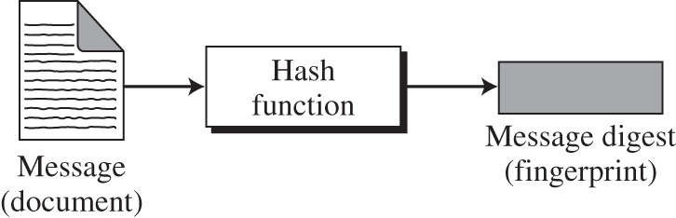

Message Digest
Created from message M using hashing function
y = h(M)
Like “fingerprint” for messages
  Different messages → different fingerprints
  Much more compact than messages: size of y < size of M
  Plausible for secure storage

Slide 46
Message Digest
Same concept as error detection in network transmission
Message
Error detection bits
•
Error detection bits = function of message
– Example: parity bit depends on even/odd of 1’s in message
If error detection bits do not match message, request message resend
Key difference: Unlike noise, adversary intelligent

Slide 47
Modification Detection Code: MDC
Used to detect modification
  Apply hash to message in storage to get h(M´)
  Compare with stored h(M)
  If h(M’) ≠ h(M) message has been modifed
Modification Detection Code (MDC)
h(M´)
compare
h
M ´
h(M)
Public storage

Slide 48
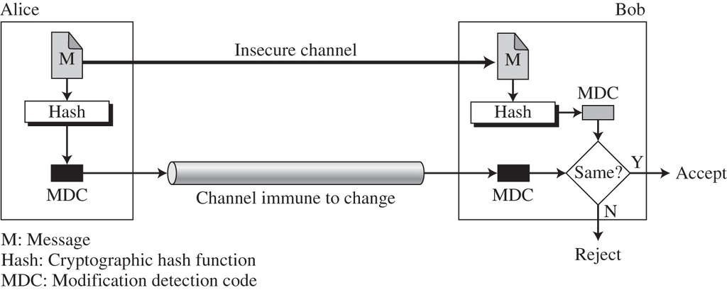
MDC
Hash applied to message by sender and recipient
If no match, message has been tampered with
Problem: Requires MDC sent securely Otherwise, adversary could modify it as well!

Slide 49
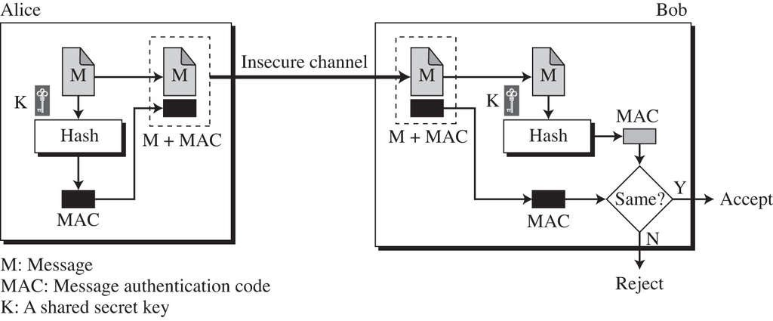
Message Authentication Code
Using secret key to prevent adversary from creating message digest to match false message
  Creates MAC as h(M, k)
  Can also encrypt message, but not necessary

Slide 50
Solving Integrity Problems
Content Modification
If adversary modifies message, will no longer match message digest
Authentication
Adversary cannot send false message since cannot generate corresponding digest
Timing Modification
Sender can add timestamp to message which adversary cannot modify without generating corresponding message digest

Slide 51
Preimage Attack
Adversary finds message M´ with same MDC
h(M´) = h(M)
Impossible to detect or prove changes!
h(M´)
Same!
h
M ´
h(M)
Public storage

Slide 52
Preimage Attack
Adversary can “tweak” new message M´ until
h(M´) = h(M)
Example:
Give | Darth | a | salary increase | of | $1000
Award | Mr. Vader | some | raise | … | $2000
Present | Darth Vader | … | bonus |  | $3000
… | … |  | … |  | $4000
 |  |  |  |  | …
“I’ll find some combination of these so they can’t detect the difference!”

Slide 53
Collision Attack
Adversary finds two messages M₁ and M₂ with same MDC
h(M₁) = h(M₂)
•
•
M₁ is harmless message
“We like kittens”
M₂ has advantage for adversary
“Give Darth a $5000 raise”
•

Slide 54
Collision Attack
Darth gets job in organization
  Presents M₁ to boss for approval
  Boss stores h(M₁)
  Darth actually stores/sends M₂
Boss has no way to prove he didn’t approve M₂
•
“We like kittens”
h(“We like kittens”)
“Give Darth a $5000 raise”

Slide 55
Digests and Networks
Same hash applied to message by sender and recipient
  Sender creates digest and sends along with message
  Recipient creates digest from received message, and compares to received digest
  If no match, message has been tampered with en route
M

Slide 56
Digests and Networks
Problem: Adversary can easily intercept digest and change it to match new message
– Must assume adversary knows hash function we use!
M
h(M  )

Slide 57
Message Authentication Codes
Using secret key to create digest
  Creates MAC as h(M, k)
  Without k, adversary cannot substitute M  and then duplicate the h(M , k) that recipient will use to check message integrity

Slide 58
Message Authentication Codes
Provides authentication of sender
  Only person with correct key k can produce h(M, k) that matches message M
  Also provides nonrepudiation protection
    Sender cannot later claim they did not send message unless key stolen
compare
M
h(M, k)
h(M, k)
“If they match, then sender must have same key k as I do”
M
h(M, k)
h
k

Slide 59
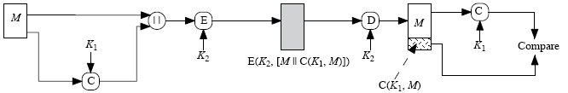
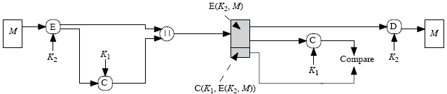
Authentication and Confidentiality
Can also encrypt message with different key
– Hash plaintext before encryption
h
h
h
h
Hash ciphertext after encryption
  Allows authentication to take place without decryption (usually much faster)
h
h
h

