Slide 2
Changing Business Environments and Computerized Decision Support

Slide 3
An Early Framework for Computerized Decision Support

Slide 4
An Early Framework for Computerized Decision Support
Degree of structuredness
Four-phase decision making process
–Intelligence
–Design
–Choice
–Implementation

Slide 5
An Early Framework for Computerized Decision Support

Slide 6
An Early Framework for Computerized Decision Support

Slide 7
The Concept of Decision Support Systems (DSS)

Slide 8
A Framework for Business Intelligence (BI)

Slide 9
A Framework for Business Intelligence (BI)

Slide 10
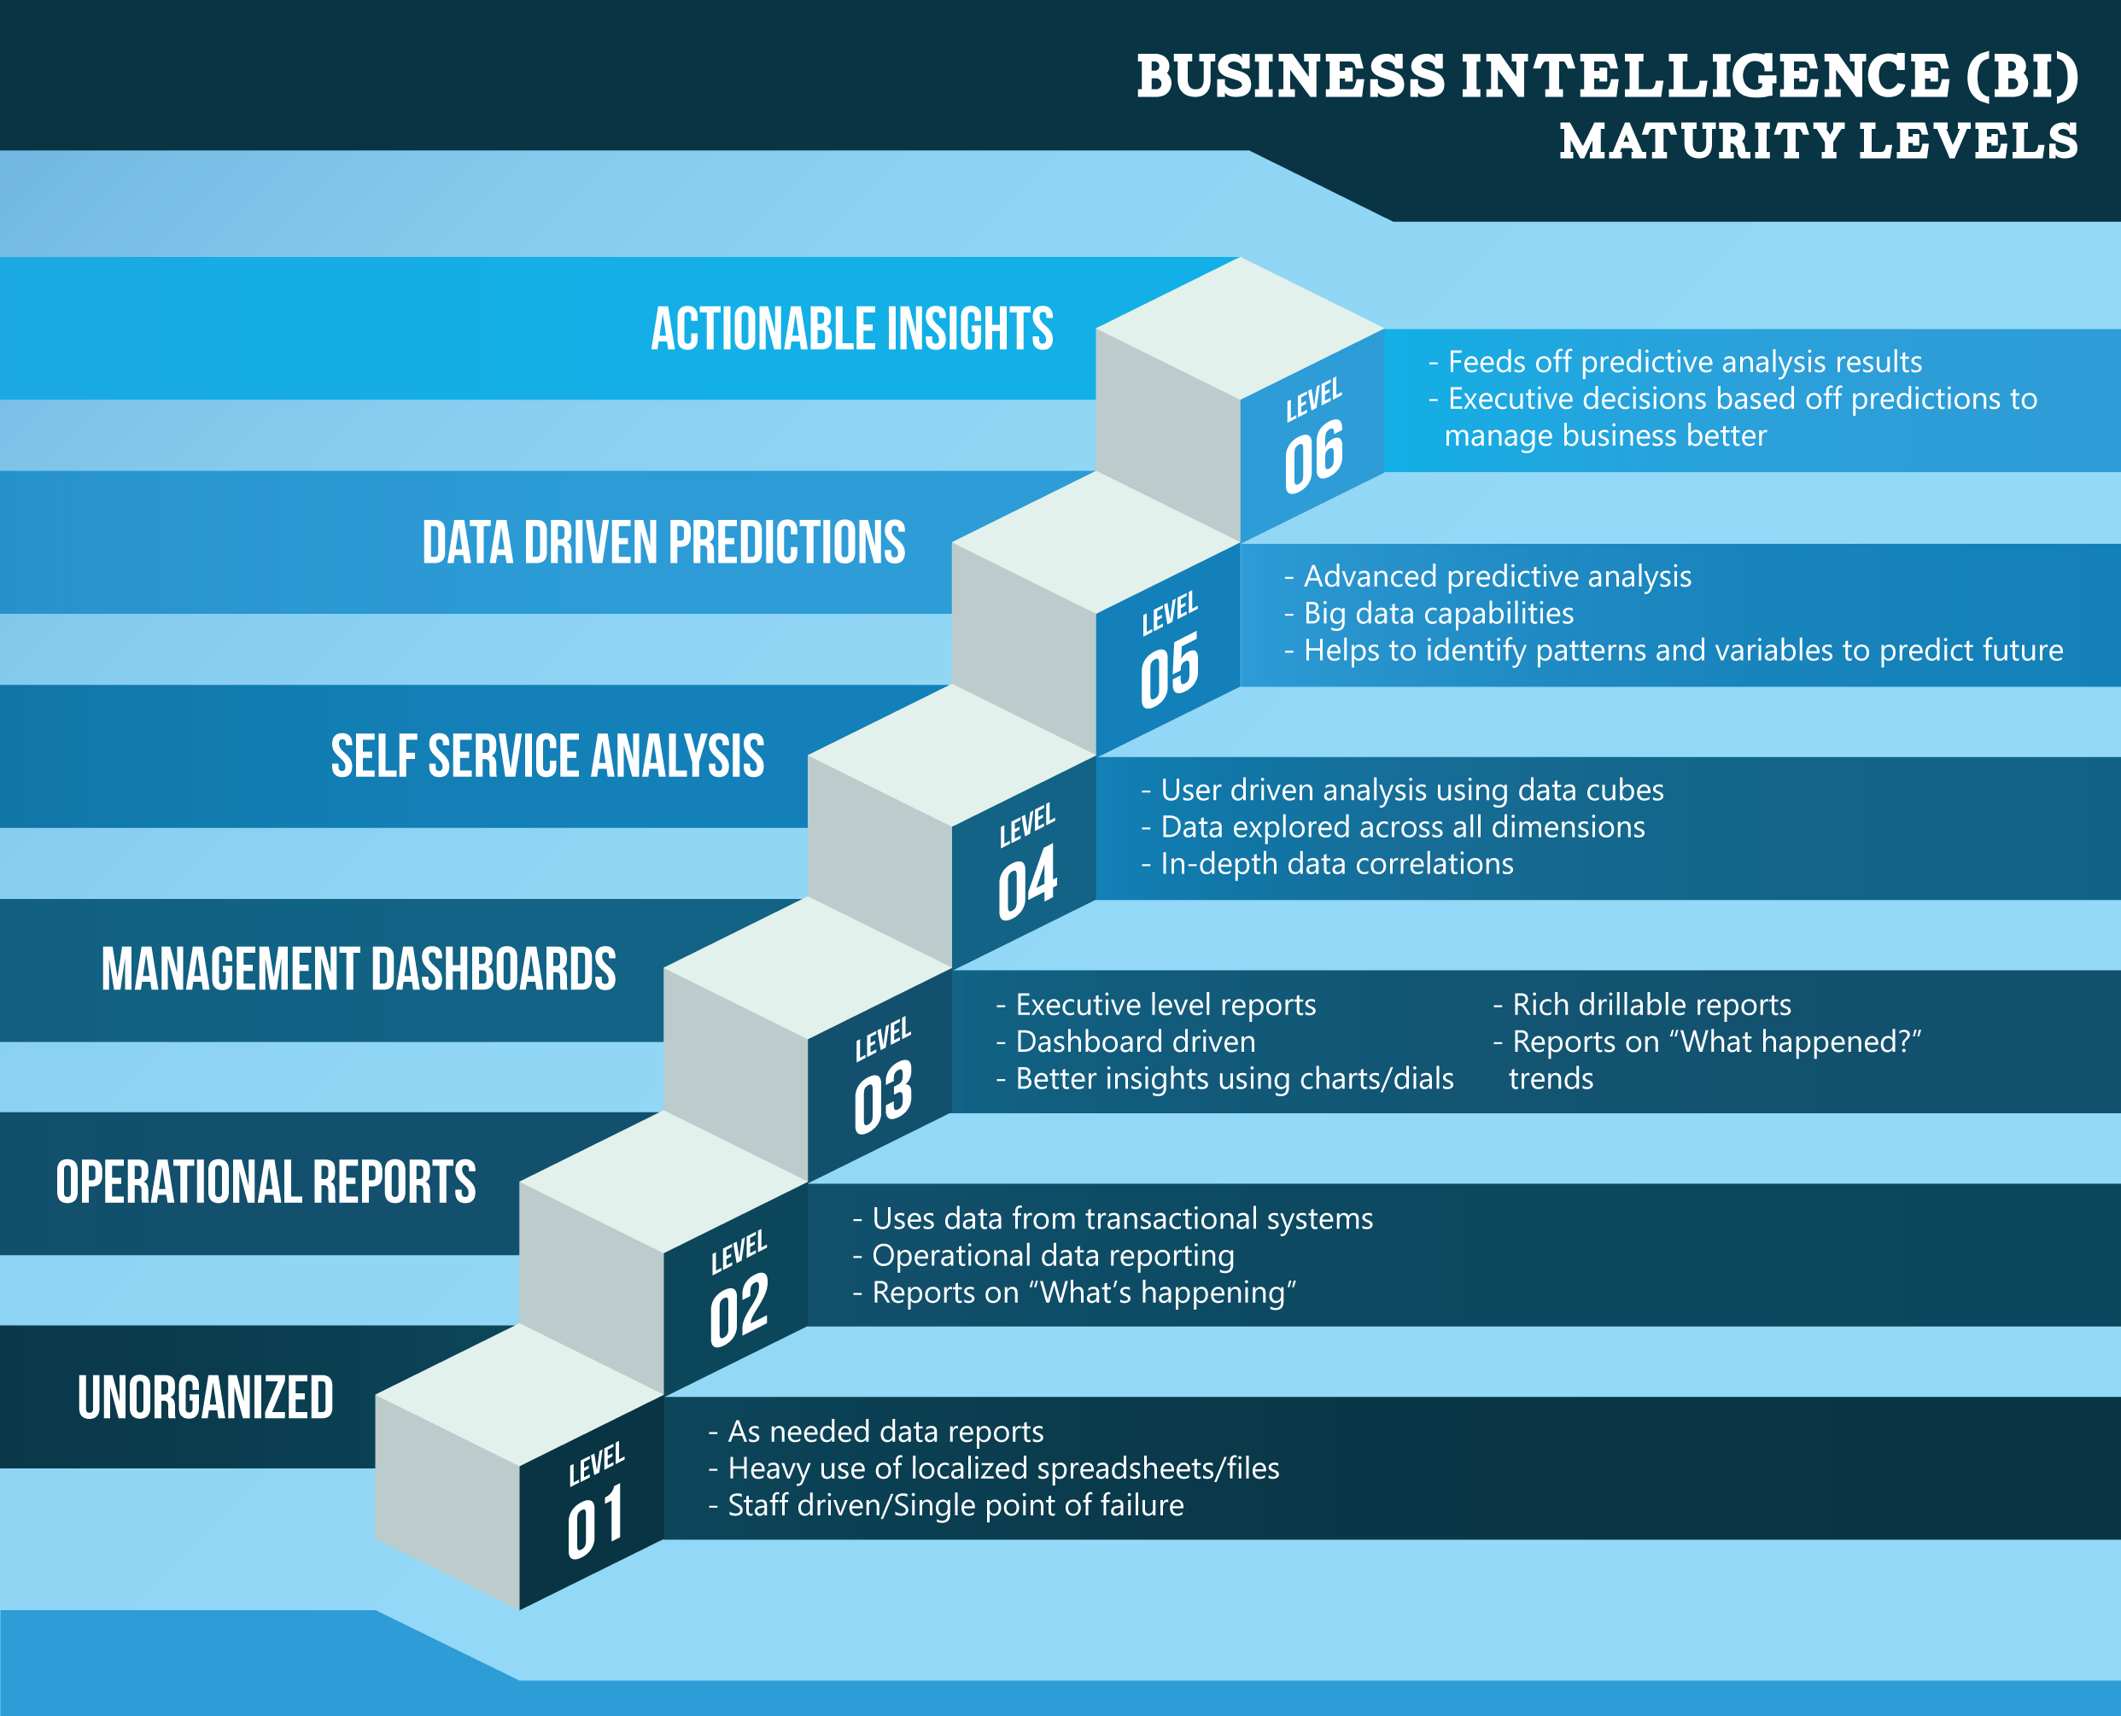
BI Maturity Levels

Slide 11
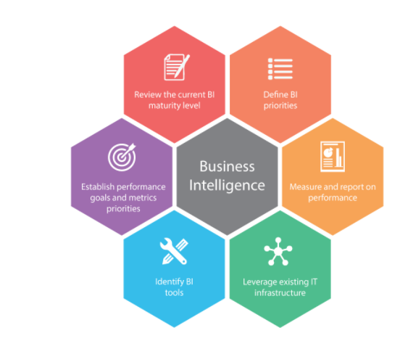
BI Implementation

