Slide 2
Data Warehousing Definitions & Concepts
Data Warehouse
Repository of current and historical data of potential interest to managers throughout the organization.
Data are usually structured to be available in a form ready for analytical processing activities, DM, querying, reporting and other decision support applications.
Characteristics of Data Ware housing
Subject-oriented
Data are organized by detailed subject such as sales, products, customers, containing only information relevant for decision support
DW is used to analyze a particular subject area

Slide 3
Integrated
DW must place data from different sources into a consistent format.
Time Variant
Data in a DW might have to be analyzed at multiple time points(daily, weekly, monthly etc)
Non-Volatile
Cannot change or update
Changes recorded as new data

Slide 4
Additional Characteristics
Web based computational environment
Relational / Multidimensional structure
Client server architecture
Real time data access
Includes Metadata

Slide 5
Data Mart
Usually smaller and focusses on a particular subject or department
Two types:
Dependent Data Mart
Independent Data Mart
Operational Data Stores
Provides recent information
Enterprise Data Warehouse
Large scale DW which provides data for DSS, CRM, SCM, BPM, BAM, PLM, KMS

Slide 6
Metadata
Pattern View
Syntactic metadata
Semantic metadata
Structural metadata
Business Metadata
Technical Metadata

Slide 7
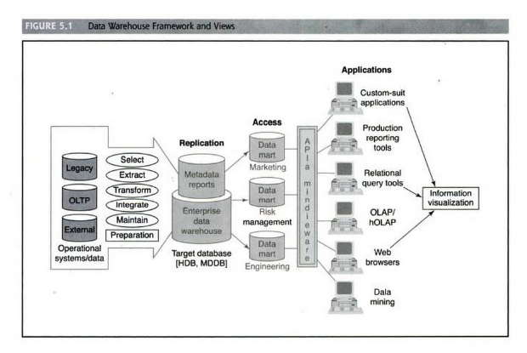
Data Warehousing Process Overview

Slide 8
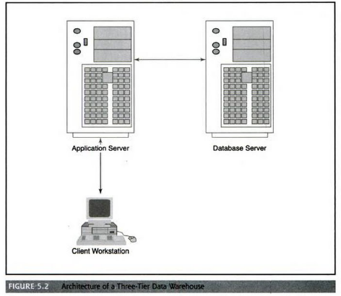
DW Architecture

Slide 9
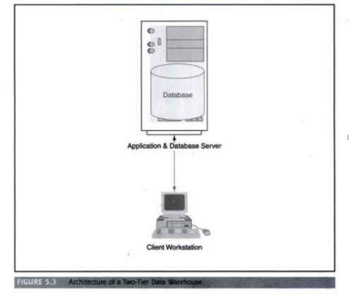
DW Architecture

Slide 10
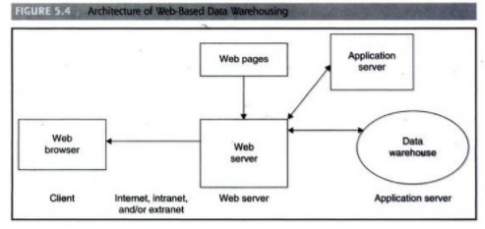
Web- based data warehousing architecture

Slide 11
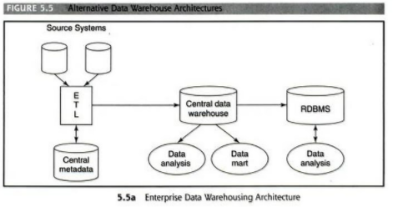
Alternative Data Warehouse Architecture

Slide 12
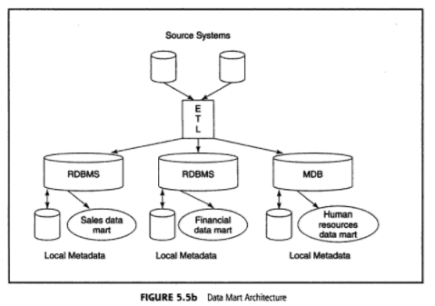
Alternative Data Warehouse Architecture

Slide 13
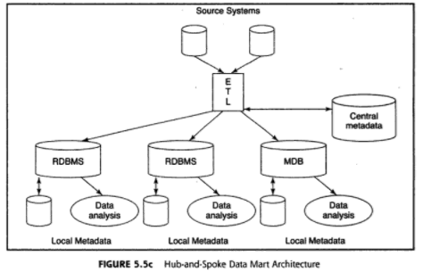
Alternative Data Warehouse Architecture

Slide 14
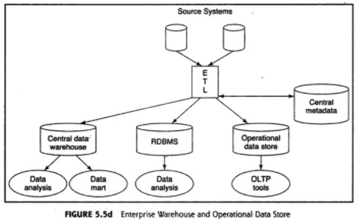
Alternative Data Warehouse Architecture

Slide 15
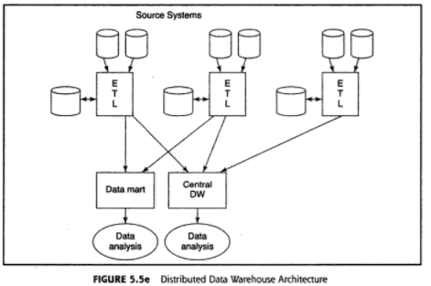
Alternative Data Warehouse Architecture

Slide 16
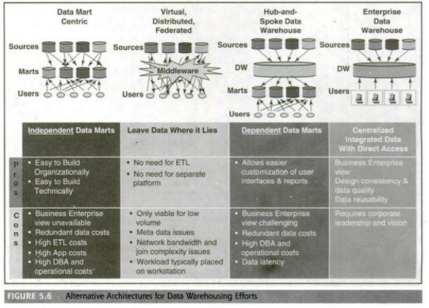

Slide 17
ETL Process

Slide 18
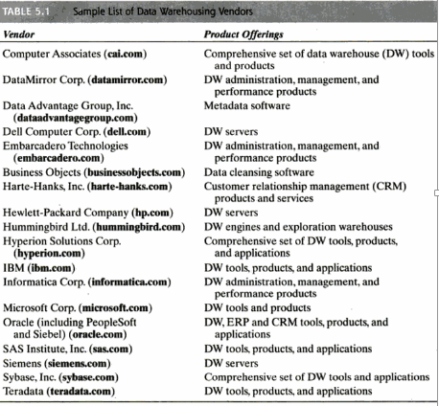
DW vendors

Slide 19
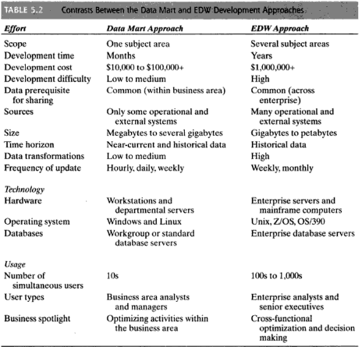

Slide 20
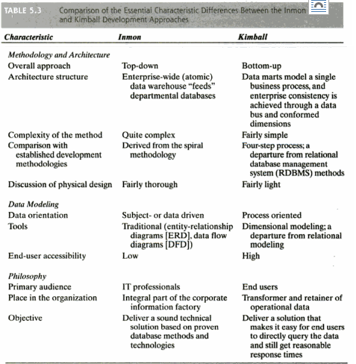

Slide 21
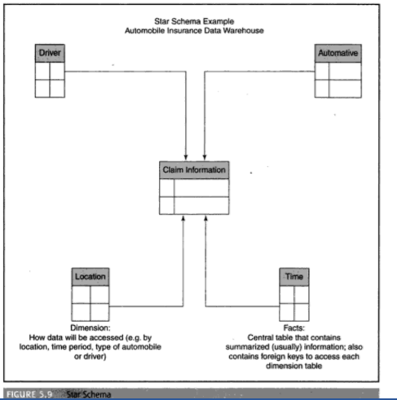

Slide 22
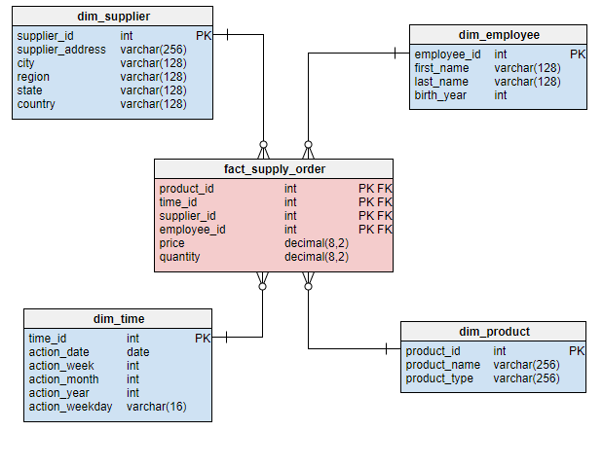
Star Schema

