Slide 1
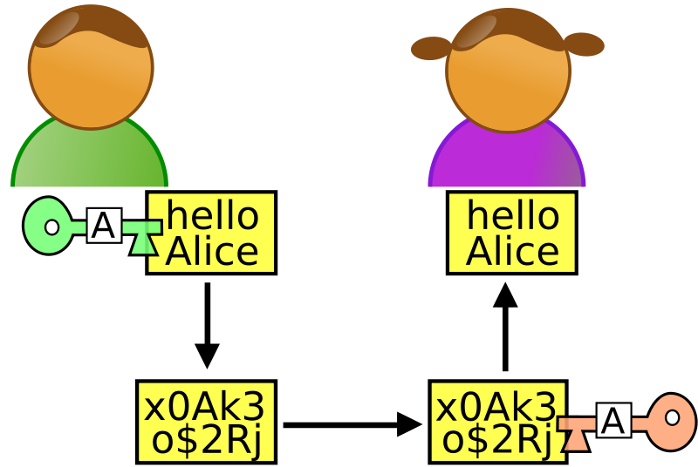
OVERVIEW

Slide 2
CONTENTS
SECURITY
SECURITY THREATS
SECURITY GOALS
WHAT IS CRYPTOGRAPHY
BASIC TERMS
ENCRYPTION & DECRYPTION
CATEGORIES OF CYRPTOGRAPHY
COMPARISON
CONCLUSION

Slide 3
SECURITY???

Slide 4
The OSI (open systems interconnection) security architecture
Security Attack: Any action that compromises the security of information.
Security Mechanism: A mechanism that is designed to detect, prevent, or recover from a security attack.
Security Service: A service that enhances the security of data processing systems and information transfers. A security service makes use of one or more security mechanisms.

Slide 5
SECURITY GOALS
CONFIDENTIALITY INTEGRITY SEC
URE
AVAILABILITY

Slide 6
Security Goals(CIA)
Confidentiality :-
The protection of data from unauthorized disclosure.
Integrity:-
The assurance that data received are exactly as sent by an authorized entity
(i.e., contain no modification, insertion, deletion or replay).
Availability
The information created and stored by an organization needs to be available to authorized entities

Slide 7
THREATS

Slide 8
Passive Attack
Passive attacks are in the nature of eavesdropping on, or monitoring of, transmissions. The goal of the opponent is to obtain information that is being transmitted
attempts to learn or make use of information from the system but does not affect system resources
Active Attack
attempts to alter system resources or affect their operation
Active attacks involve some modification of the data stream or the creation of a false stream and can be subdivided into four categories

Slide 9
Security Attacks
Interruption: This is an attack on availability
Interception: This is an attack on confidentiality
Modification: This is an attack on integrity
Fabrication: This is an attack on authenticity

Slide 11



Attacks Threatening Confidentiality:-
Snooping - unauthorized access to or interception of data.
For example, if you login to a website that uses no encryption, your username and password can be sniffed off the network by someone who can capture the network traffic between you and the web site.
Traffic Analysis- monitoring online traffic.

Slide 12
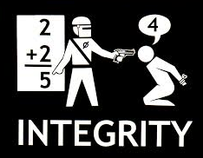
Attacks Threatening Integrity.
Modification means that the attacker intercepts the message and changes it.
An example is the man-in-the-middle attack, in which an intruder reads messages from the sender and sends (possibly modified) versions to the recipient,
Masquerading or spoofing happens when the attacker impersonates somebody else.
Replaying means the attacker obtains a copy of a message sent by a user and later tries to replay it.
Repudiation means that sender of the message might later deny that she has sent the message; the receiver of the message might later deny that he has received the message
A
B
C

Slide 13
Attacks Threatening Availability
Attacks Denial of service (DoS) is a very common attack. It may slow down or totally interrupt the service of a system
A
B
C

Slide 14
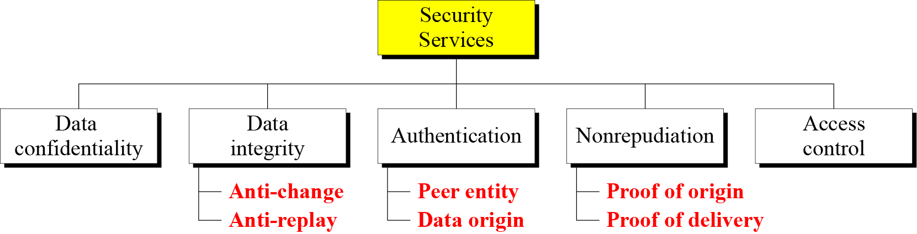
Security Services

Slide 16
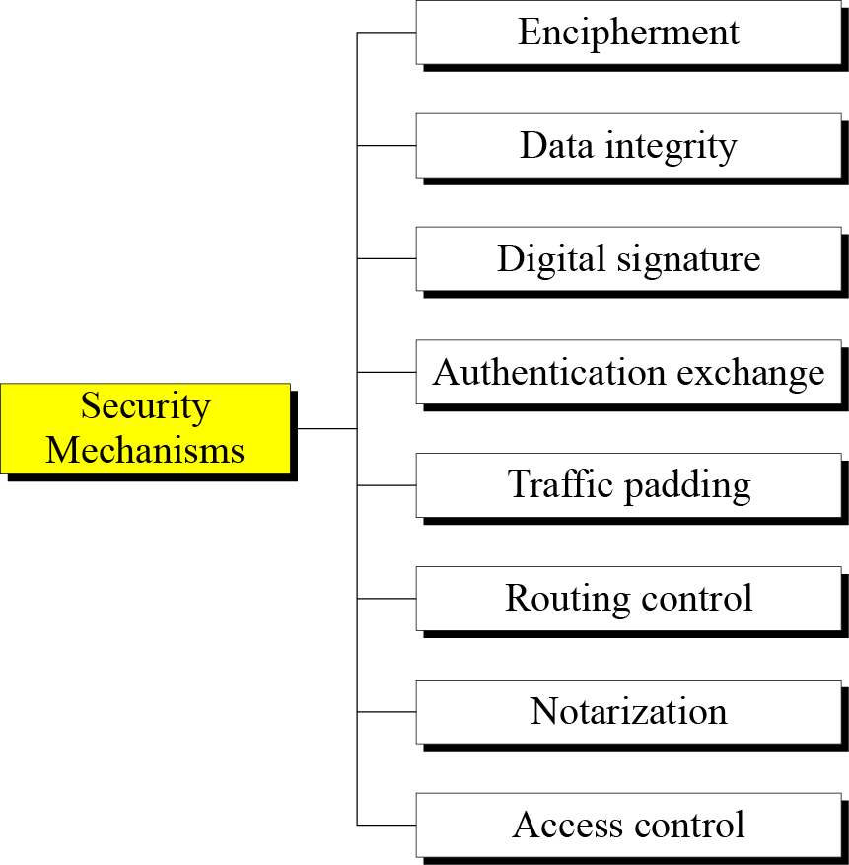
Security mechanisms

Slide 17
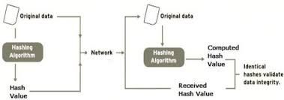
Data Integrity

Slide 18
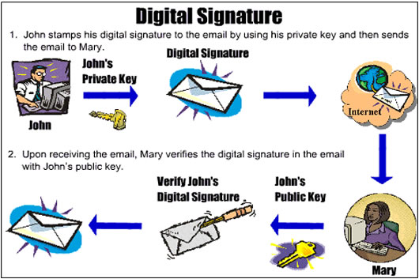
Digital Signature

Slide 19
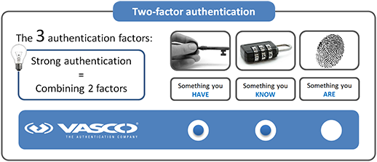
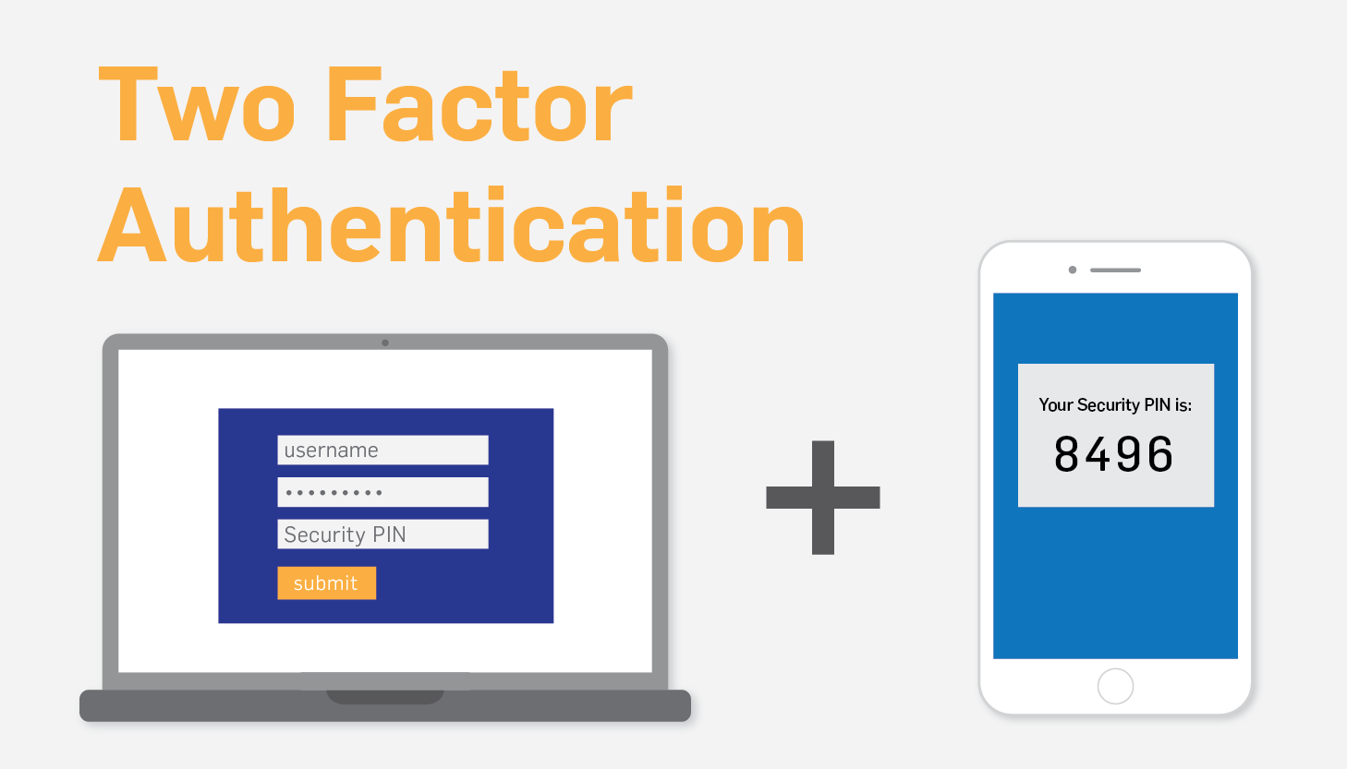
Authentication exchange

Slide 20


Access Control
It uses methods to prove that a user has access rights to the data or resources owned by a system.
Examples: passwords and PINs

Slide 21
Traffic Padding
The insertion of bits into gaps in a data stream to frustrate traffic analysis attempts.

Slide 22
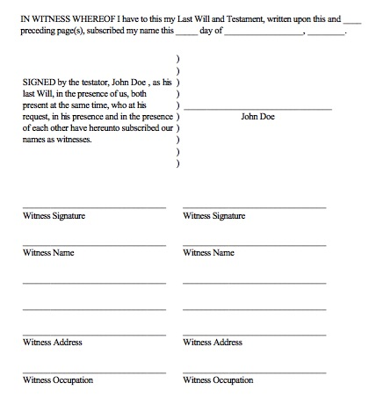
Notarization
use of a trusted third party to assure certain properties of a data exchange

Slide 23
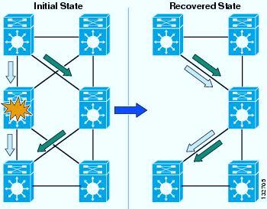
Routing Control
Enables selection of particular physically secure routes for certain data and allows routing changes, especially when a breach of security is suspected.

Slide 24



Slide 25
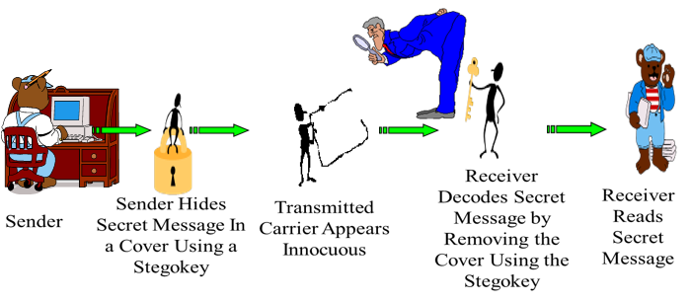
What is Steganography?
“Steganography means hiding one piece of data within another”.

Slide 26
Example
Since everyone can read, encoding text
in neutral sentences is doubtfully effective
Since Everyone Can Read, Encoding Text
In Neutral Sentences Is Doubtfully Effective
‘Secret inside’

Slide 27
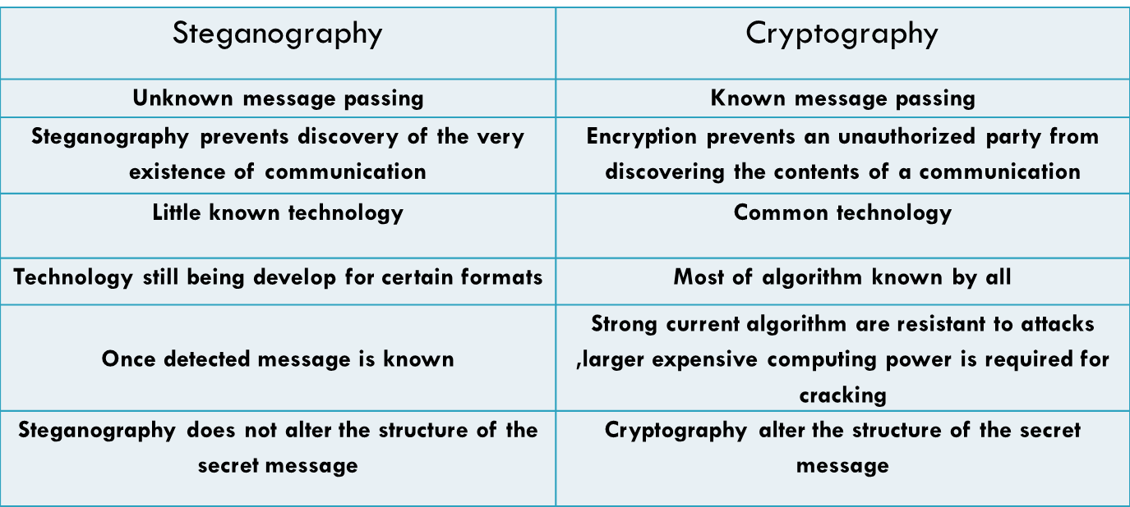
Steganography V/s Cryptography

Slide 28
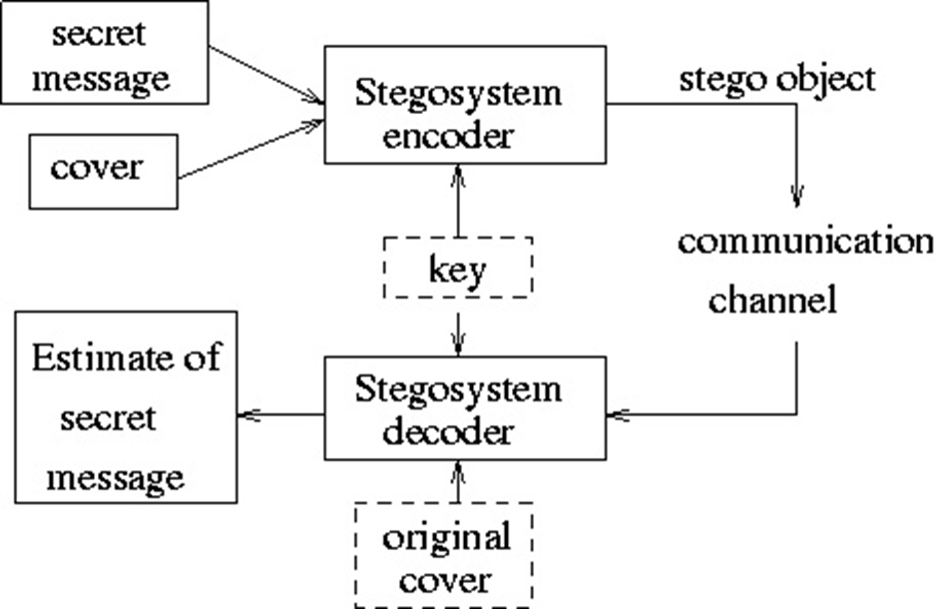
Basic Steganography Model

Slide 29
Types of steganography
Steganography In text/documents
Steganography In images
Steganography In audio
Steganography in video
Click me

Slide 30
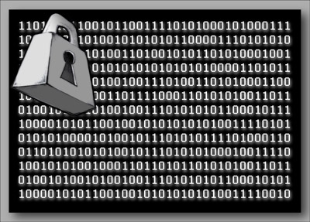
CRYPTOGRAPHY
Cryptography is the science and art of transforming messages to make them secure and immune to attack.

Slide 31
BASIC TERMS
PLAIN TEXT
CIPHER TEXT
CIPHER
ENCRYPTION & DECRYPTION
KEYS

Slide 32
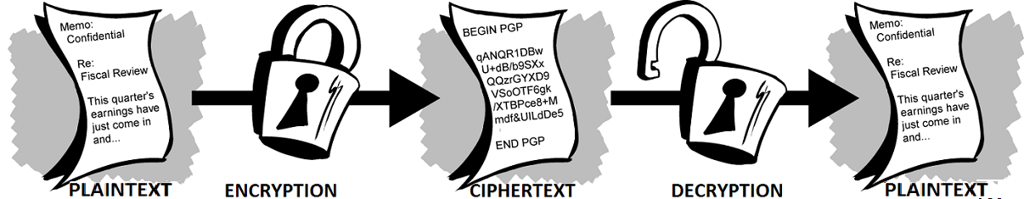
ENCRYPATION & DECRYPTION

Slide 33
CATEGORIES OF CRYPTOGRAPHY
ASYMMETRIC KEY CRYPTOGRAPHY
SYMMETRIC KEY CRYPTOGRAPHY

Slide 34

SYMMETRIC KEY CRYPTOGRAPHY
SENDER
RECEIVER
SECRET KEY
ENCRYPTION
DECRYPTION
CIPHERTEXT

Slide 35
ASYMMETRIC KEY CRYPTOGRAPHY
SENDER
RECEIVER
PUBLIC KEY
PRIVATE KEY
ENCRYPTION
DECRYPTION
CIPHERTEXT

Slide 36
COMPARISON
SYMMETRIC KEY CRYPTOGRAPHY | ASYMMETRIC KEY CRYPTOGRAPHY
The same algorithm with the same key is used for encryption and decryption. 2) The key must be kept secret. 3) It may be impossible or at least impractical to decipher a message if no other information is available. | 1) One algorithm is used for encryption and decryption with a pair of keys, one for encryption and one for decryption. 2) One of the two keys must be kept secret. 3) It may be impossible or at least impractical to decipher a message if no other information is available.

Slide 37
Relation between Services and Mechanisms

Slide 38
APPLICATIONS
Defense services
Secure data manipulation
E –commerce
Business transactions
Internet payment systems
User identification systems
Access control
Data security

Slide 39
CONCLUSION
By using of encryption techniques a fair unit of confidentiality, authentication, integrity, access control and availability of data is maintained.

Slide 40
THANKS

