Slide 1
Finite Automata

Slide 2
Central Concepts of Automata
Alphabets ( ∑ ) :- Finite non-empty set of symbols
∑ = {0,1}
Strings (word) :- sequence of symbols chosen from alphabet. Empty String (∊ ).
Length of String ( |w| ) :- |∊| = 0.

Slide 3
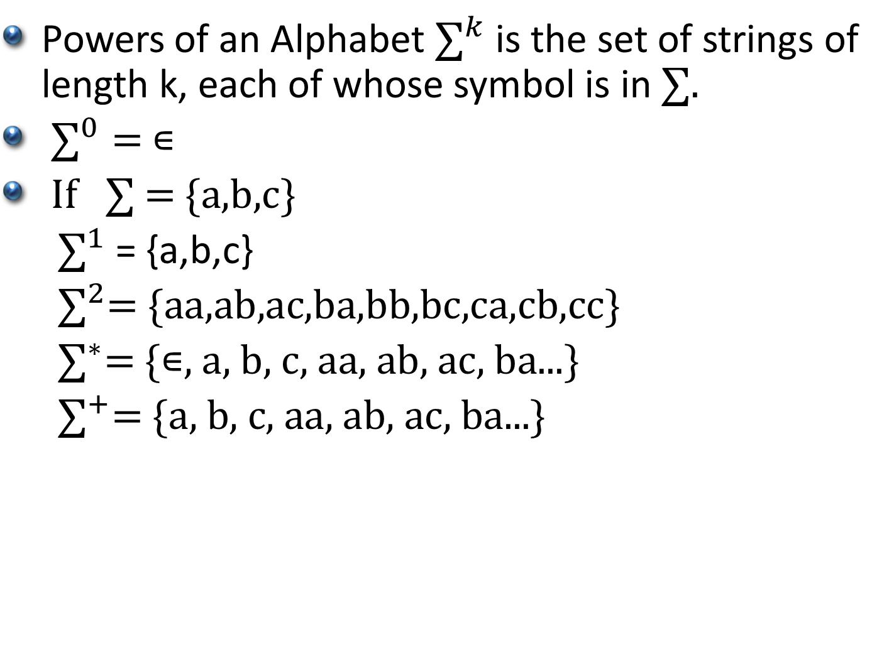
Central Concepts of Automata
Powers of an Alphabet ${\text{∑}}^{k}$ is the set of strings of length k, each of whose symbol is in ∑.
${\text{∑}}^{0}=$∊
$\text{If} \text{∑ = \{}\text{a}\text{,}\text{b}\text{,}\text{c}\text{\}}$
${\text{∑}}^{1}$ = {a,b,c}
${\text{∑}}^{2}\text{= \{}\text{aa}\text{,}\text{a}\text{b}\text{,}\text{a}\text{c}\text{,}\text{ba}\text{,}\text{bb}\text{,}\text{bc}\text{,}\text{ca}\text{,}\text{cb}\text{,}\text{cc}\text{\}}$
${\text{∑}}^{∗}\text{= \{∊}\text{, }\text{a}\text{, }\text{b}\text{, }\text{c}\text{, }\text{aa}\text{, }\text{ab}\text{, }\text{ac}\text{, }\text{ba}\text{...}\text{\}}$
${\text{∑}}^{+}\text{= \{}\text{a}\text{, }\text{b}\text{, }\text{c}\text{, }\text{aa}\text{, }\text{ab}\text{, }\text{ac}\text{, }\text{ba}\text{...\}}$

Slide 4
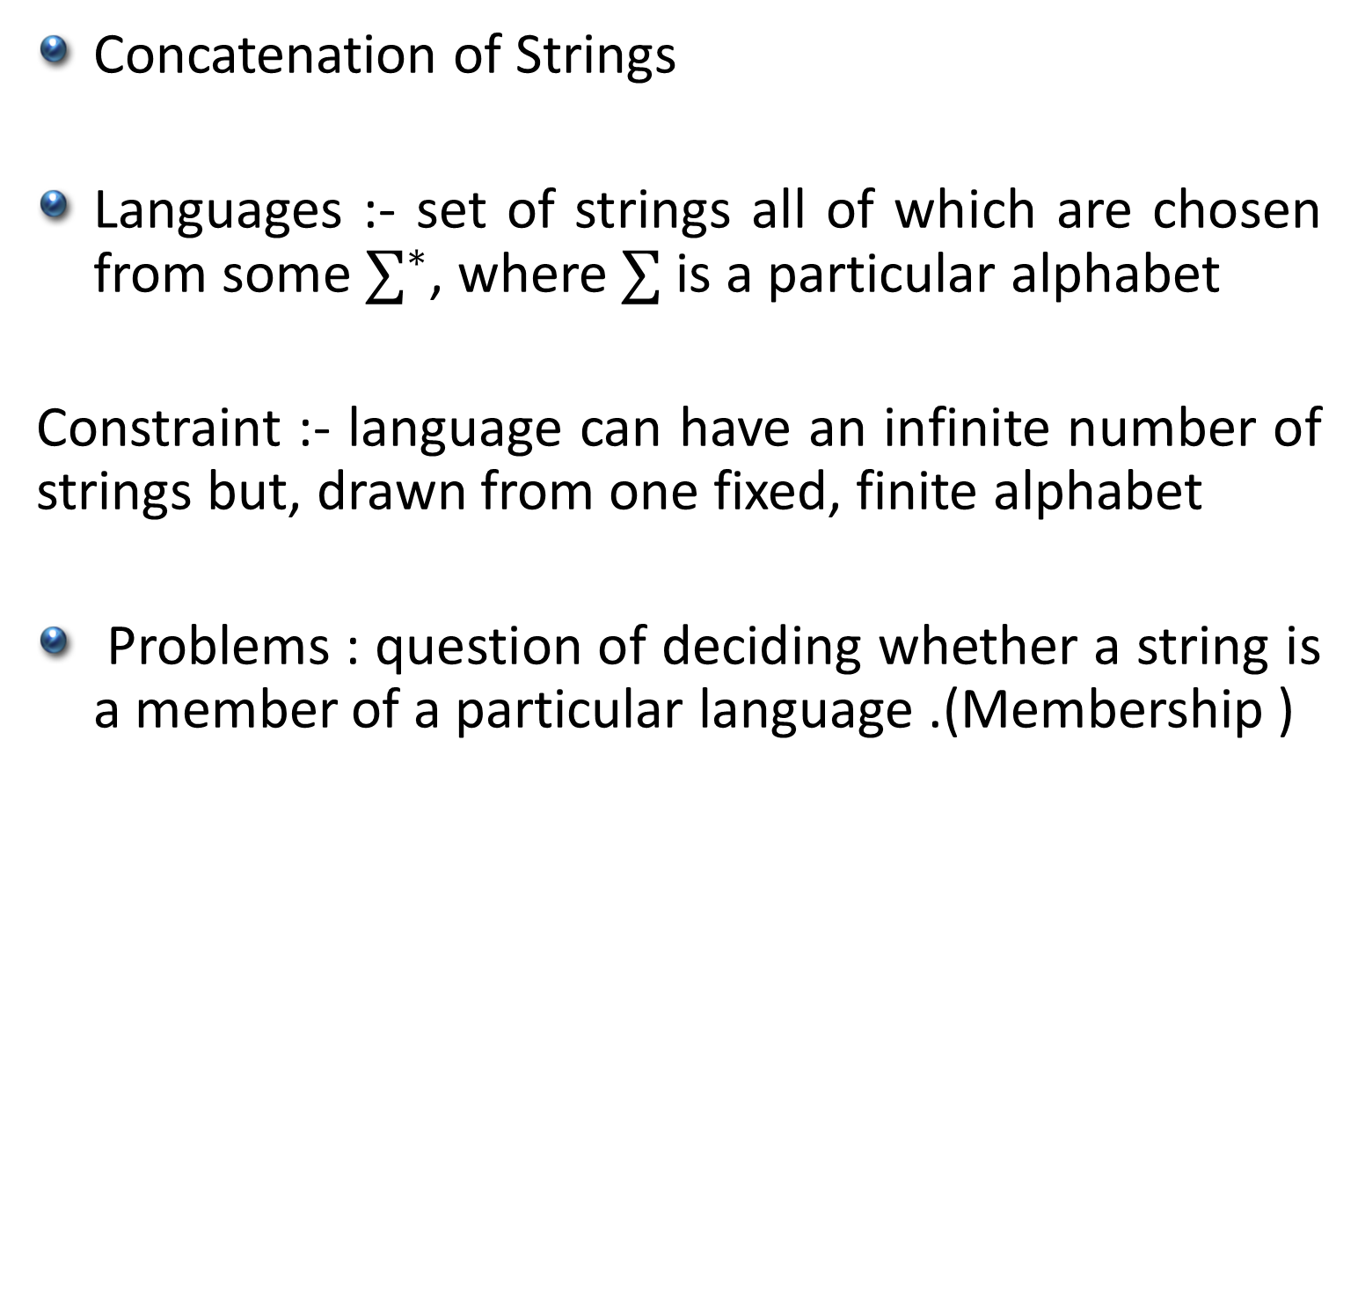
Central Concepts of Automata
Concatenation of Strings
Languages :- set of strings all of which are chosen from some ${\text{∑}}^{∗}$, where $\text{∑}$ is a particular alphabet
Constraint :- language can have an infinite number of strings but, drawn from one fixed, finite alphabet
Problems : question of deciding whether a string is a member of a particular language .(Membership )

Slide 5
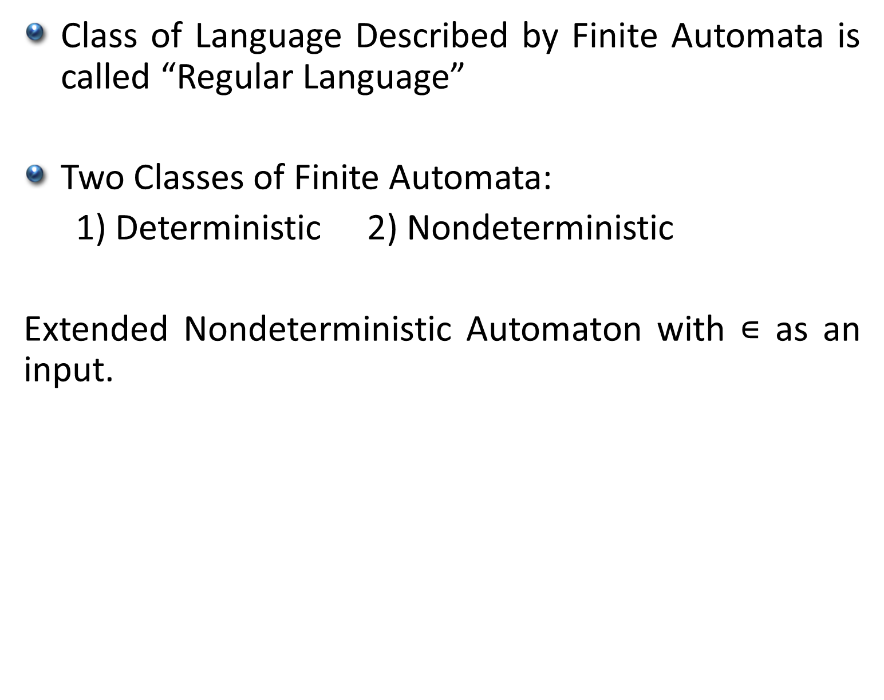
Finite Automata
Class of Language Described by Finite Automata is called “Regular Language”
Two Classes of Finite Automata:
1) Deterministic 2) Nondeterministic
Extended Nondeterministic Automaton with $\text{∊}$ as an input.

