Slide 1
Models of Molecular Computation

Slide 2
Abstract Models
Abstract Models described without considering physical implementation
Implementation varies in following ways:
Volume of DNA required (Space Complexity)
Time for each operation, hence the sequence of operation determine time complexity
Lab techniques have non zero error rate

Slide 3
Categories of DNA Computation Models
Four categories of Models:
Filtering
Splicing
Constructive
Membrane

Slide 4
Filtering Model
Series of operations on finite multi-sets of strings, which includes all possible solutions
Computation proceeds by filtering out strings which cannot be a solution

Slide 5
Adleman’s 3-vertex colorability problem
Initially T consists of strings of form c₁,c₂,…c_{n} where c_{i} ∊ {r_{i,} b_{i,} g_{i}} and n is |V| i.e. number of vertices
Each string is a possible coloring of graph but not necessarily proper coloring
V₀
V₁
b₀ g₁b₂r₃
V₂
V₃

Slide 6
Adleman’s 3-vertex colorability problem
Operations used are:
Separate
Merge
Detect

Slide 7
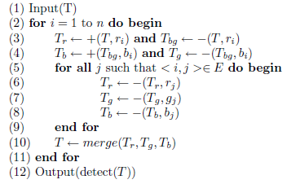
Pseudocode 3-vertex colorability problem

Slide 8
Lipton’s Satisfiability Model
Operations used are:
Separate
Merge
Detect

Slide 9
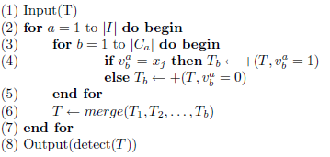
Lipton’s Satisfiability Model Pseudocode
For a formula I having clauses C_{1…}C_{n}. Each clause has variable v_{1...}v_{n}

Slide 10
References
Theoretical & Experimental DNA Computation Chapter 3

