Slide 1
Sticker Model

Slide 2
Sticker Model
Filtering Model
Operations are performed on multiset of strings over binary alphabets { 0, 1 }
Memory strands of length n consists of k non overlapping substrings of length m
Each substrand corresponds to a Boolean variable

Slide 3
Operations in Sticker Model
Separate (N,i): creates +(N,i) where i^{th} bit set on & –(N,i) where i^{th} bit is set off
Merge (N1,N2) : Merges N1 and N2
Set (N,i) : Sets i^{th} bit of all strands in N to 1
Clear(N,i) : Sets i^{th} bit of all strands in N to 0

Slide 4
Initial Set up
Initial input consists of library of memory strands A(k,l)
Comprises of k substrands 1≤ l ≤k
First l substrands maybe turned off / on
The last (k-l) substrands are turned off
First l is the input for computation
Last (k-l) used as working storage or output

Slide 5
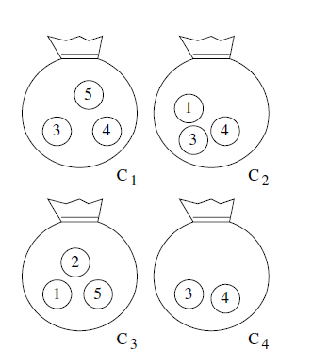
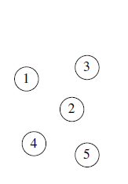
Minimal Cover Problem
Given a set of different objects and a set of bags containing various subsets of possible sets of objects, what is the smallest no. of bags a person must hold to ensure he/she has at least one of each object?

Slide 6
Sticker Model Approach
K = p+q
p = 5 (total objects)
q = 4 (total bags)
A(k,l) = A(p+q,q)

Slide 7
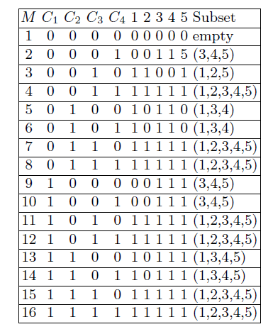
Sticker Model Approach (1)

Slide 8
Sticker Model Approach

Slide 9
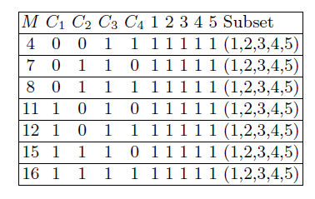
Sticker Model Approach (2)

Slide 10
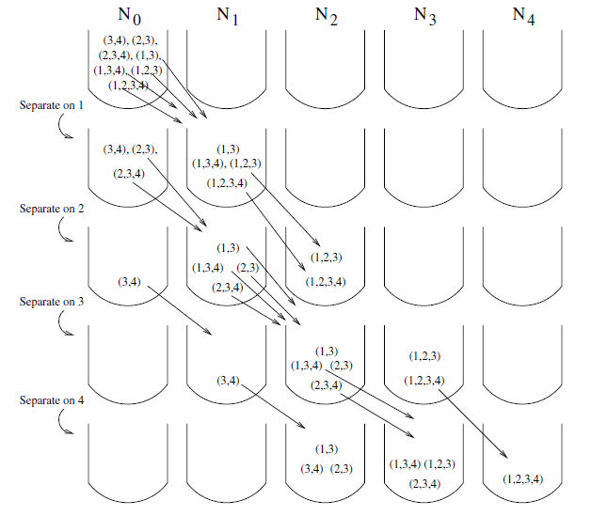
Sticker Model Approach (3)

Slide 11
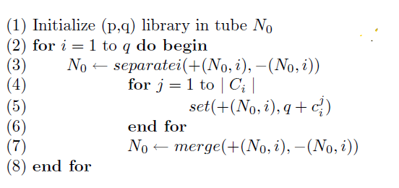
Pseudocode (1)

Slide 12
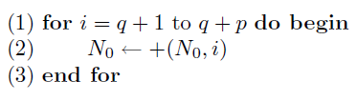
Pseudocode (2)

Slide 13
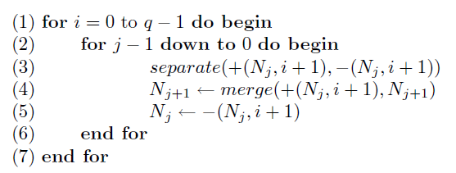
Pseudocode (3)

Slide 14
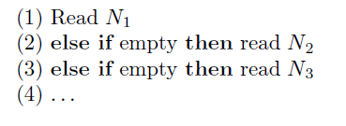
Output

Slide 15
References
Theoretical & Experimental DNA Computation Chapter 3

