Slide 1
Splicing Model

Slide 2
Splicing Model
Splicing Model
Splicing systems are generative mechanisms
Based on the splicing operation formalized by T. Head (1987) as a model of DNA recombination.

Slide 3
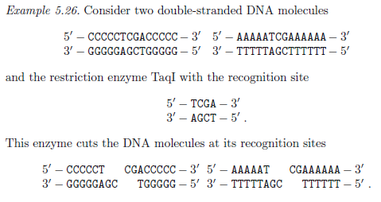
Basic Splicing Systems
Splicing system model based on the operation Splicing
DNA Recombination:- combination of cutting double stranded DNA molecules and reconnecting the cut parts to obtain new DNA molecules

Slide 4
Abstract Model
Splicing system is a Quadruple S = ( ∑ , V , R , A)
∑ - finite set of terminal symbols
V – finite set of non terminal symbol ∑ ∩ V = ∅
R – Splicing rules of form (Γ*# Γ* $ Γ*# Γ*) where Γ = ∑ U V
A – set of Axioms A ⊆ Γ*

Slide 5
Splicing Rules
Splicing rules are used to provide one step derivations
For r = w1 # w2 $ w3 # w4 ∊ R, u, v, x and y ∊ Γ*
(u , v) ⊢_{r} (x, y)
u = u1w1w2u2 x = ?
v = v1w3w4v2 y = ?

Slide 6
Splicing Rules
Consider the splicing system S = (Σ, V,R,A) with
Σ = {a, b, c}, V = ∅, R = {r_{b} = b#$b#, r_{c} = c#$c#} and
A = {abaca, acaba}.
(ab|aca, acab|a) ⊢_{rb} (aba, acabaca)
(abac|a, ac|aba) ⊢_{rc} (abacaba, aca)

Slide 7

Language generated
Language generated consists of the strings over Σ, which are iteratively obtained by applying the rules to the axioms and the strings obtained in preceding splicing steps

Slide 8
Language generated
Consider the splicing system S = (Σ, V,R, A) with
Σ = {a, b}, V = ∅, R = {r_{b} = a#b $ b#a }
A = {a^{n}b^{n}, b^{n}a^{n} | n >= 1}. Compute σ (A)

Slide 9
Multiplicity of each String
For a splicing system S = (Σ, V,R, A) with Γ = ∑ U V , multiplicity (non negative integer) associated with strings in Γ* (denotes the availability of string for splicing)
For each application of (u , v) ⊢_{r} (x, y)
Multiplicity of u and v decremented by 1 and that of x and y is incremented by 1

Slide 10
Hairpin Model

Slide 11
Autonomous Molecular Computing
Molecular computations are called autonomous if they proceed by successive autonomous reactions of molecules.
The first step of the Adleman-Lipton paradigm is a typical example of autonomous molecular computation.
They are also called one-pot reactions, because they autonomously proceed in a single test tube once the necessary ingredients are put into the tube initially.

Slide 12
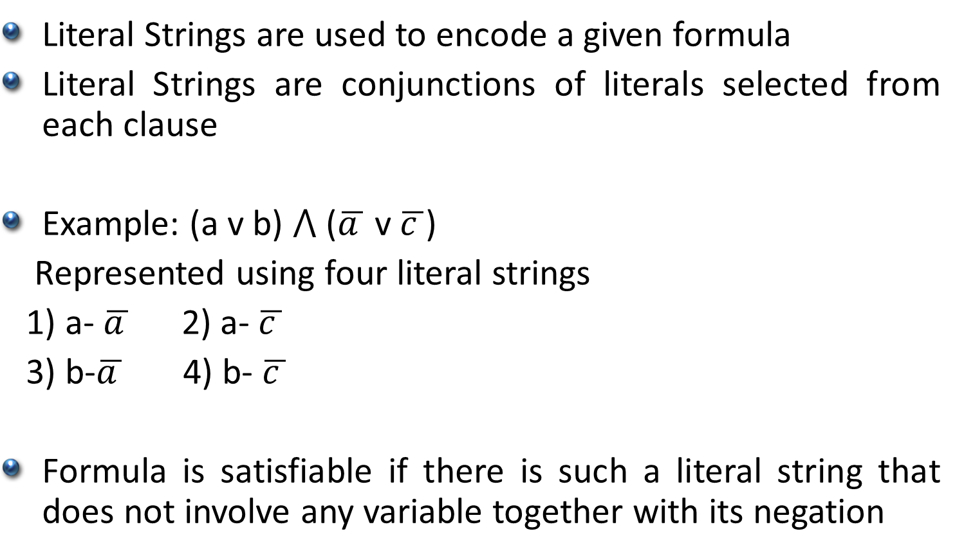
SAT using Hairpin Model
Literal Strings are used to encode a given formula
Literal Strings are conjunctions of literals selected from each clause
Example: (a v b) ⋀ ($\overline{a }$v $\overline{c }$)
Represented using four literal strings
1) a- $\overline{a }$2) a- $\overline{c }$
3) b-$\overline{a }$4) b- $\overline{c }$
Formula is satisfiable if there is such a literal string that does not involve any variable together with its negation

Slide 13
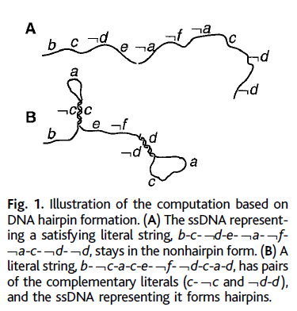
SAT using Hairpin Model

Slide 14
SAT using Hairpin Model (Steps)
Generate the literal strings according to the given formula. Implemented by ligation reaction.
(ii) Allow ssDNA molecules, each representing a literal string, to form hairpins. This step performs the main logic of computation only by regulating the temperature. Even enzymes are not necessary.
(iii) Remove the hairpin-forming molecules. The remaining molecules represent the satisfying literal strings, which can be identified with the solutions (value assignments) to the problem.

Slide 15
2 methods to distinguish hairpins from non-hairpins
The recognition site of a restriction enzyme is inserted into the middle of a sequence encoding a literal. Molecules with hairpins are cut by the enzyme.
(2) The efficiency of amplification by PCR differs for molecules with hairpins and without hairpins. The former kind of molecule is less efficient in amplification than the latter.

Slide 16
References
Splicing System / H system
DNA_Computing _Models_Zoya Chapter 5
Hairpin Model
Molecular_Computation_by_DNA_DNA_Hairpin_Model

