Slide 1
Self-Assembly Model

Slide 2
Self-Assembly
Self-assembly is the process by which a collection of relatively simple components, beginning in a disorganized state, spontaneously and without external guidance coalesce to form more complex structures.
Examples : Atoms bind to form Molecules

Slide 3
Self-Assembly Model
Constructive Model
Models of Self Assembly:
Linear Self Assembly (Adleman)
Tile Assembly Model (Winfree)

Slide 4
Comparison of 1D & 2D Self Assembly
1D Algorithmic Self-Assembly | 2D Algorithmic Self-Assembly
Only limited to simple computations | In addition to computation provides capabilities for construction.
Less Experimentally Challenging | More Experimentally Challenging

Slide 5
2 versions of Tile Assembly Model
abstract Tile Assembly Model (aTAM) | Kinetic Tile Assembly Model (kTAM)
Provides a high level of abstraction | Injects more of physical reality of chemical kinetics
Ignores the possibility of errors | Allows for the study of causes of errors and potential mechanisms for detecting, preventing and/or correcting them

Slide 6
Wang Tiling
Wang tiles are equally sized, 2-D unit squares which have colors on each edge
Tiles can be arranged side by side with edges aligned such that adjoining edges have matching colors (without rotation or flipping)

Slide 7
aTAM Definition
aTAM is based on and is similar in some aspect to Wang tiling
Initial assembly (seed) grows into a resultant structure
Each colored edge is associated with a positive integer strength value
Starting with preformed seed assembly , additional tiles can attach as long as the sum of the strengths of bonds meets a system wide threshold (temperature)

Slide 8
aTAM Definition
An assembly is τ-stable if it cannot be broken up into smaller assemblies without breaking bonds of total strength atleast τ
Self-Assembly begins with a seed assembly σ and proceeds asynchronously with tiles adsorbing one at a time to the existing assembly preserving the τ-stability
An assembly is terminal , if no tile can be τ-stably added to it

Slide 9
aTAM Definition
A Tile Assembly System (TAS) is an ordered triple
T =(T,σ ,τ)
T – finite set of tile types
σ – seed assembly
τ – total strength for τ-stability

Slide 10

aTAM Tile Type Example
Colors a and b
Strength indicated with solid extensions
Label L

Slide 11
aTAM v/s Wang Tiling
aTAM assemblies are desired goal unlike Wang Tiling
aTAM has restrictions based on the temperature unlike Wang

Slide 12
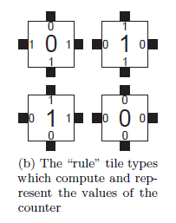
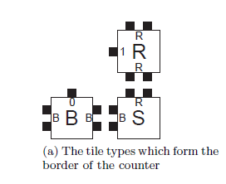
aTAM Example
Given the Following Tile Set generate 6x6 squares of tiles for T =(T,(S,(0,0)) ,2). T is the following 7 tiles

Slide 13
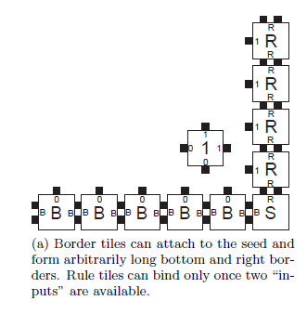
aTAM Example

Slide 14
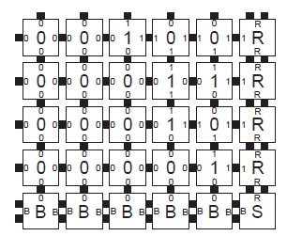
aTAM Example
Result ???
Binary Counter

Slide 15
Temperature 2 tile set
finite set of tile types:
seed
N
0
W
0
XOR
1
1
1
Cooperation: these two tiles must be present before this tile can bind
N
1
1
W
W
1
N
1
1
1
XOR
0
1
XOR
1
Tile computes a function
1
0
N
1
N
0
1
1
N
0
1
N
0
0
1
1
1
seed
W
W
W
W
W
N
0
XOR
0
0
XOR
1
W
W
0
1

Slide 16
References
An Introduction to Tile-Based Self-Assembly

