Slide 1
Self-Assembly Model

Slide 2
kTAM (Kinetic TAM)
Model considers the physical implementation aspects
Captures the types of errors in assembly
Accounts for the association and disassociation rates of tiles

Slide 3
Types of Errors
3 Types of Errors
Growth Error (Mismatch Error)
Facet Errors
Nucleation Errors

Slide 4
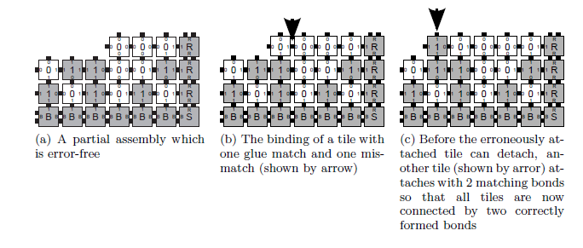
Growth Error

Slide 5
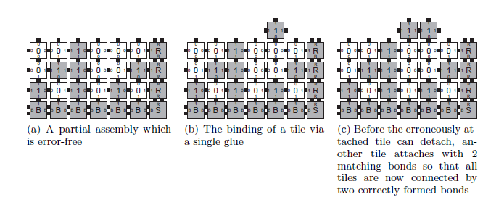
Facet Error

Slide 6


Nucleation Error
Tiles aggregate without attaching to a seed structure thus seed a new tile assembly

Slide 7
Error Handling

Slide 8
Error Suppression via Block Replacement
Proofreading
Reduce Growth errors
Individual tiles replaced by a n x n blocks
Increase in n reduces the growth errors or increases the speed of self assembly maintaining the same error rate

Slide 9
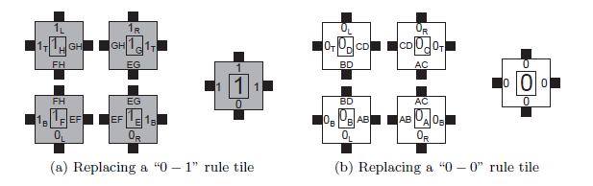
Error Suppression via Block Replacement

Slide 10
Facet Error Handling
Occurs in system which requires growth to be initiated by extending from a flat surface
Redesign the system by changing the pattern of growth to avoid large facets

Slide 11
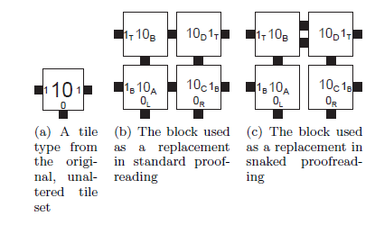
Snaked Proofreading

Slide 12
Self Healing
Growing assembly that is damaged regrows to heal, without allowing any internal errors
The major problem is that many computations are not reversible

Slide 13
Enhanced tile design
Model in which the “input” glues of tiles are “active” when the tiles are freely floating in solution, but their “output” glues are “inactive”.
Only once a tile has associated to an assembly and bound with its input sides, its output sides activated

Slide 14
Handling Nucleation Errors
Zig- Zag Systems
Kinetic barriers for Large unseeded assemblies
Allows for the growth of seeded assemblies

Slide 15

Example of aTAM for SAT
Compute the function F(i, v, j) for i = (1,0,1) and v =(x_{1,} x_{2,} x₃) for the clause given below

Slide 16
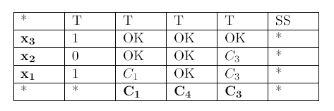
Example of aTAM for SAT
Compute the function F(i, v, j) for i = (1,0,1) and v =(x_{1,} x_{2,} x₃) for the clause given below

Slide 17





Self-Assembly Tiles for SAT
Variable 4. Assignment 7. Final
Clauses 5. Computation Boundary
Input boundaries 6. Computation

Slide 18
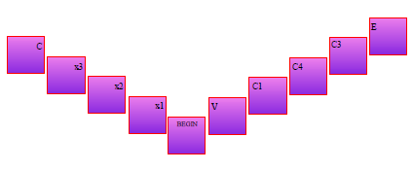
Stepwise- Tile generation

Slide 19
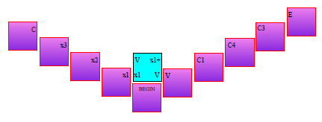
Stepwise- Tile generation

Slide 20
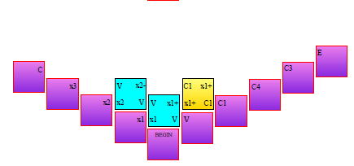
Stepwise- Tile generation

Slide 21
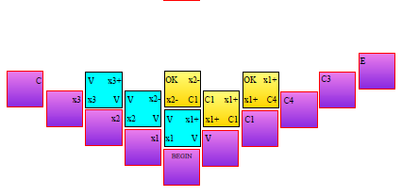
Stepwise- Tile generation

Slide 22
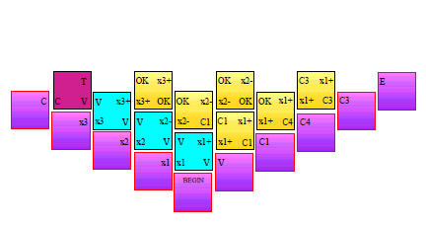
Stepwise- Tile generation

Slide 23
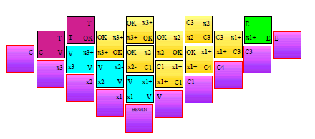
Stepwise- Tile generation

Slide 24
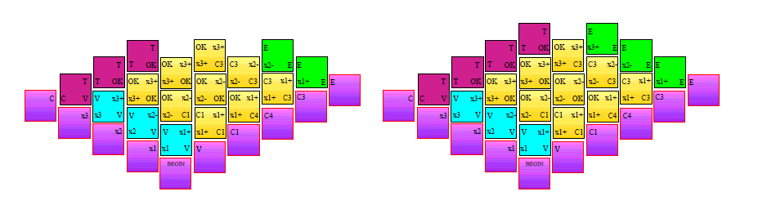
Stepwise- Tile generation

Slide 25
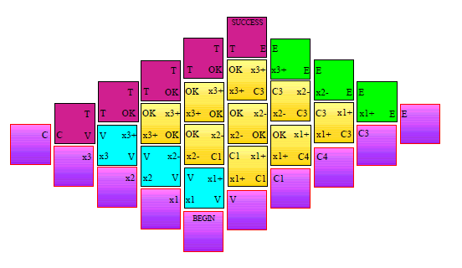
Stepwise- Tile generation

Slide 26
References
An Introduction to Tile-Based Self-Assembly
SAT_SelfAssembly

