Slide 1
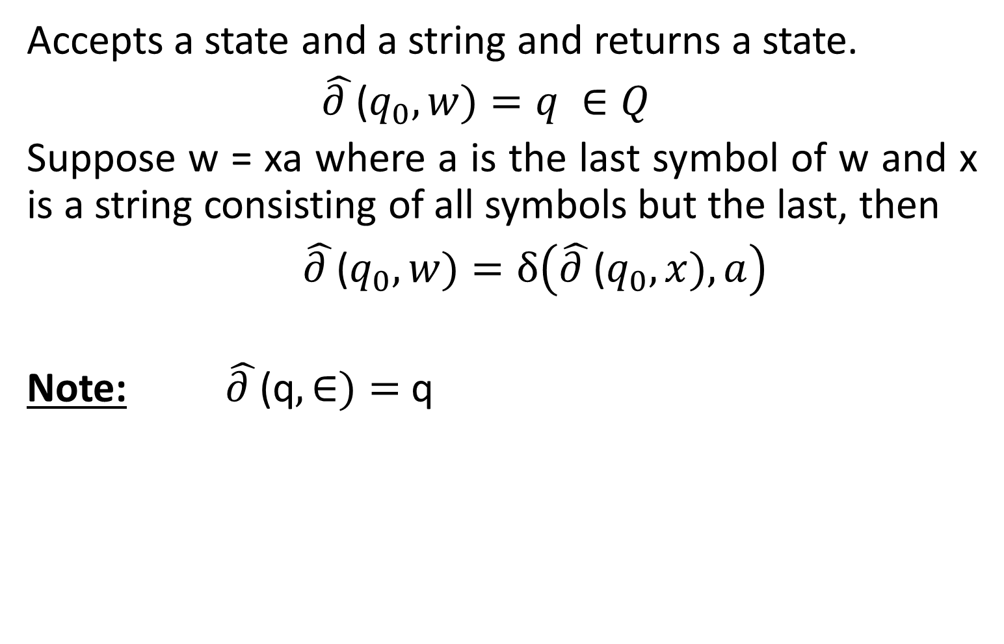


Extended Transition Function $\hat{(∂})$
Accepts a state and a string and returns a state.
$\hat{∂ }$($q_{0}, w)=q ∈Q$
Suppose w = xa where a is the last symbol of w and x is a string consisting of all symbols but the last, then
$\hat{∂ }$($q_{0}, w)=δ\left(\hat{∂ }\text{(}q_{0}, x),a\right)$
Note: $\hat{∂ }$(q$,∈)=$ q

Slide 2
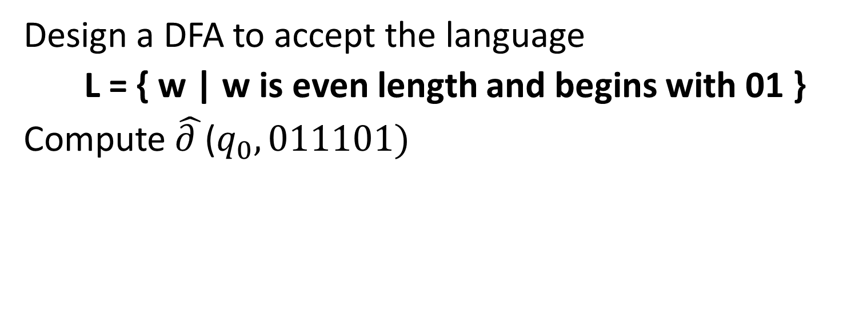
Deterministic Finite Automata
Design a DFA to accept the language
L = { w | w is even length and begins with 01 }
Compute $\hat{∂ }$($q_{0},011101)$

Slide 3
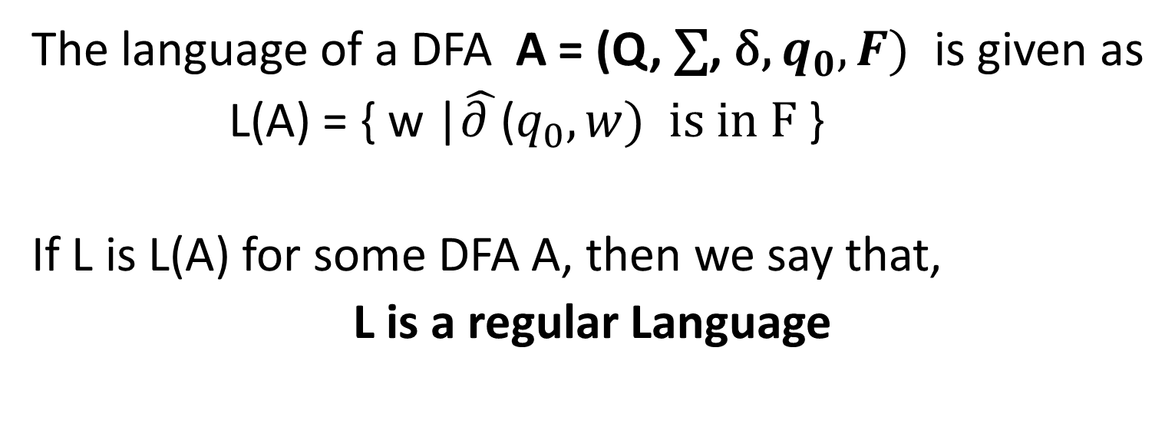
Language of DFA
The language of a DFA A = (Q, $\text{∑}$, δ, $q_{0}, F)$ is given as
L(A) = { w |$\hat{∂ }$($q_{0},w) is in F$}
If L is L(A) for some DFA A, then we say that,
L is a regular Language

Slide 4
An Example
Draw a DFA to accept a language of strings having 1 in the second last position

Slide 5
Nondeterministic Finite Automata

Slide 6
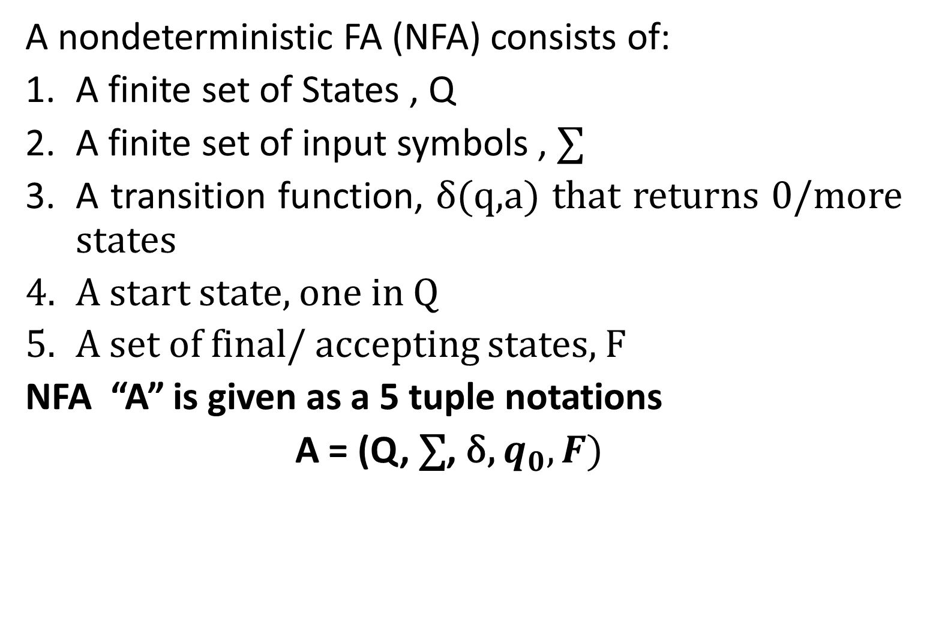
Nondeterministic Finite Automata
A nondeterministic FA (NFA) consists of:
A finite set of States , Q
A finite set of input symbols , $\text{∑}$
A transition function, δ(q,a) that returns 0/more states
A start state, one in Q
A set of final/ accepting states, F
NFA “A” is given as a 5 tuple notations
A = (Q, $\text{∑}$, δ, $q_{0}, F)$
Notes:
Transition table for a NFA
Extended Transition Function

Slide 7
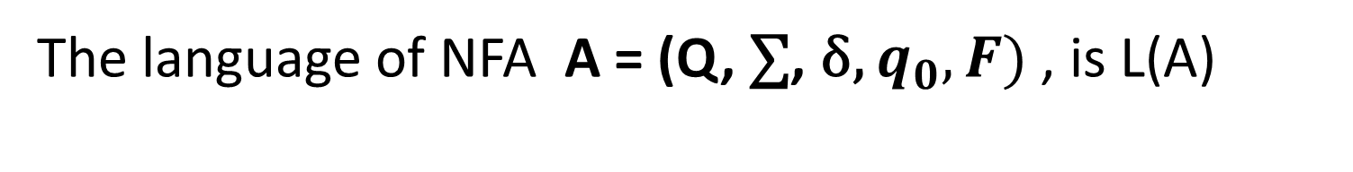
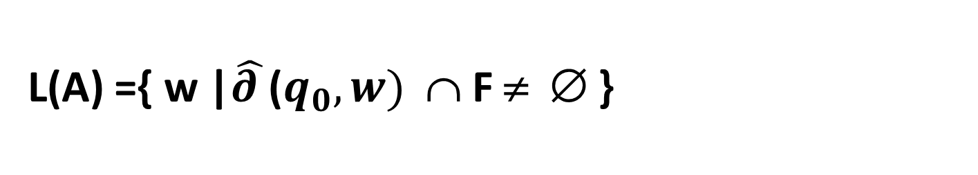
Language of NFA
The language of NFA A = (Q, $\text{∑}$, δ, $q_{0}, F)$ , is L(A)
L(A) ={ w |$\hat{∂ }$($q_{0},w)$ ∩ F ≠ ∅ }
Notes:
Transition table for a NFA
Extended Transition Function

Slide 8
Equivalence of DFA and NFA
Every language that can be described by NFA can also be described by DFA
Subset Construction
Lazy Evaluation

Slide 9
Problems
Convert the following NFA to DFA using
i) Subset Method ii) Lazy Evaluation Method
δ | 0 | 1
-> p | {p, q} | {p}
q | ∅ | {r}
*r | {p, r} | {q}

