Slide 1
Pushdown Automata (PDA)

Slide 2
Pushdown Automata
PDA is an extension of ∊ -NFA with the addition of a stack
The language defined by PDA is context-free language
Unlike FA, PDA can remember an infinite amount of information (stack), but can access only in LIFO manner.

Slide 3
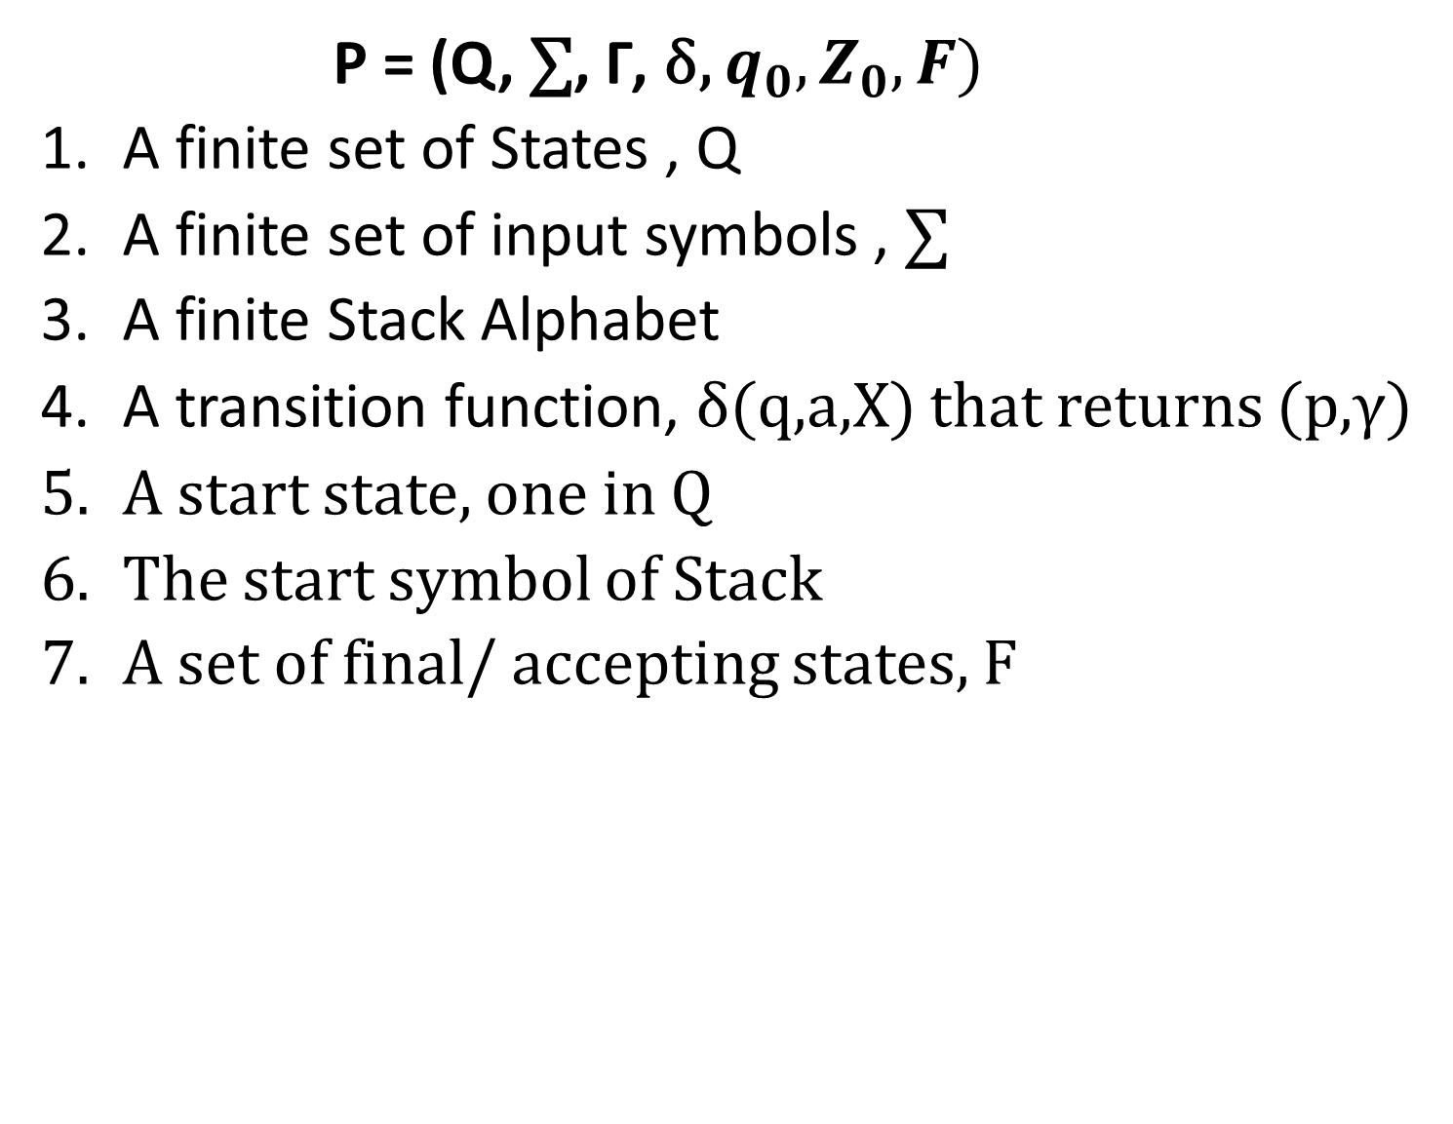
Formal Description of PDA
P = (Q, $\text{∑}$, Γ, δ, $q_{0},Z_{0},F)$
A finite set of States , Q
A finite set of input symbols , $\text{∑}$
A finite Stack Alphabet
A transition function, δ(q,a,X) that returns (p,γ)
A start state, one in Q
The start symbol of Stack
A set of final/ accepting states, F

Slide 4

Languages of a PDA
Two types of Acceptance:
Acceptance by Final State
Acceptance by Empty Stack
PDA P as a 6 tuple P = (Q, $\text{∑}$, Γ, δ, $q_{0},Z_{0})$

Slide 5
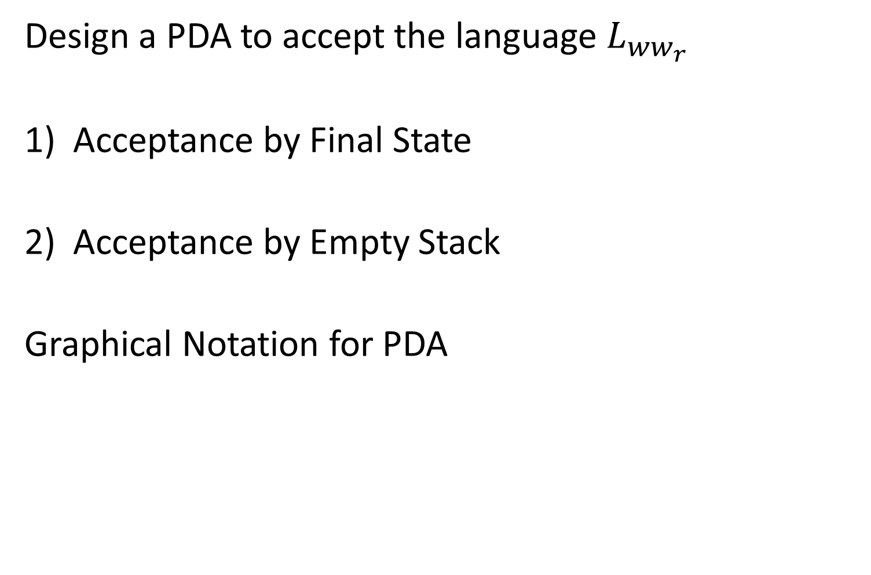
PDA Example
Design a PDA to accept the language $L_{{ww}_{r}}$
Acceptance by Final State
Acceptance by Empty Stack
Graphical Notation for PDA

Slide 6
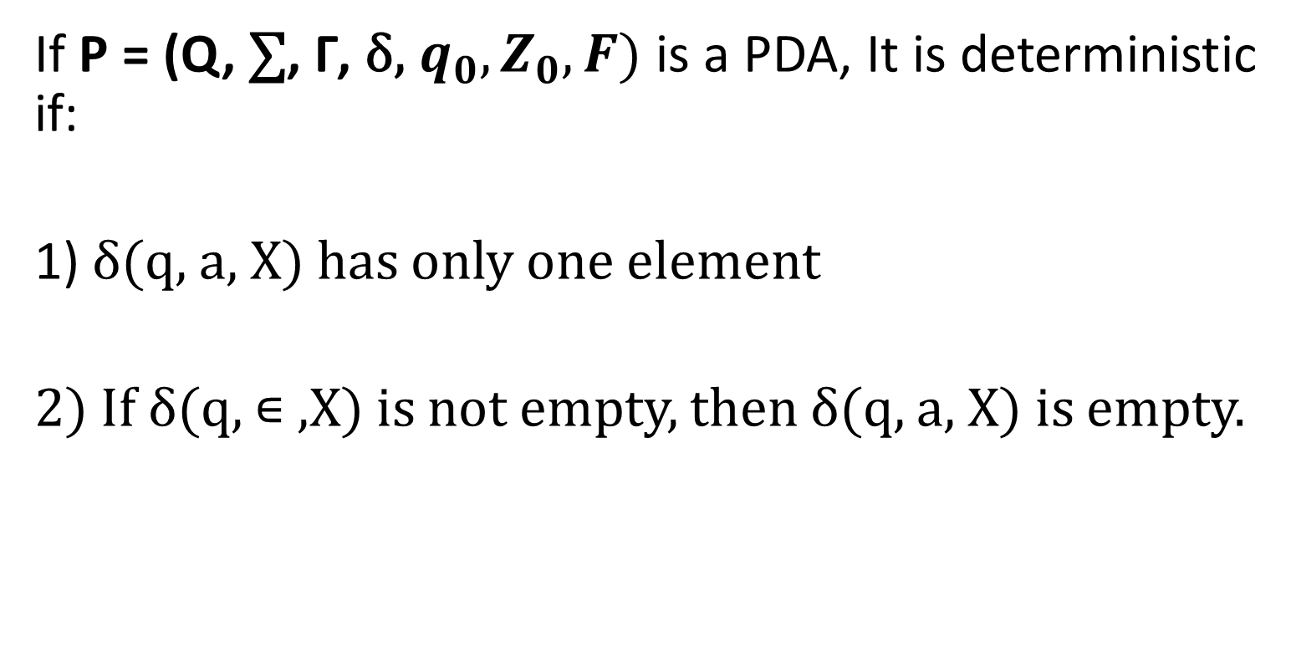
Deterministic PDA
If P = (Q, $\text{∑}$, Γ, δ, $q_{0},Z_{0},F)$ is a PDA, It is deterministic if:
1) δ(q, a, X) has only one element
2) If δ(q, ∊ ,X) is not empty, then δ(q, a, X) is empty.

