Slide 1
DNA

Slide 2
DNA Structure & Manipulation
DNA (deoxyribonucleic acid) consists of polymer chains (DNA strands)
Each strand is chain of nucleotides/bases attached to a sugar phosphate backbone.
A n-letter sequence of bases is known as an n-mer or an oligonucleotide of length n

Slide 3
DNA Nucleotides
The 4 DNA Nucleotides are classified into Purines and Pyrimidines.
Purines : 1) Adenine (A) 2) Guanine (G)
Pyrimidines: 1) Cytosine (C) 3) Thymine (T)

Slide 4
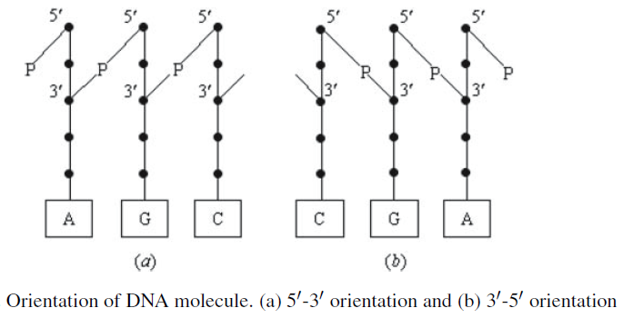
Orientation of DNA Molecule
To form a DNA strand, 5’ – phosphate group of a nucleotide combines with 3’ – hydroxyl group of another nucleotide : phosphodiester bonds

Slide 5
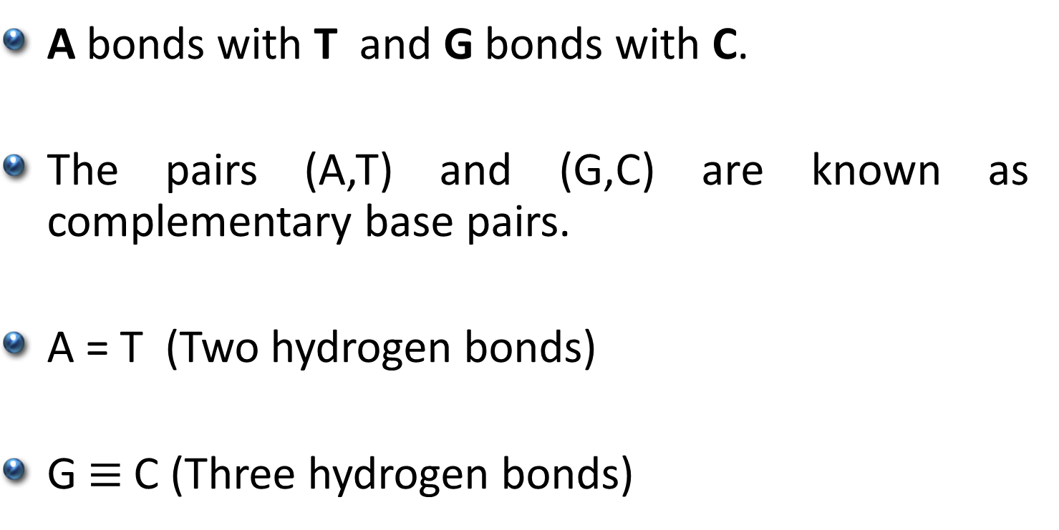
Complementary Base Pairs
A bonds with T and G bonds with C.
The pairs (A,T) and (G,C) are known as complementary base pairs.
A = T (Two hydrogen bonds)
G$≡$ C (Three hydrogen bonds)

Slide 6
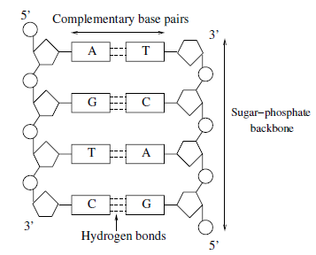
Structure of DNA

Slide 7
Protein Structure
Protein acts as enzymes
Sequence of Amino acids (20 types)
Length of proteins anything between 50-500 amino acids

Slide 8
Biological Operations on DNA
Synthesis
Denaturing
Annealing
Ligation
Separation of strands
Gel Electrophoresis
Polymerase Chain Reaction (PCR)

Slide 9
Synthesis
The synthesizer is supplied with the four nucleotide bases in solution.
The nucleotide bases are combined according to a sequence entered by the user.

Slide 10
Denaturing & Annealing
Double-stranded DNA may be dissolved into single strands (or denatured) by heating .
Heating breaks the Hydrogen bonds between the complementary pairs.
In Annealing, solution of single strands is cooled, allowing complementary strands to bind together

Slide 11
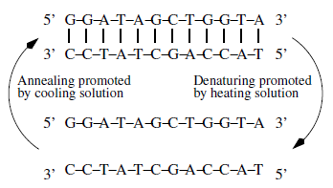
Denaturing & Annealing

Slide 12
Ligation
If one of the single strands contains a discontinuity (i.e., one nucleotide is not bonded to its neighbor) then this may be repaired by DNA ligase.

Slide 13
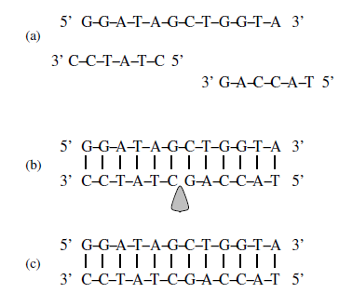
Ligation
(c) Resulting Complex

Slide 14
Separation of strands
Separation involves the extraction from single strands containing a specific short sequence
2 Methods: (i) Biotinylation
(ii) Magnetic Bead Separation

Slide 15
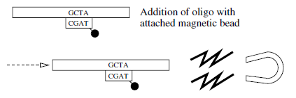
Separation of Strands

Slide 16


Gel Electrophoresis
Sorts the DNA strands by size
DNA molecules carry a negative charge, when placed in an electric field they migrate toward the positive pole.
Electrophoresis carried out in a gel (agarose/polyacramide)
The migration rate of a molecule affected by its size

Slide 17
Polymerases
Polymerase is an enzyme that synthesizes long chain of polymers.
Given a short primer oligo, p in the presence of nucleotide, the polymerase extends p if and only if p is bound to a longer oligo, t.

Slide 18
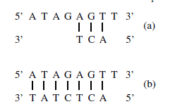
Polymerases

Slide 19
Polymerase Chain Reaction (PCR)
PCR is a process that amplifies the amount of DNA in a given solution.
Taq polymerase derived from the thermophilic bacterium Thermus aquaticus

Slide 20
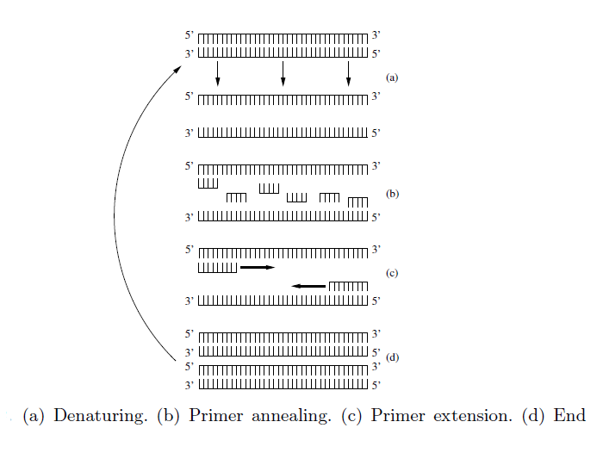
Polymerase Chain Reaction (PCR)

Slide 21
Restriction Enzymes
Recognizes a particular sequence (restriction site) and cuts the DNA containing the restriction site.
RsaI leaves blunt ended DNA (recognizes GTAC)
Sau3AI leaves sticky ends (recognizes GATC)

Slide 22
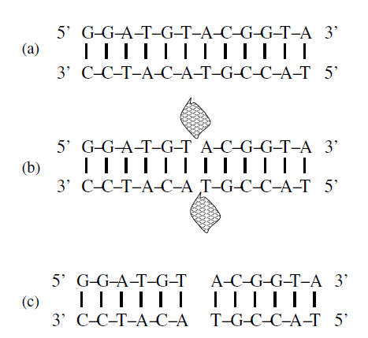
Restriction Enzymes

Slide 23
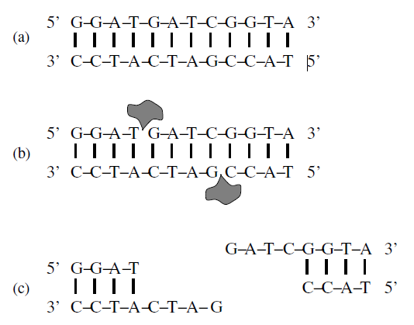
Restriction Enzymes

Slide 24
References
Theoretical & Experimental DNA Computation Chapter 1

