Slide 1
Introduction to DNA Computing

Slide 2
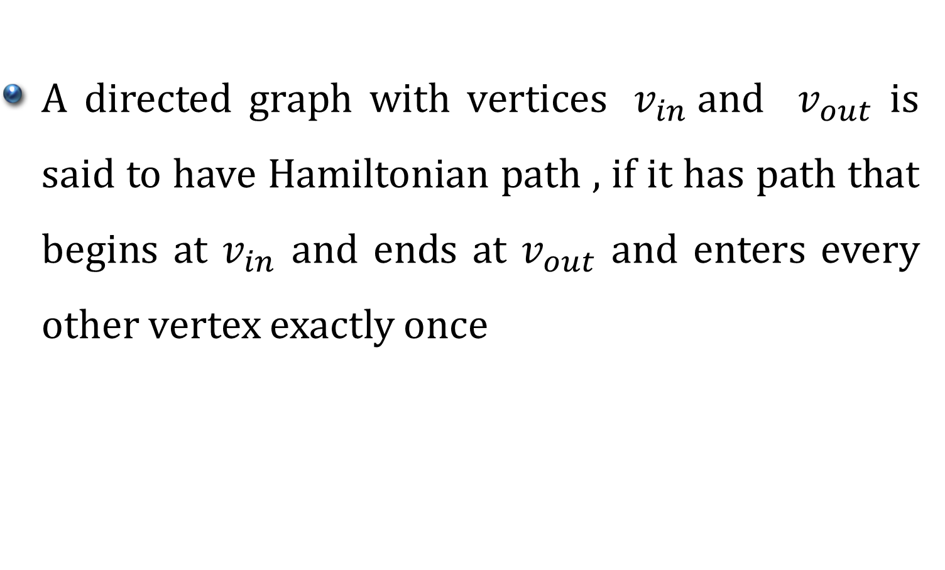
Hamiltonian Path Problem (HPP)
A directed graph with vertices ${ v}_{in}$and $v_{out}$ is said to have Hamiltonian path , if it has path that begins at $v_{in}$ and ends at $v_{out}$ and enters every other vertex exactly once

Slide 3
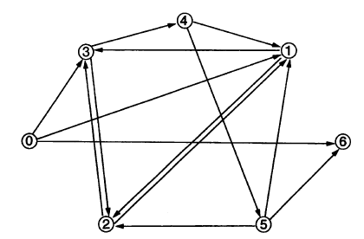
Hamiltonian Path Problem (HPP)

Slide 4
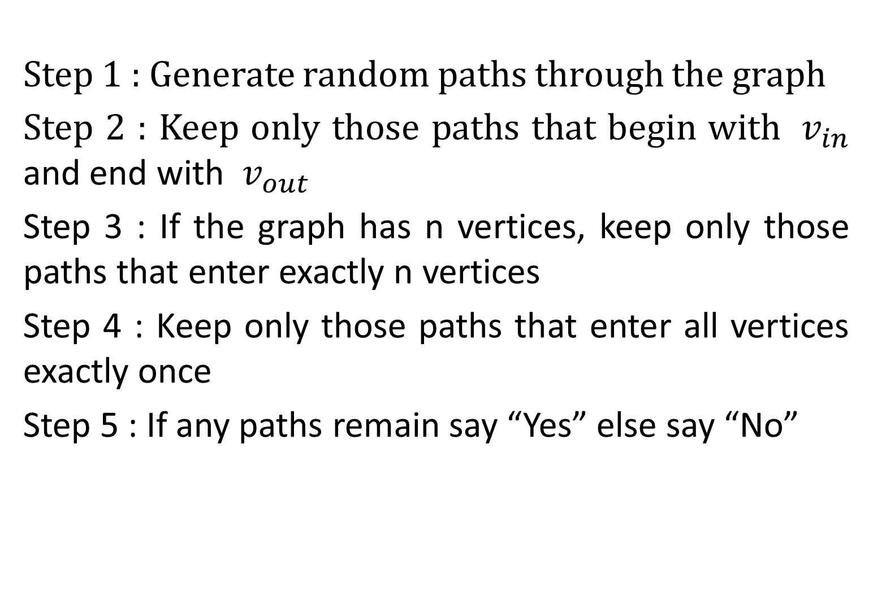
Algorithm for HPP
Step 1 : Generate random paths through the graph
Step 2 : Keep only those paths that begin with ${ v}_{in}$ and end with ${ v}_{out}$
Step 3 : If the graph has n vertices, keep only those paths that enter exactly n vertices
Step 4 : Keep only those paths that enter all vertices exactly once
Step 5 : If any paths remain say “Yes” else say “No”

Slide 5
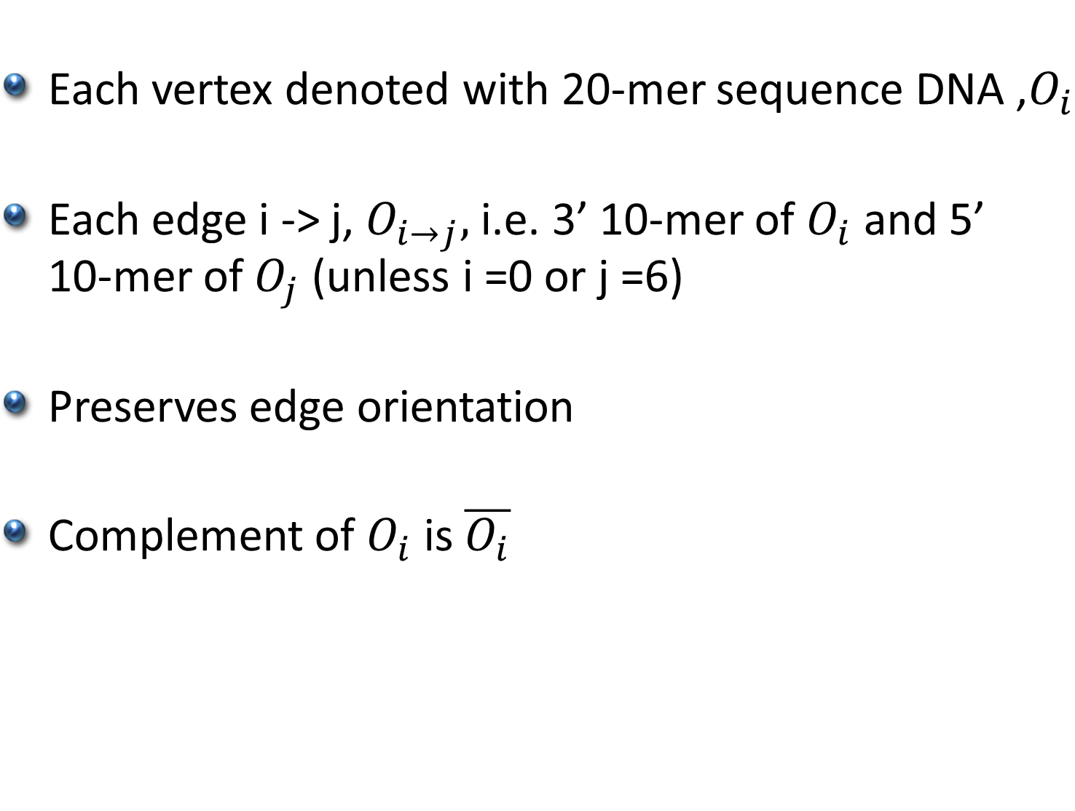
Encoding for vertices and Edges
Each vertex denoted with 20-mer sequence DNA ,$O_{i}$
Each edge i -> j, $O_{i→j},$ i.e. 3’ 10-mer of $O_{i}$ and 5’ 10-mer of $O_{j}$ (unless i =0 or j =6)
Preserves edge orientation
Complement of $O_{i}$ is $\overline{O_{i}}$

Slide 6
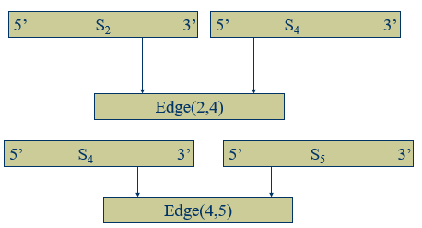
Encoding for vertices and Edges

Slide 7


Encoding for vertices and Edges
S₂ = GTCACACTTCGGACTGACCT
S₄ = TGTGCTATGGGAACTCAGCG
S₅ = CACGTAAGACGGAGGAAAAA
So,we build edges (2,4) and (4,5) from the above sequences obtaining them in the following manner:
(2,4) = GGACTGACCTTGTGCTATGG
(4,5) = GAACTCAGCGCACGTAAGAC

Slide 8

Step 1: Generating Random Path
For each vertex i and edge i->j in graph mix $\overline{O_{i}}$ and $O_{i→j}$ together in a single ligation reaction
It results in generation of random paths in the graph

Slide 9
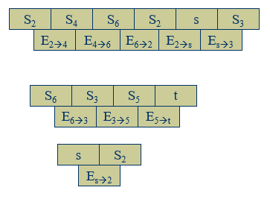
Step 1: Generating Random Path

Slide 10
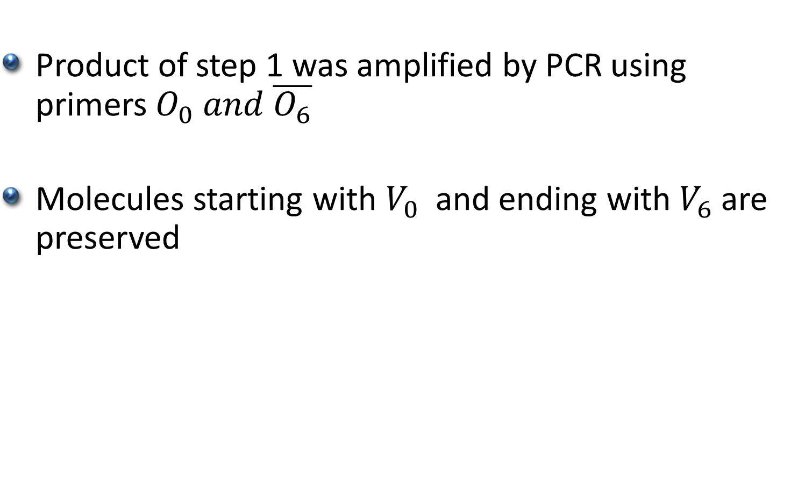
Step 2: Begin & end with ${ v}_{in}$ &${ v}_{out}$
Product of step 1 was amplified by PCR using primers $O_{0} and \overline{O_{6}}$
Molecules starting with $V_{0}$and ending with $V_{6}$are preserved

Slide 11
Step 3: Strands with exact n vertices
Select strands of 140 bp were retained by running it on agarose
Again amplified to retain purity

Slide 12

Step 4: Visit each vertex at least once
Denatured
Magnetic bead system
Process repeated with every $\overline{O_{i}}$

Slide 13
Step 5: Extract Answer
Conduct a “graduated PCR” using a series of PCR amplifications.
Use primers for the start, s and the n^{th} item in the path.
So to find where vertex 4 lies in the path you would conduct a PCR using the primers from vertex s and vertex 4. You would get a length of 60 base pairs. 60 / 20 nucleotides in the path = 3rd vertex.

Slide 14
Graduated PCR
For Hamiltonian path
0->1 , 1->2, 2->3, 3->4, 4->5, 5->6 Graduated PCR produces bands of 40, 60, 80, 100, 120, and 140 bp
For following path 0->1 , 1->3, 3->4, 4->5, 5->6 Graduated PCR produces bands of 40, x, 60, 80, 100, and 120 bp

Slide 15
Graduated PCR
For Hamiltonian path
0->3 , 3->2, 2->3, 3->4, 4->5, 5->6
Graduated PCR produces bands of x, 60,80-40, 100, 120, and 140 bp

Slide 16
References
Molecular Computations of Solutions to Combinatorial Problems - Adleman

