Slide 1
SAT Problem

Slide 2
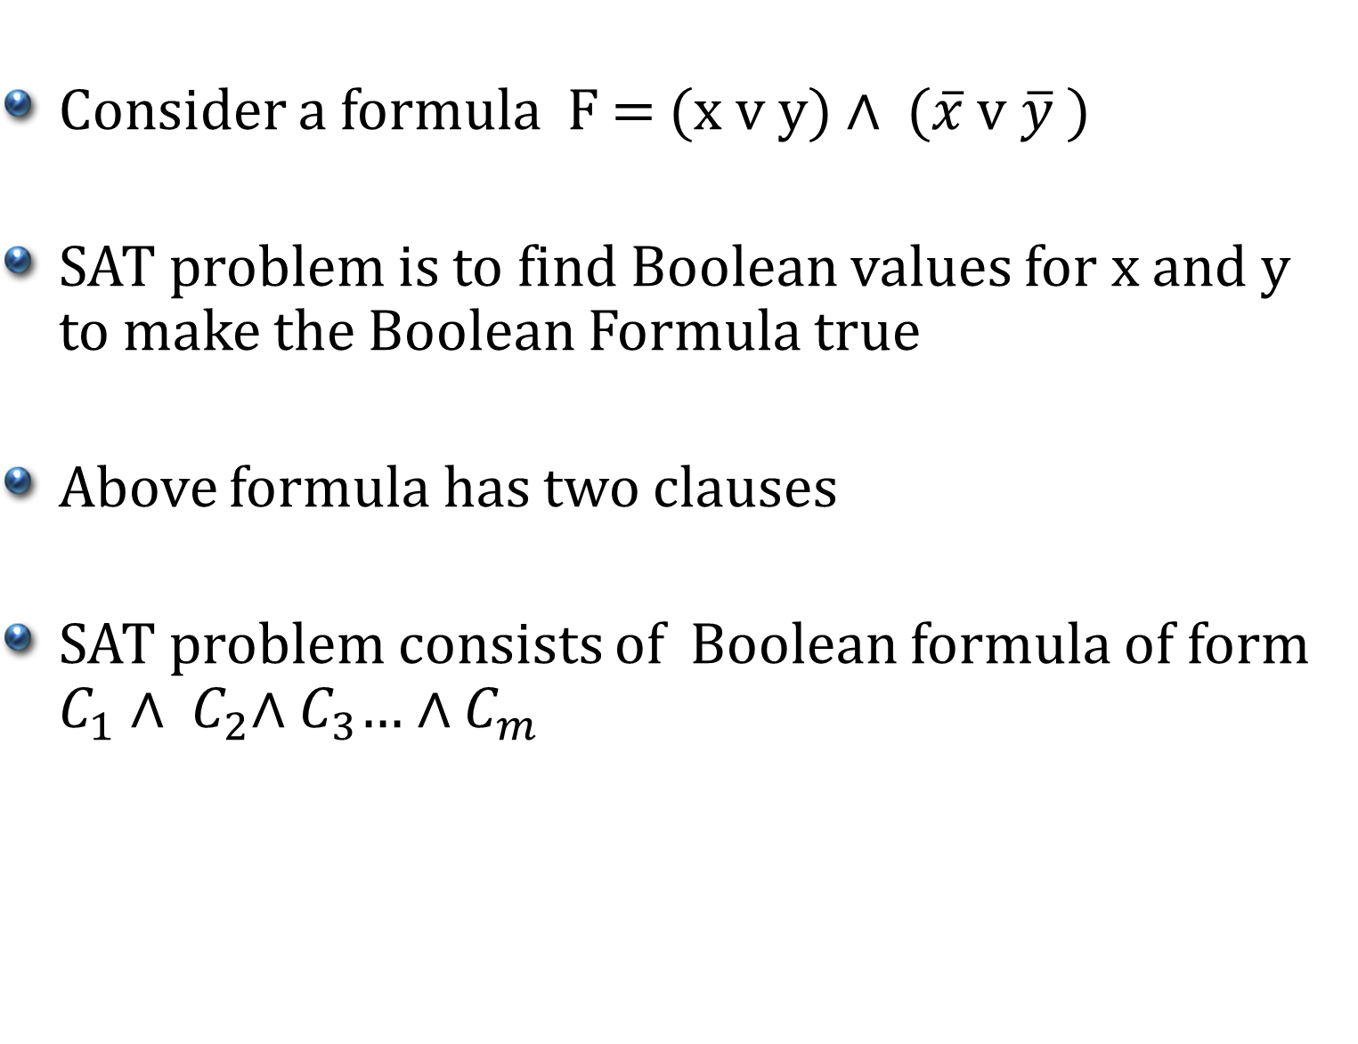
SAT Problem
Consider a formula F = (x v y) $∧$ ($\overline{x}$ v$\overline{y}$ )
SAT problem is to find Boolean values for x and y to make the Boolean Formula true
Above formula has two clauses
SAT problem consists of Boolean formula of form $C_{1}{∧ C}_{2}∧C_{3}$… $∧$ $C_{m}$

Slide 3
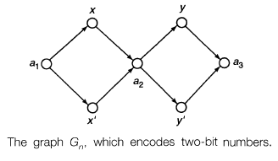
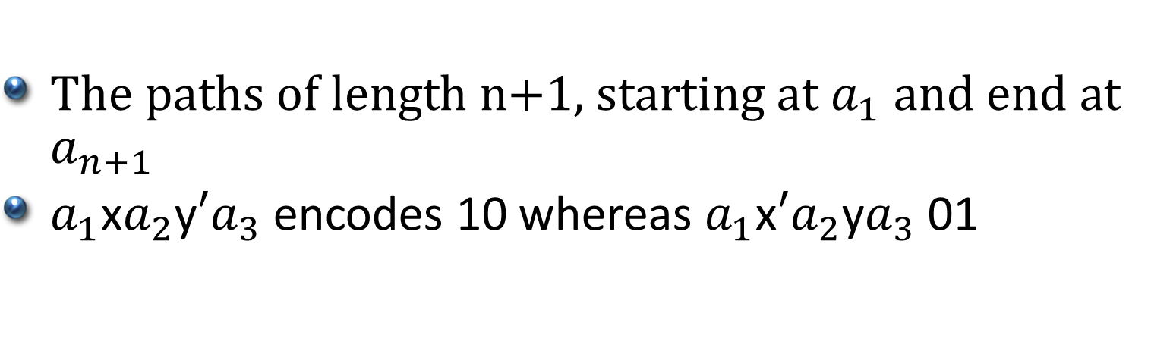


Graph to encode n bit number
The paths of length n+1, starting at $a_{1}$ and end at $a_{n+1}$
$a_{1}$x$a_{2}$y$′a_{3}$ encodes 10 whereas $a_{1}$x${′a}_{2}$y$a_{3}$ 01

Slide 4
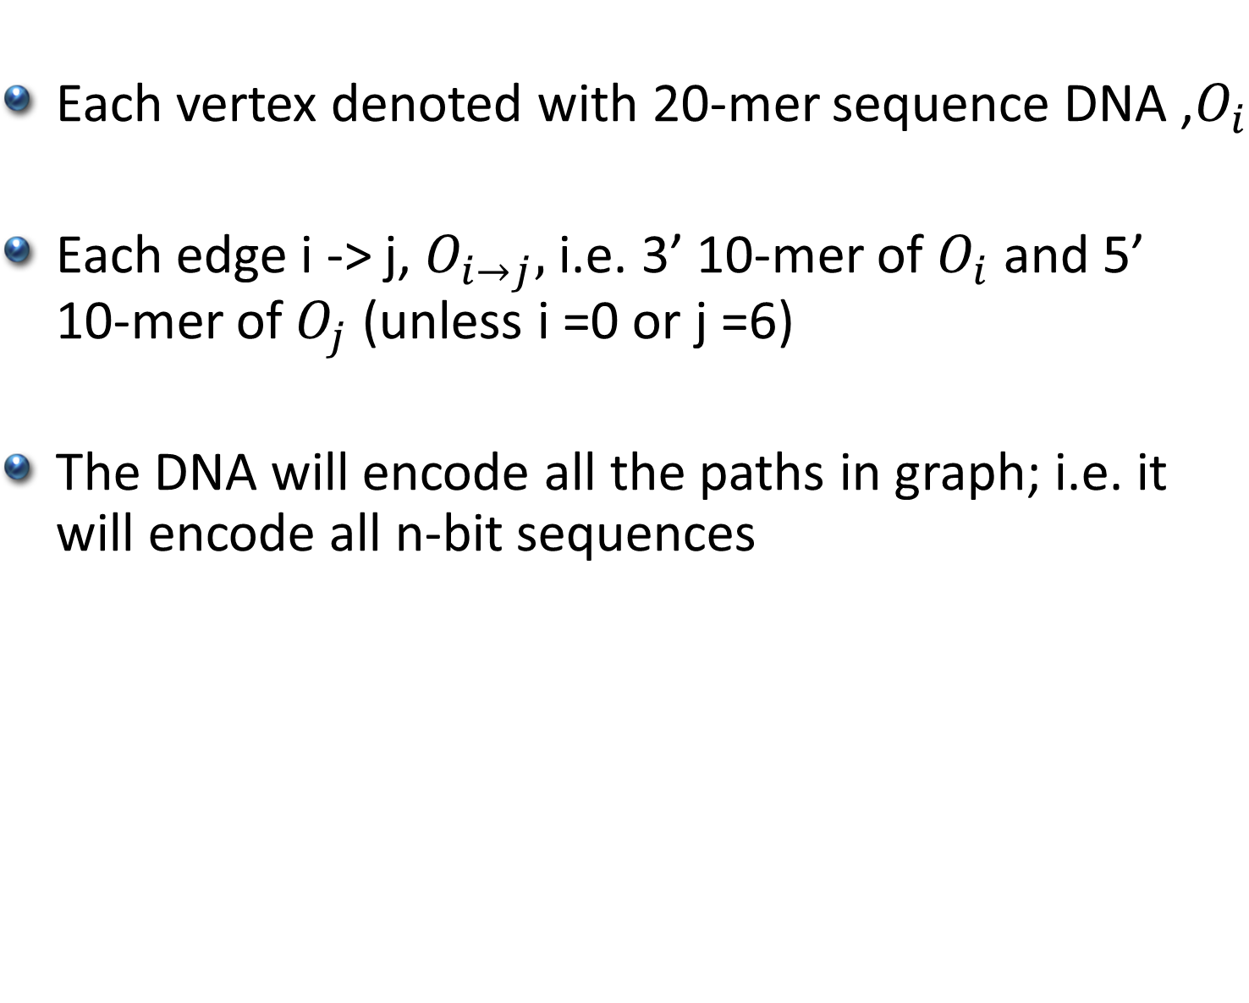
Generation of random paths
Each vertex denoted with 20-mer sequence DNA ,$O_{i}$
Each edge i -> j, $O_{i→j},$ i.e. 3’ 10-mer of $O_{i}$ and 5’ 10-mer of $O_{j}$ (unless i =0 or j =6)
The DNA will encode all the paths in graph; i.e. it will encode all n-bit sequences

Slide 5
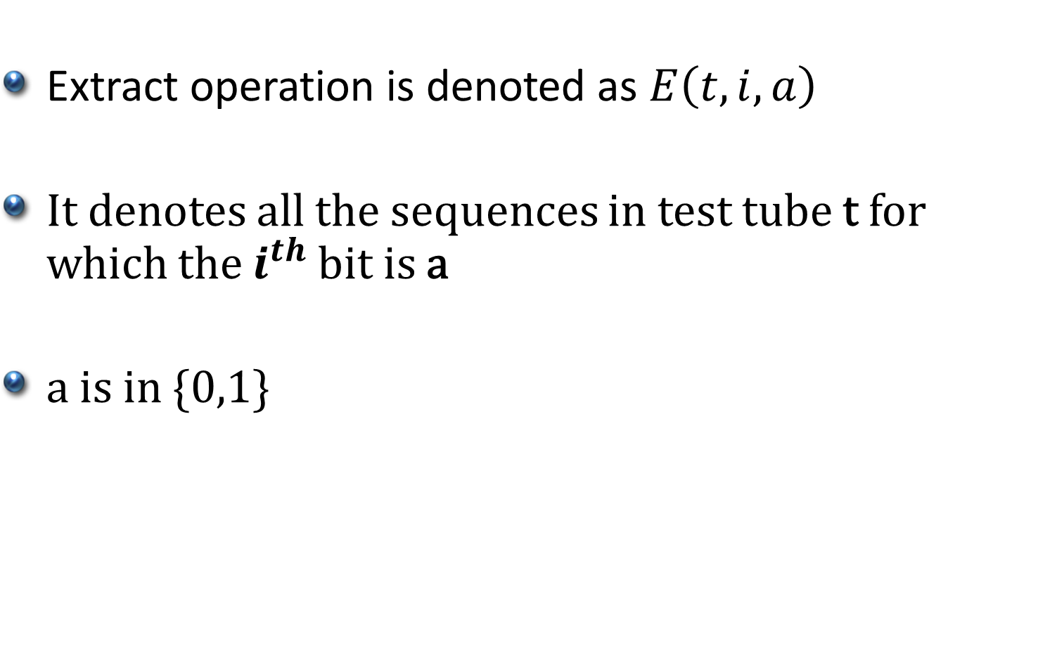
Extract Operation
Extract operation is denoted as $E\left(t,i,a\right)$
It denotes all the sequences in test tube t for which the $i^{th}$bit is a
a is in {0,1}

Slide 6
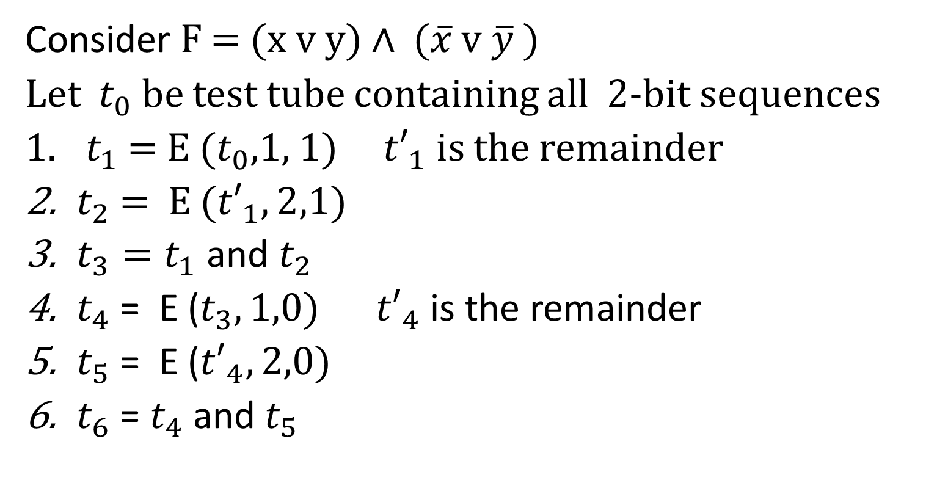
Operations for SAT
Consider F = (x v y) $∧$ ($\overline{x}$ v$\overline{y}$ )
Let $t_{0}$ be test tube containing all 2-bit sequences
$t_{1}$ = E ($t_{0}$,1, 1) ${t′}_{1}$is the remainder
$t_{2}$ = E (${t′}_{1},2$,1)
$t_{3}=t_{1}$ and $t_{2}$
$t_{4}$ = E ($t_{3},1,0)$ ${t′}_{4}$ is the remainder
$t_{5}$ = E (${t′}_{4}, 2,0)$
$t_{6}$ = $t_{4}$ and $t_{5}$

Slide 7
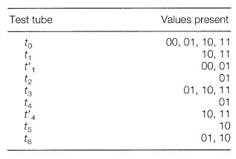
Operations for SAT

Slide 8
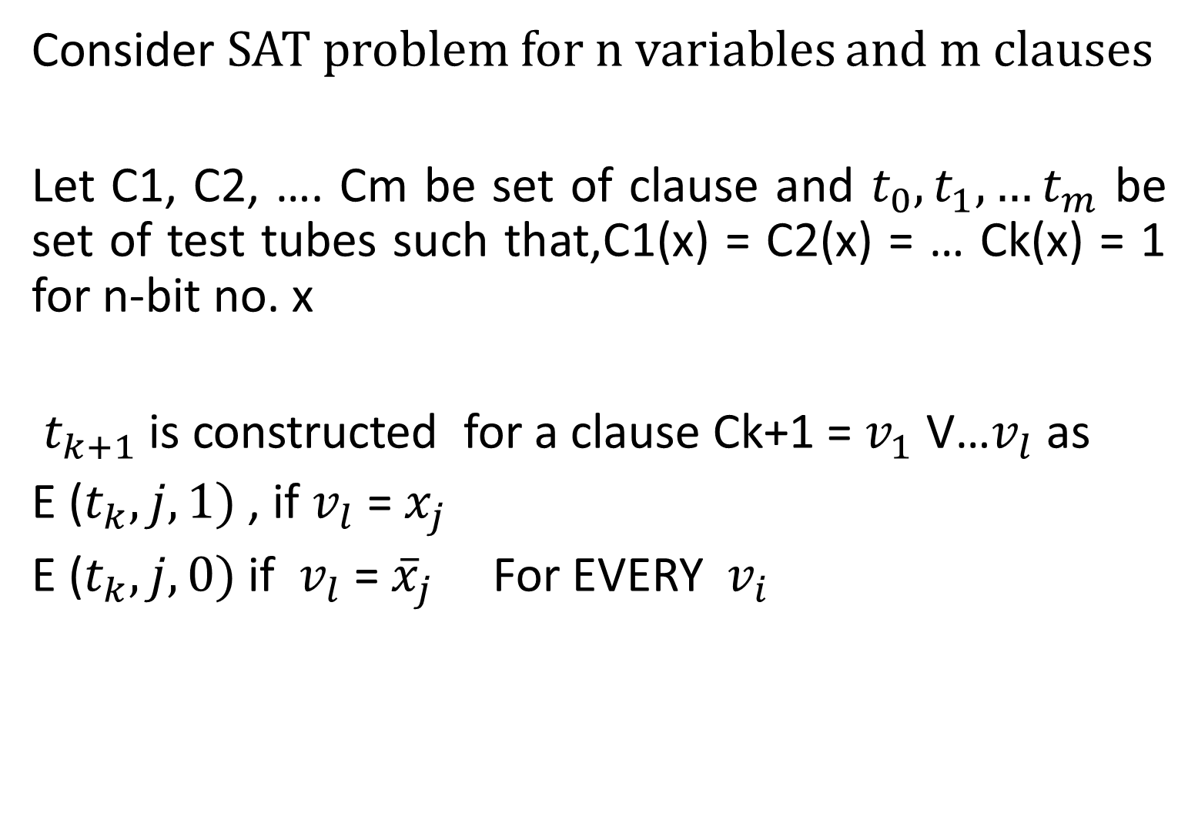
General Case
Consider SAT problem for n variables and m clauses
Let C1, C2, …. Cm be set of clause and $t_{0},t_{1},…t_{m}$ be set of test tubes such that,C1(x) = C2(x) = … Ck(x) = 1 for n-bit no. x
${ t}_{k+1}$is constructed for a clause Ck+1 = $v_{1}$ V…$v_{l}$ as
E ($t_{k},j, 1)$ , if $v_{l}$ = $x_{j}$
E ($t_{k},j, 0)$ if $v_{l}$ = ${\overline{x}}_{j}$ For EVERY $v_{i}$

Slide 9
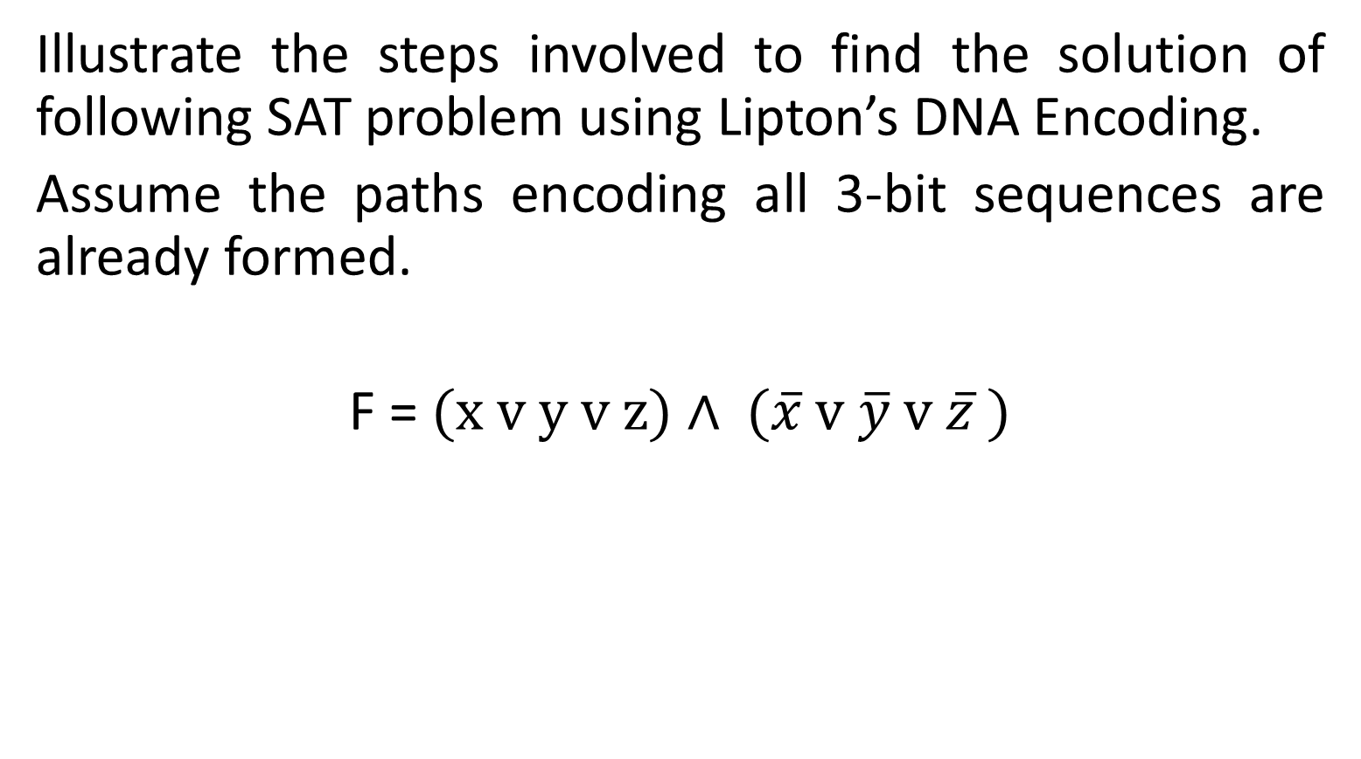
Problem
Illustrate the steps involved to find the solution of following SAT problem using Lipton’s DNA Encoding.
Assume the paths encoding all 3-bit sequences are already formed.
F = (x v y v z) $∧$ ($\overline{x}$ v$\overline{y}$ v $\overline{z}$ )

Slide 10
References
DNA Solutions of Hard Computational Problems – Richard J. Lipton

