Slide 1
DNA Encoding

Slide 2
DNA Encoding
Methods for Encoding information in DNA Computing can be divided into 2 classes:
1) Encoding information in graphs without weights
Ex: Adleman (HPP), Lipton (SAT)
2) Encoding information in graphs with weights
Ex: Narayanan (Shortest Path)

Slide 3
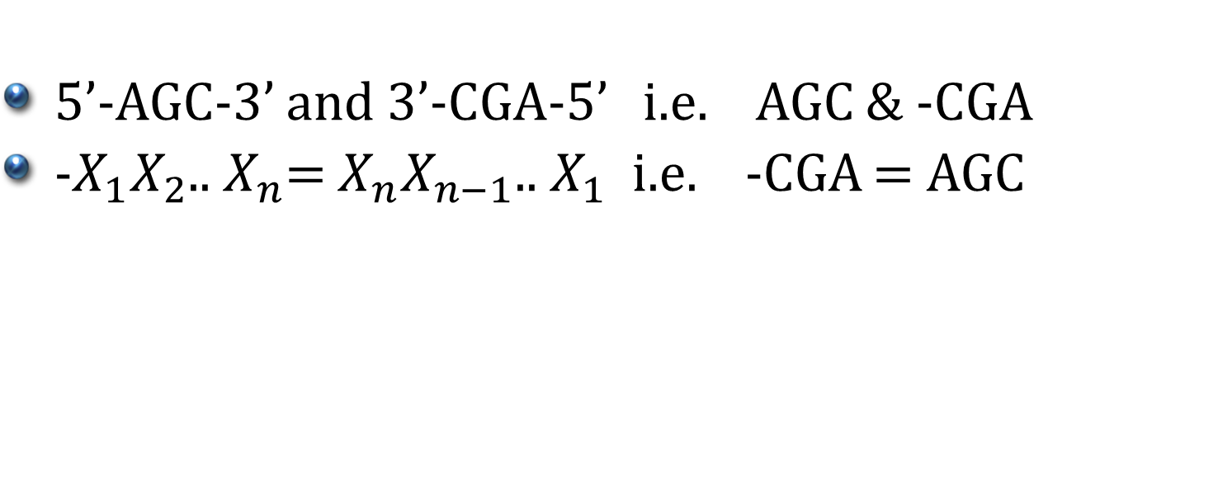
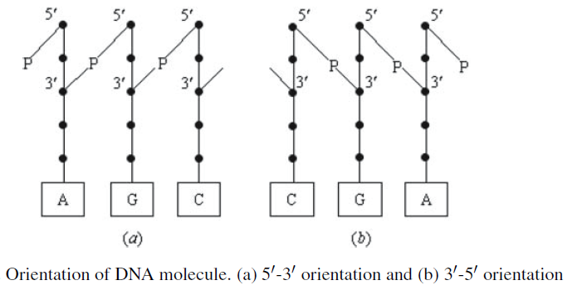
Notations

Slide 4
Notations
For any DNA strand s , h represents a mapping function from each base to its complement.
If s = AGC, h(s) = TCG –h(s) = GCT
h(s) is called the complement of s
-h(s) is called the reverse complement of s

Slide 5
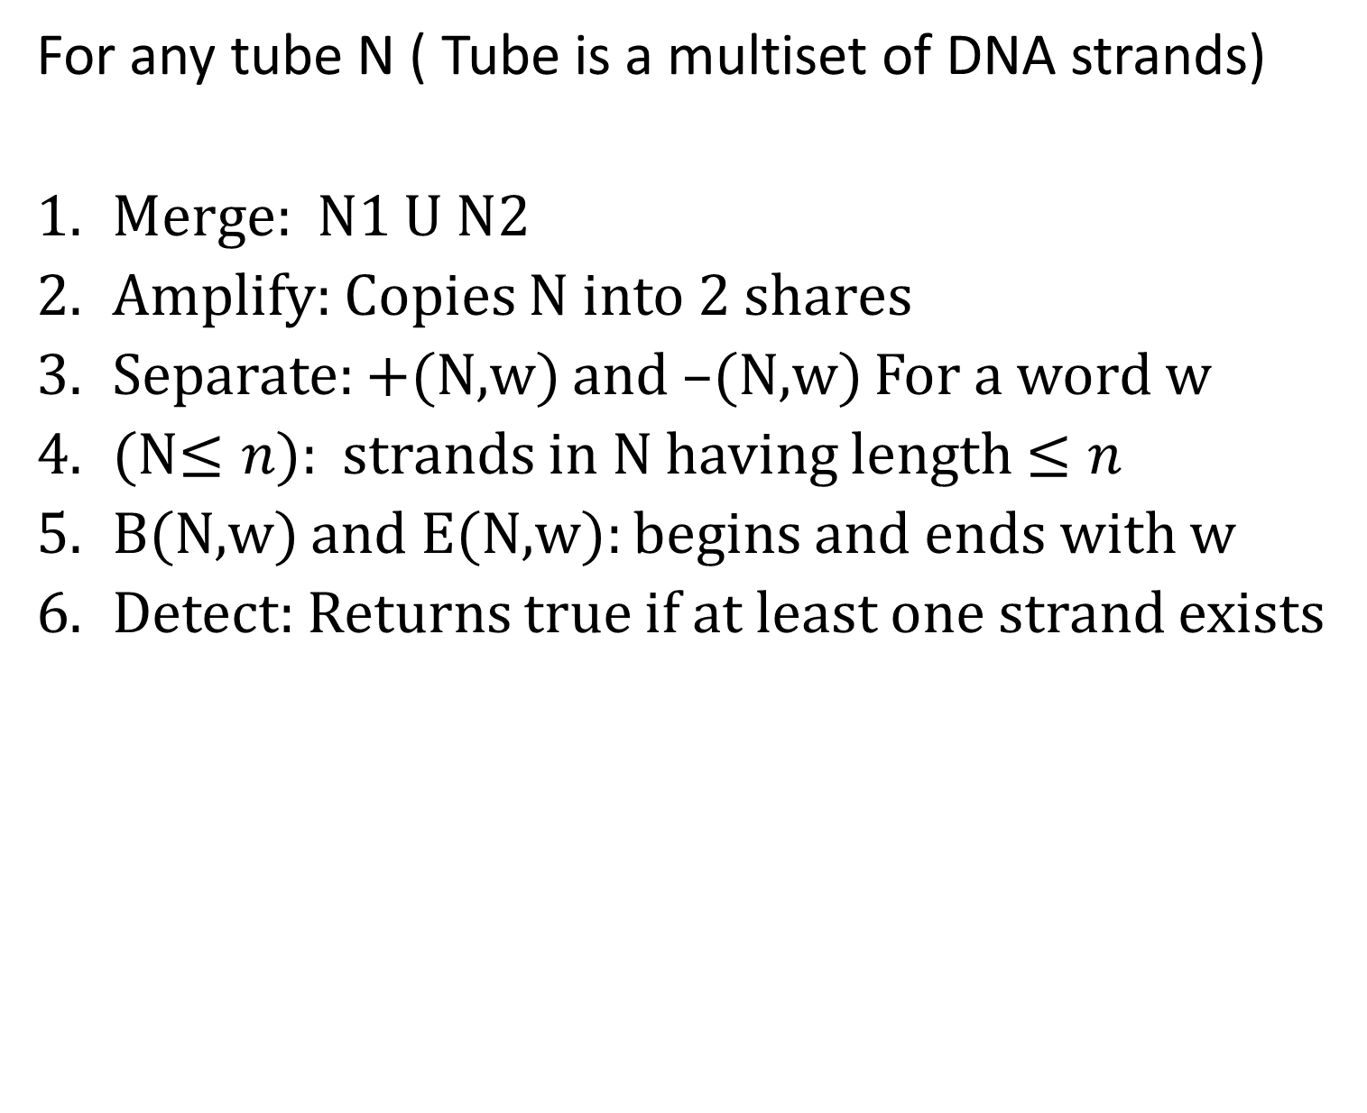
Basic Operations in DNA Computing

Slide 6
DNA ENCODING FOR GRAPHS WITHOUT WEIGHTS

Slide 7
DNA Encoding (HPP)
Each vertex v_{i} in G was associated with a random 20-merDNA strand denoted by s_{i}
For each edge e_{ij} = (v_{i},v_{j}) in G, a DNA strand s_{ij} is created as:
3’ 10-mer of s_{i} followed by 5’ 10-mer of s_{j}
(unless i = 0 in which case it was all of s_{i})
(unless j = 6 in which case it was all of s_{j})

Slide 8
DNA Algorithm (HPP)
Merge: h(s_{i}) and s_{ij} (ligation reaction)
Amplify: PCR using primers s₀ & h(s_{t})
B(N,h(s₀)) and E(N,h(s_{t} )).
(N, = 20n): Paths that enter exactly n vertices.
+(N, h(s_{i})): Paths that enter all vertices at least once
Detect: Any paths remain, return true, else false

Slide 9
DNA Encoding (SAT)
Construct a graph with V = a_{1,}x_{1,}x’_{1,}a_{2,}x_{2,}x’_{2,…}a_{n+1}
For each vertex v_{i} assign a random DNA strand s_{i} of length 20
For each edge e_{ij} = (v_{i},v_{j}) in G, a DNA strand as –h(s’’_{i}s’_{j}) where,
(s’’_{i} is the second half of strand s_{i})
(s’_{j} is the first half of strand s_{j})

Slide 10
DNA Algorithm(SAT)
Construct a graph with V = a_{1,}x_{1,}x’_{1,}a_{2,}x_{2,}x’_{2,…}a_{n+1}
Let t₀ be the tube including all n-bit sequences.
Construct t_{k+1}, k = 0, 1, . . . , m−1, step by step.
Let Ck+1 such that x1 ∨ x2 ∨. . . xl, where x_{i} is a literal or its negation. For each literal x_{i}, if x_{i} is equal to x_{j} , then form S(t_{k}, j,1); if it is equal to ¬x _{j} , then form S(t_{k}, j,0)
Detect DNA in the tube t_{m}. If exists its satisfiable.

Slide 11
DNA ENCODING FOR GRAPHS WITH WEIGHTS

Slide 12
DNA Encoding (Graphs with weights)
Encoding Weights by the Lengths of DNA Strands
Encoding Weights by the Number of Hydrogen Bonds
Encoding Weights by the Concentrations of DNA Strands
Encoding Weights by the Melting Temperatures of DNA Strands

Slide 13
Encoding Weights by the Lengths of DNA Strands
Narayanan et.al. designed the following DNA encoding method for the shortest path problem
For each vertex v_{i} (i = 1, 2, . . . , n), assign a unique DNA sequence s_{i} with fixed length to encode it.
Sort all the edges in G by distance (weight), and put their distances into a vector D. For each distance d in D, a DNA sequence s_{d} is randomly selected whose length l is associated with the location of distance d and a constant factor k.

Slide 14
Encoding Weights by the Lengths of DNA Strands
For each edge e_{ij} = (v_{i},v_{j}), the DNA strand s_{idj} is created in the following way:
if i = 1, create the strand s_{idj} as ALL s_{i}+ ALL s_{d} +HL s_{j};
if i > 1, create the strand s_{idj} as HR s_{i}+ALL s_{d} +HL s_{j} ,
where ALL represents the whole DNA strand, HL the left half, HR the right half, and + the join operation.

Slide 15
DNA Algorithm
Merge: Put all h(s_{i}) , h(s_{d} ) and s_{idj} into a tube, and perform a DNA ligase reaction to generate random paths in G
Amplify: PCR using primers s₁ and h(s_{t}).
B(N, s₁): Keep only the strands beginning with v₁.
E(N, s_{t} ): Keep only the strands ending with v_{t} .
Gel electrophoresis: The shortest strand corresponds to the desired solution.

Slide 16
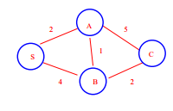
Example
Node | DNA Encoding
S | ATAA
A | CGCC
B | CAGC
C | TCTT
D | DNA Encoding
D(1) | AAT
D(2) | TCG ATT
D(4) | TCT TCG TCG
D(5) | ACG ACG TTA ATT

Slide 17
Encoding Weights by the Concentration of DNA Strands
Yamamoto et al method of encoding weights by the concentrations of DNA strands.
Each vertex vi in G is associated with a 20-mer DNA sequence denoted by s_{i}.
(2) For each edge e_{ij} = (v_{i},v_{j}) in G, a DNA strand s_{ij} that is 3’10-mer of s_{i} followed by 5’10-mer of s_{j} is created.

Slide 18
Encoding Weights by the Concentration of DNA Strands
The relative concentration D_{ij} of s_{ij} is calculated as
D_{ij} = (min/w_{ij})^{α}, where ,
min : minimum weight in G,
w_{ij} : weight on edge e_{ij},
α : parameter value.

Slide 19
DNA Algorithm
For each vertex v_{i} in G, set the concentration of h(s_{i}) to a same certain value.
For each edge e_{ij} in G, calculate the relative concentration D_{ij} of s_{ij} according as D_{ij} = (min/w_{ij})^{α} .
Put all the DNA strands h(s_{i}) with the same concentration and all the s_{ij} with different concentrations D_{ij} to construct random paths through G.
Amplify the DNA paths that begin with the start vertex and end with the destination vertex.
Determinate the DNA strand of encoding the shortest path.

Slide 20
References
DNA Encoding Methods in the Field of DNA Computing

