Slide 1
Comparison of DNA & Conventional Computers

Slide 2
Comparison
SNo. | Aspects | Conventional Computer | DNA Computer
1 | Size | Comparatively large in size in terms of equal memory storage | Comparatively smaller in size in terms of equal memory storage
2 | Representation of Data | Base 2 : in terms of bits 0 and 1 | Base 4 : in terms of nucleotides A,T,C,G
3 | Parallelism | Von –Neumann Architecture | Non-Von Neumann Architecture
4 | Material | Re-usable Materials | Non- Reusable Materials
5 | Computation | Flow of Electrons | Biological Operations on DNA

Slide 3
Advantages of DNA Computing
S No. | Aspects | DNA Computer
1 | Parallelism | Multiple parallel processes on different strands in test tube
2 | Memory capacity | 1 bit/ cubic nanometer; videotapes store 1 bit in 10¹² cubic nanometer
3 | Power Dissipation | Low Power Dissipation
4 | Solving Problems | Suitable for Combinatorial Problems

Slide 4
Drawbacks of DNA Computing
S No. | Aspects | DNA Computer
1 | Speed | Occasionally slow and laborious
2 | Hydrolysis | DNA molecules can fracture
3 | Information Transmission | Cannot transfer information from one process to another
4 | Errors | Annealing Errors Errors in PCR Errors in Affinity Separation

Slide 5
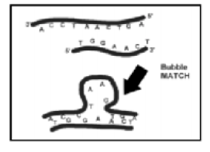
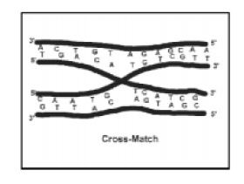
Annealing Errors
Bubble Match Error | Cross Matching Error
Two strands of different length match : The longer strand tends to link to the other only for the tails creating a bubble in the central part | Two double strands are crossed to form two double helixes. The presence of such mismatch is difficult to detect.

Slide 6
Errors in PCR
Error by Polymerase enzymes while making copies of DNA strands
Misincorporation Errors : Polymerase makes wrong base pairings when assembling a DNA strand
Templates interact with one another when the volume of template is high

Slide 7
Errors in Affinity Separation (Purification)
Process does not filter the required strings or filters the unrequired strings
Increase the survival probability by PCR, by keeping the volume constant
Alteration of encoding scheme: Encode information twice thereby increasing no. of possible binding sites

