Slide 1
Membrane Computing

Slide 2
Bio-Domains of Natural Computing
Biology Models Implementation
Neural Computing
Brain
Electronic Media
Evolution
Evolutionary Computing
?
Molecules
Bio-Media
Molecular Computing
Cell
?
Membrane Computing

Slide 3
P-System
Membrane Structure
Objects
Transform, Pass through membrane , Dissolve membrane
Rules
System will halt when no object can further evolve.
Result in a specified membrane.
Computation at cellular level.

Slide 4
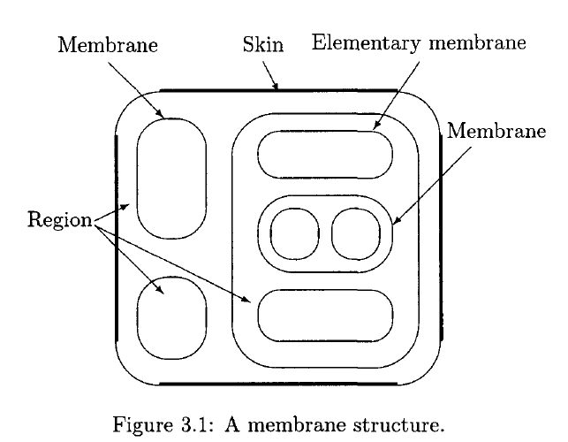
Representation as Venn Diagram

Slide 5
Formal Definition
P system of degree n, n ≥ 1, is a construct
Π= (V, T, C, μ, w₁,…,w_{n}, (R₁,ρ₁),…(R_{n},ρ_{n}), i₀),
where:
V is an alphabet; its elements are called objects;
T ⊆ V is an output alphabet;
C ⊆ V, C ∩T = Ø, is a set of catalysts;
μ is a membrane structure;
w_{i}, 1≤ i ≤ n, is a multiset of objects over V present in region i;
R_{i}, 1≤ i ≤ n, is a finite set of rules associated with region i;
ρ_{i}, 1≤ i ≤ n, is a partial order relation over R_{i};
i₀ is an output membrane.

Slide 6
P Systems with Multisets of Objects
₁ 2
3
cd
a → δ
a → (a, in₃ )
ac → δ
c → (c, in₄ )
4
c → (d , out)
b → b
a
aac
c → (b, in₄ ) > a → (a, in₂ )b dd → (a, in₄ )

Slide 7

P Systems with Multisets of Objects
2
1
3
4
a cd
a → δ
c
c → (d , out)
b → b
a → (a, in )
3
ac → δ
c → (c, in ₄ )
c →(b,in₄ ) > a →(a,in₂ )b
dd →(a,in₄ )
aa

Slide 8

P Systems with Multisets of Objects
2
4
1
c → (d , out)
b → b
aacd
a → (a, in₃ )
ac → δ
c → (c, in₄ )
c → (b, in₄ )
dd → (a, in₄ )
bbd
> a → (a, in₂ )b

Slide 9
P Systems with Multisets of Objects
1
4
c → (d , out)
b → b
ad
c → (c, in₄ )
c → (b, in₄ )
> a → (a, in₂ )b
bbd
dd → (a, in )
4

Slide 10
P Systems with Multisets of Objects
1
4
a
abb
dd→(a, in₄)

Slide 11
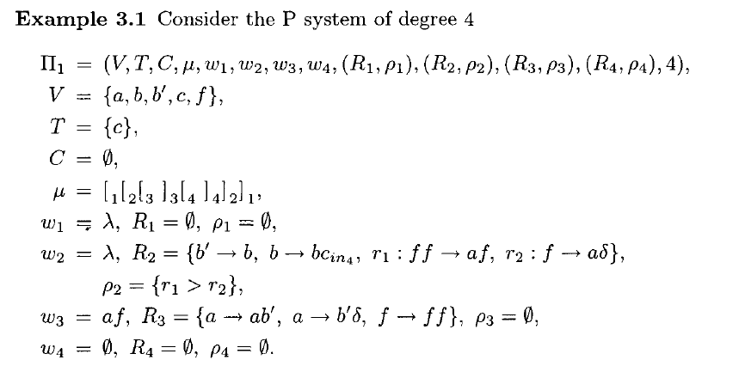
An Example: P-system generating n²

Slide 12
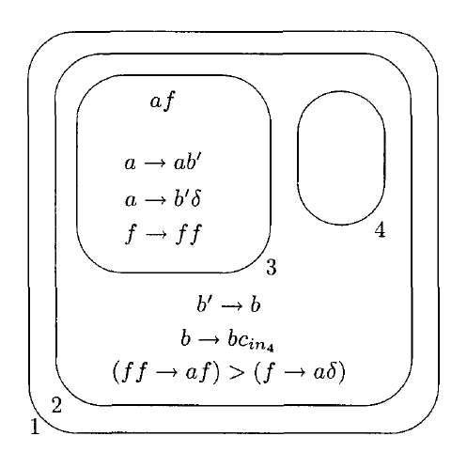
P-system generating n²

Slide 13
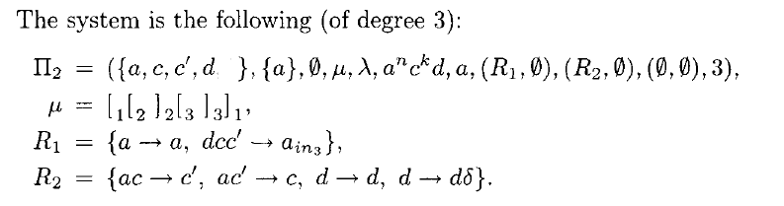
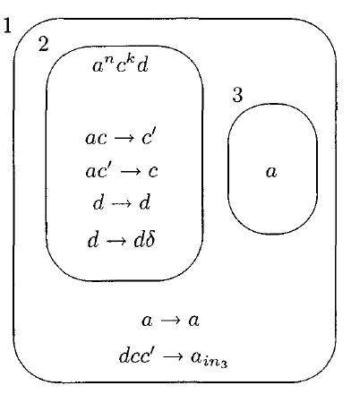
P-system to decide k divides n

Slide 14
References
Membrane_Chapter_3_Page_117_129

Slide 15
Chemical Computing

Slide 16
Chemical Computing
Real chemical computing where real molecules and real chemical processes are employed to compute.
Second, artificial chemical computing where the chemical metaphor is utilized to program or to build computational systems

Slide 17
Gamma Programming
The hallmarks of a Gamma Program are:
Reaction rules that work on multisets of molecule elements.
Reaction rules are made up of a condition and an action.
Execution takes place when the reaction replaces the elements with new elements from reaction result.
The result of the Gamma program is obtained when the solution reaches a steady-state.

Slide 18
Gamma Programming to generate prime numbers
M = { 2, ... N}
R = {a + b → b + c | a, b, c ∈ M, c = a/b, a mod b = 0}
Dynamics is stimulated by the following algorithm:
Chose two integers i, j ∈ {1, . . . ,M}, i ≠ j randomly.
If there is a rule in R where p_{i} + p_{j} matches the left hand side, replace pi and pj by the right hand side. p_{i}, p_{j} ∊ M
goto (i).
Result obtained when solution reaches steady state.

