Slide 1
Cellular Automata

Slide 2


Cellular Automata
Cellular automata may be viewed as computers, in which data represented by initial configurations is processed by time evolution.
The lattice of cells, the set of allowable states, together with the transition function is called a cellular automaton.

Slide 3
Cellular Automata Lattice
Lattice of cells, that are most commonly square in shape. Can be hexagonal.
The lattice of cell is n-dimensional (n >=1)

Slide 4
Cellular Automata States
Each of the cells can be in one of k states. k >=2
Cells in state 0 (white/dead) in state 1 (black/alive)

Slide 5
Cellular Automata Dimension
Cellular Automata is n-dimension
n >= 1
n = 1 (1-D) arranged as row of adjacent boxes
n = 2 (2-D) arranged as rows and columns of boxes

Slide 6
Cell Evolution
Cells in the cellular automata change state at discrete time moment.
The time t=0 represents the initial time period before any changes can occur

Slide 7
Cellular Automata: Rules / Transition Function
Local rule or local transition function governs the change of state from one instant of time to other
Rules take into account the current state of the cell and its neighborhood

Slide 8
Feature of Cellular Automata
Three Fundamental features of Cellular Automata:
Homogeneity: all cell states are updated by the same set of rules
Parallelism: all cell states are updated simultaneously
Locality: the rules are local in nature.

Slide 9
Neighborhood (1-D)
Neighborhood of a cell c having radius r is r cells to left and r cells to right
Total no of cells that a neighborhood contains ??
Total no of neighborhood-states for r = 1 and k = 2
In general total no. of neighborhood-states is k^{2r+1}

Slide 10
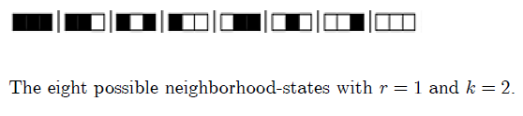
8 possible neighborhood-states (1-D)

Slide 11
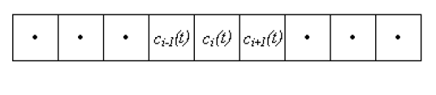
Neighborhood of a cell

Slide 12

Transition Function

Slide 13

Transition Function : Example

Slide 14
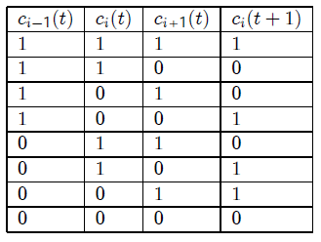

Transition Function : Example

Slide 15
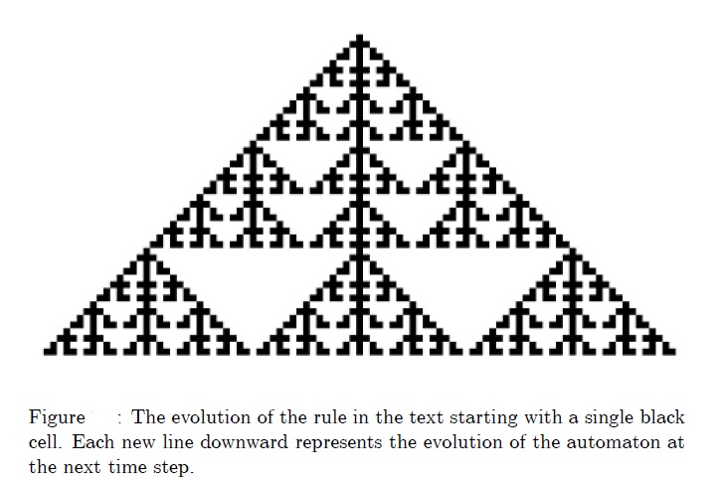
Graphical Representation

Slide 16
Transition Function
What is the total number of rules possible for r = 1 and k = 2 ???
Wolfram described it as Elementary Cellular Automata

Slide 17
Transition Function : Example
Rulestring : 10010110 or Rule 150

Slide 18
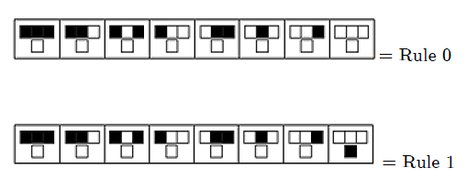
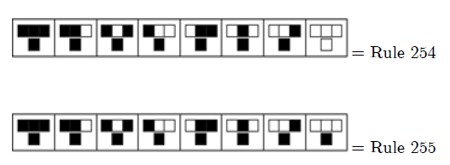
Transition Function : Rules

Slide 19
Cellular Automata
First-order Cellular Automata: state of the cell at time t+1 depends only on the state of its neighbors at previous time t
Second-order Cellular Automata: state of the cell at time t+1 depends on the state of its neighbors at previous time t as well as t-1

Slide 20
Cellular Automata
Total number of rules for r = 2 and k = 2 ???
2³²
Total number of rules r = 1 and k = 3
3 ²⁷

Slide 21

Totalistic Rules
This Class of rules is defined by taking the local transition function as some function of the sum of the values of the neighborhood cell sites

Slide 22
Boundary Conditions
Periodic (also known as ‘wrap’)
Reflective
Fixed

Slide 23


Some Elementary Cellular Automata
For an initial condition of single black state & rest white
Rule 0 only produces a 0
Rule 1 has the distinguishing feature that a neighborhood of cells entirely in state 0 spawns a live cell at the next time step

Slide 24
Some Elementary Cellular Automata: Rule 1

Slide 25
Some Elementary Cellular Automata
For an initial condition of single black state & rest white
Rule 0 only produces a 0
Rule 1 has the distinguishing feature that a neighborhood of cells entirely in state 0 spawns a live cell at the next time step
Rule 30

Slide 26
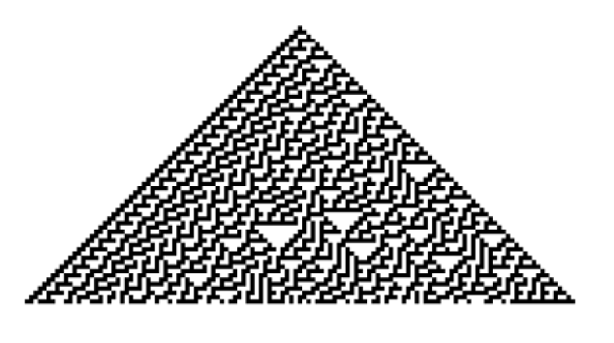
Some Elementary Cellular Automata: Rule 30

Slide 27
Rule 30 for Encryption System
Steps for Encryption
Plaintext to 8 bit ASCII (8 x n array)
Evolve rule 30 from an initial random value
Take cell values of central column i.e. b_{i}
XOR of a_{i} (plaintext) and b_{i} i.e. c_{i} = a_{i} XOR b_{i}

Slide 28
2-D Cellular Automata

Slide 29
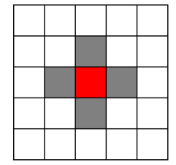
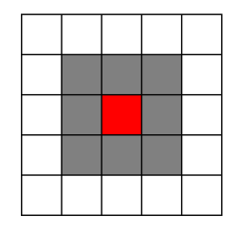
Neighborhood in 2-D CA
Two types of neighborhood:
Von-Neumann Neighborhood : 4/5 cells
Moore Neighborhood: 8/9 cells
Extended Moore Neighborhood r>1

Slide 30
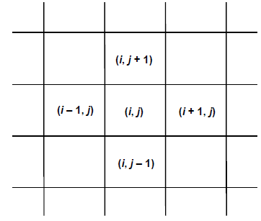
Cells of Von-Neumann Neighbourhood

Slide 31
Game of Life : Rules
Each cell has exactly two states (1 - alive, or 0 - dead) and the 8-cell Moore neighborhood is considered to determine the state of the central cell
A dead cell becomes alive at the next generation if exactly 3 of its 8 neighbors are alive
A live cell at the next generation remains alive if either 2 or 3 of its 8 neighbors is alive but otherwise it dies

Slide 32
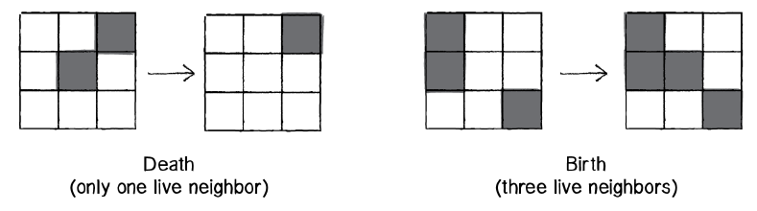
Game of Life : Example
Note: Shaded cells are live cells in this Example

Slide 33
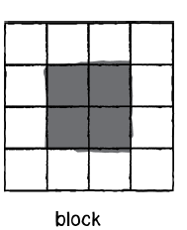
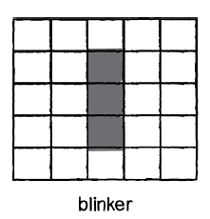
Game of Life : Configurations
Invariant Forms : Does not change with time
Oscillators: Patterns that Oscillates
Note: Shaded cells are live cells in this Example

Slide 34
References
Cellular_Automata_Schiff

