Slide 1
Peptide Computing

Slide 2


Basics
A peptide is a sequence of amino acids attached by covalent bond called peptide bonds
It consist of recognition sites for antibodies called epitopes
A peptide can contain more than one epitope for the same or different antibodies

Slide 3
Basics
With each antibody which attaches to a specific epitope, a binding power is associated, called its affinity.
When antibodies compete for recognition site which may overlap in the given peptide , then the antibodies with greater affinity have higher priority

Slide 4
Abstract Model
The resulting set of peptides and antibodies should satisfy the following properties :
Under easily achievable conditions each antibody binds reliably to epitope
Under easily achievable conditions each antibody reliably dissociates from its peptides. (Using a second antibody with higher affinity)
Under neither of conditions above does any antibody bind to another peptide (epitope)

Slide 5
Comparing the quantity of an element in 2 sets
Given two multi-sets containing elements of a finite set, verify whether a given element differs in number in both the sets
Let X denote an element to be searched in set of antibodies G and H
X is the only antibody to the epitope for X , in these sets

Slide 6
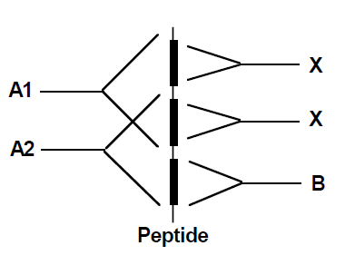
Peptide Creation for Solving the problem
Peptides with following properties are prepared:
Peptide contains 2 disjoint binding sites for element X
It contains binding site for 2 additional elements A1, A2 and B (which are not present in G & H)

Slide 7
Binding Affinities of Antibodies
Binding Affinities are crucial for calculations
Aff(B) > Aff(A2)
Aff(A2) > Aff(X)
Aff(X) > Aff(A1)
Aff(X) upper epitope > Aff(X) lower epitope
Antibody A1 can bind only when both sites for X are free

Slide 8
Steps for Computation
The antibody A2 is added. Antibody A2 blocks the second binding site of X.
The first set G is added. The elements X of the first set are bound to the first binding site of X.
The antibody B is added. Since the affinity of antibody B to its epitope is higher than the affinity of A2, B will remove antibody A2. The second binding site for X will be free.
The antibody A1 is added, A1 will bind only to those peptide positions where antibody X is not present at both binding sites.

Slide 9
Steps for Computation
Cross-linker is added. All bound antibodies will be covalently attached to the peptide via a cross-linker
The second set H is added. The elements X of the second set are bound to the second binding site of X. Bound antibodies X will be covalently attached to the peptide via a cross-linker.
Labeled antibody X is added. Labeled antibody X will bind to all remaining free binding sites for antibody X.
Detect label. If any labeled antibody X is bound, its fluorescence will be measured.

Slide 10
References
Strategies for the development of a peptide

