Slide 1
Incremental Peptide Computing

Slide 2
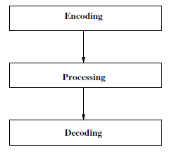
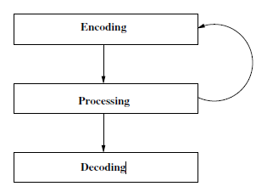


Conventional v/s Incremental Model for HPP

Slide 3
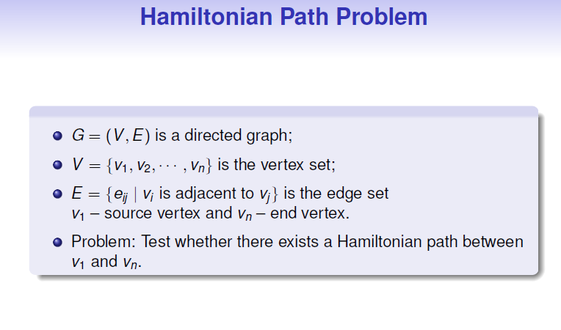
Courtesy: Tutorial on Molecular Computing, Mr. Sakthi Balan

Slide 4
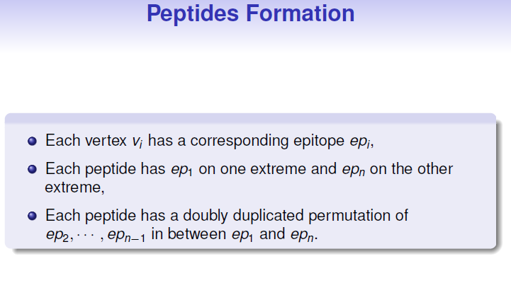

Courtesy: Tutorial on Molecular Computing, Mr. Sakthi Balan

Slide 5
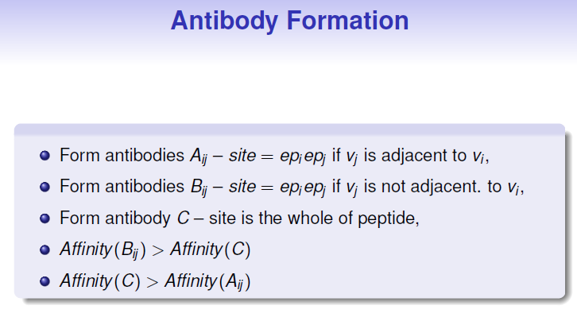
Courtesy: Tutorial on Molecular Computing, Mr. Sakthi Balan

Slide 6
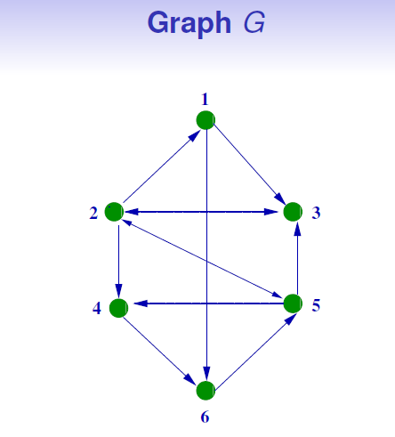
Courtesy: Tutorial on Molecular Computing, Mr. Sakthi Balan

Slide 7
Conventional HPP using Peptide : Algorithm
1. Take all the peptide sequences formed in an aqueous solution.
2. Add A set of antibodies to the collection.
3. Add B set of antibodies to the collection.
4. Add C set of antibodies to the collection.
5. If fluorescence is detected then there exists a Hamilton path in the graph G, otherwise there exists no such path.

Slide 8

Courtesy: Tutorial on Molecular Computing, Mr. Sakthi Balan

Slide 9
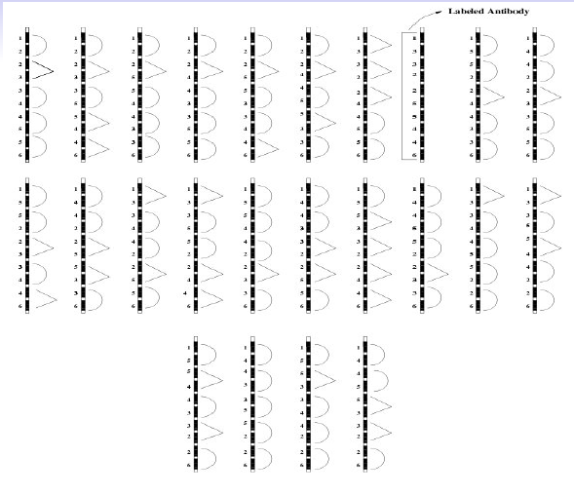
Courtesy: Tutorial on Molecular Computing, Mr. Sakthi Balan

Slide 10
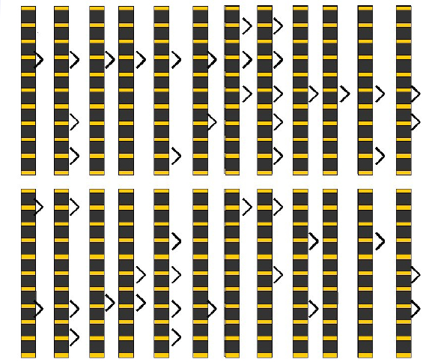
Courtesy: Tutorial on Molecular Computing, Mr. Sakthi Balan

Slide 11
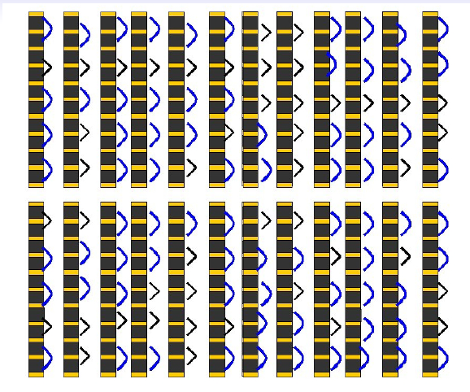
Courtesy: Tutorial on Molecular Computing, Mr. Sakthi Balan

Slide 12
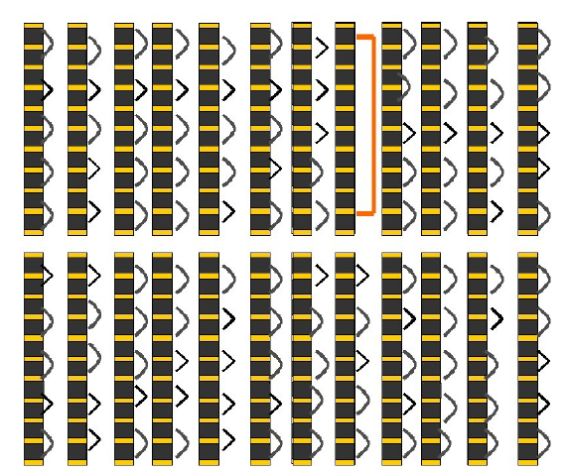
Courtesy: Tutorial on Molecular Computing, Mr. Sakthi Balan

Slide 13



Incremental Building of peptide Sequence
Pre-Processing Step
For each of the vertices an unique peptide sequence as p_{1,}p_{2,…,}p_{n}
For each of the edges e = v_{i}v_{j ,} 1 <= i, j <=n, create Antibody A_{ij}
For each of the vertices v_{i} create a set of L, of labelled antibodies binds to x_{i} of p_{i}

Slide 14
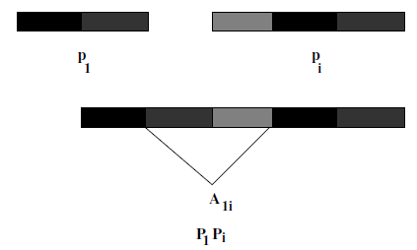
Incremental Building of peptide Sequence
Incremental Building
Two sets source and target , Initially Source = {s₁} Target = {s₂ ,s₃ ..s_{n}}
Add source, target followed by antibodies
Link between two sequences happens only if there is an edge in the graph

Slide 15
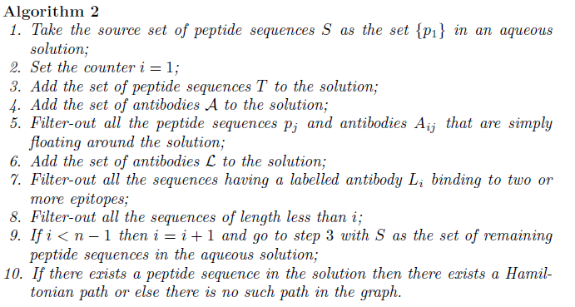
Incremental Model : Algorithm

Slide 16
References
HPP_Peptide_Computing

