Slide 1




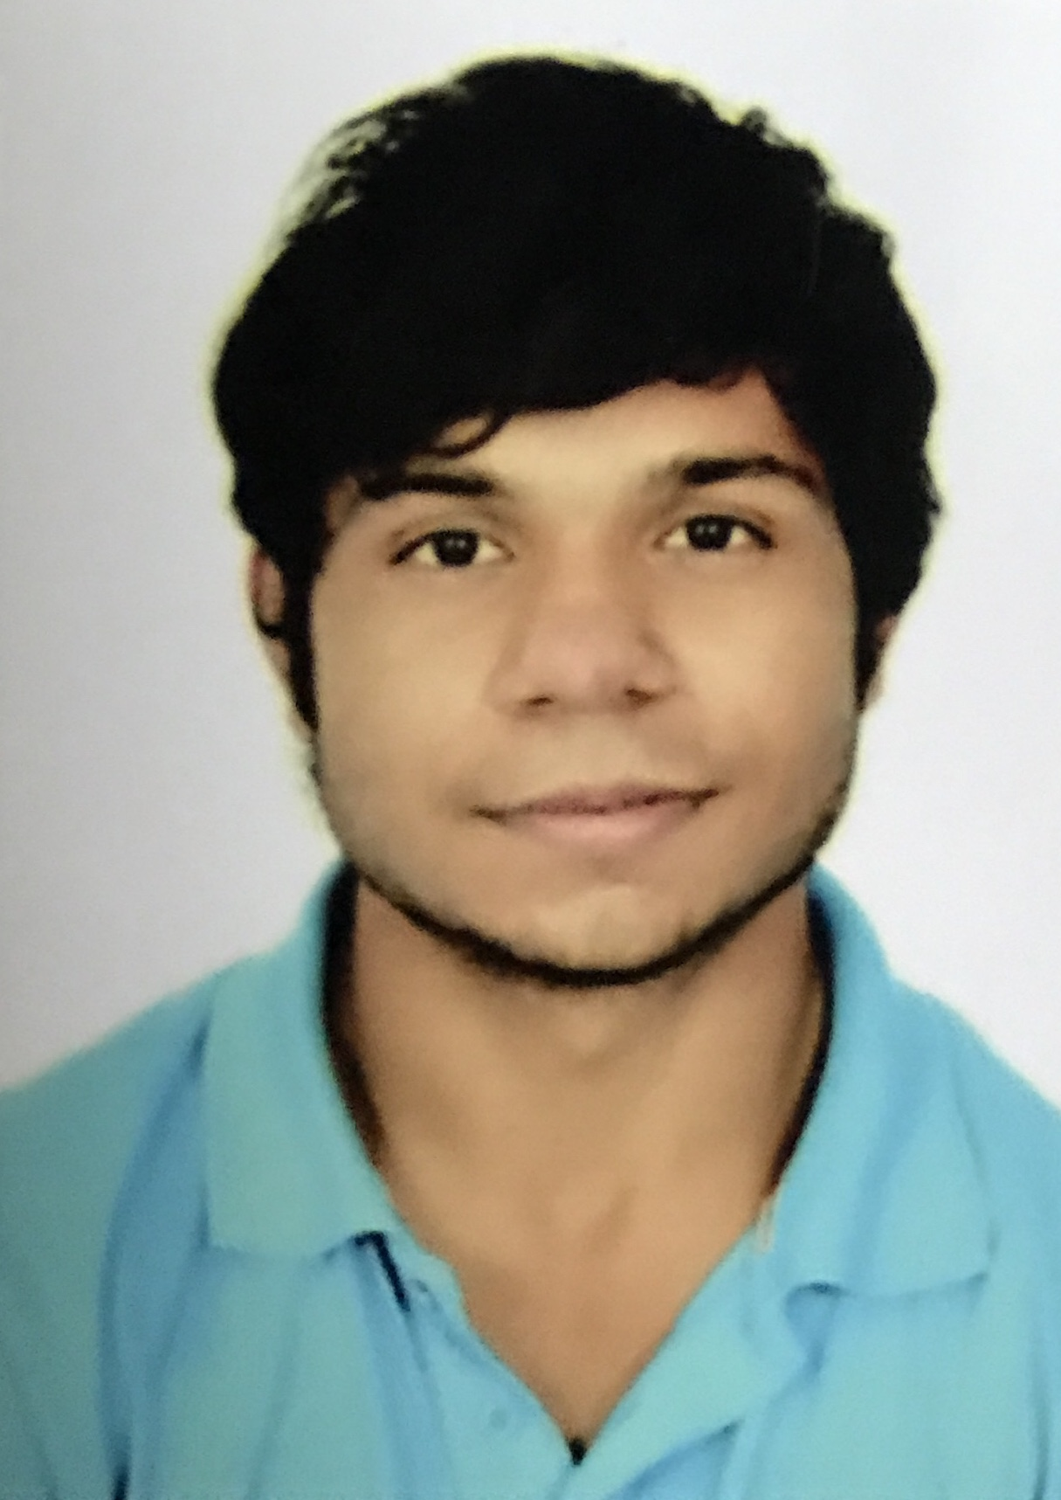
Real time prediction of American Sign Language using Convolutional Neural Networks
Shobhit Sinha, Siddhartha Singh, Sumanu Rawat, Aman Chopra

Slide 2
Outline
Problem Statement
Introduction
Related Work
Dataset
Methodology
Results
Summary
Future Work
References

Slide 3
Problem Statement Real time prediction of American Sign Language
American Sign Language
It is a natural language inspired by the French sign language and is used by around half a million people around the world with a majority in North America. The Deaf Culture views deafness as a difference in human experience rather than a disability, and ASL plays an important role in this experience.

Slide 4
Introduction
In this project, we have used Convolutional Neural Networks to create a robust model that understands 29 ASL characters (26 alphabets and 3 special characters). We further host our model locally over a real-time video interface which provides the predictions in real-time and displays the corresponding English characters on the screen like subtitles.

Slide 5
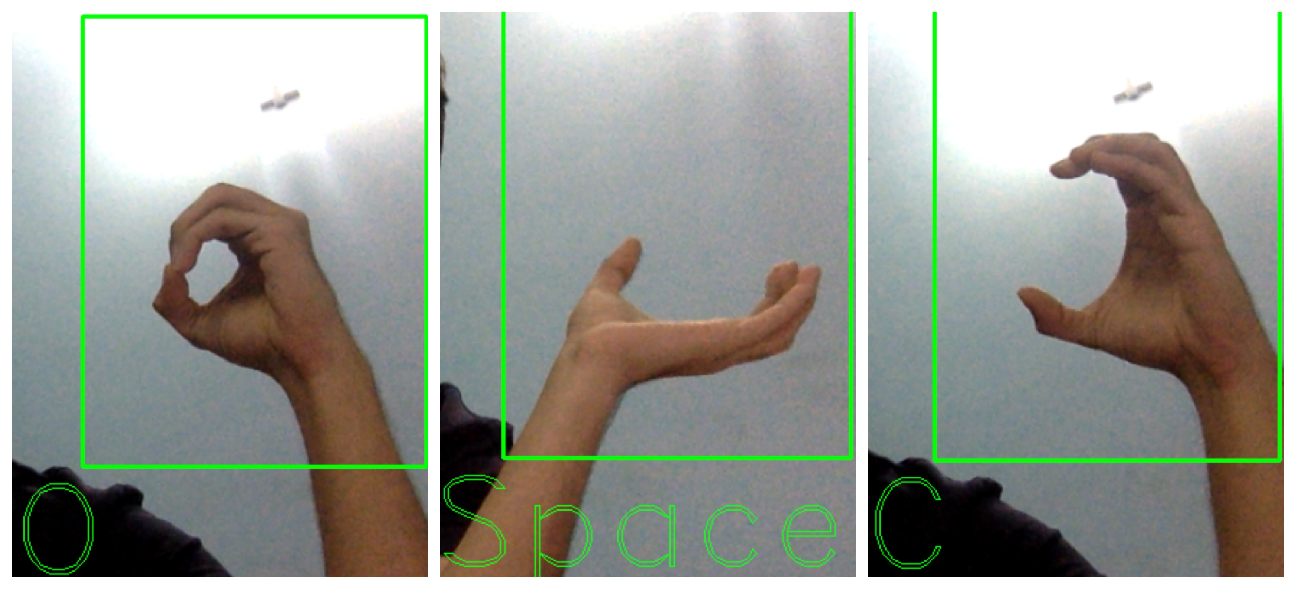
Real time prediction

Slide 6
Related work
Classification of large image datasets using Convolutional neural networks.
An approach for Indian sign language recognition.
Human-Computer Interaction on the basis of hand gesture recognition.
A real time of hand gesture on basis of detection of some shape based features.

Slide 7
Dataset
Dataset description
The ASL dataset is downloaded from Kaggle consists of all 26 alphabets of English language and 3 special characters namely delete, nothing and space. The dataset is divided into different directories for different alphabets and special characters. Each directory contains approximately 3000 images out of which 80% is used for training and 20% is used for validation. The image size of the dataset is 200 X 200 pixels and the image resolution is 72 pixels/inches. The size of the entire dataset is 1.11 GB.

Slide 8
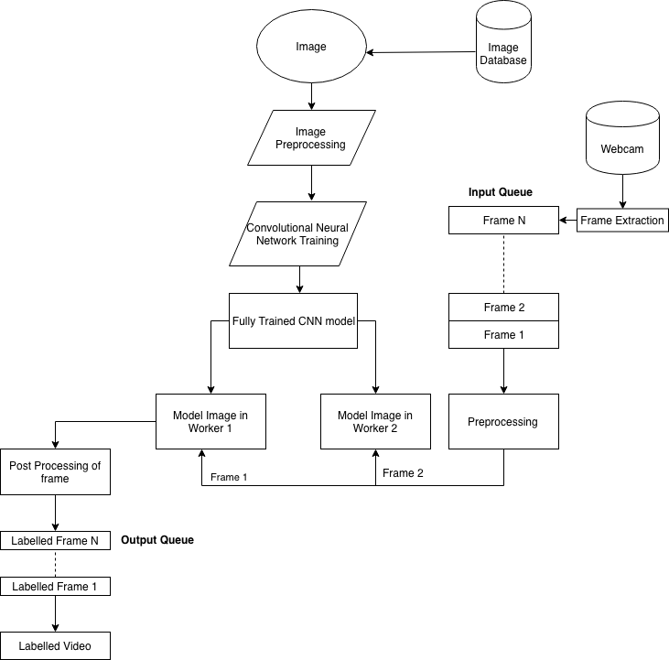
Proposed Method

Slide 9
Proposed Method
Data pre-processing:
Data Augmentation.
Image processing.
One Hot Encoding.

Slide 10
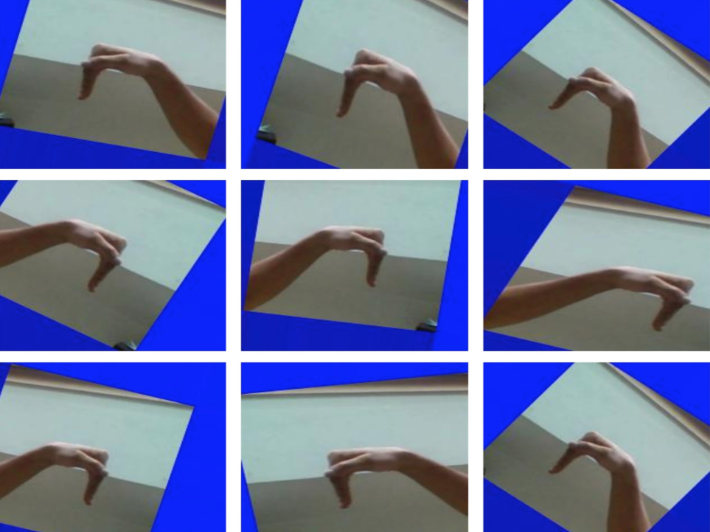
Data Preprocessing

Slide 11
Proposed Method
Model:
Since the input of this model is an image, we decided to use the CNN architecture for this model.
Activation Layer.
Pooling Layer.
Dropout.
Fully Connected Layer.

Slide 12
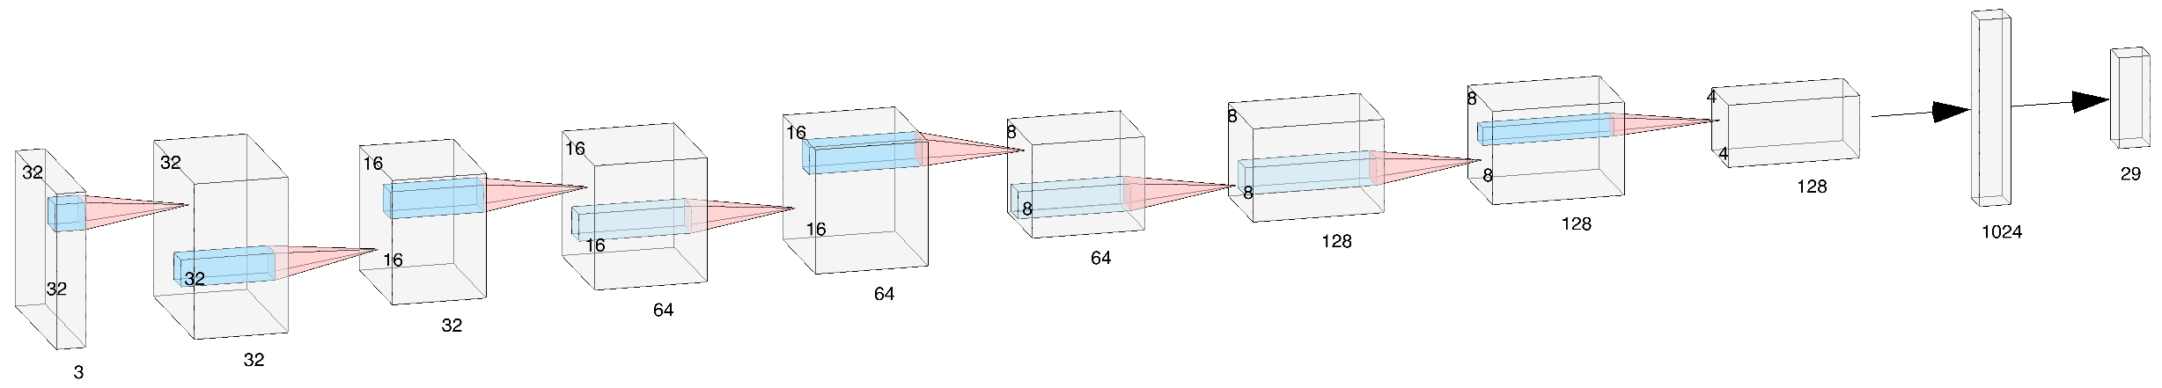
CNN Architecture

Slide 13
Proposed Method
Real time prediction of video:
Video processing was done using OpenCV and TensorFlow.
ASL sign in each frame was classified using the model that we developed.
We made use of inbuilt webcam as the source of video for the classifier.
OpenCV was used to extract frames from the video source.

Slide 14
Results
The CNN model trained on 87,000 ASL images gave an accuracy of 96.03%. The figure in the next slide depicts the Loss and accuracy vs Epoch number of the model. It can be seen that with the increasing number of epochs the accuracy increased substantially and the loss values decreased. The model was successfully used by a real time system, which could detect sign language with minimal latency.

Slide 15
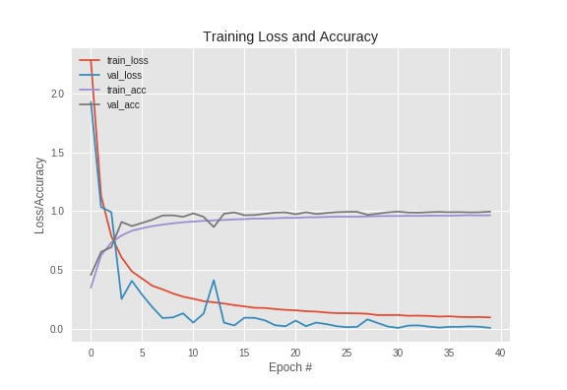
Loss/Accuracy vs Epoch graph Loss/Accuracy vs Epoch graph Loss/Accuracy vs Epoch graph

Slide 16
Summary
We have trained a CNN model from nothing but existing sign language images. It is easy to generate a database for projects like this and the reward is manifold.
Our experiments were focused on a small part of the American Sign Language, for which we were able to produce 96.03% accuracy.
We produce the live output of symbols shown to a webcam, with a negligible time lag, almost as if viewing a video with subtitles.

Slide 17
Future Work
As a part of future work, we suggest using better hardware and more computation power to come up with a more generalized model that can cover the complete ASL.
Implementation of Active Learning in our live hosted model will enable the contribution of the everyday sign language users.
Implementing this approach on other sign languages and eventually host this application on public platforms such as Android and the web, free of cost.

Slide 18
References
V. Adithya, P. R. Vinod and U. Gopalakrishnan, ”Artificial neural network based method for Indian sign language recognition,” 2013 IEEE Conference on Infor- mation & Communication Technologies, Thuckalay, Tamil Nadu, India, 2013, pp. 1080-1085.
Ragab A., Ahmed M., Chau SC. (2013) Sign Language Recognition Using Hilbert Curve Features. In: Kamel M., Campilho A. (eds) Image Analysis and Recogni- tion. ICIAR 2013. Lecture Notes in Computer Science, vol 7950. Springer, Berlin, Heidelberg
ASL Alphabet. Image dataset for alphabets in the american sign language https://www.kaggle.com/grassknoted/asl-alphabet
Emil M. Petriu Qing Chen, Nicolas D. Georganas. Real-time vision-based hand gesture recognition using haar-like features, 2007.
Helen Cooper, Eng-Jon Ong, Nicolas Pugeault, and Richard Bowden. 2012. Sign language recognition using sub-units. J. Mach. Learn. Res. 13, 1 (July 2012), 2205- 2231.
The OpenCV Library Dr. Dobbs Journal of Software Tools (2000) by G. Bradski
Nasser H. Dardas and Nicolas D. Georganas. Real-time hand gesture detection and recognition using bag-of-features and support vector machine techniques. IEEE transactions on instrumentation and measurment, 2011.
Alex Krizhevsky, Ilya Sutskever, Geoffrey E. Hinton: ImageNet classification with deep convolutional neural networks In: Advances in Neural Information Processing Systems 25 Editor: F. Pereira and C. J. C. Burges and L. Bottou and K. Q. Weinberger, 1097–1105 (2012)

Slide 19
References
A. S. Nikam and A. G. Ambekar, ”Sign language recognition using image based hand gesture recognition techniques,” 2016 Online International Conference on Green Engineering and Technologies (IC-GET), Coimbatore, 2016, pp. 1-5.
Zhou Ren, Jingjing Meng, Junsong Yuan, and Zhengyou Zhang. 2011. Robust hand gesture recognition with the kinect sensor. In Proceedings of the 19th ACM international conference on Multimedia (MM ’11). ACM, New York, NY, USA, 759-760.
S. N. Sawant and M. S. Kumbhar, ”Real time Sign Language Recognition using PCA,” 2014 IEEE International Conference on Advanced Communications, Con- trol and Computing Technologies, Ramanathapuram, 2014, pp. 1412-1415.
Raheja, J.L., Mishra, A. & Chaudhary, A. Pattern Recognit. Image Anal. (2016) 26: 434. https://doi.org/10.1134/S1054661816020164
Thad Eugene Starner. Visual recognition of American sign language using hidden Markov models. Master’s thesis, Massachusetts Institute of Technology, Cambridge MA, 1995.
Madhuri, Yellapu & g, Anitha & Mariamichael, Anburajan. (2013). Vision-based sign language translation device. 2013 International Conference on Information Communication and Embedded Systems, ICICES 2013. 565-568. 10.1109/ICI- CES.2013.6508395.
Martn Abadi, Ashish Agarwal, Paul Barham, Eugene Brevdo, Zhifeng Chen, Craig Citro, Greg S. Corrado, Andy Davis, Jeffrey Dean, Matthieu Devin, Sanjay Ghe- mawat, Ian Goodfellow, Andrew Harp, Geoffrey Irving, Michael Isard, Rafal Joze- fowicz, Yangqing Jia, Lukasz Kaiser, Manjunath Kudlur, Josh Levenberg, Dan Man, Mike Schuster, Rajat Monga, Sherry Moore, Derek Murray, Chris Olah, Jonathon Shlens, Benoit Steiner, Ilya Sutskever, Kunal Talwar, Paul Tucker, Vin- cent Vanhoucke, Vijay Vasudevan, Fernanda Vigas, Oriol Vinyals, Pete Warden, Martin Wattenberg, Martin Wicke, Yuan Yu, and Xiaoqiang Zheng. TensorFlow: Large-scale machine learning on heterogeneous systems, 2015. Software available from tensorflow.org.

Slide 20
Thank You.

