Slide 1



MANIPAL INSTITUTE OF TECHNOLOGY
DATA WAREHOUSING AND DATA MINING PROJECT
Suvimal Yashraj 140911394
Aman Chopra 140911358

Slide 2
Brief Description
ROLE OF METABOLIC OBESITY AND BODY MASS INDEX IN PATIENTS WITH CORONARY ARTERY DISEASES
Brief Problem Statement :
Train a model capable of predicting the GENSINI score which determines the severity of CAD in the following groups-
Metabolically Healthy Normal Weight (MHNW)
Metabolically Obese Normal Weight (MONW)
Metabolically Healthy Obese (MHO)
Metabolically Abnormal Obese (MAO)
Find the group showing a good association to severity of CAD that is which category is more prone to CAD, metabolically obese or phenotypically obese.
Find the prognostic markers for CAD among factors like HBA1C, FI, HOMA IR , TC, TG, HDL, LDL and hsCRP and which group shows more association?

Slide 3
Data Set
The dataset contains the following-
Covariates | Responses
GROUP (1, 2, 3 or 4) Age BMI (Body Mass Index) WC (Waist Circumference) HbA1c (Glycated Hb) FPG ( Fasting plasma glucose (mg/dl)) TC (Total Cholesterol(mg/dl)) TG (Triglycerides(mg/dl)) HDL (High density lipoprotein(mg/dl)) LDL (Low density Lipoprotein(mg/dl)) CH_HDL FI (Fasting Insulin) HOMA_IR (Insulin resistance) hsCRP (High sensitive CRP) | GENSINI SYNTAX

Slide 4
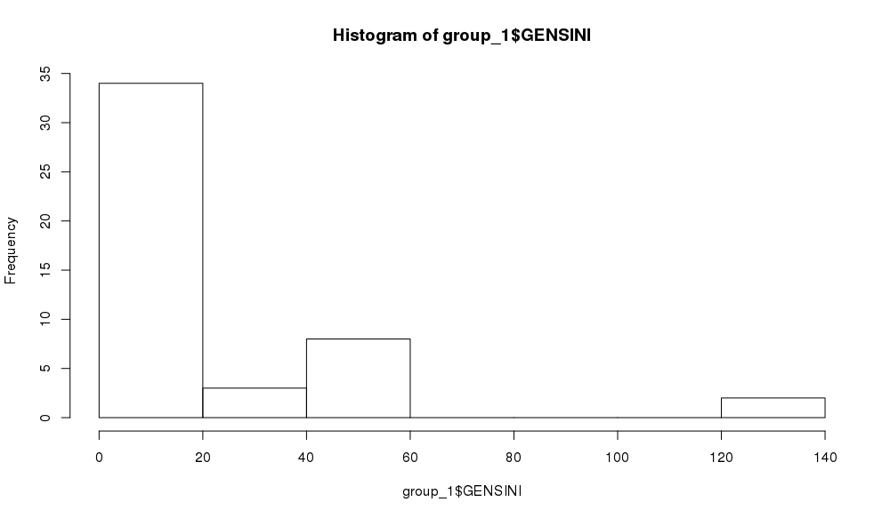
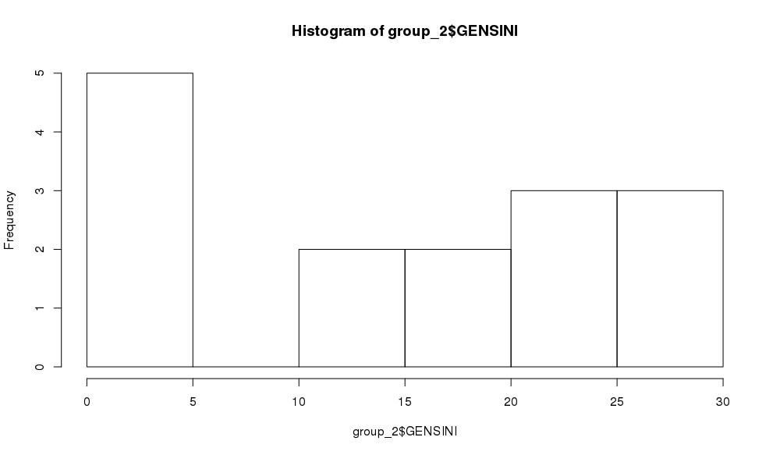
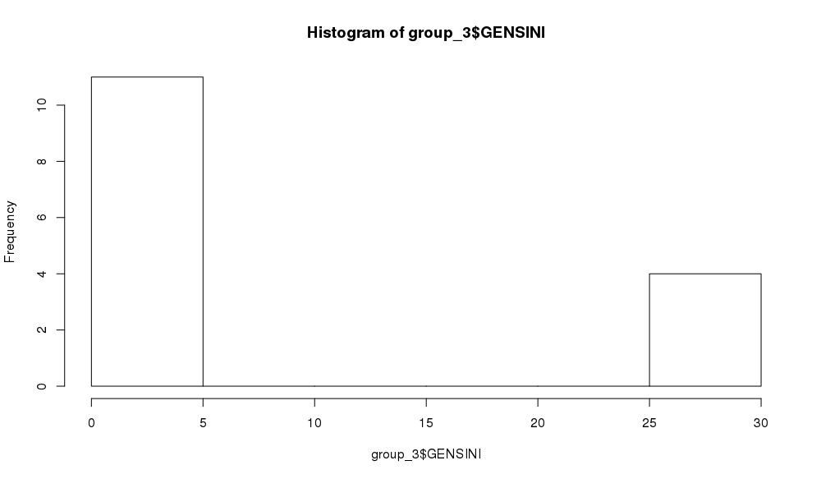
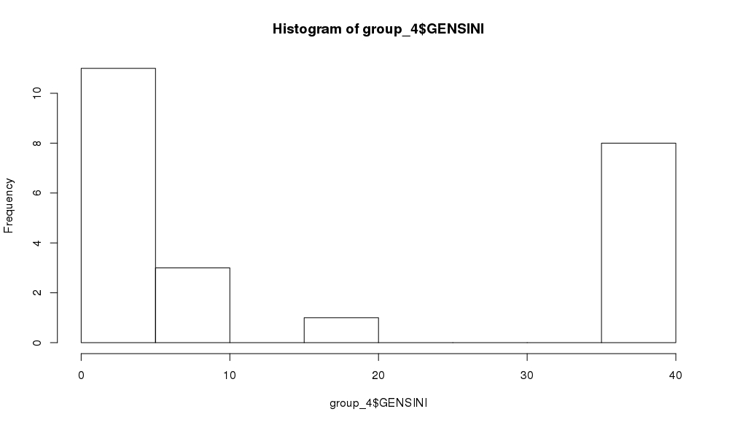
GENSINI Distribution within the groups

Slide 5
Solution
The dataset possess multi-collinearity which may affect our model later.
The factors having high Pearson’s coefficient of correlation are listed.
For the entire data together-
0.70889724141 : GROUP and BMI
0.897603908389 : TC and LDL
0.717531489708 : TC and CH_HDL
Group 1 0.852783799856 : TC and LDL 0.887927793492 : FI and HOMA_IR | Group 2 0.87153020518 : HbA1c and HOMA_IR -0.950003408973 : HDL and CH_HDL
Group 3 0.827154839926 : Age and HDL 0.810336764663 : HbA1c and TC 0.820247281312 : FPG and HDL 0.857193774502 : FPG and HOMA_IR 0.984325207983 : TC and LDL 0.977675396139 : FI and HOMA_IR | Group 3 0.937306254471 : TC and LDL 0.838328141656 : TC and CH_HDL 0.865079811939 : LDL and CH_HDL 0.959614719483 : FI and HOMA_IR

Slide 6
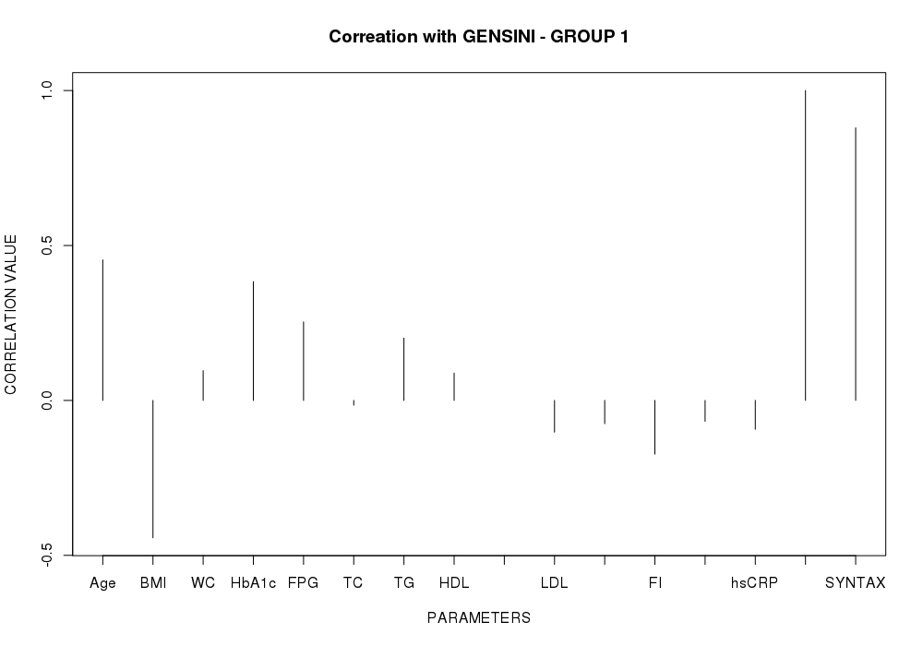
CH_HDL
HOMA_IR
GENSINI

Slide 7
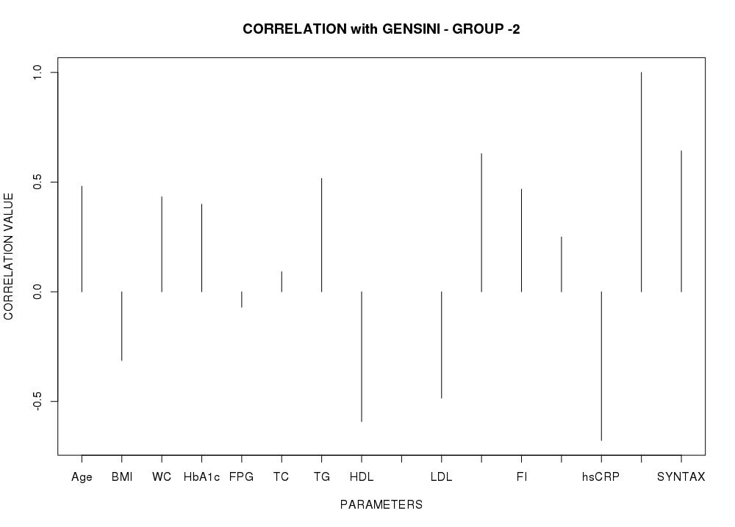
CH_HDL
HOMA_IR
GENSINI

Slide 8
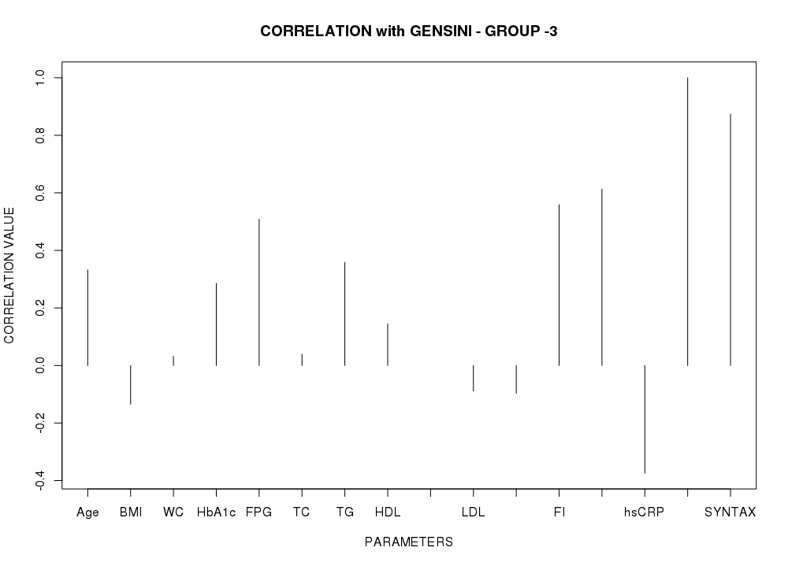
CH_HDL
HOMA_IR
GENSINI

Slide 9
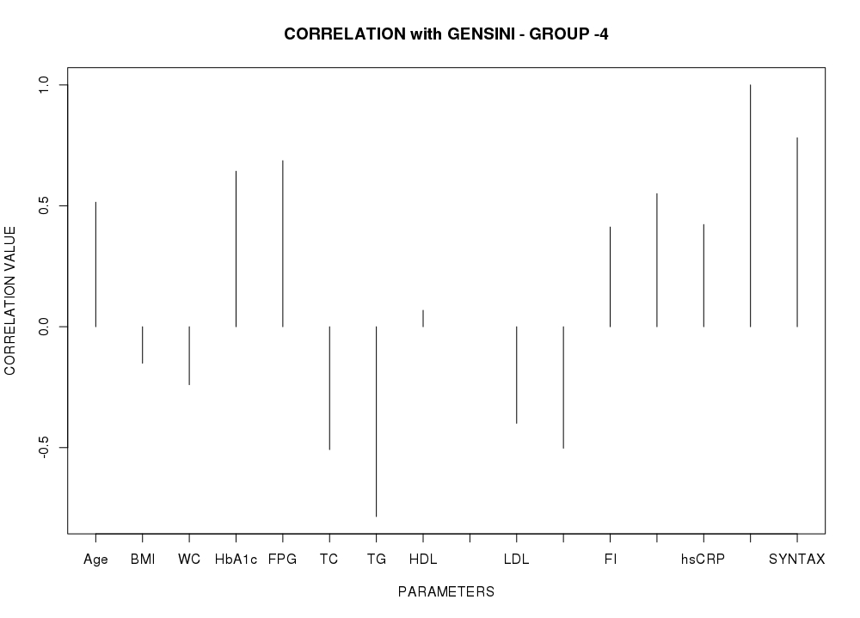
CH_HDL
HOMA_IR
GENSINI

Slide 10
From the correlation graphs, it is clear that GENSINI and SYNTAX have a high positive correlation in all the groups.
Therefore, variation trends of the SYNTAX score can be directly predicted from the trends of the GENSINI score across the various groups.
Moreover both the scores are different metrics for the same quantity that is the severity of CAD.
Hence, SYNTAX scores have been eliminated from our models for training.

Slide 11
Approach to solve the problem
Several models were used for predicting the GENSINI scores from the given features-
Ridge Regression
LASSO Regression
Neural Networks
Since the GENSINI score is a continuous value, the metric used for measuring the accuracy of predictions was:
Root mean square error

Slide 12
Solution - Preprocessing
MISSING VALUES-
Out of 15720 values (15*1048), only 2 values (all within the FI column) were missing.
Since the number of missing values are proportionately very small, the group-wise average value is used to fill them.
Missing values of FI in Group 1= Average of the FI values available in Group 1
= 35.9386
Missing values of FI in Group 4= Average of the FI values available in Group 4
= 47.99

Slide 13
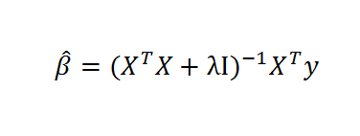
Solution - Preprocessing
NORMALIZATION
Normalization of the data elements was done for the Neural Networks.
It wasn’t required for Ridge and LASSO regression as MATRIX ALGEBRA was used for finding the coefficients instead of GRADIENT DESCENT.

Slide 14
Data Split
60% of the data was used for training the model.
The remaining 40% was used for testing it.
Root mean square error was then found out between the actual value and the predicted values of that 40% data.

Slide 15
Obtained Root Mean Square Errors
Results obtained after applying each model on test data.
Model | Groups -> | Group 1 | Group 2 | Group 3 | Group 4
LASSO Regression |  | 14.33 | 8.82 * 10e-15 | 4.79 | 10.55
Ridge Regression |  | 21.18 | 24.14 | 510.9 | 20.47
Neural Networks |  | 4.11 | 0.14 | 8.81 | 0.55
For the entire dataset together, Neural Networks gave the best results. The RMSE obtained was 6.170
For Group 2 and 3, LASSO gave the best result.
For Group 1 and 4, Neural Networks gave the best result.

Slide 16
Obtained Root Mean Square Errors
Results obtained after applying each model on train data.
Model | Groups -> | Group 1 | Group 2 | Group 3 | Group 4
LASSO Regression |  | 16.18 | 9.32 * 10e-15 | 3.74 | 2.30
Neural Networks |  | 1.27 | 0.17 | 0.46 | 0.83
Ridge regression model was eliminated because the results obtained with the test data was very inaccurate.
The results obtained for the models selected in each group were not very different from the test model. Hence, we can say that the model is not over fitting the training data.

Slide 17
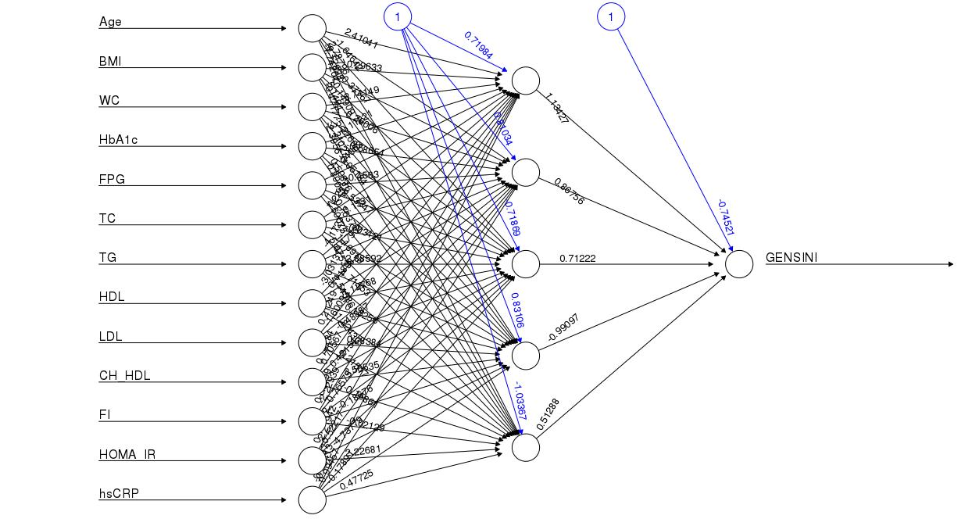
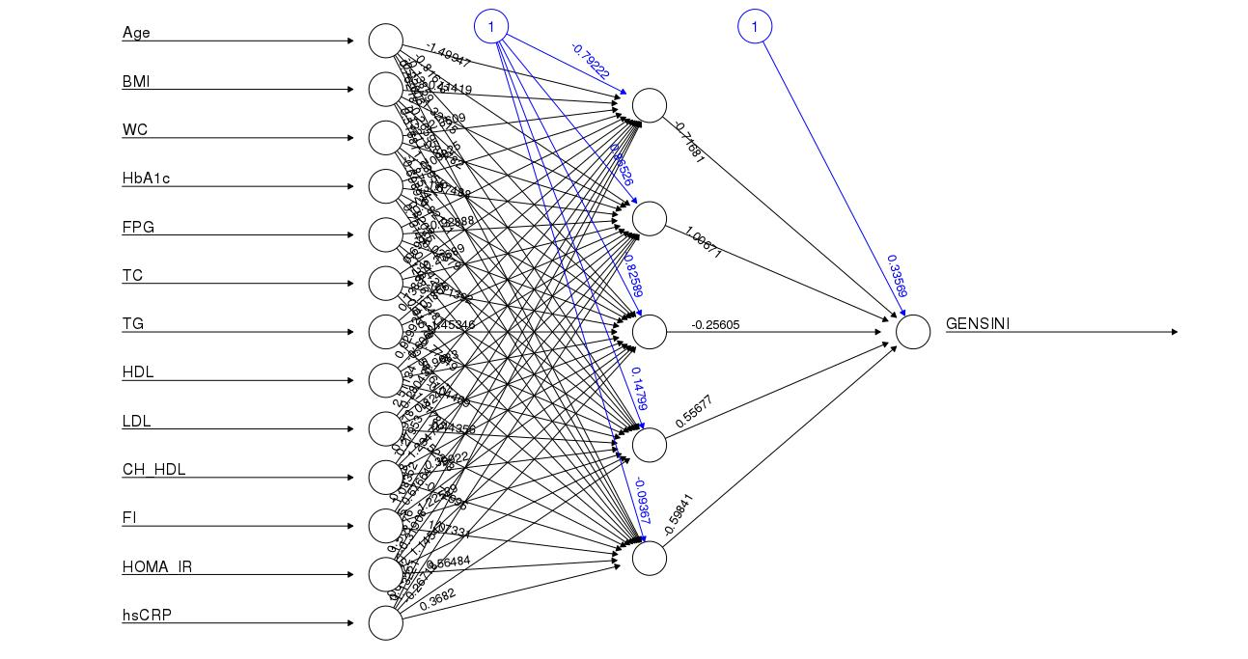
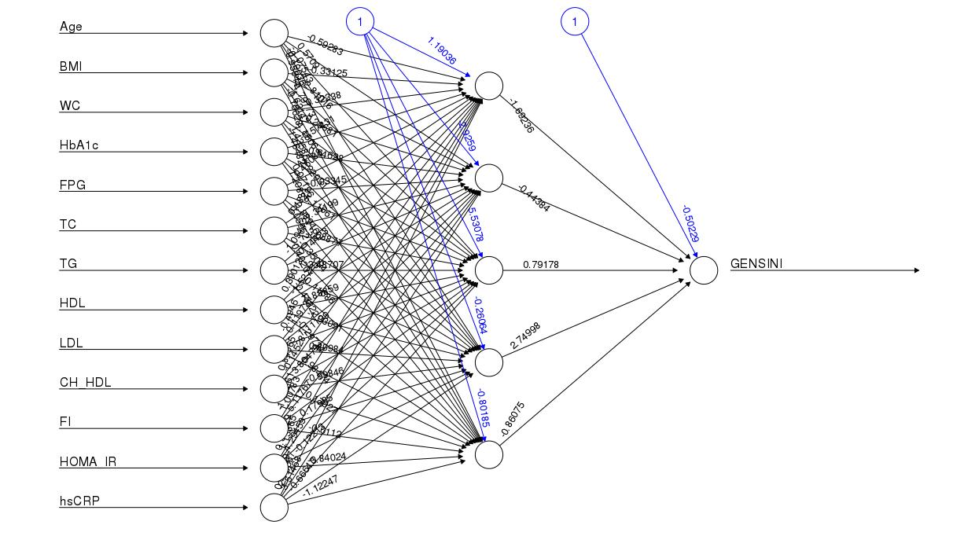
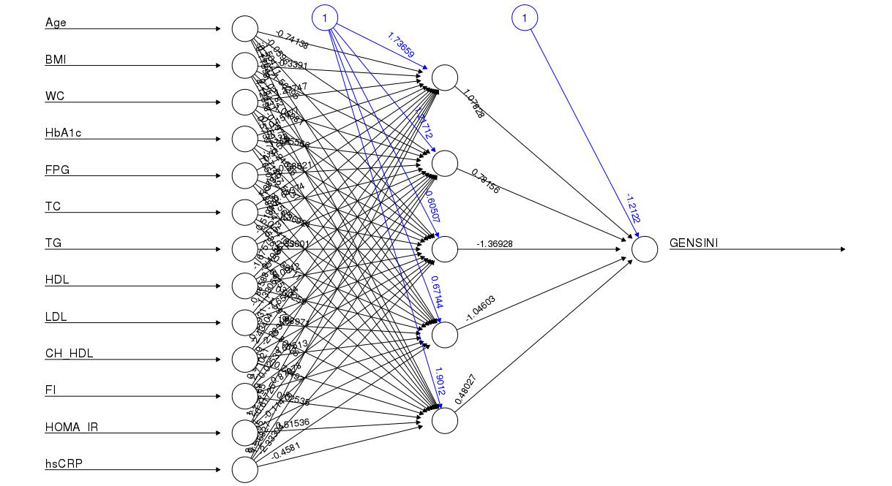

Slide 18
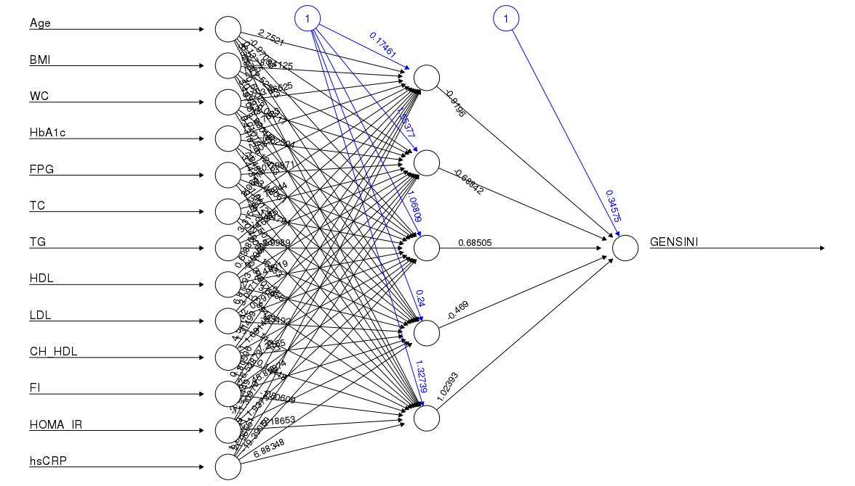
Entire Dataset

Slide 19
Ridge Regression
Ridge Regression was used as the initially for regression. The initial idea to ensure that over-fitting does not occur was to give a penalty to the cost function for every unit increase of the parameter values.
LASSO
Ridge Regression cannot zero out coefficients ; thus either all coefficients are included or none. But LASSO does both parameter shrinkage and variable selection automatically , and hence was thought of as a nice approach to avoid over fitting.
Neural Networks
We tried using Neural networks with varying number of inner layers. The best results obtained for the test data were from using only a single hidden layer. Including more layers caused the model to over fit.

Slide 20
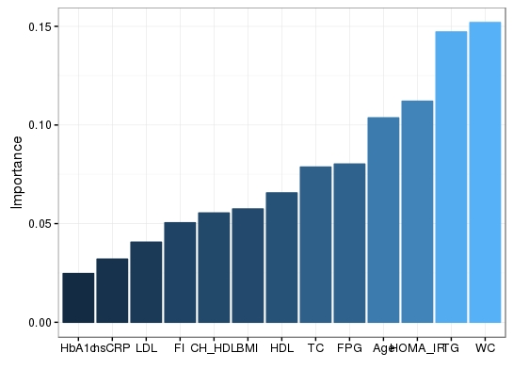
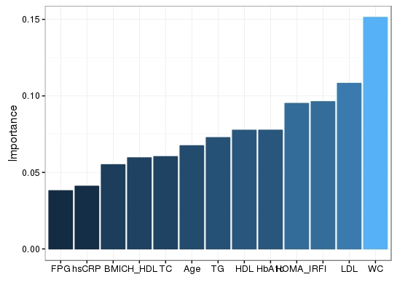
Group 1
Feature Importance
Group 2

Slide 21
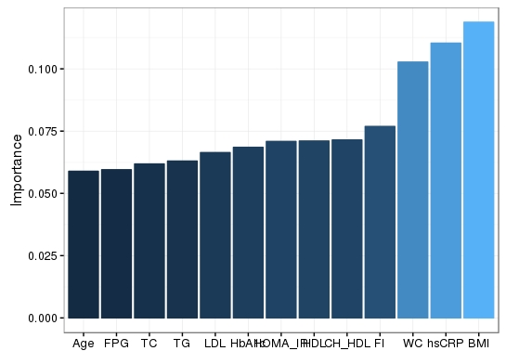
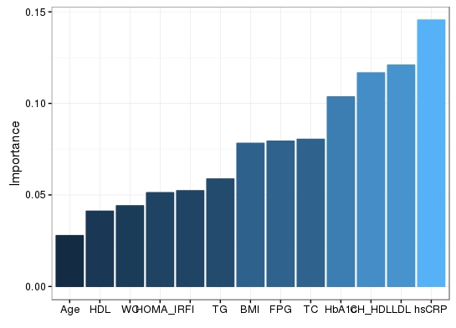
Group 3
Feature Importance
Group 4

Slide 22
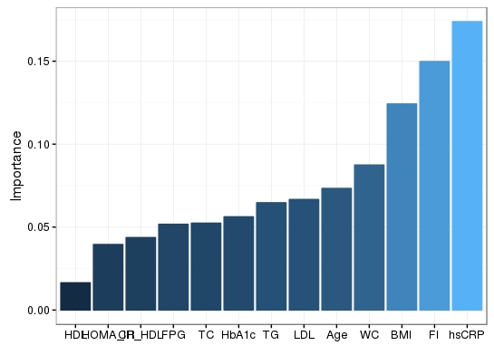
Entire Dataset

Slide 23
 | Feature Importance
Group 1 | WC > TG > HOMA_IR > AGE
Group 2 | WC > LDL > FI > HOMA_IR
Group 3 | BMI > hsCRP > WC > FI
Group 4 | hsCRP > LDL > CH_LDL > HbA1c
Entire Dataset | hsCRP > FI > BMI > WC

Slide 24
Relationship between Obesity type and CAD
95% confidence interval was found out for the GENSINI scores within each group.
Groups | 95% Confidence Intervals
Metabolically Obese Normal Weight | 8.848 to 19.818
Metabolically Healthy Obese | 2.504 to 15.629
Metabolically Abnormal Obese | 8.483 to 23.342
Metabolically Healthy Normal Weight | 1.987 to 13.867
It means that the GENSINI scores will lie between the given ranges with 95% probability in the population.
This means that the severity of CAD varies as follows-
Phenotypic obese < Metabolic obese < Metabolic and Phenotypic obese

Slide 25
Results
The GENSINI score for the groups can be accurately predicted using-
LASSO for MHNW and MAO
Neural Networks for MONW and MHO
Overall, if a single model is to be used with the group number as a parameter then Neural Networks give the best results.
With a shift from phenotypic to metabolic obesity, the severity of CAD increases.
This means that the severity of CAD varies as follows-
Phenotypic obese < Metabolic obese < Metabolic and Phenotypic obese

Slide 26
Factors | Correlation | p-Value | Statistical Significance (α = 0.05)
hsCRP | 0.109 | 0.2791 | No
FI | -0.0133 | 0.8950 | No
BMI | -0.224 | 0.0249 | Yes
WC | 0.0228 | 0.8214 | No
AGE | 0.4165 | 0.0000162 | Yes
HBA1C | 0.3430 | 0.000475 | Yes
HOMA IR | 0.09821 | 0.3309 | No
TC | -0.0732 | 0.4688 | No
TG | 0.05696 | 0.5556 | No
HDL | 0.0735 | 0.4658 | No
LDL | -0.14321 | 0.1551 | No

Slide 27
Results
BMI, AGE and HBA1C can be used as prognostic markers to determine the severity of CAD.
HBA1C and AGE have positive correlations.
BMI has a negative correlation.

Slide 28
Frameworks/libraries/ML Algorithms used
R packages used are:
caTools
MASS
lars
neuralnet
NeuralNetTools

