Slide 1


Slide 2


NeuroTrade
Second Year Project Synopsis
Submitted by
ROLL | NAME
2401010012 | Lucky
2401010005 | Aryan
2401010009 | Gaurav
2401010141 | Aman
2401010077 | Divesh
Faculty Mentor: Ms. Neetu Chauhan
Notes:
New Courses replaced with New Programmes

Slide 3

Project Overview
The Problem: The conventional stock analysis process involves the use of multiple tools, such as stock price charts on one platform and news on another. This creates a problem for individual investors, who find it hard to determine the actual market sentiment.
The Solution: The project proposes the development of a web-based platform that integrates Quantitative Analysis (historical stock prices) with Qualitative Analysis (news sentiment analysis) to present a comprehensive market outlook.
Core Logic: The project applies Deep Learning algorithms to predict stock price trends while also employing Natural Language Processing (NLP) to "read" financial news.
Notes:
New Courses replaced with New Programmes

Slide 4
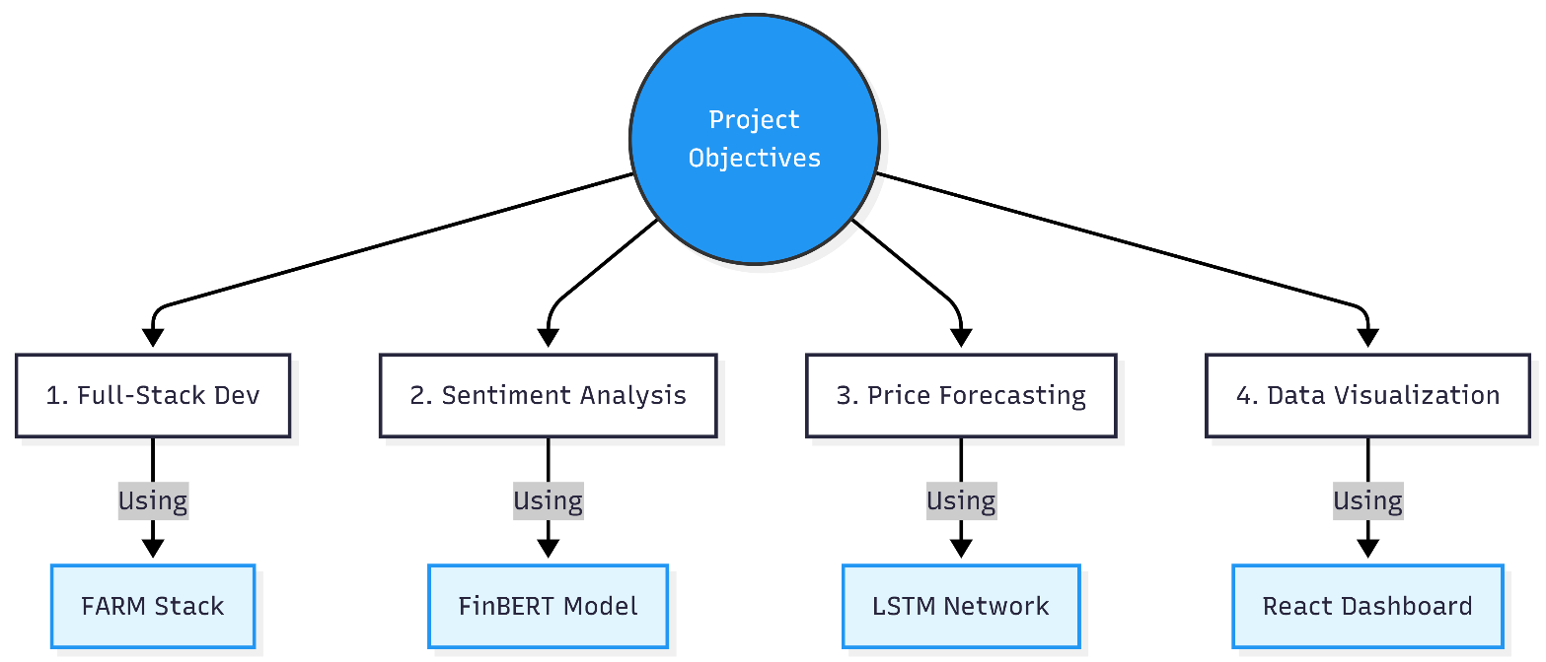
Specific Objectives
1. Create a Full-Stack Web Application: Construct a responsive and real-time dashboard with the FARM Stack (FastAPI, React, MongoDB).
2. Execute Sentiment Analysis: Launch the FinBERT model to examine financial news headlines and determine market sentiment (Positive/Negative) with high domain-specific accuracy.
3. Predict Price Trends: Train a Long Short-Term Memory (LSTM) neural network on 5 years of historical data to forecast short-term stock price trends.
4. Visualize Insights: Design interactive charts to display sentiment overlays on price charts for effective decision-making.
Notes:
New Courses replaced with New Programmes

Slide 5
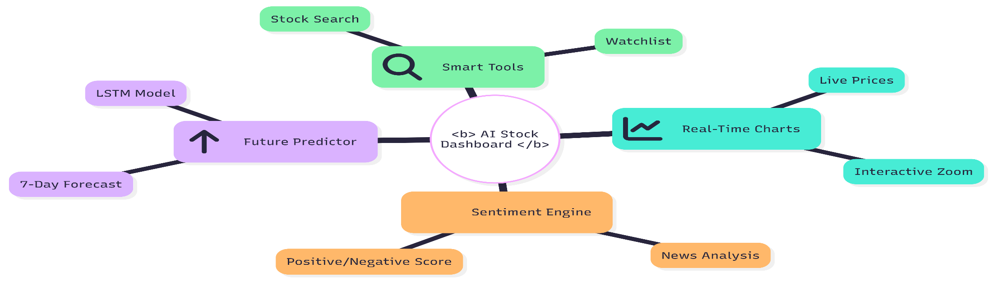
Key Features
Real-Time Dashboard: It displays real-time stock information (Open, High, Low, Close) extracted from APIs.
Sentiment Gauge: It is a meter (Green/Red) that shows the current market sentiment using the last 20 news headlines.
7-Day Price Forecast: It is a trend line that shows the forecasted stock price for the next week.
Smart Search: It enables users to search any company listed on the NSE/NASDAQ.
News Aggregator: It automatically scrapes and displays links to relevant financial news for the searched stock.
Notes:
New Courses replaced with New Programmes

Slide 6
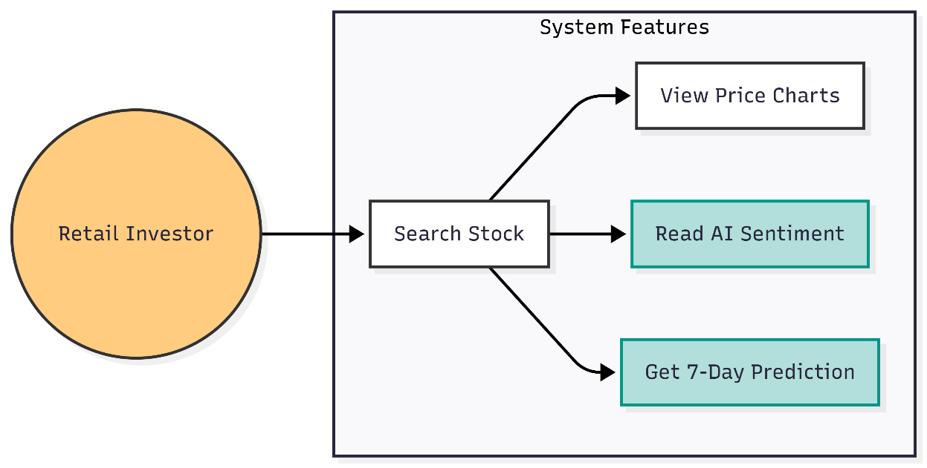
Project Usecases & Scope
Use Cases:
Retail Investors: To confirm their intuition with the help of data supported by AI.
Market Researchers: To examine the relationship between news events and market volatility.
Students: As a learning resource to learn about market behavior.
Scope:
Coverage: The system supports prominent large-cap stocks (NIFTY 50, S&P 500, etc.).
Data: The system examines English-language financial news only.
Notes:
New Courses replaced with New Programmes

Slide 7
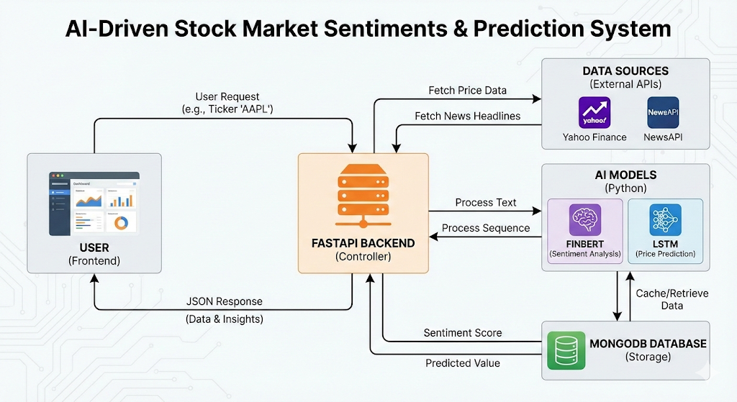
Project Flow diagram/Architecture
Notes:
New Courses replaced with New Programmes

Slide 8
Data & Resources
Data Sources:
Stock Prices: Yahoo Finance API (yfinance) for daily OHLC data.
News Data: https://newsapi.org/ or https://newsdata.io/ for real-time headlines.
Dataset: https://www.kaggle.com/datasets/adilshamim8/google-stocks-historical-data
Or https://www.kaggle.com/datasets/kalilurrahman/apple-stock-data-live-and-latest-from-ipo-date
Hardware Requirements:
A Standard Laptop
Training: Google Colab (T4 GPU) for faster model training.
Notes:
New Courses replaced with New Programmes

Slide 9
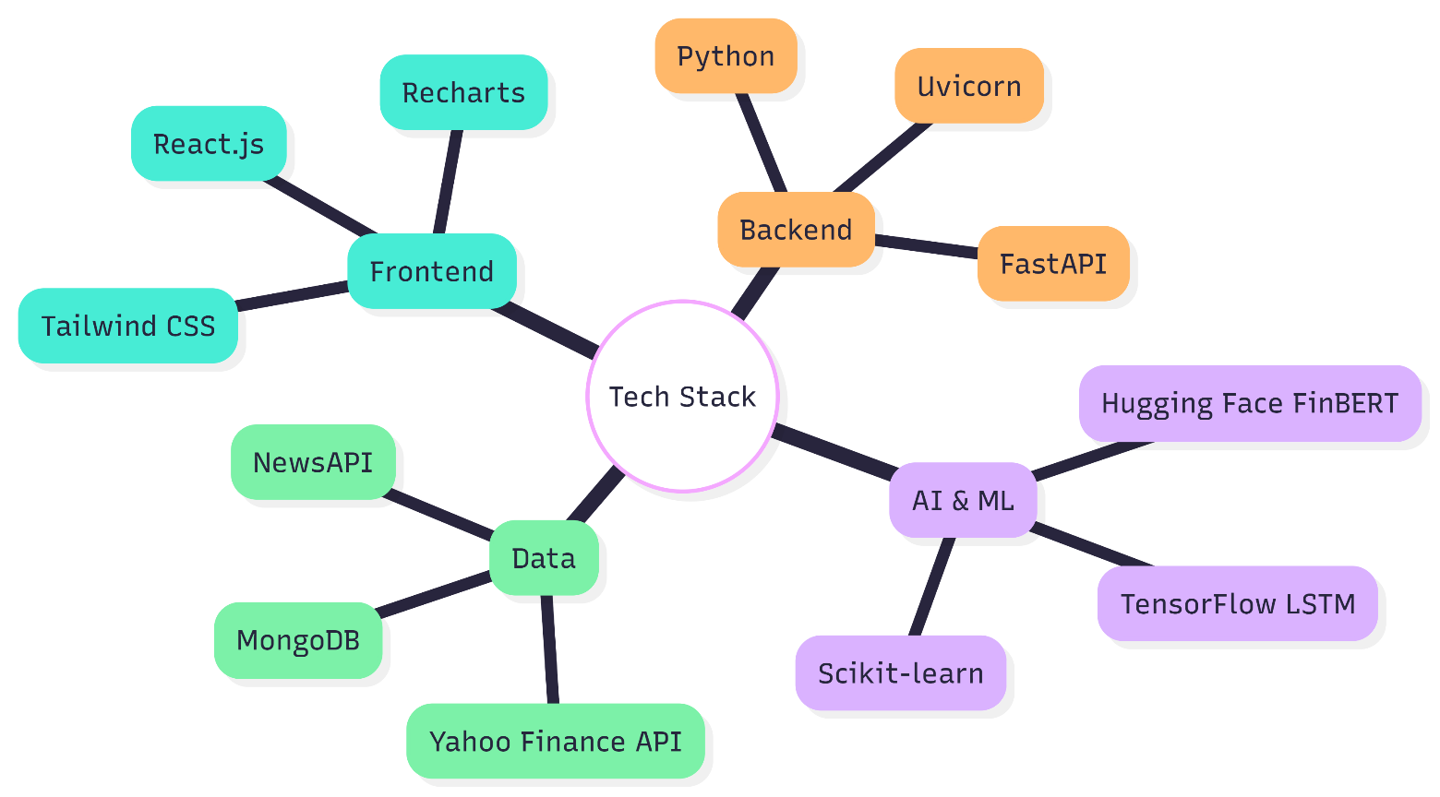
Software Stack:
Frontend: React.js, Tailwind CSS, Recharts.
Backend: Python 3.14, FastApi,Uvicorn.
AI/ML: TensorFlow (Keras), Hugging Face Transformers, Scikit-learn, Pandas.
Database: MongoDB (for caching search results).

Slide 10
Methodology
1. Automated Data Acquisition
Python codes were developed to obtain the historical OHLC data for 5 years using the yfinance library and the headlines using the NewsAPI.
Data was continuously available for effective model training.
2. Data Preprocessing
Quantitative: MinMaxScaler was used to normalize the stock prices to a range of 0 to 1 for effective LSTM training.
Qualitative: Text headlines were tokenized using the BERT tokenizer to convert the text into inputs for the NLP model.
Notes:
New Courses replaced with New Programmes

Slide 11
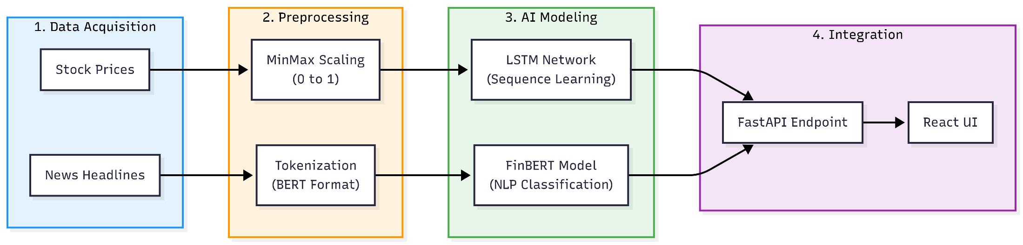
3. Dual-Model Inference
Forecasting: An LSTM model was used to identify patterns and predict the future stock price trends.
Sentiment Analysis: FinBERT was used to classify the stock market news into positive, negative, and neutral categories with high domain accuracy.
4. Integration & Visualization
Both models' outputs were aggregated using a FastAPI backend.
Combined results were visualized on a React.js dashboard for real-time user analysis.

Slide 12
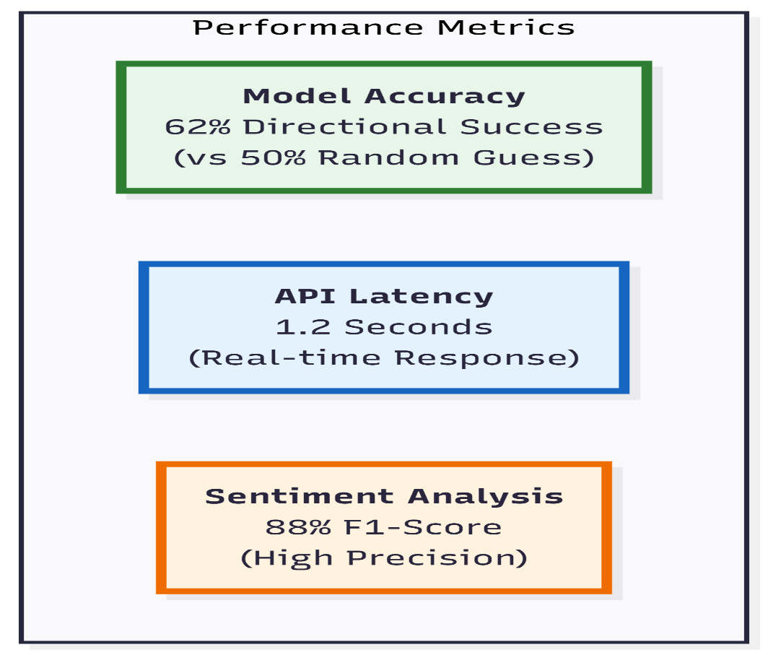
Expected Results & Impact
Performance Metrics:
LSTM Accuracy: Aiming for a Mean Absolute Error (MAE) of <5% on test data.
Sentiment Accuracy: Achieving >85% accuracy on financial headlines.
Latency: Loading entire dashboard in <3 seconds.
Impact:
Makes high-end analysis tools accessible to everyone.
Helps new investors avoid information overload by
condensing news into a single score.
Notes:
New Courses replaced with New Programmes

Slide 13
Project Timeline
Phase | Timeline | Key Activities
Phase 1 | Weeks 1-2 | Literature Review, Tech Stack Setup, Data Collection Scripts.
Phase 2 | Weeks 3-6 | AI Model Development (Training LSTM, Implementing FinBERT).
Phase 3 | Weeks 7-9 | Backend API Development (FastAPI) & Database Integration.
Phase 4 | Weeks 10-12 | Frontend Development (React UI), Integration, & Final Testing.
Notes:
New Courses replaced with New Programmes

Slide 14
THANK YOU

