Slide 1
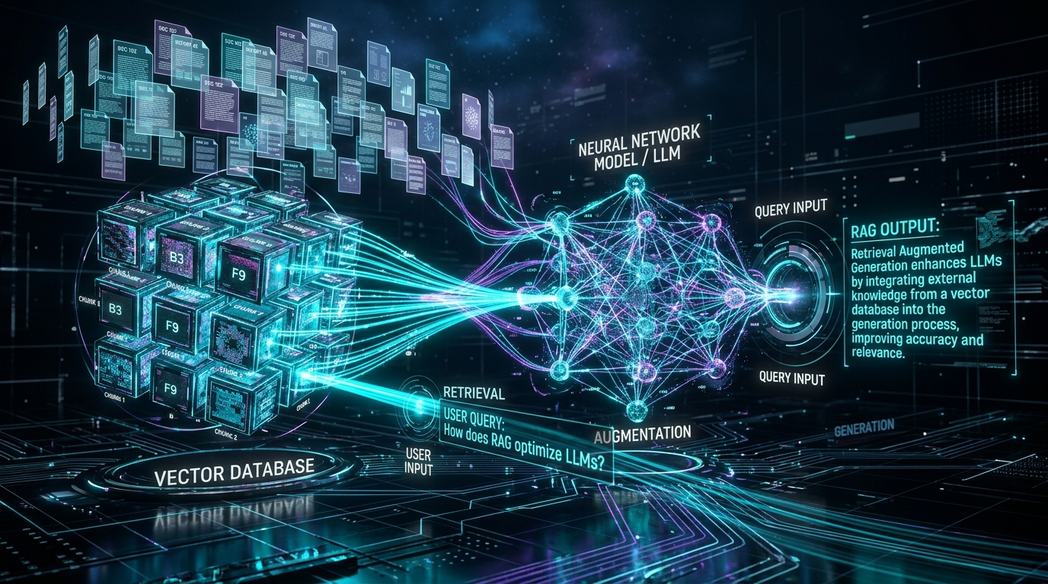
GENERATIVE AI ARCHITECTURE
Retrieval-Augmented
Generation (RAG)
How to connect foundation LLMs to your private data for accurate, real-time, and hallucination-free answers.
🛡️ 100% Grounded
Zero hallucinations via citations
⚡ Real-Time Data
Instant updates without retraining
🔒 Enterprise Privacy
Strict access control & security

Slide 2
THE PROBLEM SPACE
Why Raw LLMs Fail in the Real World
Language models are brilliant reasoning engines, but they cannot replace a database.
01
STALE DATA
02
FAKE FACTS
03
ZERO CONTEXT
04
HIGH COST
Knowledge Cutoff
Hallucination
Private Data Blind
Expensive Retraining
• Model training stops at a fixed date
• Unaware of recent events or policy updates
• Cannot read today’s changes or live records
• Predicts words, does not verify truth
• Confidently fabricates non-existent facts
• Severe legal, compliance & reputational risk
• Zero access to company intranet & wikis
• Cannot query internal codebases or CRMs
• Public LLMs cannot answer company questions
• Retraining 70B+ models costs $100K+ in GPUs
• Fine-tuning takes weeks of engineering
• Too slow and rigid for dynamic businesses
💡 Key Insight: Do not force LLMs to memorize facts. Use them to reason over retrieved facts.
Retrieval-Augmented Generation (RAG) | Enterprise Architecture Guide

Slide 3
THE SOLUTION
What is RAG? The "Open-Book Exam" Concept
RAG decouples reasoning from memorization by injecting authoritative references into the prompt.
❌ WITHOUT RAG: Closed-Book Exam
✅ WITH RAG: Open-Book Exam
• Student relies entirely on memory
• Confidently guesses when unsure
• Zero citations or page numbers provided
• Result: Plausible-sounding hallucinations
• Student is given the exact reference manual
• Reads and synthesizes only the verified facts
• Cites exact paragraph, source & page numbers
• Result: Grounded, transparent & verifiable truth
1. RETRIEVE
2. AUGMENT
3. GENERATE
Fetch top 3-5 relevant chunks from Vector DB
Combine context + user query into smart prompt
LLM generates answer with direct source citations
Retrieval-Augmented Generation (RAG) | Enterprise Architecture Guide

Slide 4
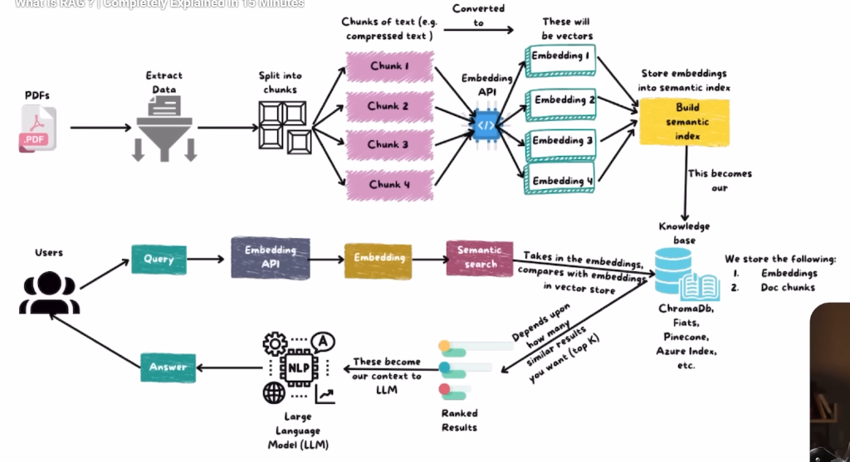
VISUAL ARCHITECTURE
Complete RAG Architecture: End-to-End Flow
The two fundamental workflows: Ingestion (Indexing) and Query (Retrieval & Synthesis).
TRACK 1: Ingestion & Indexing
1. Raw PDFs / Docs extracted
2. Split into text chunks (Chunk 1..4)
3. Embedding API converts to vectors
4. Store in Vector DB (Pinecone/Chroma)
TRACK 2: Query & Generation
1. User submits question
2. Query converted to embedding vector
3. Semantic search ranks Top-K chunks
4. LLM reads context -> generates Answer!
Retrieval-Augmented Generation (RAG) | Enterprise Architecture Guide

Slide 5
STEP 1: PREPARATION
Data Ingestion & Smart Chunking Strategies
How you slice your documents dictates what your AI can find later.
SIMPLE & FAST
GOLD STANDARD
CONTENT-AWARE
HIERARCHICAL
Fixed-Size Chunking
Recursive Chunking
Semantic Chunking
Document-Structure
✓ Strength: Uniform size (e.g. 500 chars, 50 overlap)
✗ Tradeoff: Risks splitting sentences mid-thought
★ Ideal For: Basic text, logs, uniform prose
✓ Strength: Splits by paragraphs (\n\n) then sentences
✗ Tradeoff: Slightly variable chunk lengths
★ Ideal For: Articles, manuals, wikis, docs
✓ Strength: Splits when semantic topic shifts
✗ Tradeoff: Requires multiple embedding calls
★ Ideal For: Interviews, transcripts, dialogue
✓ Strength: Preserves tables, Markdown headers & code
✗ Tradeoff: Needs custom parsers per file type
★ Ideal For: Financial 10-K filings, API specs
🔑 Why Chunk Overlap Matters: Always maintain 10-15% overlap between adjacent chunks. This prevents losing context when an important sentence crosses a boundary.
Retrieval-Augmented Generation (RAG) | Enterprise Architecture Guide

Slide 6
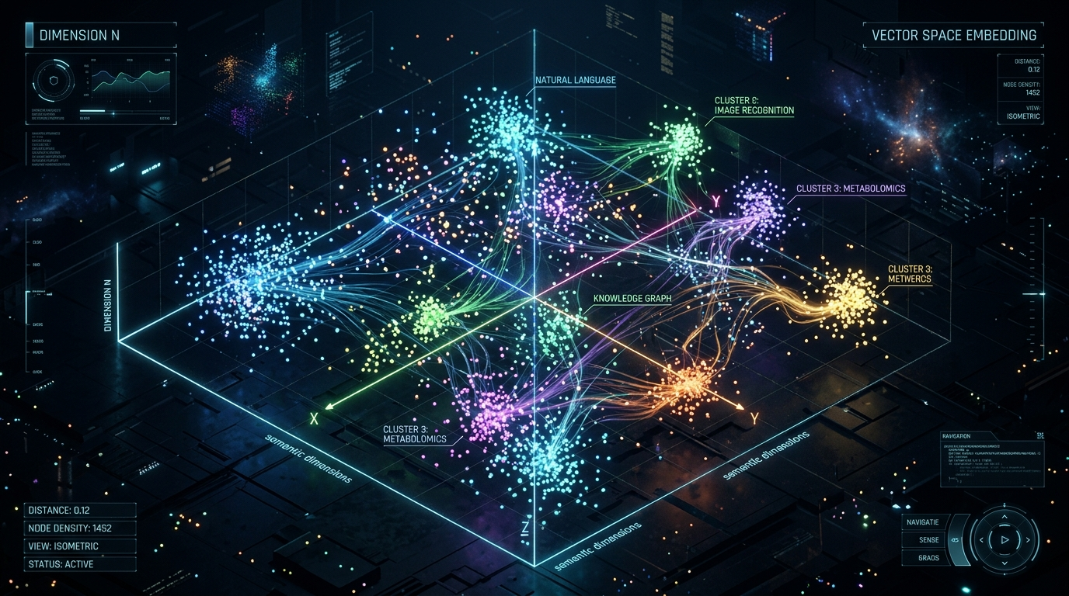
STEP 2: VECTORS
Vector Embeddings: Meaning in Math Form
How words and concepts become high-dimensional geometric coordinates.
What is an Embedding?
• Turns raw text into an array of 1536+ numbers
Example: [0.012, -0.045, 0.891, ...]
• Semantic Proximity:
Words with similar meaning cluster close in space
"King" - "Man" + "Woman" ≈ "Queen"
"Puppy" is near "Dog", far from "Toaster"
• Similarity Metrics:
- Cosine Similarity: Measures angle between vectors
- Dot Product: Angle + vector magnitude
- Euclidean (L2): Direct straight-line distance
Retrieval-Augmented Generation (RAG) | Enterprise Architecture Guide

Slide 7
STEP 3: STORAGE
Vector Databases: The Long-Term Memory
Storing millions of vectors and searching them in milliseconds.
Dedicated Vector Stores
Relational & Hybrid Stores
Pinecone • Qdrant • Milvus • Chroma • Weaviate
PostgreSQL (pgvector) • OpenSearch • Elasticsearch
• Built from scratch for ANN (Approximate Nearest Neighbor)
• Sub-10ms search across 100M+ vectors
• Built-in HNSW and IVF vector clustering algorithms
• Managed cloud clusters with automatic sharding
• Store vectors alongside standard SQL relational tables
• Enables ACID transactions and strict foreign keys
• Easy to adopt if your company already runs Postgres
• Perfect for datasets up to 10 million vectors
🎯 Production Must-Have: Metadata Filtering
Never search the whole database blindly. Always filter vectors by metadata like user_role, department_id, and document_date at query time for strict security!
Retrieval-Augmented Generation (RAG) | Enterprise Architecture Guide

Slide 8
STEP 4: SEARCH
Advanced Retrieval: Beyond Simple Vector Search
Why pure vector search fails on product codes, acronyms, and names—and how to fix it.
Hybrid Search
BEST OF BOTH
Cross-Encoder Re-Ranking
PRECISION BOOST
• How: Combines Dense Vectors (semantic concepts) + BM25 (exact keyword match).
• Why: Fixes vector blind spots for exact part numbers, names, and error codes.
• How: Fast retrieval gets Top 50; Re-Ranker scores actual relevance for Top 5.
• Why: Massively boosts precision by analyzing query and chunk together.
Query Expansion & HyDE
SMART REWRITE
Context Compression
TOKEN SAVER
• How: Hypothetical Document Embeddings: LLM creates fake answer to search with.
• Why: Bridges the gap between short vague queries and long informative documents.
• How: Strips out filler sentences before passing the chunk to the LLM.
• Why: Saves context window tokens and eliminates misleading background noise.
Retrieval-Augmented Generation (RAG) | Enterprise Architecture Guide

Slide 9
STEP 5: GENERATION
Prompt Augmentation & Grounded Response
The exact formula that prevents hallucinations during the final LLM step.
1. SYSTEM PROMPT
2. RETRIEVED CHUNKS
3. USER QUESTION
➔ GROUNDED ANSWER
Strict rules: "Answer ONLY using provided context. If unknown, state unknown."
Top-K facts: [Source: HR_Policy_2026.pdf, Page 4] "Maternity leave is 16 weeks."
Input: "How many weeks of parental leave do employees get in 2026?"
Output: "Employees receive 16 weeks [1]." (Zero guesswork, full citation)
🛡️ The 3 Non-Negotiable Generation Guardrails:
1. Source Attribution: Force the model to append [Source ID] to every factual claim.
2. Fallback Honesty: Explicitly forbid guessing when retrieved chunks do not contain the answer.
3. Output Structuring: Enforce JSON or Markdown tables for consistent UI integration.
Retrieval-Augmented Generation (RAG) | Enterprise Architecture Guide

Slide 10
STRATEGY
RAG vs. Fine-Tuning: When to Use Which?
Fine-tuning trains how a model speaks; RAG provides what the model knows.
CRITERIA | RETRIEVAL-AUGMENTED GEN (RAG) | FINE-TUNING (PEFT / LoRA)
Core Purpose | Adding dynamic facts, knowledge & documents | Teaching style, tone, format & domain jargon
Data Freshness | Instant (update database record in seconds) | Delayed (requires new GPU training cycle)
Citations & Audit | 100% transparent (cites source & page number) | Black box (cannot cite where it learned a fact)
Access Control (RBAC) | Easy (filter chunks by user permission role) | Impossible (all data baked into model weights)
★ THE EXECUTIVE DECISION RULE:
Need factual accuracy, changing data, or access control? -> Always choose RAG.
Need specialized format (e.g. strict SQL), custom persona, or specific medical terminology? -> Use Fine-Tuning.
Best in class enterprise apps do both: Fine-tune for formatting, RAG for knowledge!
Retrieval-Augmented Generation (RAG) | Enterprise Architecture Guide

Slide 11
MATURITY LEVELS
Evolution of RAG: Naive to Agentic Systems
How enterprise architectures progress from simple lookup to autonomous research agents.
LEVEL 1: NAIVE RAG
LEVEL 2: ADVANCED RAG
LEVEL 3: AGENTIC RAG
Single-Pass Lookup
Pre & Post-Retrieval Pipeline
Self-Correcting & Autonomous
• User Query -> Vector Match -> Answer
• Fails on ambiguous or multi-part questions
• High hallucination if search fetches noise
• No verification or reflection step
• Pre-retrieval query rewriting & HyDE
• Hybrid Search (Dense + BM25 Keywords)
• Cross-Encoder Re-Ranking for Top-5 precision
• Metadata filtering by tenant permissions
• LLM decides IF retrieval is even needed
• Corrective RAG (CRAG): Fallback to web search
• Self-RAG: Evaluates if generated text is true
• Multi-hop reasoning across SQL, APIs & Docs
Retrieval-Augmented Generation (RAG) | Enterprise Architecture Guide

Slide 12
QUALITY & TESTING
Evaluation Framework: The RAG Triad
How to objectively measure and benchmark RAG accuracy in production.
1. Context Relevance
2. Groundedness (Faithfulness)
3. Answer Relevance
Did the search fetch the right information?
Is every statement backed by the context?
Did the LLM answer the user’s actual question?
Measures noise in retrieved chunks. If relevance is low, improve chunking, embeddings, or re-ranking.
Validates that every claim and number in the answer is strictly sourced from retrieved text—no wild guesses.
Ensures the model does not dodge the inquiry, give partial answers, or wander off on tangents.
Failure: Distracted by irrelevant sentences.
Failure: Model hallucinates unbacked facts.
Failure: Polite refusal or evasive waffle.
🛠️ Standard Production Evaluation Stack:
• Ragas: Automated synthetic evaluation datasets • TruLens: Real-time hallucination feedback functions
• DeepEval: Unit tests in CI/CD pipeline • LangSmith / Phoenix: Tracing, latency & token telemetry
Retrieval-Augmented Generation (RAG) | Enterprise Architecture Guide

Slide 13
ENGINEERING
4 Critical Production Pitfalls & Hard Fixes
The real-world traps teams fall into when going from prototype to scale.
The "Lost in the Middle" Trap
Security & Permission Leakage
⚠️ Trap: LLMs pay attention to top & bottom of prompts, ignoring chunks in the center.
💡 Fix: Sort re-ranked chunks strategically: place top 2 critical excerpts at the very start and very end.
⚠️ Trap: Employees query the AI and accidentally see payroll, executive emails, or HR notes.
💡 Fix: Enforce Role-Based Access Control (RBAC) via metadata pre-filtering before vector similarity search.
Dirty Data & Garbage Extraction
Latency & API Cost Explosion
⚠️ Trap: Messy scanned PDFs and broken multi-column layouts destroy embedding quality.
💡 Fix: Use specialized vision-based parsers (LlamaParse, Unstructured) that output clean Markdown tables.
⚠️ Trap: Querying vector stores + re-ranker + frontier LLM creates 4-6 second latency.
💡 Fix: Add Semantic Caching (Redis/GPTCache) for similar queries, parallelize retrieval, and stream tokens.
Retrieval-Augmented Generation (RAG) | Enterprise Architecture Guide

Slide 14
BUSINESS IMPACT
Real-World Enterprise RAG Applications
Proven production architectures delivering measurable business ROI.
🏢 Enterprise Internal Copilot
💬 Autonomous Customer Support
ROI: 70% fewer IT/HR tickets
ROI: 90% first-contact resolution
Connects to Notion, Confluence, Jira, and Slack. Employees query company policies, technical runbooks, and benefits in natural language.
Retrieves from live product manuals, warranty guides, and return policies. Answers customer queries with clickable official help center links.
⚖️ Legal & Contract Intelligence
💻 Codebase Q&A & Onboarding
ROI: 10x faster review cycles
ROI: 50% faster dev onboarding
Audits 300+ page supplier agreements and NDAs. Instantly flags non-compliant clauses and compares vendor terms with exact line citations.
Indexes multi-repo microservices, API schemas, and git commits. Developers ask architectural questions and locate endpoints instantly.
Retrieval-Augmented Generation (RAG) | Enterprise Architecture Guide

Slide 15
SUMMARY & FUTURE
The Frontier: What Comes Next for RAG?
RAG is evolving toward knowledge graphs, multi-modality, and proactive agency.
GraphRAG
Multimodal RAG
Long-Context Symbiosis
Combines vector search with Knowledge Graphs to uncover complex thematic relationships across documents.
Searches and generates across diagrams, blueprints, financial charts, video clips, and audio recordings.
Million-token LLMs do not replace RAG; RAG acts as the precision filter to feed the long context window clean signal.
🌟 KEY TAKEAWAY
"RAG converts creative language models into reliable, grounded, and auditable enterprise experts."
Thank You! Open for Questions & Discussion 💬
Retrieval-Augmented Generation (RAG) | Enterprise Architecture Guide

