Slide 1
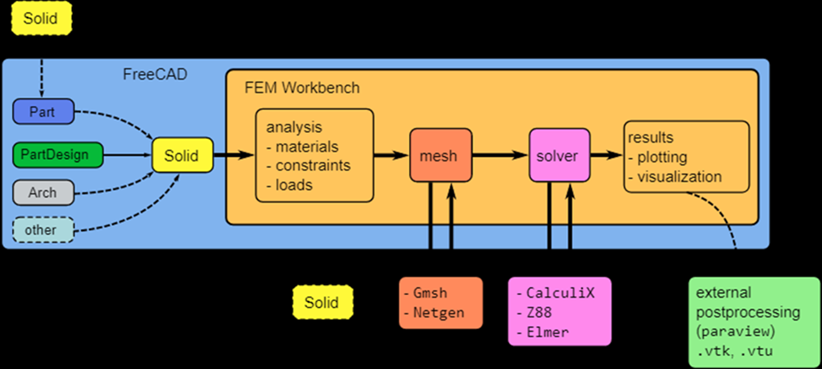
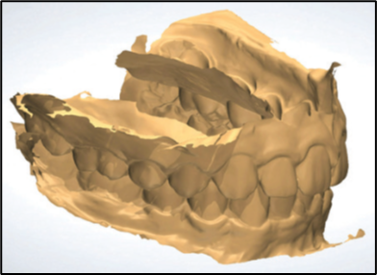
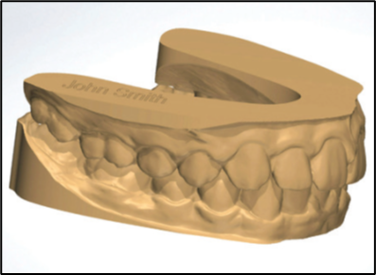
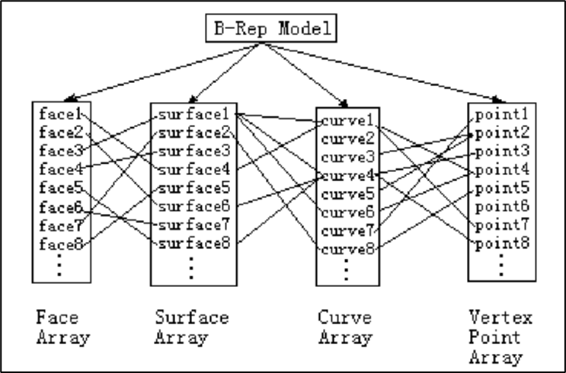
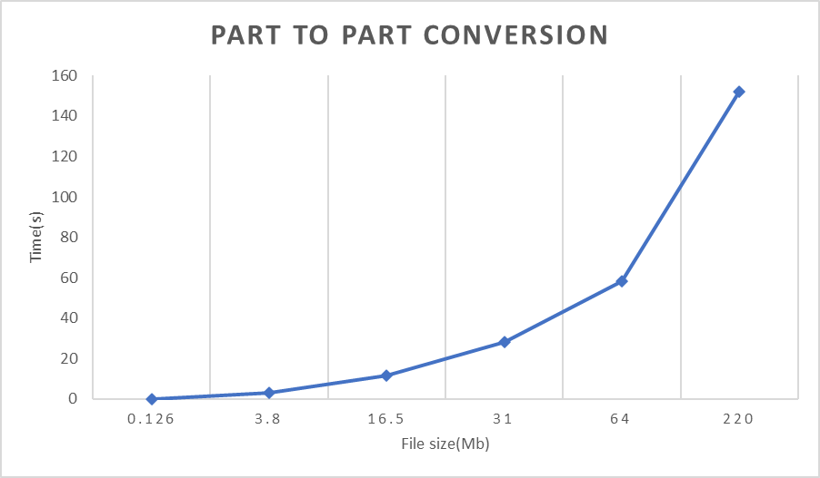
Introduction The reason for writing the CAD conversion software is to be able to provide a way of converting CAD part files that can then be uploaded onto the digital wind tunnel, before they be run through the simulation of Computational fluid dynamics. The CAD conversion is written using the Python programming language, and the written script uses the FreeCAD open-source software modules to be able to convert CAD files into other CAD files as well as mesh files. The reason for using Python is because FreeCAD provides the capability to be able to use Python macros where the whole CAD design can be completed using only a Python script. CAD File Formats There are various CAD file formats that are used within the industry including STL, STEP, IGES and DXF. * The STL file format is mostly used for 3D printing and for CFD simulations. It is made of an array of linked triangles that recreate the surface geometry. Figure 1: Raw STL file on the left and a repaired and cleaned file on the right (Neal et al., 2018) Figure 2 above shows two STL files, the one on the left is the raw format of the file and the one on the right shows the same file once it has been repaired. The more triangles that are added to the mesh, the smoother it becomes, however it should be noted that this also increases the size of the file. * The STEP file format is based on an international standard for 3D objects in CAD to be able to exchange data, i.e. ISO 10303. The STEP format is made up of all the parts of the model defined individually such as the points, curves and the surface of the model, and then positioned. Figure 2 below shows the STEP format architecture. Figure 2: The inner geometry of the data structure of a STEP file (Zhou, 2005) * The IGES file format is like the STEP format, and it is controlled by the National Computer Graphics Association (NCGA). STEP format is the newer agreed standard 3D file format, however there various older CAD models that still exist in the IGES format and that is why it is supported by most CAD design software. * The DXF file format is a proprietary format developed by Autodesk in 1982. It is a text-based format which makes it easier to be able to exchange data between CAD software programs that are part of the Autodesk family of software. Pre-processing To be able to carry out analysis on a solid model, it is necessary to carry out the pre-processing work on the model. There are various commercial and open-source software that can carry out this pre-processing work, and in some cases this process can be automated. Some of the open-source software that can be used for pre-processing are FreeCad, GMSH and Salome. The commercial software includes Ansys, SimLab, HyperMesh, SimScale and Simula Abaquas. Pre-processing is one of the steps when carrying out design work. The process includes: CAD modelling, meshing the solid CAD model and post-processing. 1) CAD model – this can be an existing model with necessary changes required for the specific design or, new CAD model created. 2) Meshing – for the purposes of consistency, the most used mesh file format that is used across the industry is the STL file format. Therefore, the CAD model (usually in STEP, IGES or similar file format) is converted into the STL file format. Meshing uses triangular facets to represent the 3D geometry of a solid model, the more triangles would mean better approximation of the shape, however there is one disadvantage is that more triangles also mean bigger file size. Therefore, a compromise must be made between the size of the file and granularity of the CAD model.
CAD Convertor
FreeCAD
Figure 3: FreeCAD software architecture (FEM Module - FreeCAD Documentation, n.d.)
Freecad is an open-source CAD software that is used across various industries, specifically in smaller and start-up companies that struggle to pay the subscriptions costs of a commercial CAD software. Figure 1 above shows FreeCAD architecture and there various modules that are available such as the Part module, that is used to create simple shapes such as cubes and cylinders. The OpenScad module that imports the OpenCascade library and uses its functions, PartDesign module that is used to create more complex 2D sketches, Draft module that is used to draw and modify 2D objects, the Drawing module that is used to save 3D shapes as various other formats, Assembly module that is used to assemble parts and the Mesh module used to convert parts into triangle meshes.
Methodology
In order to write the CAD convertor software, FreeCAD modules have been used. FreeCAD provides user the capability to be able to use Python macros, these can be used directly in the FreeCAD GUI or as a separate Python script that provides the path to the FreeCAD DLL files. The CAD convertor software has been designed to make it portable and the object orientated principles have been used to make the program portable, and although it designed to run in conjunction with the DWT, it can be used with other programs as well. The program has one class that has four modules.
The __init__ method is a requirement for all Python classes and in this software it is used to ask the user for the input and output file information, and it also calls a help screen method written for the purposes of this program.
The second method is the convertor method, where the bulk of the work to convert CAD files is carried out. It ensures that the user enters at least 3 arguments, including the name of the Python file, an input file name with its format and an output file name with the required format and if incorrect information is provided it calls the publish_help_screen method. The method calls the Mesh and Part function from FreeCAD, the Mesh function is used to convert Part models into Mesh formats. The part_convertor (discussed later) method is called to convert part models to part formats. The method also measures the amount of time required to convert the files.
The third method is the part_convertor method, this is where part conversion takes place. FreeCAD’s part module is made use of here, it has “export” methods within the module. For example, to convert a model to step format, the call would be part.exportStep(output file) and it can also convert other part formats into the step file format.
The fourth method is the publish_help_screen method, it is a simple method that is only used when the user enters incorrect information in the command prompt. It provides a breakdown of how the software is to be used, helping the user, and providing a better user experience.
Discussion and Results
To ensure that all the functionalities of the CAD convertor are met and that it provides expected results, various tests have been carried out. This included performance testing, integration testing, acceptance testing and input/output testing. Furthermore, testing included converting CAD part files to other part files, converting part files to mesh files and converting mesh files to part files.
Converting one part file to another part file was easily done with no issues, as the size of the part file increased so did the amount of time required to convert the file.
Converting part files to mesh was also relatively easy and straightforward, and similar to that of part to part conversion as the size of the file increase so did the amount of time required to convert the file.
Converting mesh to part file did not work as expected, only very small mesh files could be converted back to part files. However, it should be noted that it is in very rare cases that a mesh file needs to be converted into part files and it would not be needed for the DWT.
Conclusion To conclude, this thesis carried out a through research into reviewing open-source CAD software, as well as commercial CAD software and OpenCascade technology. Furthermore, a CAD convertor software have been written that can convert part files to other part files and mesh files. Python has been used to write a script that uses modules provided by the FreeCAD open-source CAD software and various tests have been carried out to ensure the software meets it requirements and limitations.
Figure 4: Part to Part conversion comparison
Aman Makkar
Professor Karl Jenkins

