Slide 1
MACHINE LEARNING PROJECT
TOPIC : HEART DISEASE prediction system
Team : tech squad
Submitted by :
Aman panchal
Aakash Yadav
Aman Pandey

Slide 2

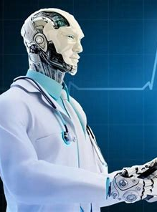
AIM
Aim Of Project :-
Our main goal is to predict whether the patient
is suffering from heart disease or not.
For this project we use Heart Disease UCI dataset
from Kaggle .

Slide 3
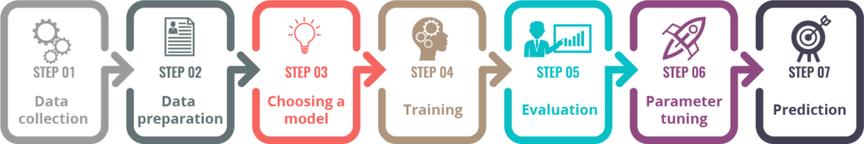
Approach to solve problem
Frame the problem
Get the Data
Explore the data to gain insight
Prepare the data for Machine Learning algorithms
Explore many different models and short list best one
Fine Tune thaw model
Present the solution

Slide 4
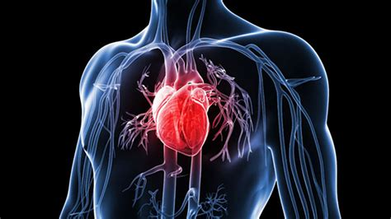
Problems : Heart Disease a rising killer
In India, about 45 million people suffer from coronary artery disease.
Death rate due to cardiovascular disease is rose by around 34% from 155.7 to 209.1 per 1lakh from 1990 to 2016.
India has 1 doctor in 1445 patient.
According to NITI Aayog India has 6 lakh shortfall of doctors.
In rural 70 % people live and doctors are 1/4 of urban area.
India will soon bear the largest burden of heart disease globally

Slide 5
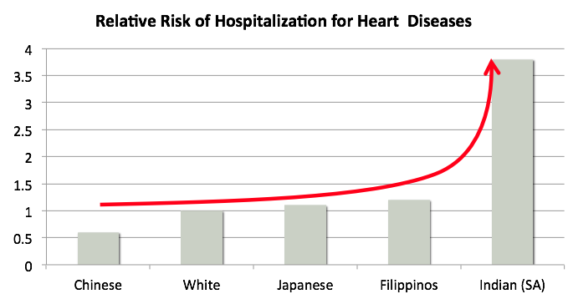
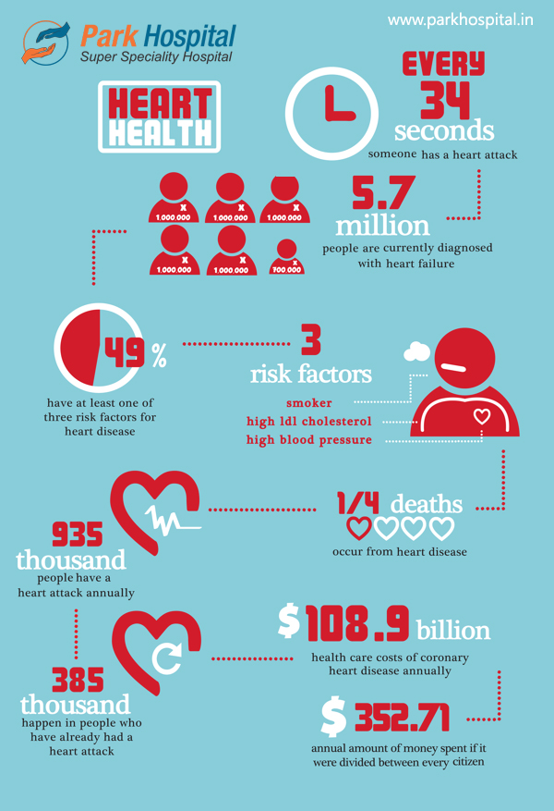
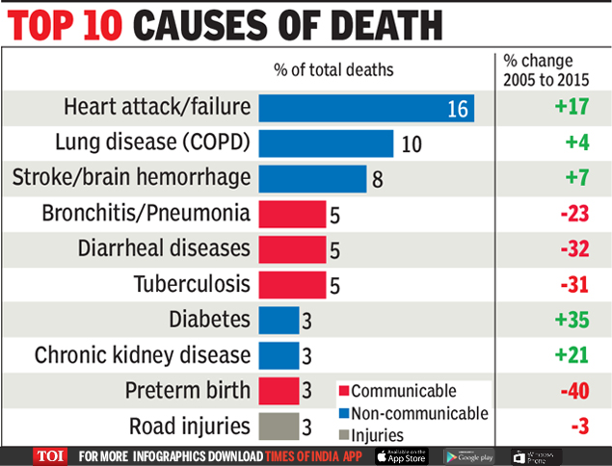
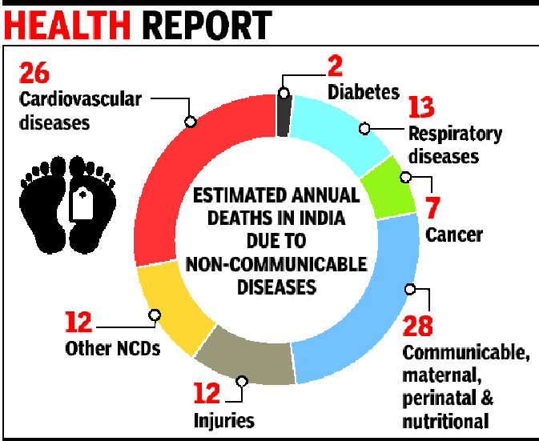
Facts of Heart Disease

Slide 6

Get the Data: The Heart Disease(UCI) dataset which we had used in our project is taken from kaggle.
Age
Sex
Chest pain type
Blood pressure
Cholesterol level
Blood sugar level
Electrocardiographic(ecg) report
Heart rate

Slide 7
Software and Hardware Requirement
Software
Hardware
IDE – Anaconda Prompt
Libraries –Pandas, Numpy, sklearn, matplotlib.
Programming Language – Python 3.6
Processor : i5 or above
RAM : 8 GB
Hard Disk : 160 GB

Slide 8
Advantage & Disadvantage
Advantage
Disadvantage
Increase availability to patient.
Available to 14 hours and 7 week.
Less costly.
Not for emergency patient.

Slide 9
Future Scope
Create a website.
Then create database of doctors and patient, than suggest the contact no. is passed of nearest doctor to him.
Also prescript medicine to patient.

Slide 10

Thank You

