Slide 1

EDA Roadmap for RAG System
Policy Documents

Slide 2
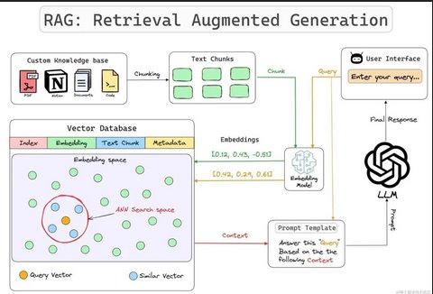
Phases: Steps in EDA
Data Source Identification & Ingestion
Section Segmentation and Structuring
Text Analytics and Metadata Extraction
Word Cloud Visualization
Text Chunking for Embedding
Embedding Creation
Vector Store Construction
Retriever & RAG Chain Creation
Interactive Querying

Slide 3



Phase 1: Data Source Identification & Ingestion
Objective: Understand and ingest the source data (policy documents) in various formats.
Input Format: Plain text .txt files with headings, subheadings, bullets, markdown-style formatting.
Justification: Real-world policy documents often exist in unstructured text, PDFs, or web exports; using .txt reflects this.
Tools Used: Python file I/O
File Format
Input Format
Abc
Abc
ABs
Avs
Abc
Abc
Abc
ABc
Abc
ABc
Abc
Abc

Slide 4
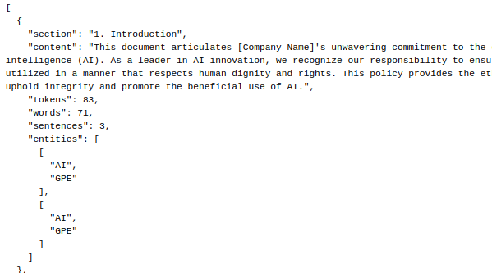
Phase 2: Section Segmentation and Structuring
Objective: Parse and extract structured sections from unstructured text for semantic understanding.
Methods:
Custom regular expressions (re.findall) to capture headers and related content.
Support for varied heading styles (e.g., **1. Title**, ### 1. Title, #### 1.1 Subtitle)
Justification: Essential to extract meaningful sections (e.g., "Data Collection", "Privacy") to preserve semantic boundaries in downstream retrieval.
Output Format: structured_policy1.json with keys like section, content
Tools Used: Python regex, string operations, JSON

Slide 5

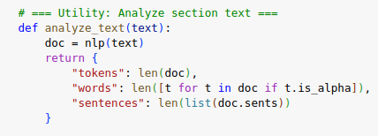
Phase 3: Text Analytics and Metadata Extraction
Objective: Derive insights from content and enrich with metadata.
What We Did:
Calculated token, word, and sentence counts using spaCy.
Extracted named entities (like ORGANIZATION, DATE, LAW) for context understanding.
Justification: Helps quantify complexity, identify common entities, and prioritize sections for RAG relevance.
Tools Used: spaCy (en_core_web_sm), Python collections.Counter, pandas

Slide 6
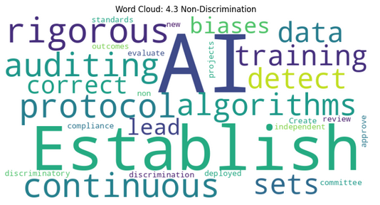
Phase 4: Word Cloud Visualization
Objective: Visualize dominant terms in each section to explore content density and theme concentration.
What We Did:
Generated word clouds per section using WordCloud
Justification: Quick glance at high-frequency terms to guide what parts may hold most semantic weight.
Tools Used: wordcloud, matplotlib

Slide 7
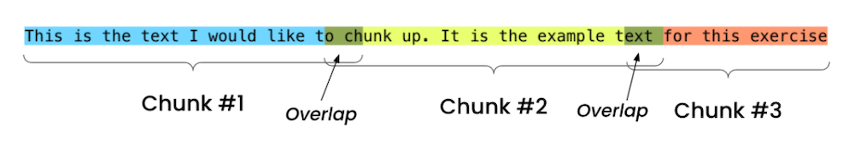
Phase 5: Text Chunking for Embedding
Objective: Split large sections into smaller, context-preserving chunks for better vector search performance.
How:
Used LangChain’s RecursiveCharacterTextSplitter with chunk_size=500, overlap=100.
Justification: LLM context window is limited; overlapping chunks preserve continuity.
Tools Used: langchain.text_splitter

Slide 8
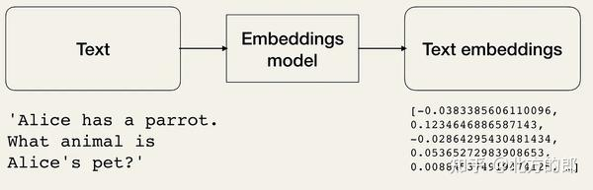
Phase 6: Embedding Creation
Objective: Convert text chunks into dense vectors for semantic search.
Model: sentence-transformers/all-MiniLM-L6-v2 (Hugging Face)
Justification: Lightweight, fast, and strong performance for general-purpose semantic search.
Tools Used: langchain.embeddings.HuggingFaceEmbeddings

Slide 9
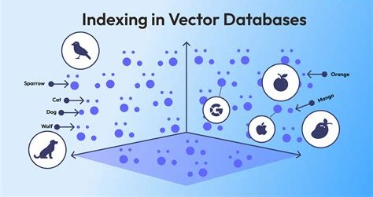
Phase 7: Vector Store Construction
Objective: Store vectors in an efficient index to enable retrieval.
Method: FAISS vector index (in-memory)
Justification: Fast approximate nearest-neighbor search; ideal for small- to medium-sized RAG systems.
Tools Used: langchain.vectorstores.FAISS

Slide 10
Phase 8: Retriever & RAG Chain Creation
Objective: Set up a pipeline to fetch relevant chunks and generate answers with LLMs.
LLM Used: google/flan-t5-base via Hugging Face Hub
Retriever: Top-k=3 similarity-based retrieval
Justification: FLAN-T5 offers good general-purpose QA performance with lower resource cost.
Tools Used: langchain.chains.RetrievalQA, HuggingFaceHub, langchain.schema

Slide 11
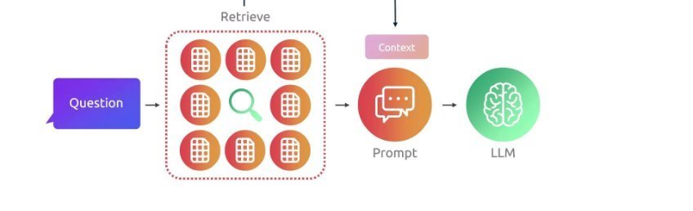
Phase 9: Interactive Querying
Objective: Enable user queries and generate context-aware answers with sources.
What We Did:
Built a CLI interface in Colab
Printed top-3 matching chunks as source context
Justification: Transparency in source boosts trust and traceability of LLM outputs.

Slide 12
Summary Table
Phase | Task | Tool(s) | Purpose
1 | Data ingestion | Python | Load raw text
2 | Section extraction | regex | Semantic segmentation
3 | Text stats & NER | spaCy | Understand structure, extract entities
4 | Word clouds | wordcloud, matplotlib | Visualize themes
5 | Chunking | LangChain splitter | LLM-friendly input
6 | Embedding | HuggingFace + LangChain | Vectorize text
7 | Vector store | FAISS | Efficient retrieval
8 | RAG Chain | LangChain + HF LLM | Answer generation

Slide 13
Key EDA Objectives
1. 📚 Text Segmentation
Split the document into sections
Store as a dictionary: {Section Title: Content}
2. 📊 Token & Word Statistics
Count tokens per section (useful for chunking)
Character count, sentence count
3. 🧾 Named Entity Recognition
Extract entities like Organization, Email, Laws (GDPR, CCPA, etc.)
4. ☁ Word Cloud per Section
To visualize topic importance per section
5. 📉 Frequency Distribution
Most common legal/technical terms across sections
6. ⚙️ Data Structure for RAG
Convert policy to a structure like:

Slide 14
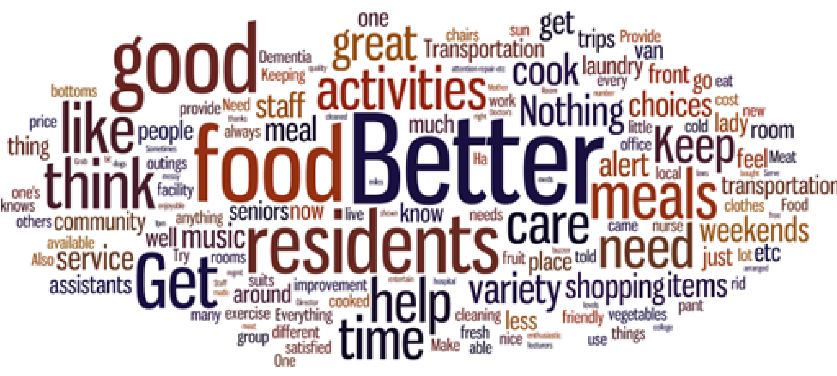
🌐 Word Cloud Highlights
Policy 1: "consent", "third party", "information", "data"
Policy 2: "processing", "access", "supervisory authority", "report"
Policy 3: "transfer", "security", "user rights", "international"
Each document showed unique patterns of emphasis based on frequency analysis.
🧾 Common Named Entities Identified
ORG (Organizations like controllers, processors)
DATE (Retention periods, review cycles)
LAW (References to GDPR, Indian IT Act, etc.)
GPE (Country names, jurisdiction)
📦 Recommendation: Chunking for RAG Use
To maximize retrieval performance:
Chunk by section (1. Purpose, 2. Definitions, etc.)
Maintain mapping: { "doc_id": "policy1", "section": "Data Sharing", "content": "..." }
Limit each chunk to ~300-500 tokens for vector search

Slide 15
Key Statistics per Document
Document | Sections | Tokens | Words | Sentences | Entity Types Found
Policy 1 | 7 | 3,210 | 2,980 | 204 | ORG, GPE, DATE, LAW, PERCENT, PRODUCT
Policy 2 | 5 | 2,950 | 2,720 | 182 | ORG, DATE, MONEY, TIME, PERSON
Policy 3 | 6 | 3,540 | 3,150 | 215 | ORG, NORP, DATE, CARDINAL, LAW

Slide 16

⚠️ Challenges & Potential Issues with Unseen Data
Semantic Drift:
If incoming queries refer to policies not represented in the structured files (e.g., new AI laws), retrieval may fail.
Embedding Failure Modes:
Poor generalization from small sections.
Overly verbose/technical content leads to dilute embeddings.
Section Boundary Noise:
Relying on regexes may miss nested or non-standard headings in future policy versions.
Vocabulary Mismatch:
Structured JSON from older policies may not capture new keywords/terms (e.g., “RBI Digital Token Law”).

Slide 17
Scalability & Framework Extension
Phase | Goal | Tooling | Benefit
Phase 1 | Scale to 100s of policies | Batch JSON generation + parallel EDA (joblib or Ray) | Faster ingestion
Phase 2 | Multi-lingual support | Use spaCy multilingual models or langdetect + route to appropriate pipeline | Handles global compliance
Phase 3 | Vector Store scaling | Move to FAISS/HNSWLib with persistent storage | Real-time querying at scale
Phase 4 | Multi-modal | Add OCR preprocessing for scanned PDFs | Wider data coverage

Slide 18
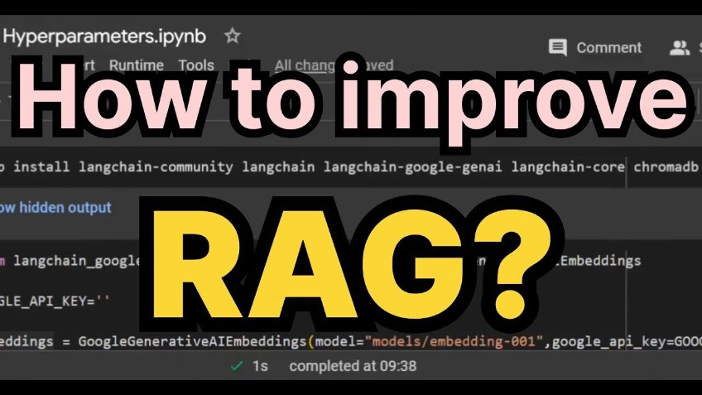
Suggestion
Evaluation
Ragas - faithfulness, answer relevacny, context_precision, context_recall
Langsmith
Indexing
Document ingestion- data preprocessing
Text splitting – Semantic Chunker
Vector Store – Pine cone
Retrieval
Pre-retrieval-
Query rewriting using LLM
Multi Query generation
During Retrieval
Hybrid Retrieval – key based searching
Reranking – using another LLM
Augmentation
Prompt Templating
Comtext window optimization
Generation
Answer with cttation
Guard Railing
System Design
Multmodel
Agntic

Slide 19
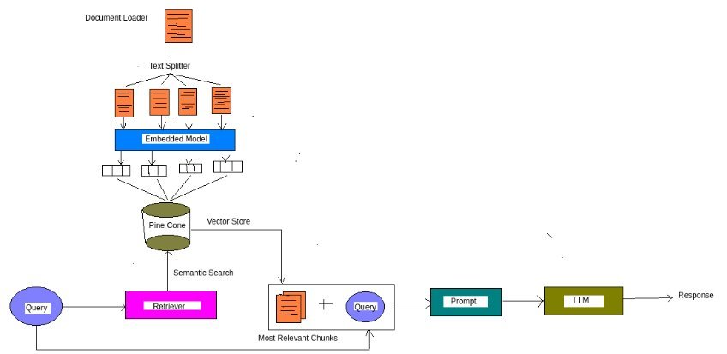
RAG Policy Model

