Slide 1

ARYA INSTITUTE OF ENG. AND TECH. DEPARTMENT OF COMPUTER SCIENCE & ENGINEERING
Major Project on
" Smart voice lock "
Submitted By:
Aman Panchal
Aakash Yadav
Ashish Meena
Ajay joshi
Dheeren Divya
Under Guidance of
Ms. Apoorva Sharma

Slide 2

Contents
Introduction
Problem Objective
Hardware and Software Requirements
Implementation
Current Status
Future Scope

Slide 3
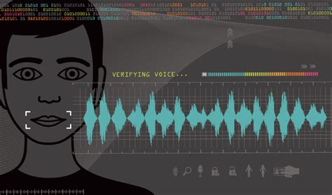
Introduction
This device used user specific voice to lock and unlock.
Speech is the most natural way of communicating for human beings.
Objective of the project is design an IOT based system of smart voice lock with the model of speech recognition.

Slide 4
Project Objective
Why this project?
Objective
Makes user experience easier.
Increases security level.
Useful for disabled person.
Get familiar with Arduino.
Research in audio processing
Interfacing Arduino with hardware

Slide 5
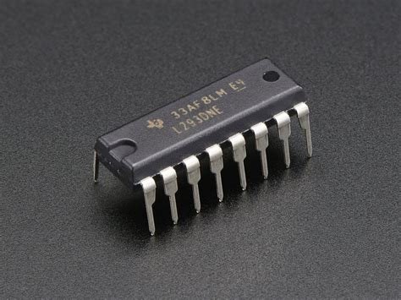
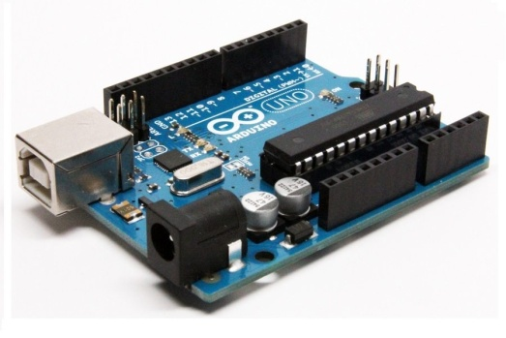
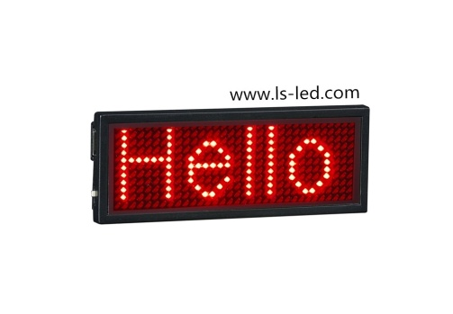
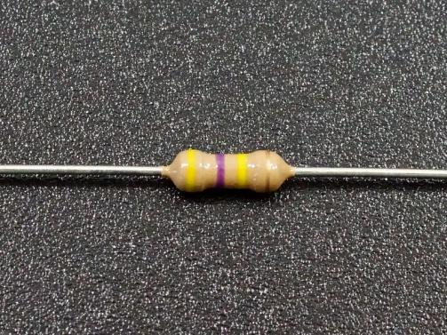
Hardware Requirement
Hardware Used:-
Arduino-UNO
Motor Driver – IC L293D
DC Motors
9V Battery
LED’s
Battery Caps
Resistor
Breadboard

Slide 6




Software Requirement
Software Details:-
Python
OS: Linux/Windows
PyCharm
Anaconda

Slide 7
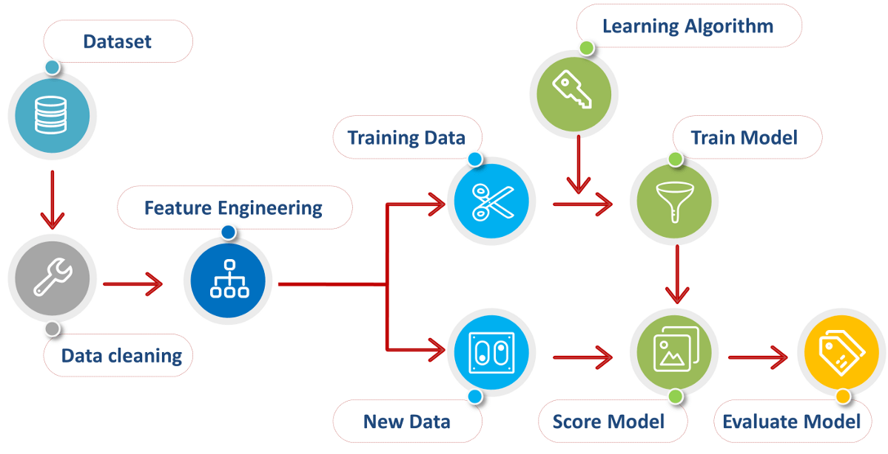
Implementation
First of all import libraries.
Abstract features by mfccs.
Split the dataset.
Create a model.
Fit the data into model.
Predict the data.

Slide 8
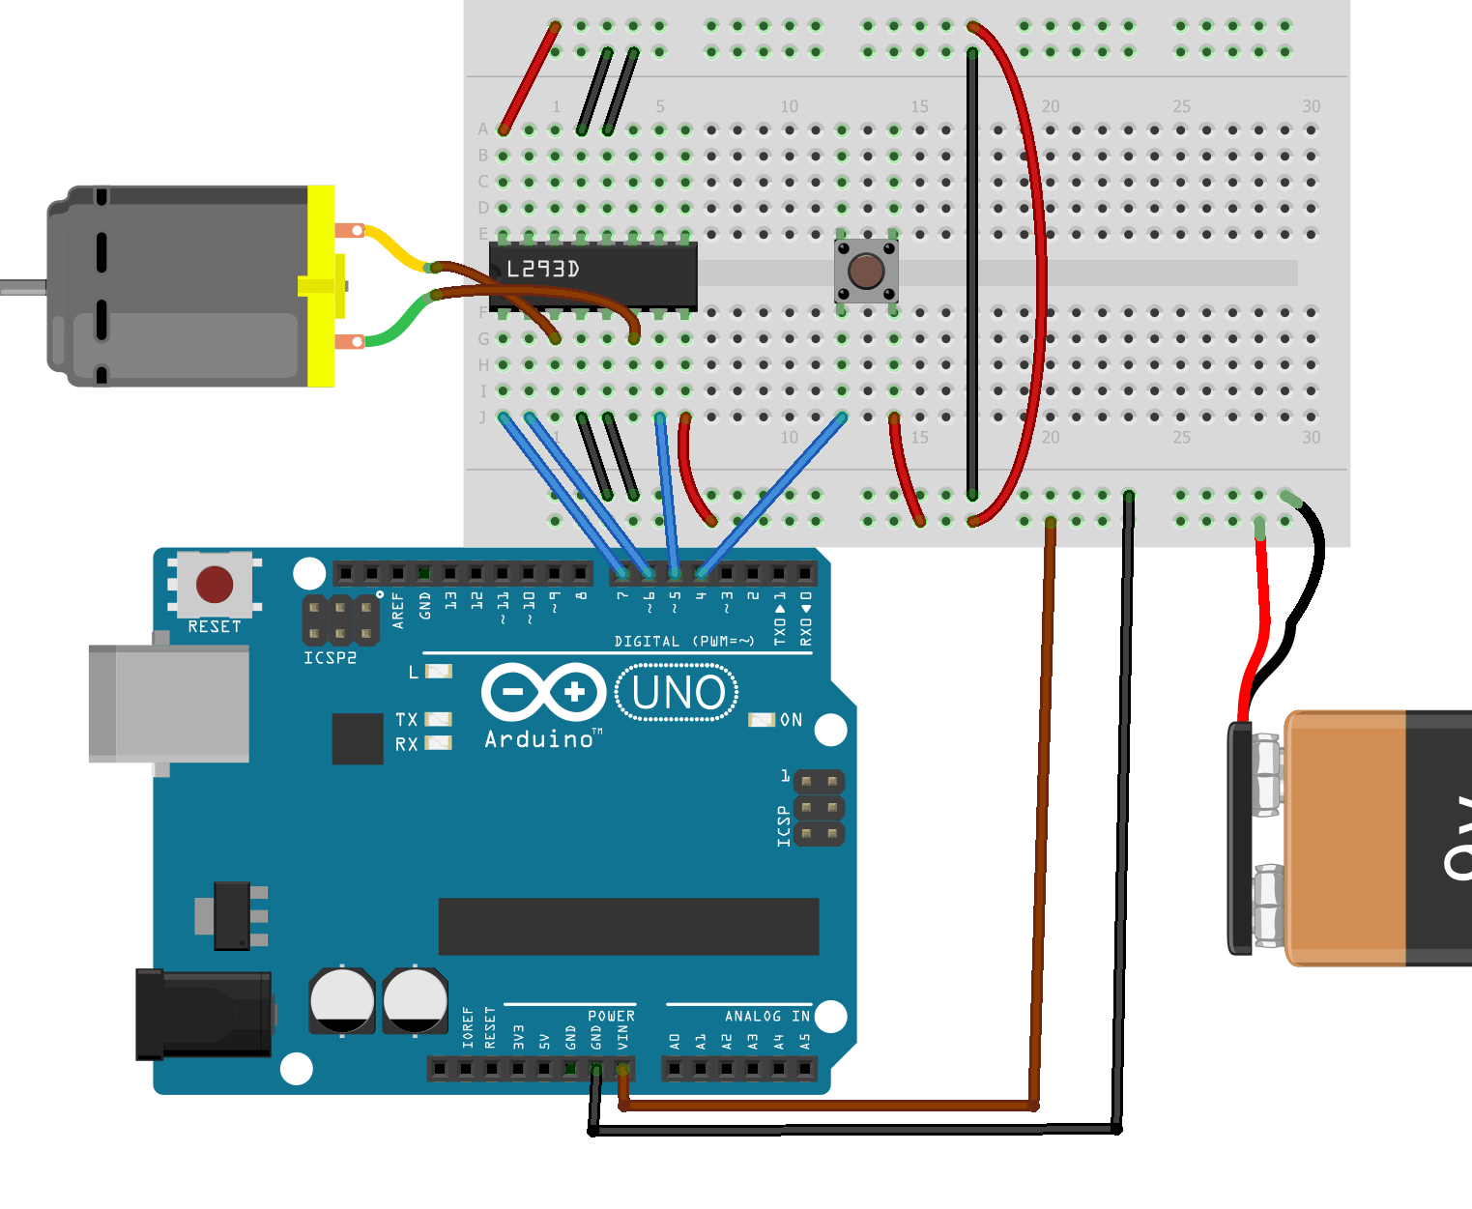
Current Status
Currently we focus mainly on software side.
We had created demo dataset.
And fitted our dataset in various ML and DL algo.
Build a model
Coding in IOT.

Slide 9
Future Scope
Connect it with cloud based server and create database of user .
It works on multiple voices at same time.
Make it more secure by innovating new features of sound.

Slide 10


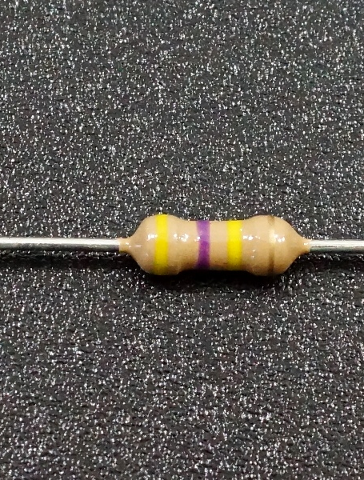
Thank You

