Slide 1



Environmental Monitoring and Pollution Control using Machine Learning

Slide 2


Learning ObSjectives
To understand environmental pollution datasets.
To learn data cleaning and preprocessing techniques.
To apply Machine Learning models for air quality prediction.
To evaluate and deploy ML models in real-time.
AI Model
Source :
www.freepik.com/

Slide 3
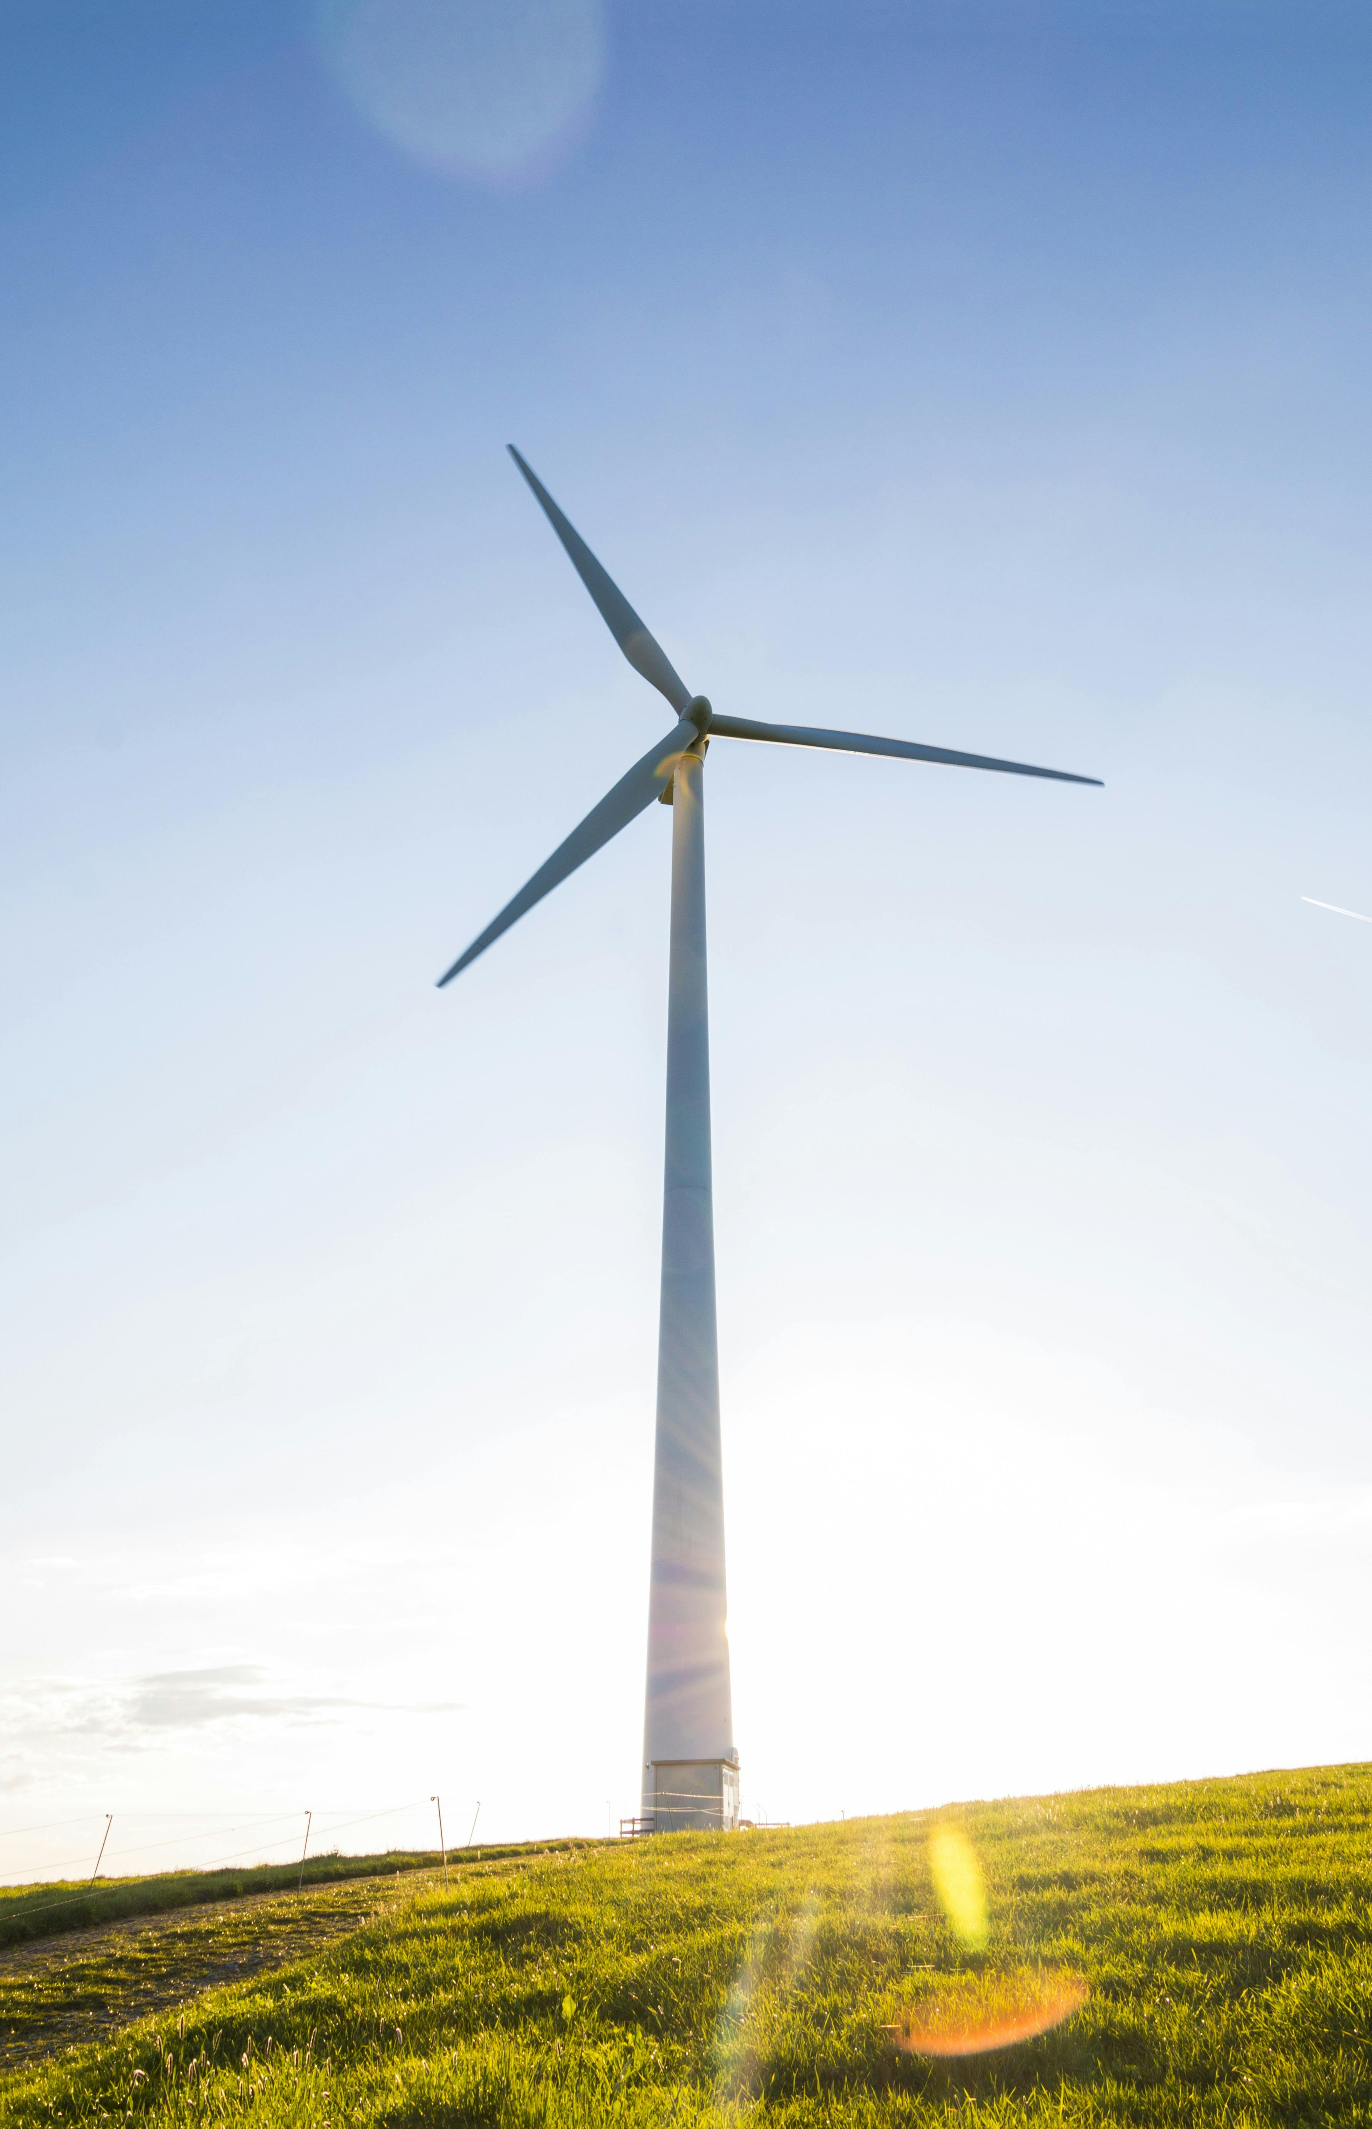
Tools and Technology used
Programming Language: Python
Libraries: Pandas, NumPy, Scikit-learn, Matplotlib, Seaborn, Joblib
Framework: Streamlit (for deployment)
IDE: Spyder (Anaconda)
Dataset: Air Quality Data (CSV file)

Slide 4
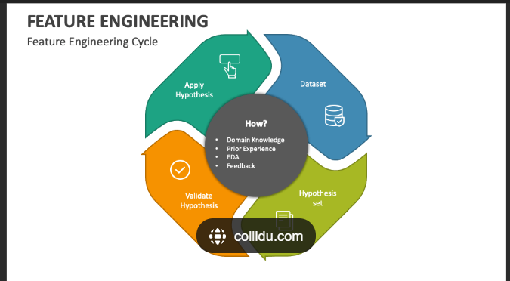
Methodology
1. Data Collection → Environmental dataset (Air Quality CSV).
2. Data Cleaning → Handling nulls, removing duplicates, scaling.
3. Feature Selection → Selected pollutant features (CO, NOx, NO2, O3, SO2).
4. Model Training → Regression models (Linear, Random Forest, Gradient Boosting).
5. Model Evaluation → Compared accuracy & errors.
6. Deployment → Streamlit-based app for predictions.

Slide 5
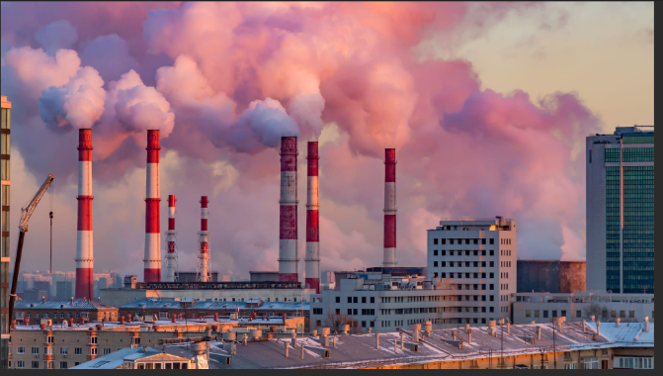
Problem Statement:
Increasing urban air pollution is a global challenge.
Monitoring and predicting pollution levels in real-time is difficult.
Manual methods are slow and not scalable.
Need for AI-based predictive systems to provide early warnings.

Slide 6
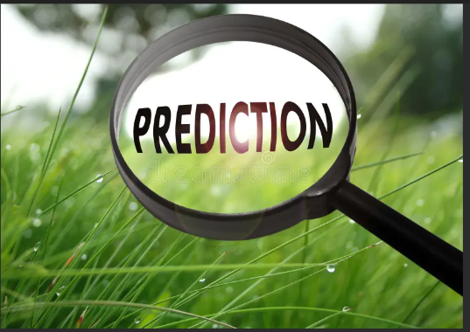
Solution:
Use Machine Learning models to predict PM2.5 concentration.
Provide an easy-to-use web app (Streamlit) for input & prediction.
Improve decision-making for environmental monitoring authorities.
Scalable system for future datasets & cities.

Slide 7
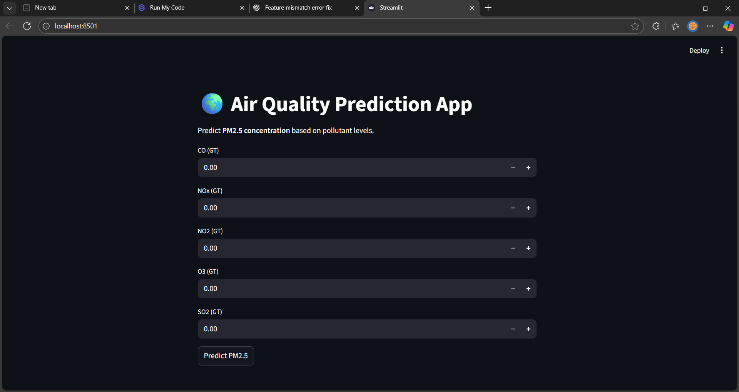
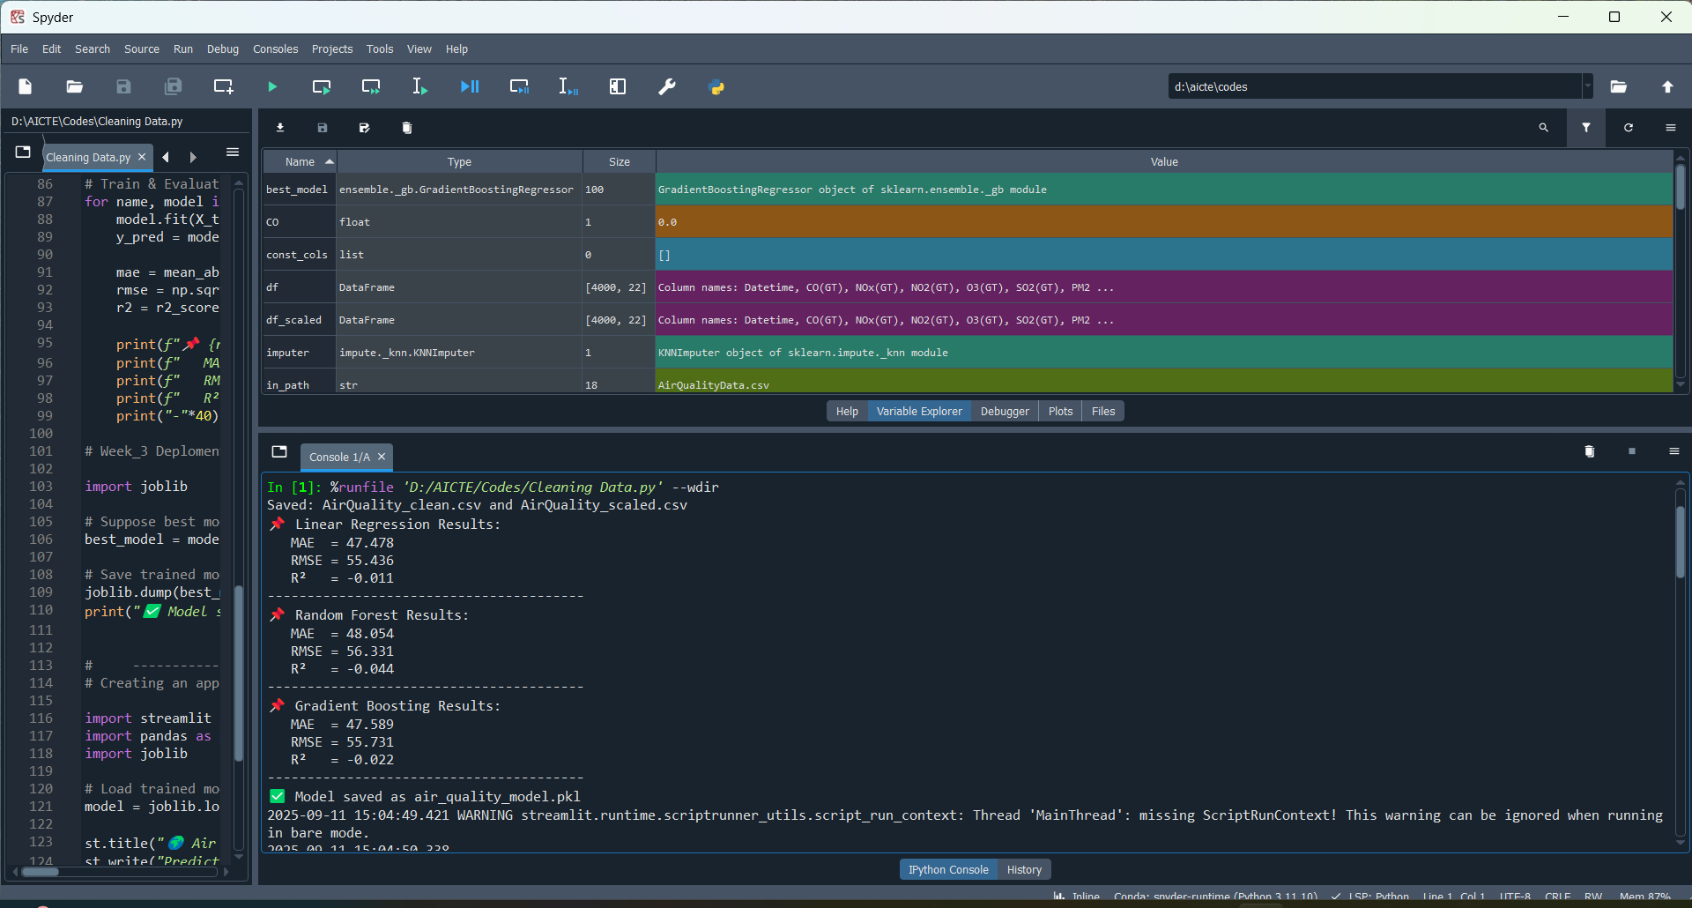
Screenshot of Output:

Slide 8
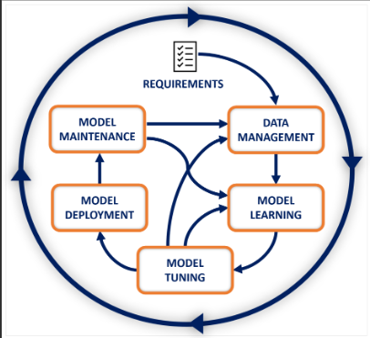
Conclusion:
Successfully developed an ML model for pollution prediction.
Gradient Boosting gave best accuracy.
Deployed model as an interactive Streamlit app.
This project can help governments, researchers, and citizens monitor air quality in real time.

