Slide 1
ASTHMASENSE: AI-Powered Asthma Detection
BY
- Raj Roy
- Aman Sah
- Bisant Chowdhury

Slide 2

Introduction
AsthmaSense is an AI-powered real-time asthma prediction system that utilizes breathing sound analysis to detect and monitor asthma conditions. By integrating Convolutional Neural Networks (CNNs) for feature extraction and ANN for classification, our solution aims to provide early warnings.

Slide 3

Project Objectives
Early Detection: Create a machine learning model to predict asthma risk based on respiratory sound analysis, minimizing reliance on hospitalization.
AI Implementation: Apply CNN and ANN to classify respiration patterns from sound waves, differentiating between normal sounds and wheezing.
Medical Datasets: Utilize publicly available data from Kaggle to train and test the model, ensuring high accuracy and reliability.
Cost Effective & Scalable Solution: Through the use of open-source technologies, we hope to develop a low-cost and scalable solution.

Slide 4
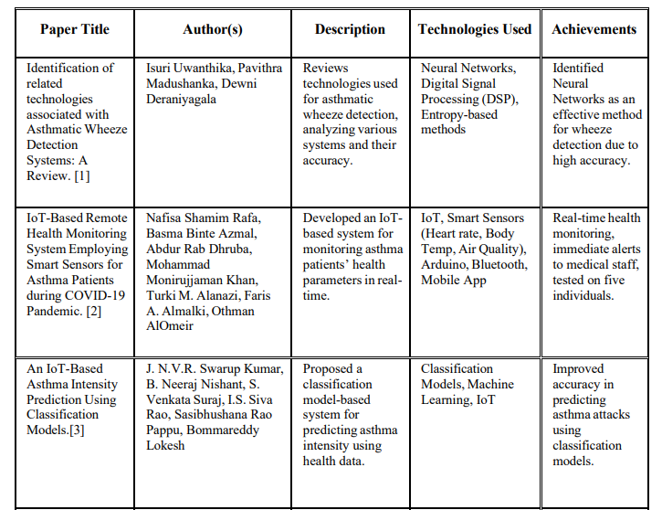
Literature Review

Slide 5
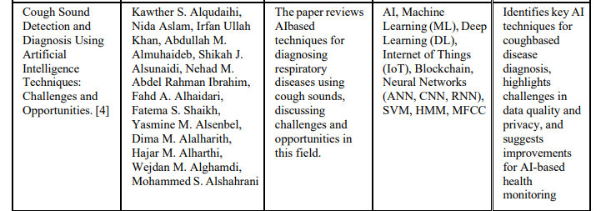
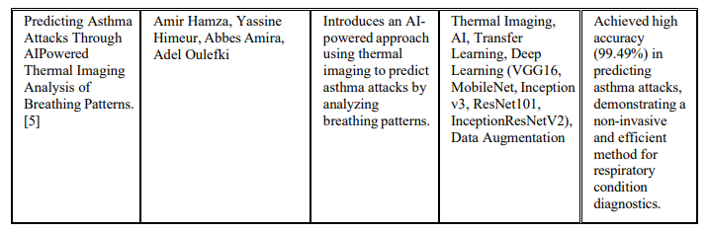

Slide 6
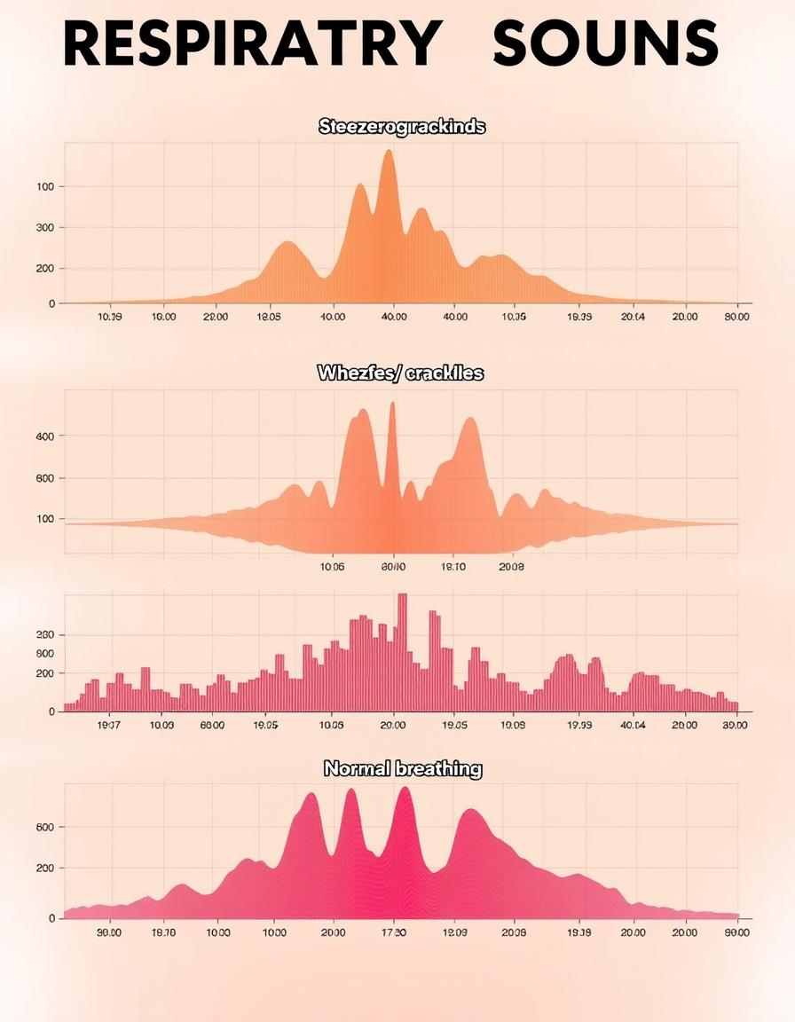
Research Methodology
AI Model Selection
CNN will be used for respiratory sound classification, effective for audio-based pattern recognition when converted into spectrogram images.
Feature Extraction
Key features will be extracted from spectrogram images to analyze human respiratory sounds.
Data Processing
The dataset will be preprocessed, cleaned, labeled, and divided into training and testing sets to improve accuracy.

Slide 7
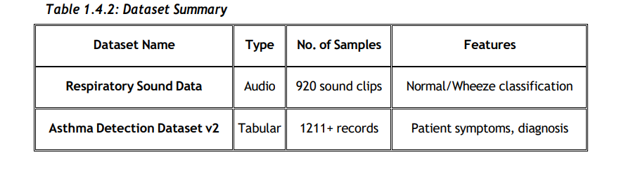
Dataset
For training and validation, we are using two publicly available Kaggle datasets:
Respiratory Sound Data: Contains labeled breathing sounds, categorized as normal or wheezing.
Asthma Detection Dataset v2: Includes patient medical history, symptoms, and diagnoses related to asthma.

Slide 8

System Requirements
Hardware
High-performance computing with 8GB RAM minimum, multi-core processor, and optional NVIDIA RTX 3050 or higher GPU.
Software
Python 3.8+, TensorFlow/Keras, Jupyter Notebook, and Google Colab for AI model development and testing.
The system requires robust hardware and software components to ensure efficient AI model training and deployment. The use of open-source tools minimizes costs while providing a scalable solution.

Slide 9
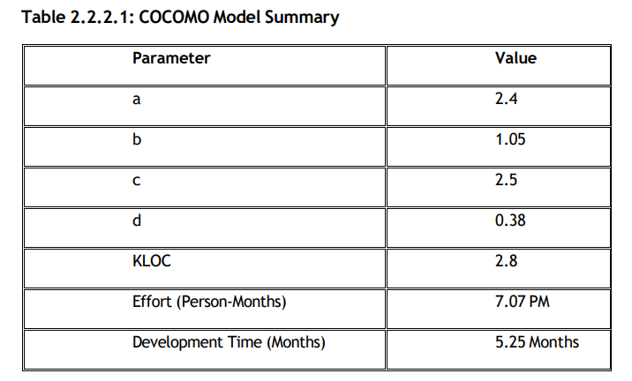
Feasibility Study
Technical Feasibility
AI-based respiratory sound analysis is technically feasible with CNN and ANN architectures and existing datasets on Kaggle.
Economic Feasibility
Open-source tools and cloud-based training minimize software expenses and eliminate the need for high-end local GPUs.
Operational Feasibility
Developers need to learn and implement deep learning models, requiring training and practice, with proper documentation maintained.

Slide 10
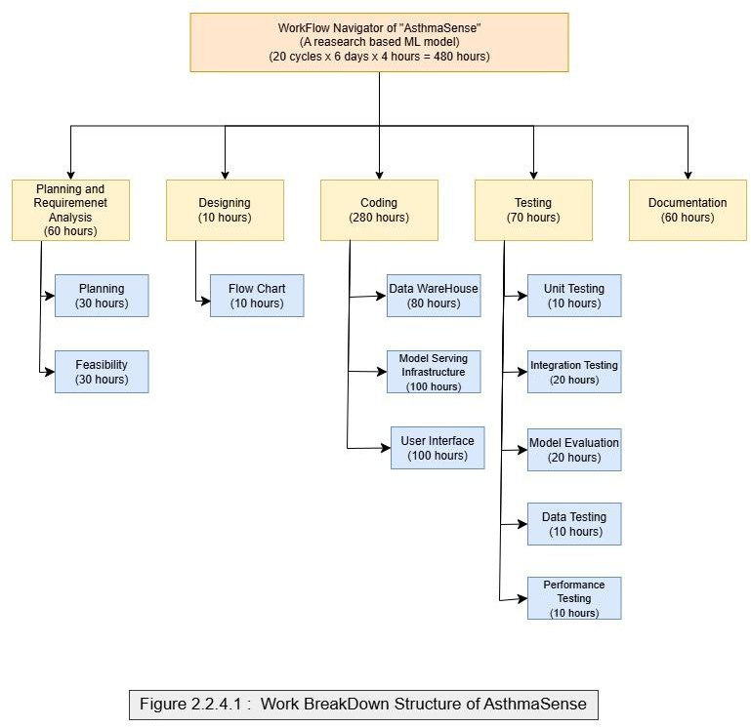
4. Scheduled Feasibility : WBS

Slide 11
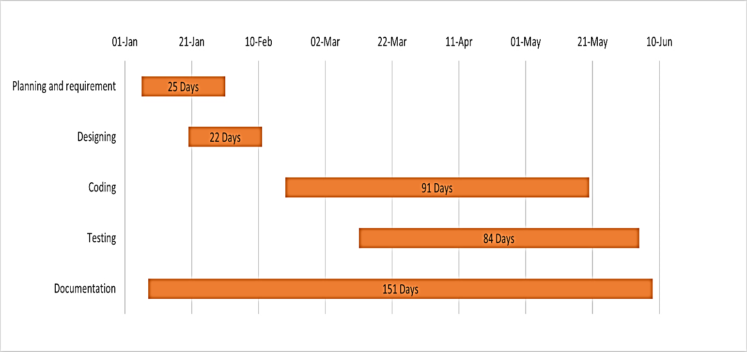
Gantt Chart

Slide 12

Project Timeline
Month 1-2
Data Collection and Preprocessing
Month 2-4
Model Training and Validation
Month 4-5
Testing and Deployment

Slide 13
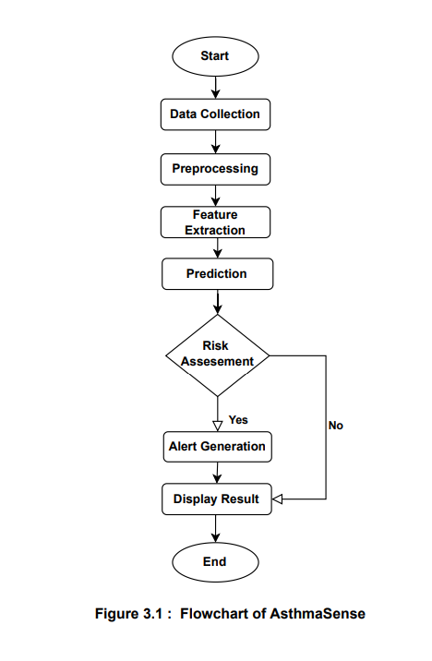
Flow Chart

Slide 14
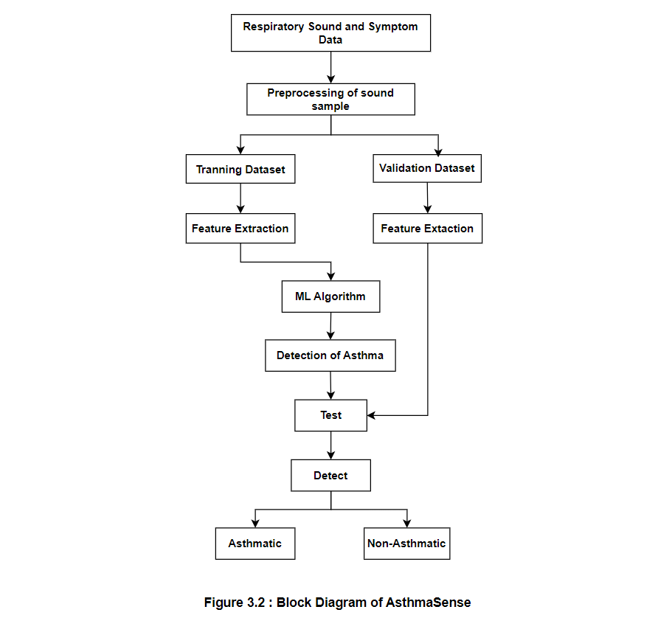
Block Diagram

Slide 15
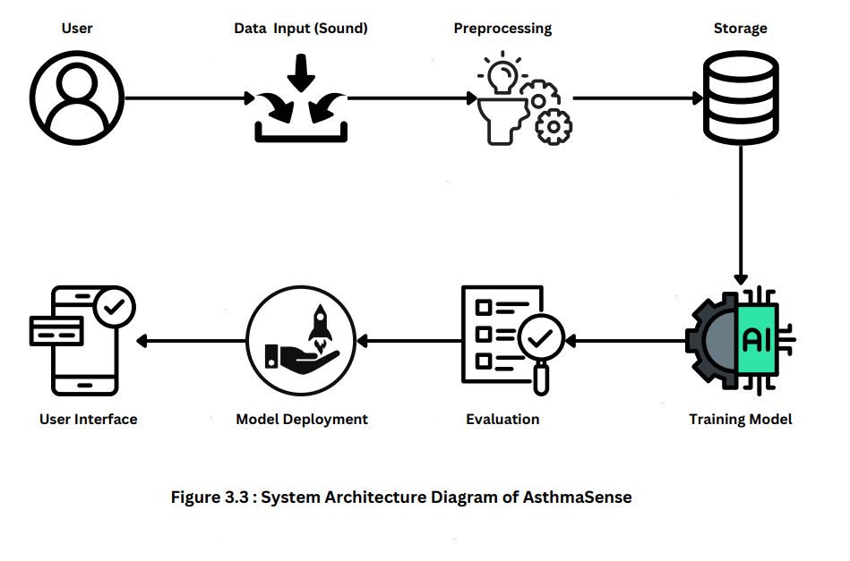
System Architecture

Slide 16
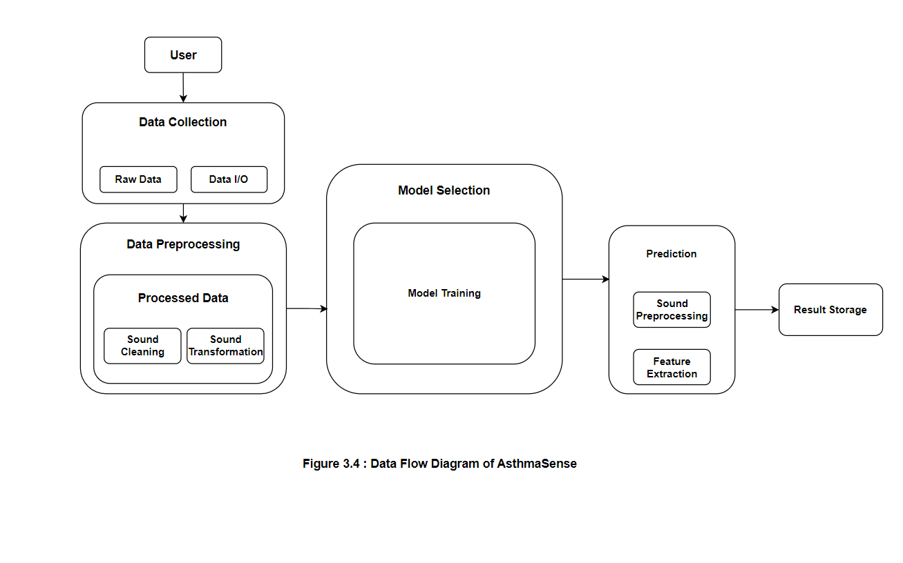
Data Flow Diagram

Slide 17

Conclusion
AsthmaSense aims to revolutionize asthma diagnosis and treatment through AI-assisted respiratory sound classification. By using deep learning algorithms, it offers an affordable, scalable, and accessible tool. The use of CNN and ANN architectures ensures effective differentiation between breathing sounds, improving risk prediction and early intervention for asthma sufferers.
Future improvements include using real-time data from IoT devices and implementing the model in a mobile app for real-time respiratory sound analysis. Expanding the dataset to include various demographics will further enhance the model's efficiency across diverse patient populations.

