Slide 1

Voice Controlled Home Automation
Presented by Guided by
[Student Name ]: Aman Shinde [Guide Name]: Prof. Yogita Narule
Roll No : 66 , TE Computer Asst. Prof. Dept. Of Computer Engg.

Slide 2
CONTENTS
Introduction
Motivation
objectives
Literature Survey
Architecture and working
Conclusion
Future Work
References

Slide 3
Introduction
A fully autonomous home is going to be the future. Everyone want that the complete control such as switching on/off the lights, fans, televisions and other appliances through one device. This project presents a novel solution that makes this future a bit nearer. Voice controlled automation on an Android platform, has been presented. The efficient utilization of various available apps on Google play store has been done. Using the Bluetooth module HC-05, Arduino Uno, and Android application, voice controlled automation

Slide 4
Motivation
My motivation are the people who are disable and cannot walk to get things done, the blind people are also one of the major motivation for us to work on this project. As they cannot walk to switch on/of their home appliance. Home automation results in a smarter home and is used to provide a higher & healthier standard of living.
Additionally, a home automation system can also provide other features like security, alarms, emergency systems etc.
There are some existing systems for controlling home appliences but the major disadvatages of that systems are their complexity and price

Slide 5
Objectives
1) Control any home apparatuses by utilizing our voice.
2) Help physically incapacitated/physically impair individual.
3) Build the system more effective and less costly
4) Complexity must be reduced in campared with other existing systems
5) Power used by system must be as low as possible

Slide 6
Literature Survey
Title of Paper | Journal/Conference Name/Year of publication | Author Names | Summary of Paper ( algorithm/methodology used, results obtained etc..)
Voice control of home appliances using Android | 2014 Electrical Power, Electronics, Communicatons, Control and Informatics Seminar (EECCIS) Date of Conference: 27-28 Aug. 2014 | Norhafizah bt Aripin M. B. Othman | In this paper mentioned system is totally based on google`s text to speech converter and they used java for programming
Voice and touch control home automation | 2016 3rd International Conference on Recent Advances in Information Technology (RAIT) Date of Conference: 3-5 March 2016 | Sushant Kumar S.S Solanki | In this paper voice and touch control home automation system are implemented .While using the voice commands, care must be taken to have a noise free environment. This system works well in the range of 20m, as it is the range for the Bluetooth.

Slide 7
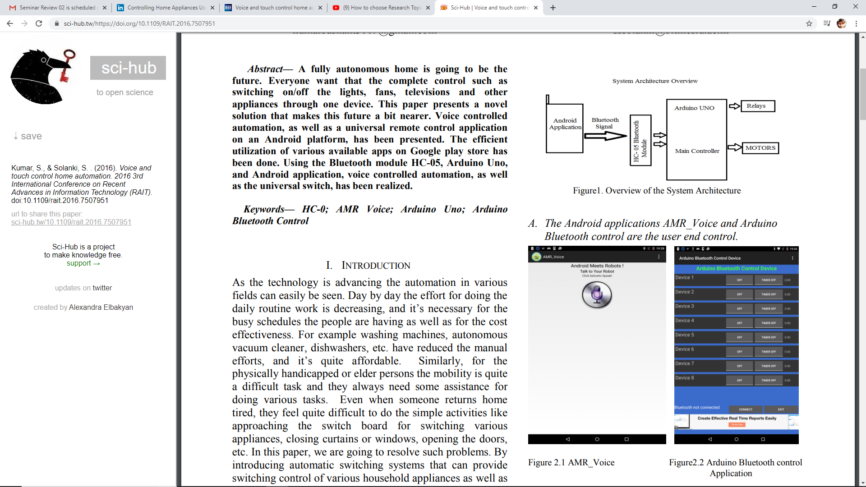
Overall Architecture

Slide 8
Table 1 :- Distance of Bluetooth ability to send and receive data
Distance (m) | Ability send and receive data
5 | Success
10 | Success
15 | Success
20 | Success
25 | Failed
Table 2 :- Result for each input using control using voice
Input | Command 1 | Command 2 | Output
Light ON | Light on | - | Light ON
Light OFF | Light of | Light off | Light OFF
Fan ON | Fan on | - | Fan On
Fan OFF | Fan of | Fan off | Fan OFF

Slide 9
Working
Android application act as interface between smart phone and Bluetooth.Users either give the input via voice command or by pressing buttons on the smart phone .If the user give voice command then android application take that voice input by using google voice application later on convert it into the text format using google`s “Speech to Text” and send it to arduino using Bluetooth, the arduino processes the command switches on and off the appliances after identifying the command.If user gives the input by pressing the buttons ,we already assign the commands to the buttons. commands are send to the arduino by bluetooth module accordingly.

Slide 10
conclusion
Home automation based on voice recognition has been built and successfully
developed in this project. The voice recognition system in this project are identified until 20 m of range to transmit the signal from the smart phone to the home appliances via Bluetooth.This system was targeted for elderly and disabled people.
Voice system is a sensitive system, so other disruption such as weather, buildings and noise must be avoided to get a better performance.

Slide 11
Future work
1) Try to find a way to the Bluetooth module signal towork in larger
strengthen away.
2) Test each part before putting them above the relays safety purposes.
3) Instead of Arduino UNO use customized arduino board for cost cutting
4) Use better communication module instead of bluetooth for wide
range

Slide 12
References
[1] Sushant Kumar,S.S Solanki,“Voice and touch control home automation”, 2016 3rd International Conference on Recent Advances in Information Technology (RAIT),3-5 March 2016
[2] Norhafizah bt Aripin,M. B. Othman,“Voice control of home appliances using Android”, 2014 Electrical Power, Electronics, Communicatons, Control and Informatics Seminar (EECCIS),27-28 Aug. 2014

Slide 13
Thank you !!

