Slide 1



ENIGMA
FASTR
DYNAMIC PRICING MODEL FOR RIDE-HAILING SERVICES

Slide 2

CONTENT
01
ABOUT US
02
OUR TEAM
03
OBJECTIVES
04
STRATEGY
05
APPLICATION
06
WORK
07
CONCLUSION

Slide 3
VIPS - TC
MEMBERS -
SHIVAM GUPTA
AMAN SIGROHA
MITISH RAINA
EISH CHANDEAL

Slide 4



BYTE BANDITS
PROBLEM STATEMENT:
Developing a dynamic pricing model for ride-hailing services to optimize fares based on real-time factors including driver availability, demand patterns, location, and customer loyalty status. The objective is to maximize revenue for the service provider while maintaining competitive pricing and enhancing customer satisfaction

Slide 5

DYNAMIC PRICING
Dynamic pricing strategy is a flexible technique that allows businesses to adjust prices in real-time to optimise revenue and meet market dynamics.
Unlike traditional fixed pricing models, dynamic pricing enables businesses to set prices depending upon their competition, market demand trends, customer behaviour, and so on.
This enables you to optimise pricing and hence revenue, improve profitability, and enhance customer satisfaction.

Slide 6





PRIMARY OBJECTIVES
Objective n° 1
Objective n° 2
Objective n° 3
Using dynamic pricing to adjust fares based on real-time factors (driver availability, demand, location, loyalty)
Improve efficiency with shorter wait times for riders and more consistent income for drivers. Optimize revenue for service providers.
For riders: Shorter wait times, potentially lower fares, transparent pricing.

Slide 7

STRATEGY
Data Collection & Analysis:
Gather historical data on: Ride requests (locations, times, fares) Driver availability (location, activity)Customer demographics and loyalty status
Analyze data to identify patterns in demand, pricing elasticity (how price changes affect demand), and customer behavior.
Choose a machine learning algorithm suitable for demand prediction.
Train the model on historical data to predict future demand for specific locations and times.

Slide 8
LIBRARIES USED
Pandas - Used for data cleaning and preprocessing. it helps us manipulate data to create new features relevant to feature engineering. It is used for data exploratory analysis
Plotpy - Used for data visualisation and creating a machine learning model for demand prediction and pricing algorithms . Plotpy also involves interactive charts
Numpy - It is great for data manipulation, It is efficient for data manipulation. It is great for storing and manipulating numerical data. Also for linear algebra.

Slide 9
LIBRARIES USED
Scikit-learn -It is a go to library for creating a dynamic pricing system. It is used for model selection and training. Data preprocessing and model analysis is also what it is primarily used for.

Slide 10


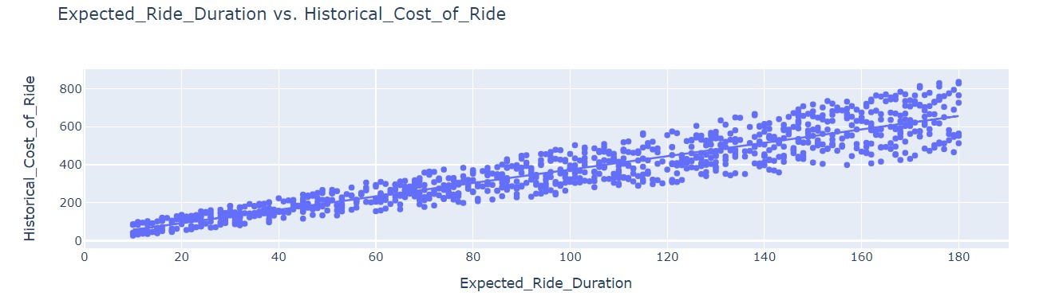
RIDE DURATION VS COST OF RIDE
By analyzing the relationship between ride duration and the cost of the ride, we can gain a better understanding of the pricing dynamics in our Fastr service and identify opportunities for optimizing pricing strategies to maximize revenue and enhance customer satisfaction.

Slide 11
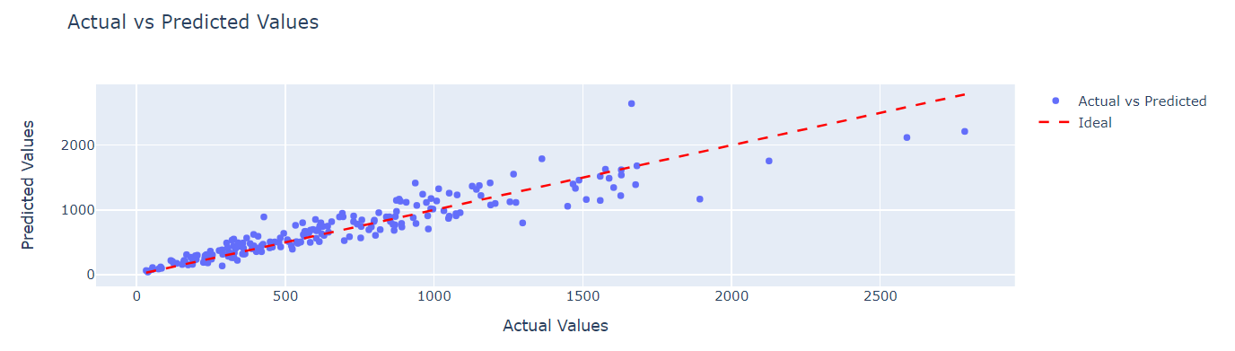
ACTUAL VS PREDICTED VALUES
The actual vs. predicted values graph provides a visual representation of the model's performance, allowing us to quickly assess its accuracy, identify areas for improvement, and make informed decisions about model refinement or adjustment.

Slide 12
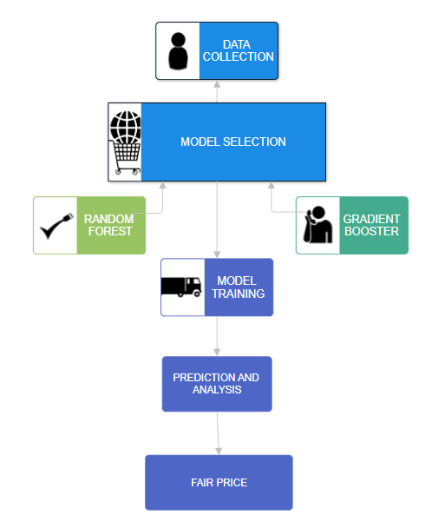
ML MODEL WORKING

Slide 13

THANK YOU

