Slide 1





CREDIT CARD
WEEKLY
STATUS REPORT
1

Slide 2





Project Objective
To develop a comprehensive credit card weekly dashboard that provides real-time insights into key performance metrics and trends, enabling stakeholders to monitor and analyze credit card operations effectively.

Slide 3
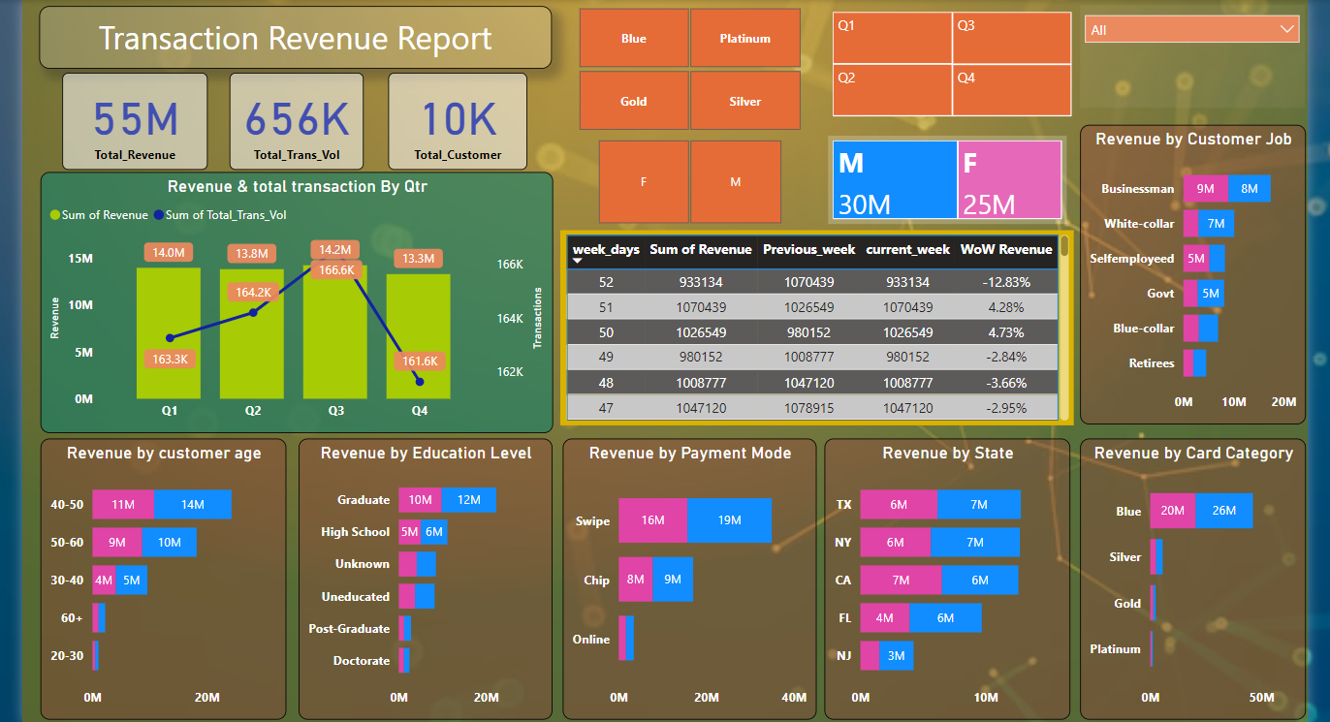
Project Insights- Week 52 (31st Dec)
Week on Week change:
Revenue decreased by 12.83%, in the 52nd week.

Slide 4
Overview YTD:
Overall revenue is 55M
Total transaction volume is 656K
Total customer is 10.1K
Q4 revenue is 13.3 M which is less than Q3 performance
Transaction volume also declined in Q4 to 161.6K from 166.6K in previous quarter.

Slide 5
Overview YTD:
Most of the customers are from the age group of 40-50.
Most of the customers are Graduate and are from high schools.
Most of the revenue comes to the business from swipe.
TX, NY & CA is contributing to 68%.
Blue & Silver credit card are contributing to 93% of overall transactions.

Slide 6
Overview YTD:
Male customers are contributing more in revenue 30M, female 25M
Overall Activation rate is 57.5%
Overall Delinquent rate is 6.06%

Slide 7

Thank You
LinkedIn -
linkedin.com/in/aman-tripathy

