Slide 1













Bank Management System
presented by
Aman Yati

Slide 2






Team Members:
AMAN YATI
ANSH SABHNANI
DHRUV GAGNANI
ANKIT KUMAR

Slide 3







Table of contents:
01.Introduction | 02.Objectives | 03.Key Features | 04.Technologies Used
05.How does it work | 06.Benefits | 07.Challenges | 08.Conclusion

Slide 4
Introduction
A Bank Management System (BMS) is a comprehensive software application designed to facilitate the seamless management of banking operations, including account management, transaction processing, customer relationship management, and reporting.
The primary objective of a Bank Management System is to provide both banks and customers with a secure, user-friendly environment to conduct financial transactions. As the banking sector evolves with rapid technological advancements, traditional banking processes have increasingly shifted to digital platforms. A robust BMS integrates various functionalities—such as loan processing, fund transfers, interest calculations, and risk assessment—into a single, cohesive framework.

Slide 5



Objectives of Bank Management System:
01
02
03
04
Streamlining Banking Operations
Improving Customer Experience
Ensuring Data Security
Regulatory Compliance
Adheres to financial regulations, ensuring accountability and transparency in operations.
Facilitates efficient management of daily banking activities, minimizing errors.
Enhances user interactions through intuitive interfaces and quick service delivery.
Incorporates robust security measures to protect sensitive financial information.

Slide 6







Key Features of Bank Management System:
Account Management:
Transaction Processing:
Security Features:
Creation and maintenance of customer accounts (savings, current, fixed deposits, etc.).
Tracking account balances, transactions, and statements.
Facilitating deposits, withdrawals, fund transfers, and bill payments.
Ensuring secure and quick transaction processing.
Protecting sensitive customer and financial data with encryption and secure access controls.
Implementing fraud detection and prevention mechanisms.

Slide 7




Technologies Used: Python and MySQL
Python for Dynamic Applications
Synergy of Technologies
The combination of Python and MySQL enhances application performance, providing a seamless experience in banking operations.
MySQL for Data Management

Slide 8




How does it work?
Real-time Financial Reporting
Generates reports like balance sheets and income statements to aid management decisions.
01
02
Data Analysis Capabilities
Analyzes trends in customer behavior and market conditions for informed strategies.
03
User-Friendly Customer Portal
Allows customers to manage accounts, view transactions, and apply for services easily.
Employee Interface Access
Staff can manage customer accounts through an intuitive interface, enhancing operational efficiency.
04

Slide 9




How does it work?
Data Encryption for Security
Protects sensitive information through encryption, ensuring unauthorized access is prevented.
05
Robust User Authentication
Utilizes multi-factor authentication to safeguard customer accounts from unauthorized access.
06
Regular Software Updates
Periodic updates fix bugs, enhance performance, and introduce new features for users.
07

Slide 10








Benefits of a Bank Management System:
Increased Efficiency
Improved Customer Experience
Data Accuracy
Centralized databases reduce errors and ensure data integrity across all operations.
Automating repetitive tasks reduces manual effort and speeds up transaction processing.
Quick and easy access to banking services enhances customer satisfaction and loyalty.
Scalability
Enhanced Decision Making
A well-designed BMS can grow with the bank and accommodate increasing customer and transaction volumes.
Access to real-time data and analytics supports informed strategic planning.

Slide 11



Potential Challenges:
Data Security
Implement robust security measures to protect sensitive banking information.
User Adoption
Develop strategies to encourage user engagement and build trust in the system.
System Integration
Ensure seamless integration with existing banking systems for improved functionality.

Slide 12
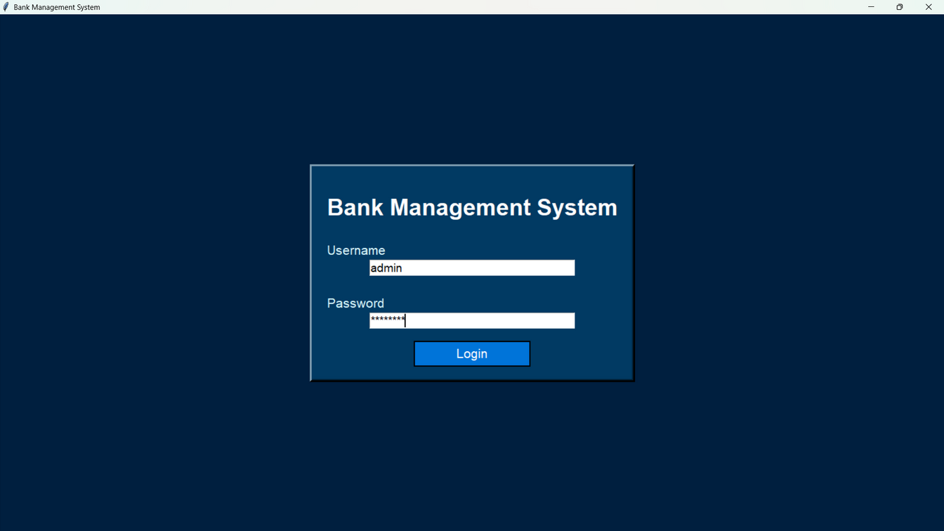
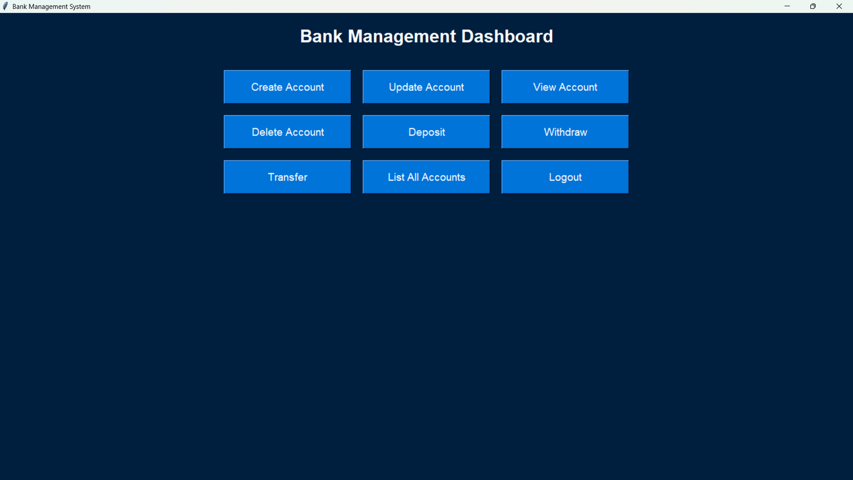
Output:

Slide 13
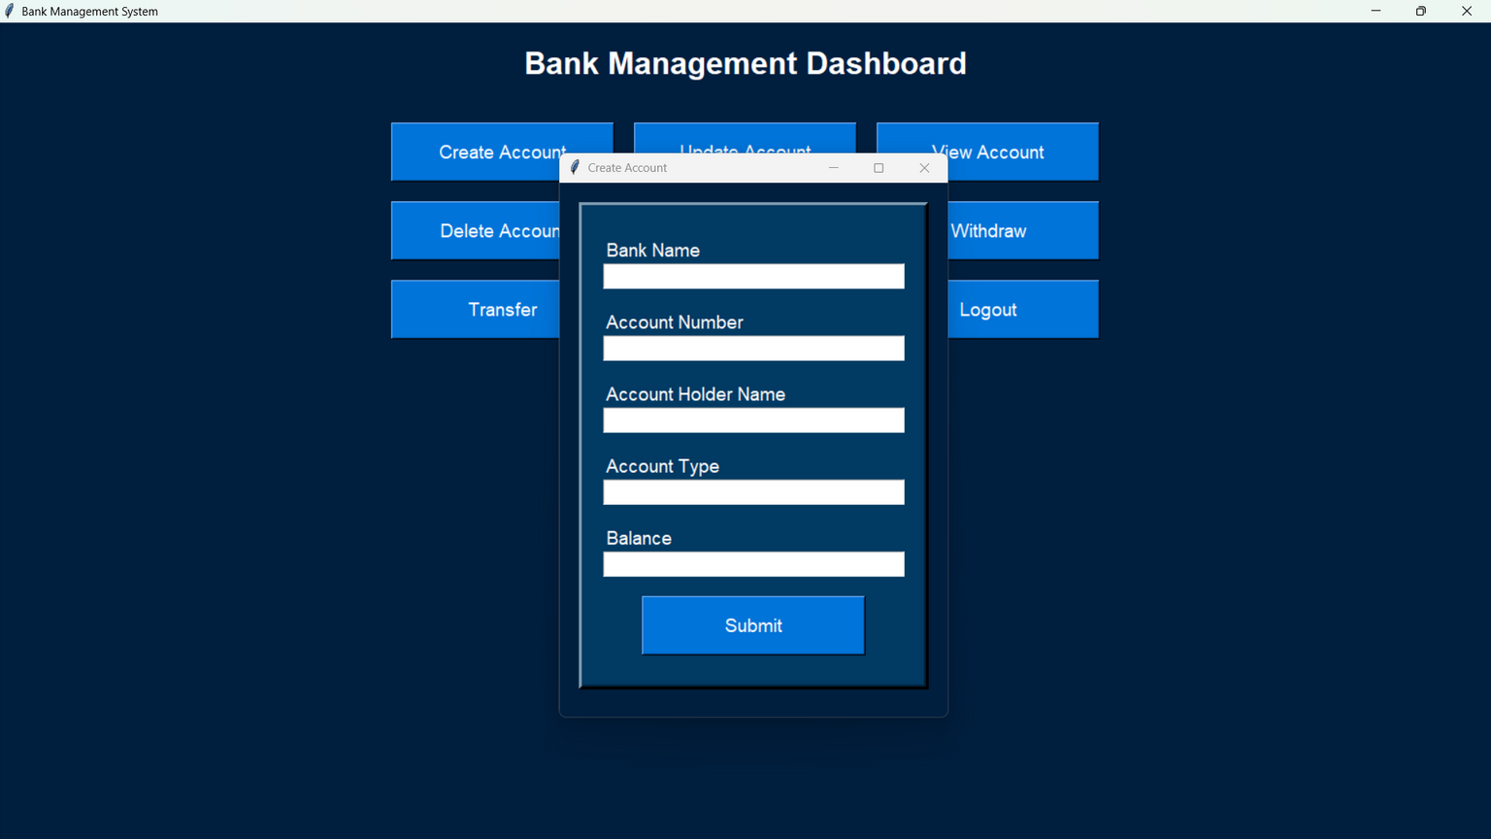
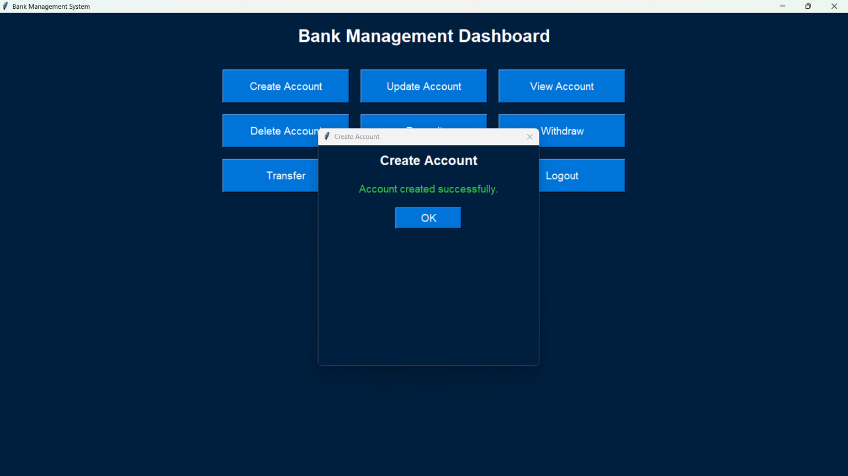
Output:

Slide 14
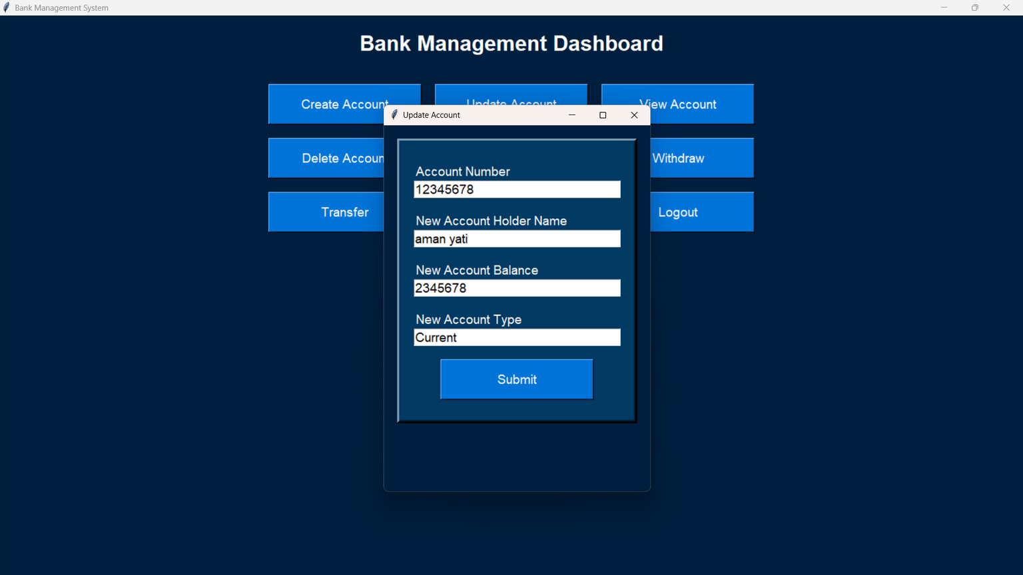
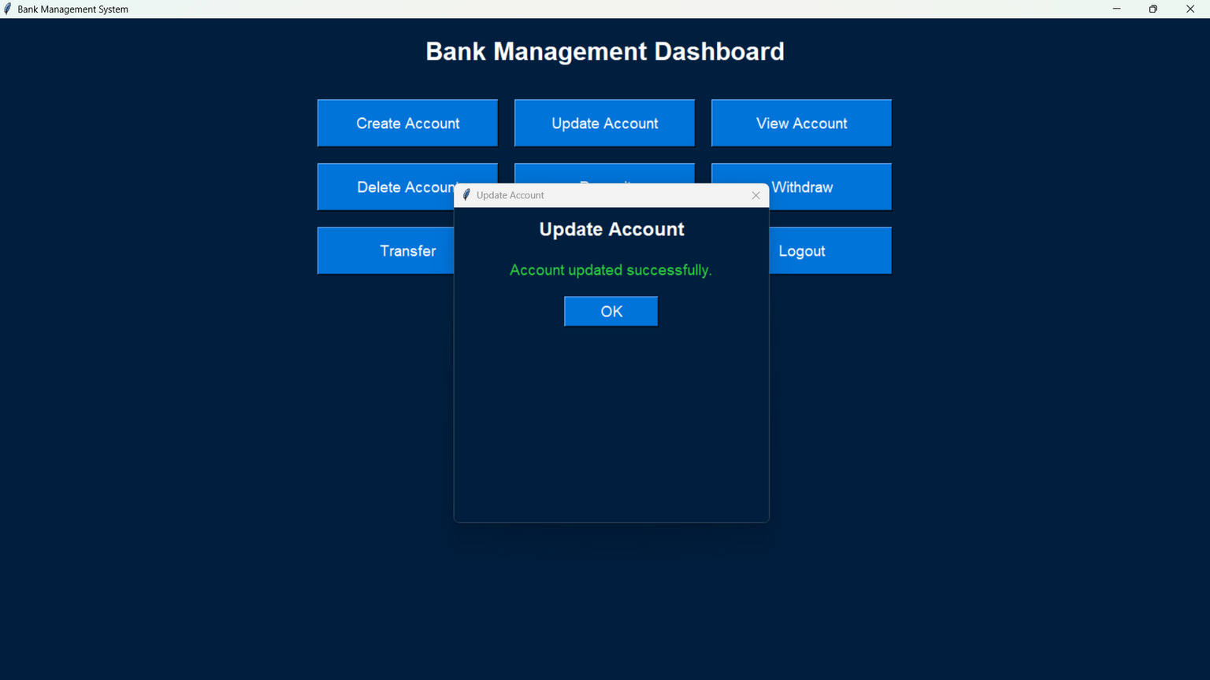
Output:

Slide 15
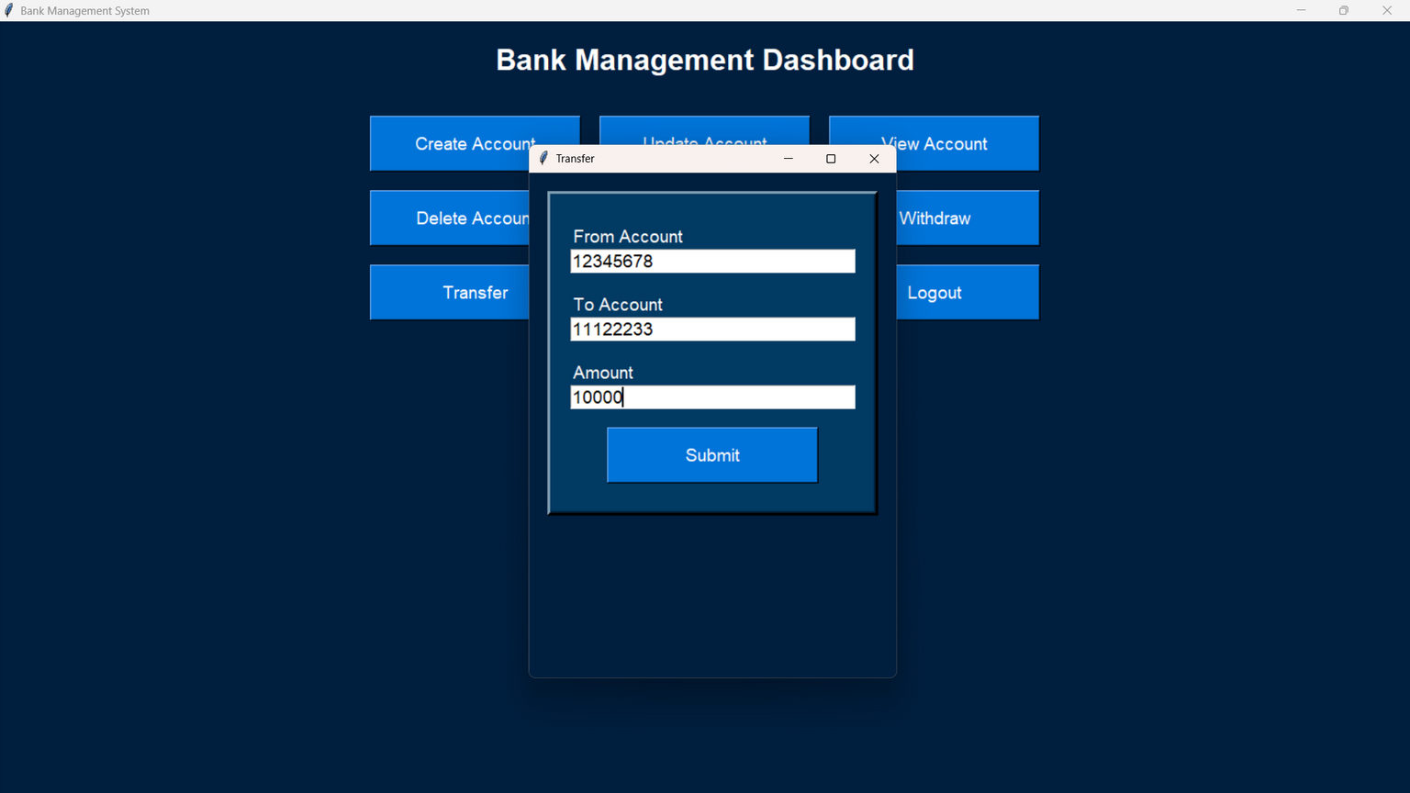
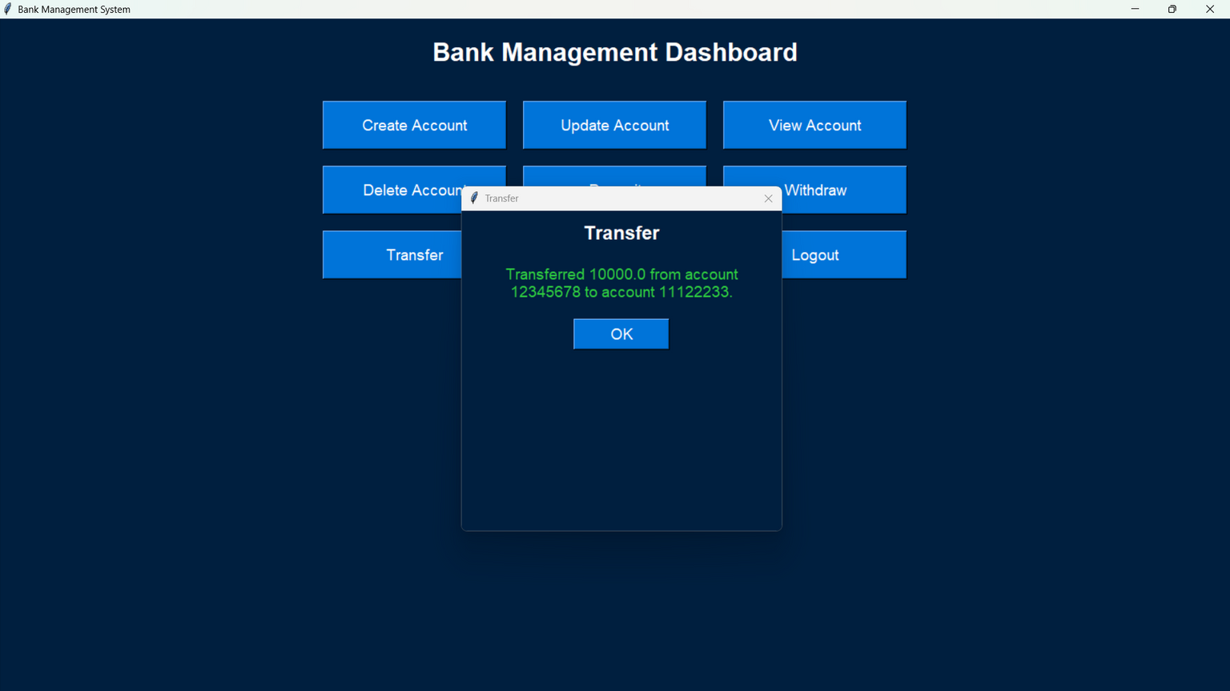
Output:

Slide 16
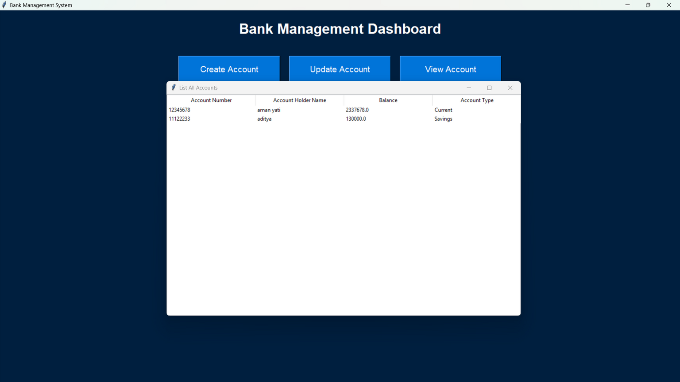
Output:

Slide 17
Conclusion and Future Outlook:
In conclusion, a bank management system (BMS) plays a pivotal role in the efficient operation of financial institutions. It integrates various banking functions including customer management, transaction processing, risk management, compliance, and reporting, enabling banks to enhance their service delivery and operational efficiency. The implementation of a robust BMS leads to streamlined processes, reduced operational costs, improved customer satisfaction, and the ability to make data-driven decisions. As the banking industry continues to evolve in future, the adaptability and scalability of these systems are crucial for meeting the changing demands of both customers and regulatory authorities. Continuous technology adoption can further enhance system capabilities and user experience.

Slide 18






References:
ARTICLES:
"The Role of Data Analytics in Banking Management" - Deloitte Insights
An article discussing how data analytics can enhance decision-making processes in banking management.
"Modern Banking: New Trends and Functions" - European Central Bank Review
This article highlights the technological and functional trends in modern banking and their impact on bank management systems.
WEBSITES:
WWW.GEEKSFORGEEKS.ORG
WWW.WIKIPEDIA.COM
WWW.BANKINGMANAGEMENT.COM

Slide 19










Thanks!

