Slide 1

Swiggy
Data Analysis
Microsoft Fabric
SQL
Power BI
CAPSTONE PROJECT
₹53M
197K
4.34
15
Amankumar
Bhatu
Sales
Orders
Rating
States
Data Engineering & Analytics Track
March 2026
End-to-End Data Engineering & Analytics Pipeline on Microsoft Fabric

Slide 2





The Business Problem
PROBLEM
Swiggy processes hundreds of thousands of food orders monthly — but had no structured way to answer the questions that drive business decisions.
Scattered Data
Broken Date Column
No Data Model
5 raw CSVs with no single source of truth or unified storage
order_date stored as text — time analysis completely impossible
Tables disconnected — impossible to slice revenue by any dimension
No Reporting Layer
No Live Dashboard
Stakeholders needed raw data access just to get one number
Insights locked in local files — nothing shareable with leadership
Amankumar Bhatu | Swiggy Analytics Capstone | Microsoft Fabric + SQL + Power BI

Slide 3





The Solution — Architecture
FABRIC
One unified Microsoft Fabric pipeline — from raw CSV to live Power BI dashboard.
RAW DATA
Ingestion
BRONZE
Lakehouse
SILVER
Delta Tables
GOLD
Warehouse
REPORTING
Power BI
→
→
→
→
CSV files
→ Lakehouse
Files section
raw data
Parquet
ACID tables
Star schema
SQL clean
Semantic model
Dashboard
₹53.01M Revenue
197,430 Orders
₹268.51 Avg Order
4.34 Avg Rating
5.59M Ratings
Amankumar Bhatu | Swiggy Analytics Capstone | Microsoft Fabric + SQL + Power BI

Slide 4
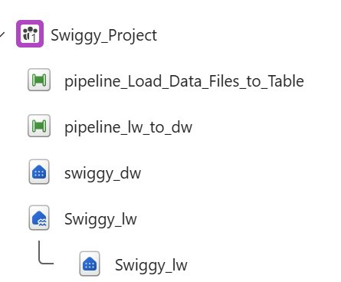
Part 1 — Lakehouse & Data Ingestion
PART 1
Swiggy_lw
[Lakehouse]
Raw files + Delta tables (Bronze & Silver layer)
swiggy_dw
[Warehouse]
Star schema — query-ready gold layer
pipeline_Load_Data_Files_to_Table
[Pipeline]
CSV → Delta table conversion inside Lakehouse
Fig 1 — Swiggy_Project Fabric workspace
pipeline_lw_to_dw
[Pipeline]
Lakehouse → Warehouse migration (5 tables)
BRONZE
SILVER
GOLD
Files — raw CSVs
Delta / Parquet
Warehouse schema
Amankumar Bhatu | Swiggy Analytics Capstone | Microsoft Fabric + SQL + Power BI

Slide 5
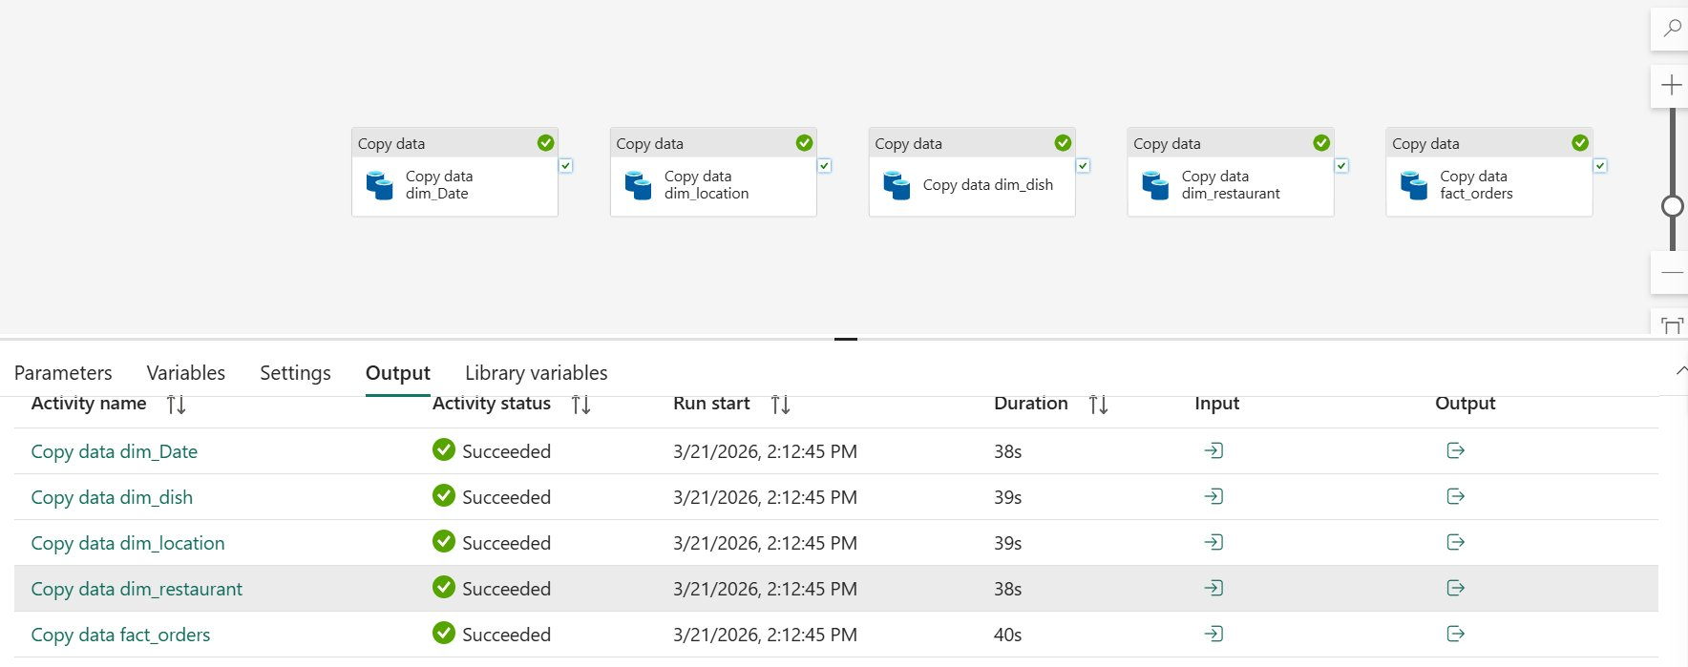
Pipeline Execution — Lakehouse to Warehouse
PIPELINE
Fig 2 — pipeline_lw_to_dw: all 5 Copy Data activities succeeded in under 40 seconds each
Activity
Status
Time
Records
dim_Date
✓ Succeeded
38s
243
dim_dish
✓ Succeeded
39s
8,891
dim_location
✓ Succeeded
39s
995
dim_restaurant
✓ Succeeded
38s
993
Amankumar Bhatu | Swiggy Analytics Capstone | Microsoft Fabric + SQL + Power BI
fact_orders
✓ Succeeded
40s
197,430

Slide 6
Data Model — Star Schema
MODEL
dim_date
dim_location
fact_orders
date_id (PK)
location_id (PK)
order_date
city
order_id (PK)
order_date_new
state
date_id (FK)
food_id (FK)
dim_dish
location_id (FK)
dim_restaurant
restaurant_id (FK)
dish_id (PK)
restaurant_id (PK)
dish_name
price | rating | rating_count
restaurant_name
category
One-to-Many relationships | 4 active joins in semantic model | Standard star schema pattern
Amankumar Bhatu | Swiggy Analytics Capstone | Microsoft Fabric + SQL + Power BI

Slide 7
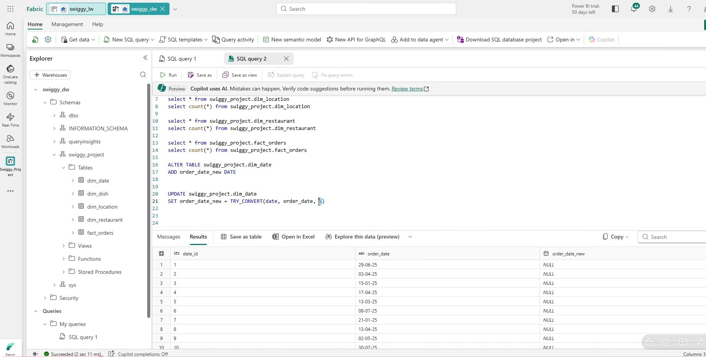
Part 2 — SQL Data Cleaning
SQL
⚠ Problem: order_date stored as STRING — time intelligence impossible
✓ Fix: ALTER TABLE + TRY_CONVERT(DATE, order_date, 5) — 0 NULLs confirmed
Fig 3 — Fabric Warehouse: ALTER TABLE adds order_date_new; UPDATE + TRY_CONVERT(DATE, order_date, 5) populates it
01
ALTER TABLE
02
TRY_CONVERT
03
NULL CHECK
Add order_date_new
as DATE column
Style 5 = dd-mm-yyyy
243 rows converted
0 rows returned
100% data integrity
Amankumar Bhatu | Swiggy Analytics Capstone | Microsoft Fabric + SQL + Power BI

Slide 8
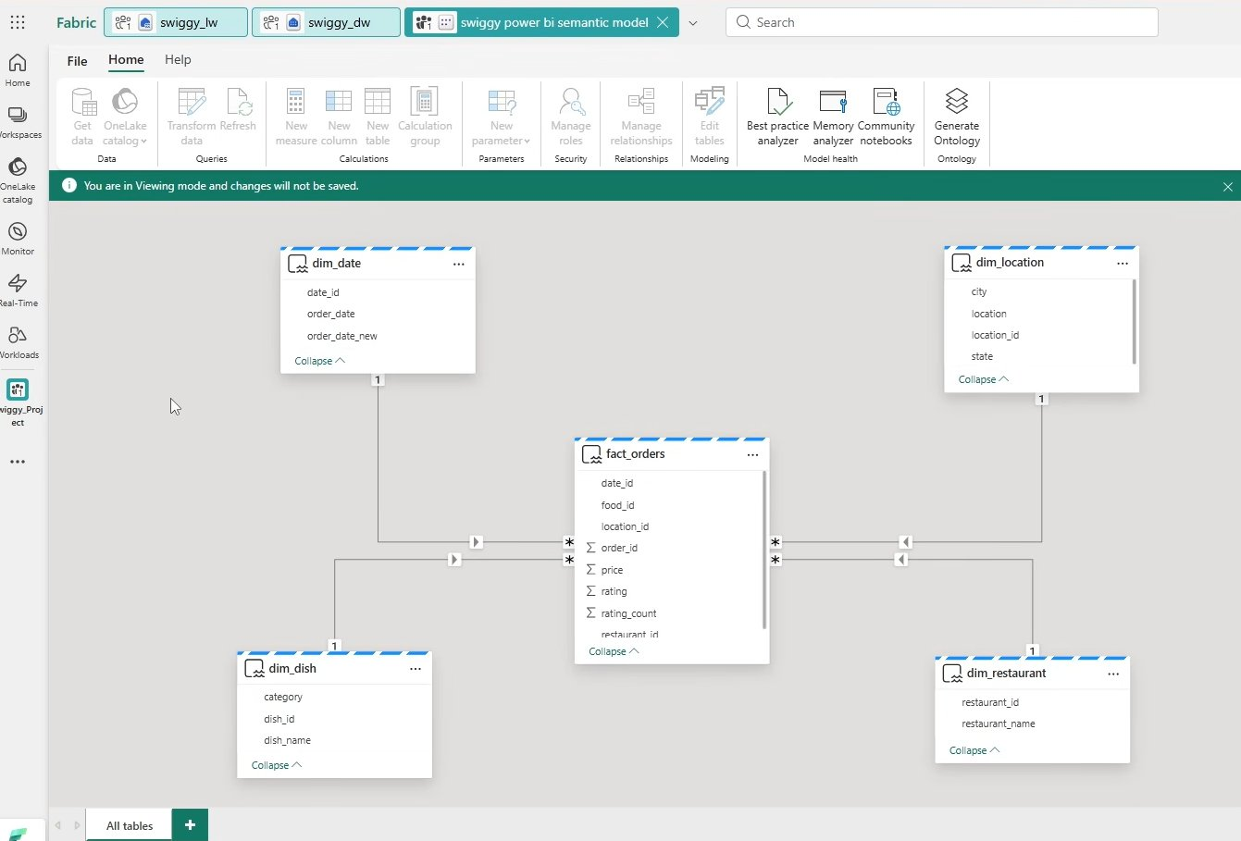
Semantic Model — Power BI Connected to Fabric
SEMANTIC
4 Active Relationships
fact_orders
→ dim_date
Many:One
date_id → date_id
fact_orders
→ dim_dish
Many:One
food_id → dish_id
fact_orders
→ dim_location
Many:One
location_id → location_id
fact_orders
→ dim_restaurant
Many:One
restaurant_id → restaurant_id
Fig 4 — Star schema with 4 active relationships published to Fabric workspace
Connection: DirectQuery → Fabric Warehouse | Local model unlocks DAX column creation
Amankumar Bhatu | Swiggy Analytics Capstone | Microsoft Fabric + SQL + Power BI

Slide 9
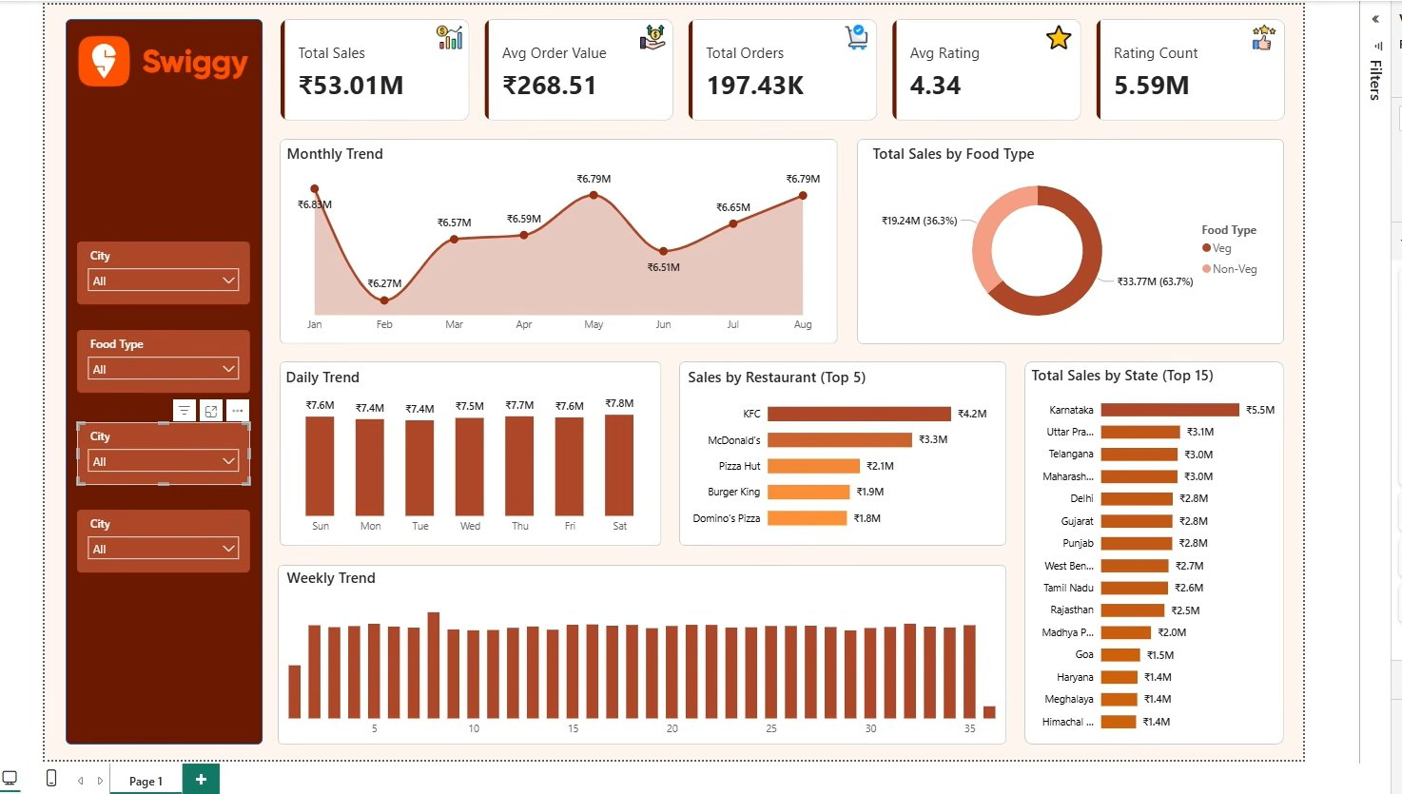
Power BI Dashboard — Published to Fabric Workspace
LIVE
₹53.01M
₹268.51
197.43K
4.34
5.59M
Total Sales
Amankumar Bhatu | Swiggy Analytics Capstone | Microsoft Fabric + SQL + Power BI
Avg Order
Orders
Avg Rating
Ratings

Slide 10




Key Business Insights
INSIGHTS
Karnataka #1
KFC leads
Top revenue state at ₹5.5M — nearly double Uttar Pradesh (₹3.1M)
Top restaurant at ₹4.2M — McDonald's ₹3.3M, Pizza Hut ₹2.1M
63.7% Veg
4.34 Rating
Majority revenue from veg (₹33.77M) vs non-veg (₹19.24M)
High satisfaction with 5.59M total rating interactions
Saturday Peak
₹268.51 AOV
Highest order day — May & August peak months at ₹6.79M each
Consistent average order value across India's diverse food market
Amankumar Bhatu | Swiggy Analytics Capstone | Microsoft Fabric + SQL + Power BI

Slide 11

Microsoft Fabric Skills Demonstrated
SKILLS
Workspace & Capacity
DirectQuery Semantic Model
Created Swiggy_Project workspace with Fabric trial capacity
Power BI connected to Fabric Warehouse, model published to workspace
Lakehouse (OneLake)
DAX Measures & Columns
Uploaded CSV files, converted to ACID Delta/Parquet tables
5 KPI measures + 6 time/classification calculated columns
SQL Analytics Endpoint
Star Schema Design
T-SQL record validation inside Lakehouse without leaving Fabric
4 one-to-many relationships between fact and dimension tables
Data Pipelines
Power BI Dashboard
2 pipelines — 5 parallel Copy Data activities via ADLS Gen2
8-visual dashboard — KPIs, trends, top-N charts, 4 slicers
Data Warehouse (T-SQL)
Report Publishing to Fabric
Schema creation + ALTER TABLE data fix + schema-qualified queries
Published .pbix to Fabric workspace — accessible live via browser
Medallion Architecture
Bronze → Silver → Gold layering across Files, Tables, Warehouse
Amankumar Bhatu | Swiggy Analytics Capstone | Microsoft Fabric + SQL + Power BI

Slide 12

Thank You
Amankumar Bhatu
Data Engineering & Analytics Track | March 2026
End-to-end Fabric pipeline — Bronze to Gold layer
SQL data cleaning — ALTER + TRY_CONVERT date fix
COMPLETE
PROJECT
Star schema — 4 active relationships in semantic model
8-visual Power BI dashboard published to Fabric workspace
Both parts delivered
end-to-end
Microsoft Fabric
T-SQL
Power BI
Delta / Parquet
DAX
ADLS Gen2

