Slide 1
Waste Classification Using Deep Learning: A Comparative Analysis
A project on CNN-based models for automated waste classification

Slide 2
Introduction
The Need for Automation:
Objective of the Study:
The Growing Waste Problem:
Traditional Sorting Challenges:
Labor-intensive and costly.
Prone to human errors affecting recycling efficiency.
Non-scalable for large-scale waste processing.
Deep Learning as a Solution:
Automates waste classification with high accuracy.
Reduces reliance on manual labor and improves efficiency.
Enables real-time waste sorting for smart waste management.
Develop and compare deep learning
models for automatic waste classification.
Analyze the performance of:
- Custom CNN (built from scratch).
- ResNet50 (deep residual network).
- MobileNetV3 (optimized for mobile/edge devices).
- EfficientNetB3 (optimized for a ccuracy and efficiency).
Identify the best model for real-world deployment based on accuracy, efficiency, and computational feasibility.
Global waste production has reached 2.24 billion tons annually, expected to rise by 73% by 2050.
Inefficient waste management leads to land pollution, water contamination, and greenhouse gas emissions.
Proper waste sorting is crucial for recycling and sustainability, but manual methods are time-consuming and error-prone.

Slide 3
Dataset
A deep learning model is only as good as the dataset it is trained on. To build an accurate and robust waste classification system, we curated a real-world dataset that represents diverse types of waste.
Our dataset consists of 1987 labeled images categorized into five different waste classes:
Textile - 20%
Plastic - 20%
Paper - 20%
Glass - 20%
Organic - 18%
Image Properties:
Resolution: 224 × 224 pixels – Standardized for deep learning models.
Color Mode: RGB (3 channels) – Ensures color-based feature extraction.
Uniform Labeling: Manually verified for correctness.
Dataset Challenges & solution
.
🔴 Class Imbalance: Some waste types had significantly more images than others.
✅ Solution: Class weighting applied to prevent bias during training.
🔴 Visual Similarity: Plastic and glass waste often look similar.
✅ Solution: Advanced feature extraction models (like ResNet50) help differentiate them.
🔴 Lighting & Background Variability: Images were captured in different lighting conditions and angles.
✅ Solution: Data Augmentation to simulate real-world variations.
.

Slide 4
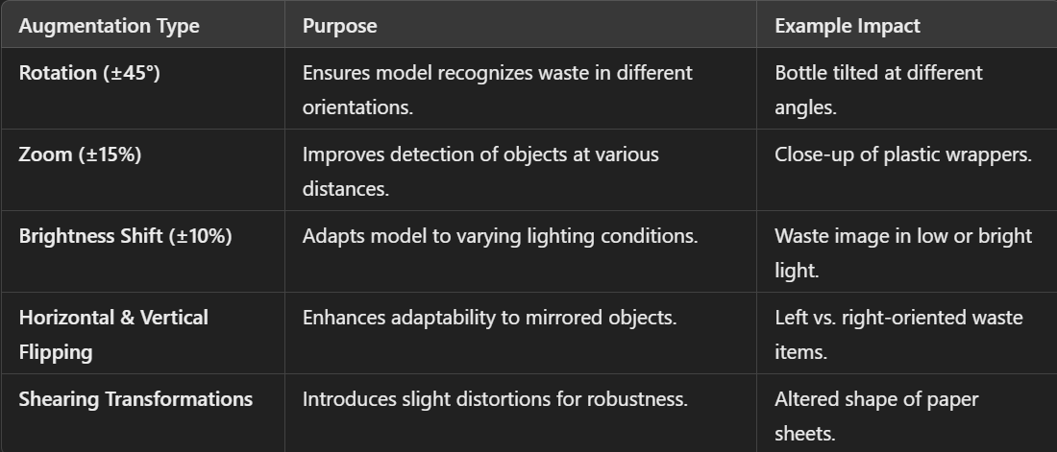
Data Preprocessing & Data Augmentation
The Need for Automation:
To ensure the model performs well on unseen data, we applied augmentation only to training images:
Why Preprocessing is Crucial?
Before feeding images into deep learning models, preprocessing ensures:
Standardization
Noise Reduction
Efficient Learning
Class Balance
Preprocessing Steps:
Dataset Inspection & Cleaning
Ensured all images were RGB format, 224×224 pixels.
Checked for duplicate, corrupted, or misclassified images.
Train-Test Split
80% Training, 20% Validation, ensuring all classes are well-represented.
Used stratified sampling to maintain class balance across both sets.
Image Normalization
Raw pixel values range from 0 to 255, which can lead to unstable training.
Rescaled to [0,1] using ImageDataGenerator
Why Not Augment Validation Data?
The validation set should represent real-world unseen data.
Augmenting validation images would lead to misleading performance metrics.

Slide 5
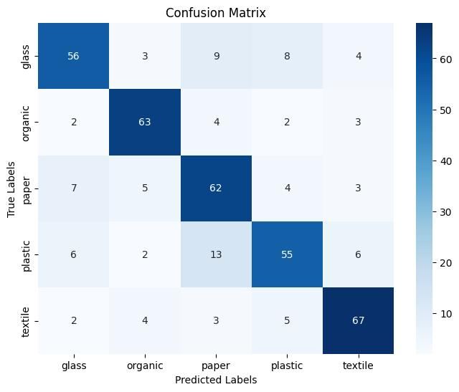
Custom CNN – Model & Performance
Why Use a Custom CNN?
Provides full control over architecture design.
Tailored for waste classification based on dataset characteristics.
Helps compare custom-built models against pre-trained deep learning models.
Custom CNN Architecture
The model consists of four convolutional blocks for feature extraction, followed by fully connected layers for classification.
Convolutional Layers: Extract spatial features such as edges, textures, and object shapes.
Batch Normalization: Stabilizes training and speeds up convergence.
Max-Pooling Layers: Reduces spatial dimensions while retaining essential information.
Dropout Layers: Prevents overfitting by randomly deactivating neurons during training.
Fully Connected Layers: Converts extracted features into class predictions.
Activation Functions:
ReLU (Rectified Linear Unit): Applied to convolutional layers for non-linearity.
Softmax: Used in the output layer to assign probabilities to each waste category.
Observations from Confusion Matrix:
Struggles with distinguishing plastic vs. paper due to similar visual features.
High misclassification rate.
Demonstrates basic feature extraction but lacks deep representation learning.

Slide 6
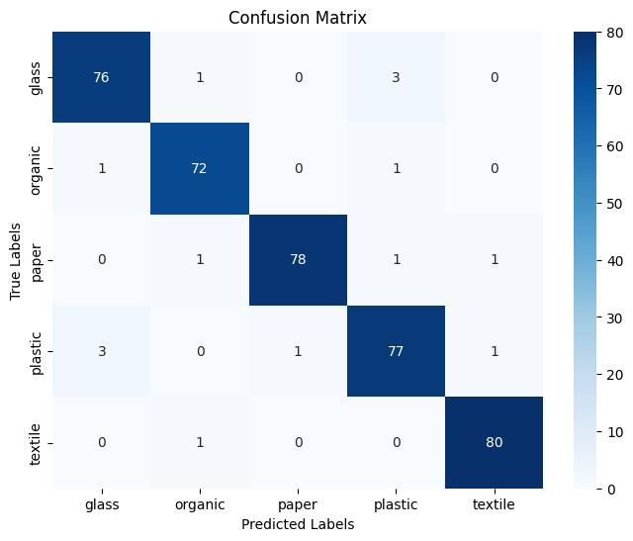
ResNet50 – Model & Performance
Why Use a ResNet50?
Traditional deep networks suffer from vanishing gradients as they get deeper.
ResNet50 (Residual Network with 50 layers) uses skip connections (residual learning) to solve this issue.
Allows training deeper networks while improving gradient flow and convergence.
ResNet50 Architecture
Convolutional Layers: Extracts hierarchical features from waste images.
Residual Connections: Helps the model retain important information from earlier layers.
Global Average Pooling: Reduces feature dimensions while preserving essential data.
Fully Connected Layers: Converts extracted features into final classification.
Activation Functions:
ReLU: Used in hidden layers for non-linearity.
Softmax: Used in output layer for multi-class classification.
🚀 Best suited for large-scale industrial waste classification systems.
Observations from Confusion Matrix:
Very few misclassifications across all categories.
Strong generalization even for visually similar waste types.
Computationally expensive – requires high processing power.

Slide 7
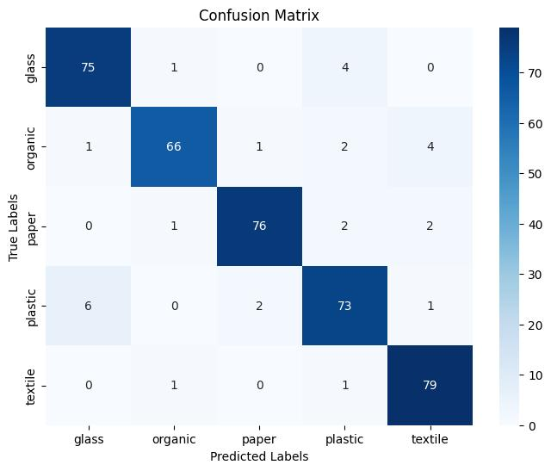
MobileNetV3 – Model & Performance
Why Use a MobileNetV3?
Designed for mobile and edge devices where computational power is limited.
Uses depth-wise separable convolutions to reduce the number of parameters while maintaining accuracy.
Achieves high efficiency with fewer computations compared to larger models like ResNet50.
MobileNetV3 Architecture
Depth-Wise Separable Convolutions: Reduces computations while maintaining feature extraction.
Squeeze-and-Excitation Modules: Dynamically adjusts channel importance for better accuracy.
Global Average Pooling: Reduces dimensionality for efficient computation.
Fully Connected Layers: Outputs final classification probabilities.
Activation Functions:
ReLU6: Optimized for low-power mobile processors.
Softmax: Converts predictions into class probabilities.
🚀 Best choice for real-world deployment in smart waste bins and IoT applications!
Observations from Confusion Matrix:
Some misclassifications in organic and plastic categories.
Efficient trade-off between accuracy and computation speed.
Best suited for real-time waste classification applications.

Slide 8
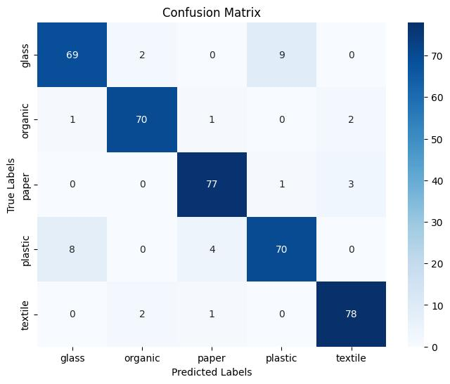
EfficientNetB3 – Model & Performance
Why Use a EfficientNetB3?
Uses compound scaling to balance depth, width, and resolution efficiently.
Achieves high accuracy with fewer parameters compared to other deep networks.
Scales efficiently for cloud-based applications requiring moderate computation.
EfficientNetB3 Architecture
Compound Scaling: Adjusts model size across all dimensions (depth, width, resolution).
Inverted Residual Blocks: Enhances learning efficiency.
Global Average Pooling: Reduces feature dimensionality.
Fully Connected Layers: Final classification step.
Activation Functions:
Swish (better than ReLU) for smooth learning.
Softmax for probability-based classification.
🚀 A strong choice for large-scale cloud-based waste management systems!
Observations from Confusion Matrix:
Slightly lower accuracy than MobileNetV3 but more efficient than ResNet50.
Well-suited for cloud-based waste classification systems.

Slide 9
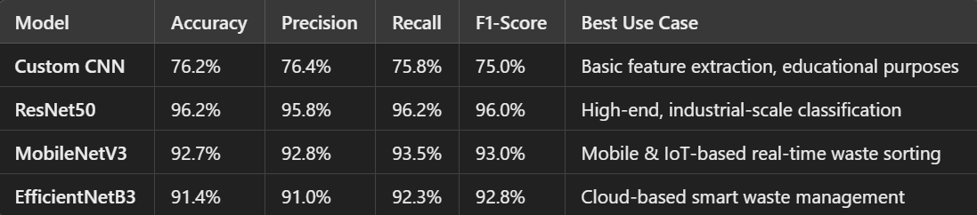
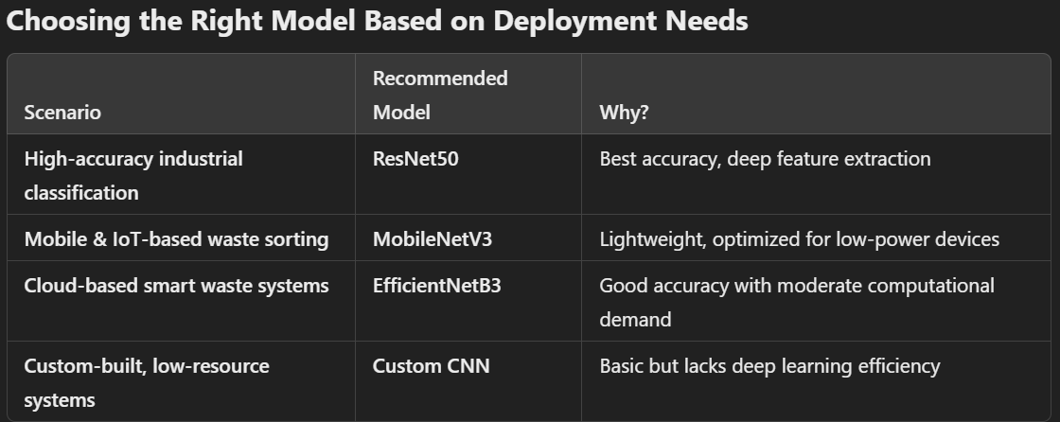
Model Comparison – Finding the Best Waste Classifier
Observations & Insights
Best Accuracy: ResNet50 (96.2%) – Excellent for precise classification but requires high computational power.
Best for Mobile & IoT: MobileNetV3 (92.7%) – Lightweight, fast, and ideal for edge devices.
Best for Cloud-Based Deployment: EfficientNetB3 (91.4%) – Balanced accuracy and efficiency.
Weakest Performer: Custom CNN (76.2%) – Struggles with complex feature extraction, highlighting the importance of pre-trained models.
Why Compare Models?
Each model has unique strengths and trade-offs. Comparing them helps identify the best model based on:
Accuracy – How well does it classify waste correctly?
Efficiency – How computationally expensive is it?
Deployment Feasibility – Can it run on edge devices, mobile platforms, or cloud servers?

Slide 10
Future Scope – Advancing AI in Waste Management
Edge AI Innovations for Smart Waste Management
Real-World Deployment
& Smart Waste Sorting
Hybrid AI Architectures
Deploy AI models in industrial waste sorting systems.
Test models in smart waste bins for real-time classification.
Integrate AI-powered sorting into recycling plants and municipal waste centers.
📌 Key Challenges & Solutions:
Environmental Variability (Lighting, Backgrounds, Camera Angles)
✔ Solution: Train models on diverse real-world waste datasets.
Processing Speed & Latency Issues
✔ Solution: Optimize models for faster inference on hardware like Jetson Nano & Raspberry Pi.
Decentralized AI for On-the-Spot Waste Classification.
AI-powered edge devices (e.g., embedded processors, IoT-enabled bins).
Waste classification without reliance on cloud computing, reducing latency.
Real-time decision-making for waste sorting, improving efficiency.
📌 Potential Use Cases:
AI-enabled waste bins that classify trash before disposal.
Robotic sorting arms using real-time AI analysis to separate recyclables.
Mobile applications that help users classify waste using smartphone cameras.
Current CNN models can be improved by integrating transformer-based models and attention mechanisms.
📌 Future Approach:
Combine CNNs with Vision Transformers (ViTs) to enhance feature extraction.
Use attention mechanisms to focus on key image regions for better classification.
Hybrid models can reduce misclassification errors in visually similar waste types.

Slide 11
Conclusion
Key Findings:
ResNet50 delivers the highest accuracy (96.2%) but requires substantial computational resources.
MobileNetV3 provides an optimal balance of efficiency and accuracy, making it suitable for real-world deployment.
EfficientNetB3 offers strong accuracy while being computationally efficient, ideal for cloud-based applications.
Custom CNN, while lightweight, struggles with complex classification due to its limited depth.
AI-driven waste classification is a major step toward sustainable waste management.
Real-World Implications:
Implementing AI-based waste classification can improve recycling processes and reduce environmental impact.
Choosing the right model depends on deployment needs—cloud vs. mobile vs. edge computing.

Slide 12
Thank you
Satyabrata Sahoo :- 22051971
Saswat Chandan :- 22052150
Aman Raj :- 22052273
Archit Anand :- 22052282
Kushagra Dhari :- 22052308
Lokesh Sahu :- 22052310

