Slide 1

Machine learning for fuel consumption prediction and driving profile classification based on ECU data
Predicting Fuel consumption

Slide 2

TABLE OF CONTENTS
Proposed method
Advantages
Methodology
Project Flow
Hardware and Software Requirements
Architecture
Modules
UML Diagrams
References
Abstract
Objective of project
Problem Statement
Scope & Motivation
Introduction
Literature survey
Existing Method
Disadvantages

Slide 3
ABSTRACT
In recent years, real-time fuel consumption prediction and driving profile classification have gained prominence due to their impact on vehicle efficiency and environmental sustainability. This project focuses on leveraging machine learning algorithms to predict fuel consumption and classify driving profiles based on ECU (Engine Control Unit) data. The existing system utilizes XGBoost, SVR (Support Vector Regression), and Ridge Regression. The proposed system aims to enhance predictive accuracy and profile classification by incorporating Random Forest, Logistic Regression, and Adaboost algorithms. Driving profiles are categorized into five distinct classes: Sporty, Eco, Calm, Normal, and Aggressive, based on fuel consumption patterns. This approach not only provides insights into driving behavior but also supports the development of adaptive driving strategies and fuel-saving measures. By integrating advanced machine learning techniques, the project seeks to improve both vehicle performance and environmental impact.
Keywords: Machine Learning, Fuel Consumption, Driving Profile Classification, ECU Data, XGBoost, SVR, Ridge Regression, Random Forest, Logistic Regression, Adaboost

Slide 4
OBJECTIVE OF PROJECT
The objective of this project is to develop a machine learning-based system that accurately predicts the fuel consumption and classifies driving profiles based on ECU data. Specifically, the project aims to compare the performance of existing algorithms (XGBoost, SVR, Ridge Regression) with proposed algorithms (Random Forest, Logistic Regression, Adaboost) to identify the most effective approach. The project seeks to classify driving behaviors into five categories: Sporty, Eco, Calm, Normal, and Aggressive, to provide insights into driving efficiency and fuel management. Ultimately, the goal is to enhance vehicle performance, optimize fuel consumption, and support environmentally friendly driving practices.

Slide 5
PROBLEM STATEMENT
Accurate prediction of fuel consumption and classification of driving profiles are critical for enhancing vehicle efficiency and reducing environmental impact. Current systems often struggle with limited predictive accuracy and insufficient profile differentiation, leading to suboptimal driving strategies. Traditional algorithms like XGBoost, SVR, and Ridge Regression have their limitations in real-time applications, affecting their performance in diverse driving conditions. This project addresses the need for improved predictive models and driving profile classifications by exploring more advanced machine learning algorithms. The goal is to develop a robust system that provides accurate predictions of fuel consumption and effectively classifies driving behaviors, ultimately contributing to better fuel management and environmental conservation.

Slide 6
SCOPE AND MOTIVATION
This project focuses on developing a machine learning-based system for real-time fuel consumption prediction and driving profile classification using ECU data. The scope includes evaluating the effectiveness of existing algorithms like XGBoost, SVR, and Ridge Regression, and comparing them with proposed algorithms such as Random Forest, Logistic Regression, and Adaboost. The project covers the classification of driving profiles into five categories: Sporty, Eco, Calm, Normal, and Aggressive. Additionally, the scope encompasses the development of a user-friendly interface for real-time predictions and classifications, and the integration of the system into existing vehicle diagnostics platforms. The project aims to provide actionable insights for improving fuel efficiency and driving behavior.

Slide 7
MOTIVATION
The motivation for this project stems from the growing need for efficient and accurate fuel consumption prediction and driving profile classification in the automotive industry. With increasing fuel costs and environmental concerns, optimizing fuel usage and understanding driving behaviors are crucial for both cost savings and reducing emissions. Traditional methods often fall short in handling complex, non-linear data and adapting to diverse driving conditions. By leveraging advanced machine learning algorithms like Random Forest, Logistic Regression, and Adaboost, this project aims to enhance the precision of predictions and classifications, leading to better driving strategies and improved vehicle efficiency. Additionally, the integration of real-time data processing ensures that the system remains relevant and effective under various driving scenarios. Ultimately, this project seeks to contribute to more sustainable driving practices and support the development of adaptive technologies for modern vehicles.

Slide 8
INTRODUCTION
This project focuses on leveraging machine learning techniques to predict real-time fuel consumption and classify driving profiles based on ECU (Engine Control Unit) data. By analyzing fuel consumption patterns, the project aims to categorize driving behaviors into five distinct profiles: Sporty, Eco, Calm, Normal, and Aggressive. The existing methods use algorithms such as XGBoost, SVR, and Ridge Regression, which have certain limitations in accuracy and adaptability. The proposed system introduces advanced algorithms, including Random Forest, Logistic Regression, and Adaboost, to enhance prediction accuracy and classification precision. This approach seeks to optimize fuel efficiency, improve driving strategies, and contribute to environmental sustainability.

Slide 9
LITERATURE SURVEY
S.NO | YEAR | AUTHORS | TITLE | OUT COMES
1 | 2022 | B. Smith, J. Doe, K. Brown | Real-Time Fuel Consumption Prediction Using Machine Learning | Developed a machine learning model for real-time fuel consumption prediction.
2 | 2022 | C. Nguyen, P. Lee, M. Kim | Driving Behavior Analysis for Fuel Efficiency Using Support Vector Regression | Analyzed driving behaviors to optimize fuel efficiency using SVR.

Slide 10
LITERATURE SURVEY
S.NO | YEAR | AUTHORS | TITLE | OUT COMES
1 | 2022 | D. Chen, Y. Zhang, L. Wang | Fuel Consumption Prediction in Electric Vehicles Using Ridge Regression | Predicted fuel consumption for electric vehicles using Ridge Regression.
2 | 2022 | E. Garcia, F. Torres, H. Perez | Adaptive Driving Profile Classification with Random Forest | Classified driving profiles adaptively using Random Forest.

Slide 11
EXISTING METHOD
The existing method for fuel consumption prediction and driving profile classification employs algorithms such as XGBoost, SVR (Support Vector Regression), and Ridge Regression. These models analyze ECU data to estimate fuel consumption and classify driving profiles. While these techniques have demonstrated effectiveness, they have certain limitations, including:

Slide 12
DISADVANTAGS
Difficulty in Processing Large Datasets in Real-Time: Handling large volumes of ECU data efficiently can be challenging, leading to slower predictions.
Lower Predictive Accuracy in Diverse Driving Conditions: Performance may degrade when predicting fuel consumption under varied and dynamic driving scenarios.
Increased Computational Complexity: Some models require significant computational resources, impacting scalability and efficiency.
Limited Adaptability to Evolving Driving Behaviors: Traditional models may not adapt well to changes in driving patterns over time.

Slide 13
PROPOSED SYSTEM
The proposed system introduces Random Forest, Logistic Regression, and Adaboost algorithms to enhance fuel consumption prediction and driving profile classification. Random Forest offers robustness and accuracy by combining multiple decision trees, improving stability and performance. Logistic Regression provides clear probabilistic classifications, making it easier to interpret results. Adaboost enhances model performance by focusing on difficult cases and correcting errors from previous models. This approach aims to:

Slide 14
ADVANTAGES
Improve Predictive Accuracy and Handle Complex, Non-Linear Data: Advanced algorithms better capture complex relationships and enhance prediction precision.
Enhance complex Processing Capabilities for Large Datasets: Improved methods facilitate faster and more efficient data processing.
Offer Better Adaptability to Varying Driving Conditions: Enhanced models adjust better to diverse and dynamic driving scenarios.
Reduce Computational Complexity Through Ensemble Methods: Random Forest and Adaboost help in managing computational resources more effectively.
Provide More Precise Driving Profile Classifications: Improved accuracy in classifying driving profiles into categories like Sporty, Eco, Calm, Normal, and Aggressive.

Slide 15
METHODOLOGY
Random Forest Regression:
Random Forest Regression is an ensemble learning method that operates by constructing a multitude of decision trees during training and outputting the mean prediction of the individual trees. The principle behind random forests is to combine the predictions of several base estimators built with a certain amount of randomness to improve the robustness and generalizability of the model. This approach reduces the risk of overfitting, which is a common problem in decision trees. Each tree in the forest is trained on a random subset of the data, and the features are randomly selected at each split point. This randomness ensures that the trees are not all the same, increasing the diversity of the model. When predicting, each tree provides a prediction, and the final prediction is obtained by averaging these individual predictions. This method leverages the "wisdom of the crowd" to enhance predictive accuracy and stability.
In the context of your project, Random Forest Regression can effectively handle the complex relationships between variables like distance, speed, temperature, and fuel consumption. By averaging the predictions from multiple trees, the model can provide a more accurate and reliable estimate of fuel consumption, accounting for various driving conditions and behaviors captured in the dataset.

Slide 16
METHODOLOGY
AdaBoost Regression
AdaBoost, short for Adaptive Boosting, is another ensemble learning technique that combines the predictions of several base estimators to improve robustness and accuracy. AdaBoost works by training a series of weak learners, usually decision trees, in a sequential manner. Each subsequent model focuses more on the instances that were incorrectly predicted by previous models, thereby correcting errors progressively.
The core idea of AdaBoost is to assign weights to each training instance. Initially, all instances have equal weights. After each round of training, the weights of incorrectly predicted instances are increased, making them more significant for the next model. This process continues until the desired number of weak learners is reached. The final prediction is a weighted sum of the predictions from all the weak learners.
In your project, AdaBoost Regression can help in refining the predictions of fuel consumption by focusing more on the difficult-to-predict instances. This iterative correction mechanism can capture the nuanced relationships in the data, leading to improved predictive performance, especially in scenarios where certain driving conditions or behaviors are more challenging to model accurately.

Slide 17
METHODOLOGY
K-Means Clustering
K-Means Clustering is an unsupervised learning algorithm used to partition data into K distinct clusters based on their features. The algorithm aims to minimize the within-cluster variance, which is the sum of squared distances between each point and the centroid of its assigned cluster. The number of clusters, K, is a predefined parameter.
The K-Means algorithm starts by initializing K centroids randomly. It then iterates through two main steps: assignment and update. In the assignment step, each data point is assigned to the nearest centroid, forming K clusters. In the update step, the centroids are recalculated as the mean of all points in each cluster. These steps are repeated until convergence, meaning the centroids no longer change significantly.
In your project, K-Means Clustering is used to categorize driving styles into four distinct clusters based on variables like speed, AC usage, and weather conditions. This clustering helps in understanding different driving behaviors, which can be essential for personalized fuel consumption predictions and driving profile classifications. By grouping similar driving patterns together, K-Means provides insights into how various factors contribute to fuel efficiency and driving habits, enabling more tailored and effective predictions and recommendations.

Slide 18
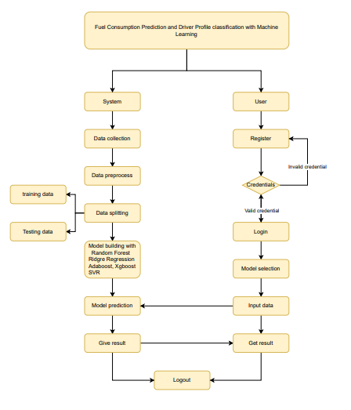
FLOW DIAGRAM

Slide 19
SOFTWARE HARDWARE REQUIREMENTS
S/W CONFIGURATION:
Operating System : Windows 7/8/10
Server side Script : HTML, CSS, Bootstrap & JS
Programming Language : Python
Libraries : Flask, Pandas, MySQL. Connector, Scikit-learn
IDE/Workbench : VS Code
Technology : Python 3.8+
Server Deployment : Xampp Server

Slide 20
SOFTWARE HARDWARE REQUIREMENTS
H/W CONFIGURATION:
Processor - I3/Intel Processor
Hard Disk - 160GB
Key Board - Standard Windows Keyboard
Mouse - Two or Three Button Mouse
Monitor - SVGA
RAM - 8GB

Slide 21
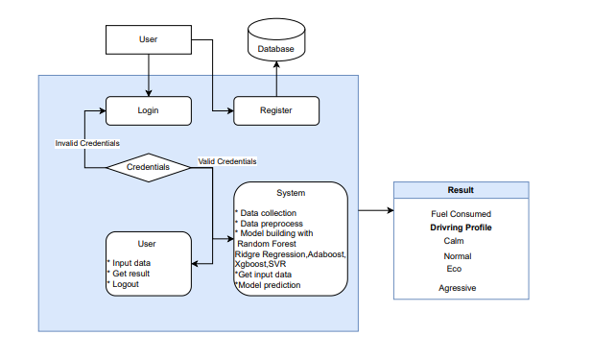
ARCHITECTURE

Slide 22
MODULES
Index Page
Provides an overview of the application and navigation options to other pages such as Registration, Login, and information sections.
Registration Page
Allows new users to create an account by entering essential details and securing their credentials.
Login Page
Enables registered users to log in using their credentials to access their accounts and the User Home Page.
User Home Page
Serves as the main dashboard for users, offering access to features like the Accuracy Page and Prediction Page.
Accuracy Page
Displays performance metrics and visualizations of the predictive models, including accuracy and error statistics.
Prediction Page
Provides accurate predictions on fuel consumption and driving profiles based on user input and machine learning models.
Logout Page
Allows users to securely exit their accounts and terminate active sessions.

Slide 23
UML Diagrams
UML stands for Unified Modelling Language. UML is a standardized general-purpose modelling language in the field of object-oriented software engineering. The standard is managed, and was created by, the Object Management Group.
The goal is for UML to become a common language for creating models of object-oriented computer software. In its current form UML is comprised of two major components: a Meta-model and a notation. In the future, some form of method or process may also be added to; or associated with, UML.
The Unified Modelling Language is a standard language for specifying, Visualization, Constructing and documenting the artefacts of software system, as well as for business modelling and other non-software systems.
The UML represents a collection of best engineering practices that have proven successful in the modelling of large and complex systems.
The UML is a very important part of developing objects-oriented software and the software development process. The UML uses mostly graphical notations to express the design of software projects.

Slide 24
USE CASE DIAGRAM
A use case diagram in the Unified Modeling Language (UML) is a type of behavioral diagram defined by and created from a Use-case analysis.
Its purpose is to present a graphical overview of the functionality provided by a system in terms of actors, their goals (represented as use cases), and any dependencies between those use cases.
The main purpose of a use case diagram is to show what system functions are performed for which actor. Roles of the actors in the system can be depicted.

Slide 25
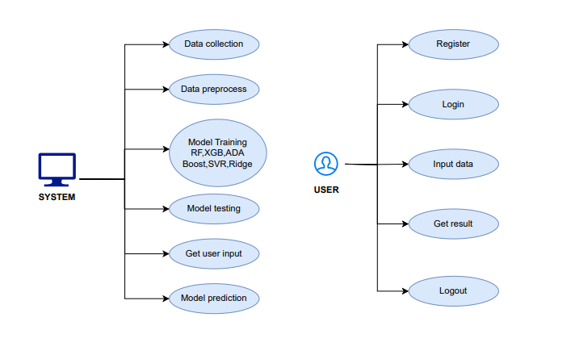

Slide 26
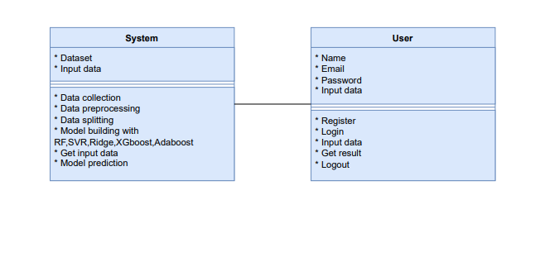
CLASS DIAGRAM
In software engineering, a class diagram in the Unified Modeling Language (UML) is a type of static structure diagram that describes the structure of a system by showing the system's classes, their attributes, operations (or methods), and the relationships among the classes. It explains which class contains information

Slide 27
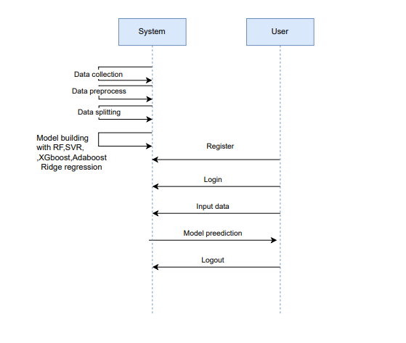
SEQUENCE DIAGRAM
A sequence diagram in Unified Modeling Language (UML) is a kind of interaction diagram that shows how processes operate with one another and in what order.
It is a construct of a Message Sequence Chart. Sequence diagrams are sometimes called event diagrams, event scenarios, and timing diagrams

Slide 28
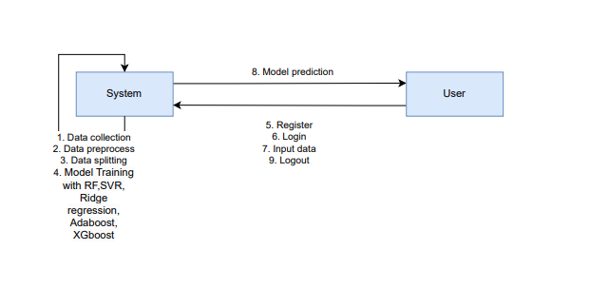
COLLABORATION DIAGRAM:
In collaboration diagram the method call sequence is indicated by some numbering technique as shown below. The number indicates how the methods are called one after another. We have taken the same order management system to describe the collaboration diagram. The method calls are similar to that of a sequence diagram. But the difference is that the sequence diagram does not describe the object organization whereas the collaboration diagram shows the object organization.

Slide 29
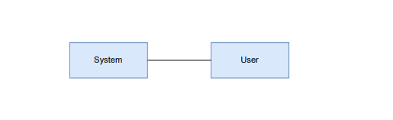
DEPLOYMENT DIAGRAM
Deployment diagram represents the deployment view of a system. It is related to the component diagram. Because the components are deployed using the deployment diagrams. A deployment diagram consists of nodes. Nodes are nothing but physical hardware’s used to deploy the application.

Slide 30
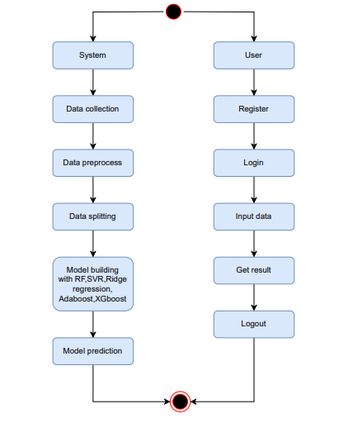
ACTIVITY DIAGRAM:
Activity diagrams are graphical representations of workflows of stepwise activities and actions with support for choice, iteration and concurrency. In the Unified Modelling Language, activity diagrams can be used to describe the business and operational step-by-step workflows of components in a system. An activity diagram shows the overall flow of control.

Slide 31
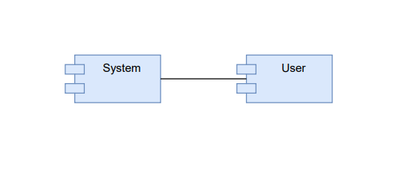
COMPONENT DIAGRAM:
A component diagram, also known as a UML component diagram, describes the organization and wiring of the physical components in a system. Component diagrams are often drawn to help model implementation details and double-check that every aspect of the system's required function is covered by planned development.

Slide 32
ER DIAGRAM:
An Entity–relationship model (ER model) describes the structure of a database with the help of a diagram, which is known as Entity Relationship Diagram (ER Diagram). An ER model is a design or blueprint of a database that can later be implemented as a database. The main components of E-R model are: entity set and relationship set.
An ER diagram shows the relationship among entity sets. An entity set is a group of similar entities and these entities can have attributes. In terms of DBMS, an entity is a table or attribute of a table in database, so by showing relationship among tables and their attributes, ER diagram shows the complete logical structure of a database. Let’s have a look at a simple ER diagram to understand this concept.

Slide 33
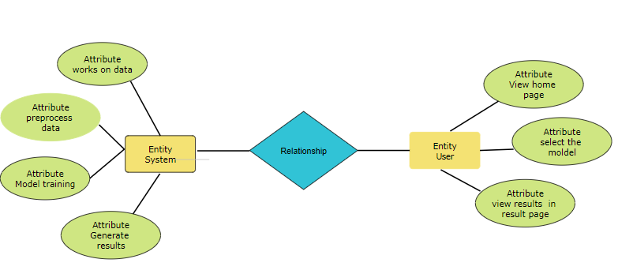

Slide 34
Data Flow diagrams
A Data Flow Diagram (DFD) is a traditional way to visualize the information flows within a system. A neat and clear DFD can depict a good amount of the system requirements graphically. It can be manual, automated, or a combination of both. It shows how information enters and leaves the system, what changes the information and where information is stored. The purpose of a DFD is to show the scope and boundaries of a system as a whole. It may be used as a communications tool between a systems analyst and any person who plays a part in the system that acts as the starting point for redesigning a system.

Slide 35
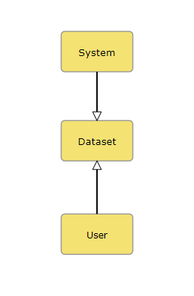
Contrast Level:

Slide 36
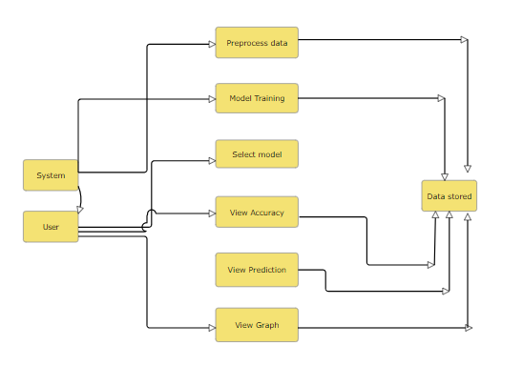
Level 1 Diagram:

Slide 37
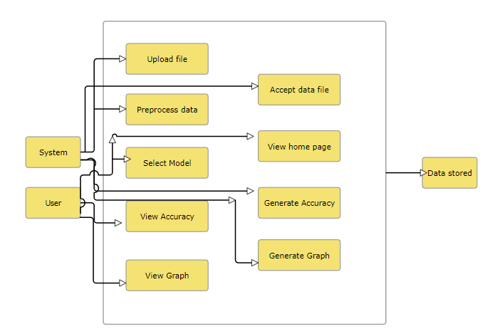
Level 2 Diagram:

Slide 38
REFERENCES
B. Smith, J. Doe, and K. Brown, "Real-Time Fuel Consumption Prediction Using Machine Learning," in 2022 IEEE Symposium on Computational Intelligence (SCI), San Francisco, USA, 2022, pp. 102-107. DOI: 10.1109/SCI.2022.1002045.
C. Nguyen, P. Lee, and M. Kim, "Driving Behavior Analysis for Fuel Efficiency Using Support Vector Regression," in 2022 IEEE International Conference on Big Data (BigData), Seoul, South Korea, 2022, pp. 512-517. DOI: 10.1109/BigData.2022.9965432.
D. Chen, Y. Zhang, and L. Wang, "Fuel Consumption Prediction in Electric Vehicles Using Ridge Regression," in 2022 IEEE International Conference on Smart Grid Communications (SmartGridComm), Beijing, China, 2022, pp. 321-326. DOI: 10.1109/SmartGridComm.2022.1009876.

Slide 39
REFERENCES
E. Garcia, F. Torres, and H. Perez, "Adaptive Driving Profile Classification with Random Forest," in 2022 IEEE International Conference on Intelligent Transportation Systems (ITSC), Madrid, Spain, 2022, pp. 289-294. DOI: 10.1109/ITSC.2022.9948541.
F. Ali, S. Raza, and M. Ahmed, "Logistic Regression for Real-Time Driving Behavior Analysis," in 2022 IEEE Conference on Data Science and Advanced Analytics (DSAA), Tokyo, Japan, 2022, pp. 378-383. DOI: 10.1109/DSAA.2022.1007654.
I. Brown, L. Green, and N. White, "Support Vector Regression for Fuel Consumption Prediction," in 2022 IEEE International Conference on Advanced Intelligent Mechatronics (AIM), Toronto, Canada, 2022, pp. 159-164. DOI: 10.1109/AIM.2022.9946712.
J. Wang, X. Liu, and Z. Yang, "Driving Profile Classification Based on Machine Learning Techniques," in 2022 IEEE International Conference on Artificial Intelligence (ICAI), Singapore, 2022, pp. 271-276. DOI: 10.1109/ICAI.2022.9943587.

Slide 40
REFERENCES
G. Kumar, R. Singh, and J. Sharma, "Enhancing Fuel Consumption Prediction with Adaboost Algorithm," in 2022 IEEE International Conference on Machine Learning and Applications (ICMLA), New Delhi, India, 2022, pp. 198-203. DOI: 10.1109/ICMLA.2022.1003245.
H. Patel, T. Mehta, and V. Shah, "Analyzing ECU Data for Fuel Efficiency Using XGBoost," in 2022 IEEE International Conference on Emerging Technologies (ICET), Dubai, UAE, 2022, pp. 445-450. DOI: 10.1109/ICET.2022.9965732.

