Slide 1

PROJECT PRESENTATION
Feedo
Submitted By
Aman Kumar
Enrollment No.: 23ADV3CST1012
Course: B.Tech
Semester: 7th Semester
A Food Delivery Web Application
Connecting customers, local restaurants, delivery partners and admins through one responsive full-stack platform.
University & Guide
SAGE University
Project Guide: Naman Arora
Feedo | Aman Kumar | 1

Slide 2
PROBLEM
Why Feedo Is Needed
Current Challenges
Platform Requirement
Traditional ordering is slow and error-prone. Customers do not get proper menu comparison, discounts, payment records or real-time delivery updates.
Restaurants need online order tools, delivery partners need assigned-order workflows, and admins need a central dashboard for users, orders and revenue.
Feedo | Aman Kumar | 2

Slide 3
OBJECTIVES
Project Objective And Scope
Connect customers with local restaurants for online ordering.
Provide restaurant listings with menus, ratings and delivery estimates.
Support cart, checkout, promo code, tip, schedule and payment options.
Enable real-time order tracking from placement to doorstep delivery.
Offer dashboards for restaurant owners, delivery partners and admins.
Feedo | Aman Kumar | 3

Slide 4
USERS
Main Users And Modules
Customer
Restaurant Owner
Delivery Partner
Admin
Browse restaurants, add to cart, checkout, pay, track order, review food.
Manage menu, availability, inventory, orders and reviews.
View assigned orders, update status and share live location.
Manage users, restaurants, revenue, delivery records and analytics.
Core Modules
Authentication and role access
Ratings, reviews and loyalty rewards
Restaurant and menu management
Promo codes and scheduled orders
Cart, checkout and payment
Inventory and availability control
Delivery tracking and notifications
Admin analytics dashboard
Feedo | Aman Kumar | 4

Slide 5
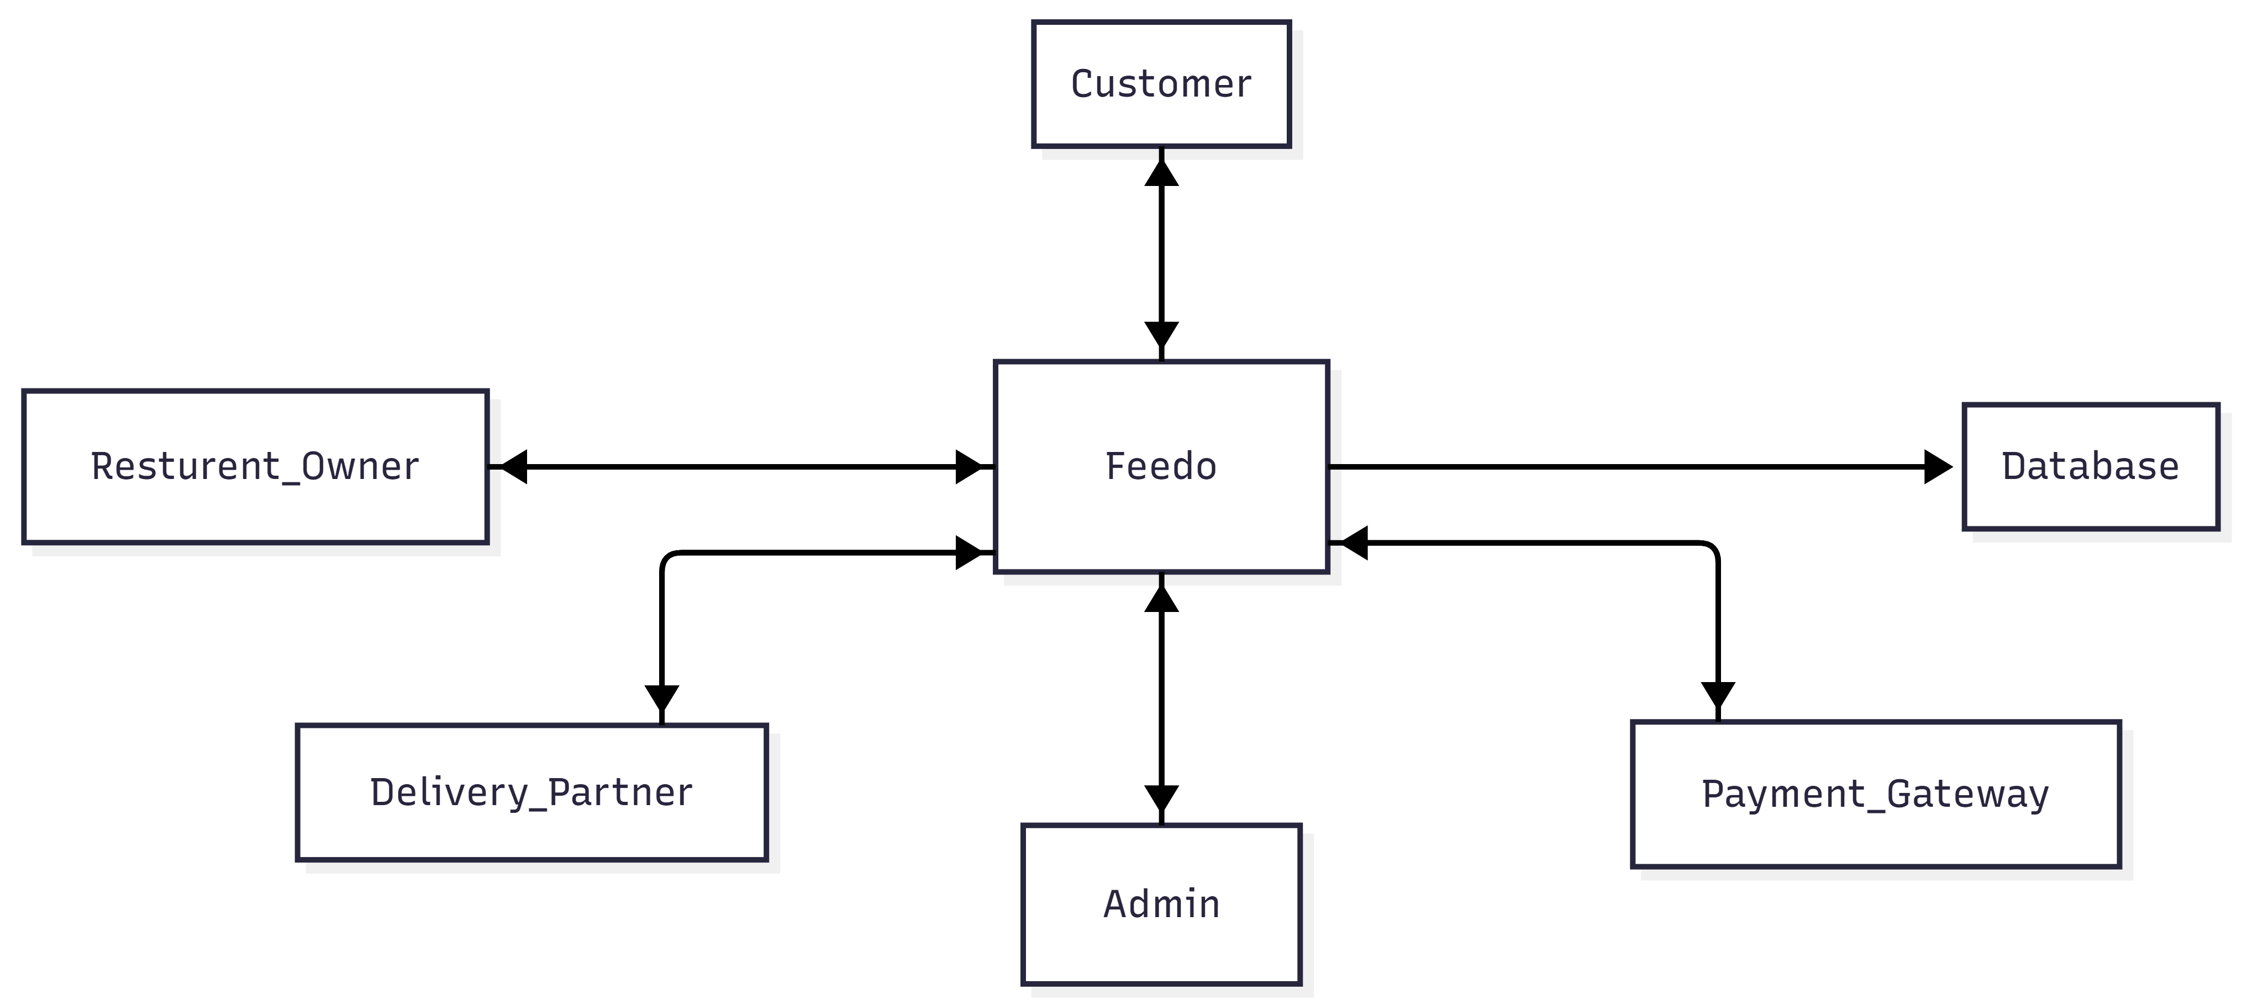
DFD
Data Flow Diagram
The diagram shows how Customer, Restaurant Owner, Delivery Partner, Admin, Database and Payment Gateway interact with Feedo.
Feedo | Aman Kumar | 6

Slide 6
TECH STACK
Hardware And Software To Be Used
Frontend
Backend & Database
Integrations
React.js
React Router
Tailwind CSS
Bootstrap
Node.js
Express.js
MongoDB
Mongoose
Socket.io
Razorpay / Stripe
Leaflet / Google Maps
Chart.js / Recharts
Hardware: Intel i3 or above, minimum 4 GB RAM, 2 GB free storage and internet connection.
Feedo | Aman Kumar | 7

Slide 7
FEATURES
Advanced Features Covered
Live map-based order tracking
Multiple payment methods
Promo codes and first-order discounts
Razorpay / Stripe integration
Scheduled orders
Push notifications
Dietary filters: veg, vegan, allergens
Loyalty rewards
Ratings and reviews
Delivery tip and split payment
Feedo | Aman Kumar | 8

Slide 8
FUTURE WORK
Future Enhancements
Android and iOS mobile application
AI-based food recommendations
Advanced route optimization
Chat support between users and delivery partners
Refund management and GST invoices
Multi-city restaurant onboarding
Feedo | Aman Kumar | 11

Slide 9
CONCLUSION
Project Summary
Conclusion
Key References
Feedo is a complete food delivery platform connecting customers, restaurants, delivery partners and admins. It combines ordering, payment, live tracking, dashboards, reviews, loyalty and analytics in one system.
React, Tailwind CSS, Bootstrap, Express.js, MongoDB, Socket.io, Razorpay, Leaflet and Chart.js official documentation.
Thank You
Feedo | Aman Kumar | 12

