Slide 1
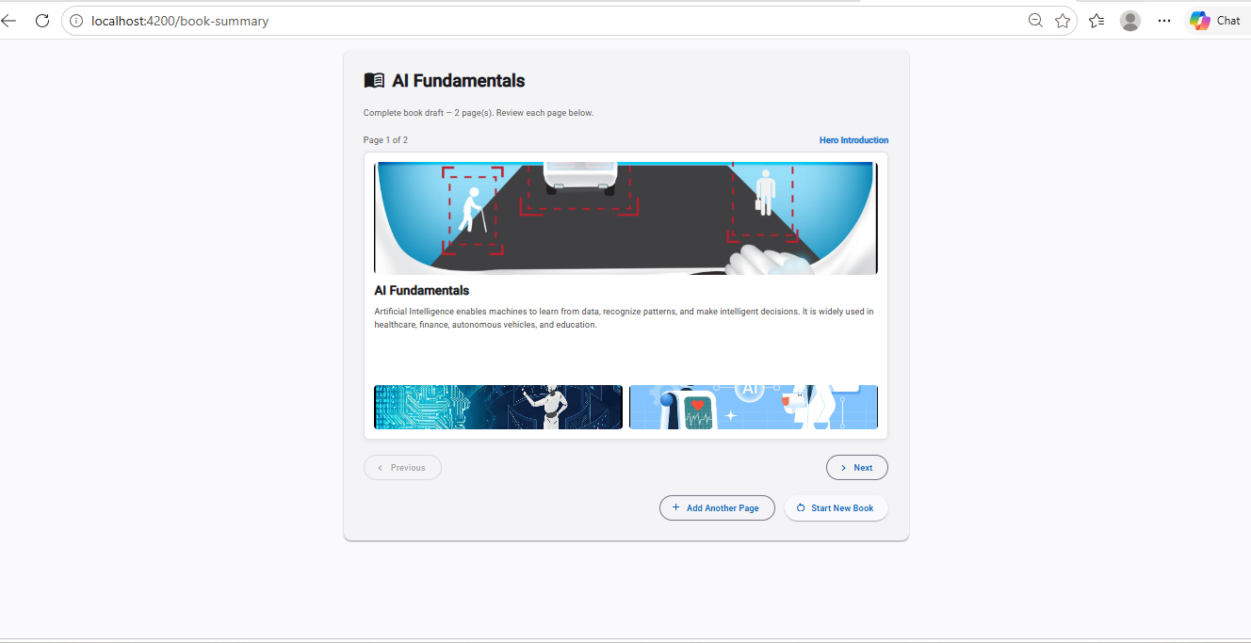
EY GENAI ENGINEERING ASSIGNMENT
AI-Powered
Visual Book Generator
AA
Aman Agrawal ~11+ years in software engineering · M.Tech in AI & ML, IIT Jodhpur
aman.agrawal@telus.com linkedin.com/in/aman-agrawal007 github.com/Aman007Agg/ai-powered-visual-book-generator
Notes:
Hello, my name is Aman Agrawal. I have around 11+ years of software engineering experience and an M.Tech in AI and ML from IIT Jodhpur. Today I'll demonstrate my solution for the EY GenAI assignment: the AI-Powered Visual Book Generator.

Slide 2
THE BUSINESS PROBLEM
Problem Statement
Marketing and content teams create content-heavy documents that take significant manual effort to turn into visually appealing layouts.
Designers spend considerable time arranging text and images and iterate many times before producing a polished document.
The objective is to automate the first-draft generation using Large Language Models — cutting manual effort while keeping layout recommendations context-aware.
Today's cost
Heavy manual effort
Multiple design iterations
Significant designer time
Documents up to ~500 pages
Notes:
Marketing teams create content-heavy documents needing significant manual effort to become appealing layouts. Designers iterate many times. This project automates the first draft with LLMs, reducing effort while keeping context-aware layout recommendations.

Slide 3
WHAT WE'RE BUILDING
Project Objectives
1
Browser-based app
2
Accept book context
3
Accept page content
Runs entirely in the browser — no install.
Optional title and objective guide the AI.
Page-by-page text input.
4
Accept images
5
Two layout options
6
User selects
Upload one or more images per page.
AI generates two intelligent options per page.
The user picks the preferred layout.
7
Complete draft
Continue page by page to a full book draft.
Notes:
Objectives from the PRD: a browser-based app that accepts book context, page text and images; the AI generates two layout options per page; the user selects one; and we continue page by page until the complete book draft is assembled.

Slide 4
HIGH-LEVEL DESIGN
Architecture
→
→
→
→
Angular
FastAPI
OpenAI
JSON
Renderer
UI · state · rendering
validation · prompt · errors
layout reasoning
validated contract
Hero / Split / Magazine
Why the LLM never generates HTML or CSS
The model decides layout SEMANTICS as JSON; Angular owns PRESENTATION. That separation means: no markup from the model = no XSS/injection surface · deterministic, testable rendering · restyling costs no AI call · the same JSON could later drive PDF/print.
Notes:
The flow: Angular to FastAPI to OpenAI, which returns JSON, which Angular renders. The key decision: the LLM returns structured JSON only — never HTML or CSS. Angular owns presentation. That gives security, determinism, testability and low cost.

Slide 5
CHOICES & RATIONALE
Technology Stack
Angular
FastAPI
OpenAI
Modern SPA
Component architecture
Strong TypeScript support
Signals + zoneless
High performance, async
Pydantic validation
Clean REST APIs
Typed request/response
Strong reasoning
Structured JSON outputs
Vision-capable (roadmap)
Prompt engineering
Notes:
Angular for a modern component-based SPA with strong typing and Signals. FastAPI for a high-performance async API with Pydantic validation — ideal for a typed AI contract. OpenAI for strong reasoning and structured JSON output; it's vision-capable, which is on our roadmap.

Slide 6
HOW THE AI FITS IN
AI Workflow
1
2
3
4
5
6
→
→
→
→
→
User
input
Backend
validation
Prompt
construction
GPT layout
reasoning
Structured
JSON
Angular
rendering
Separation of concerns: the AI focuses only on reasoning and layout decisions; Angular is solely responsible for presentation. The result is safe, predictable, and easy to test.
Notes:
Input flows from the user, through backend validation, prompt construction, GPT layout reasoning, into structured JSON, and finally Angular rendering. The AI only reasons about layout; Angular handles presentation — a clean separation of concerns.

Slide 7
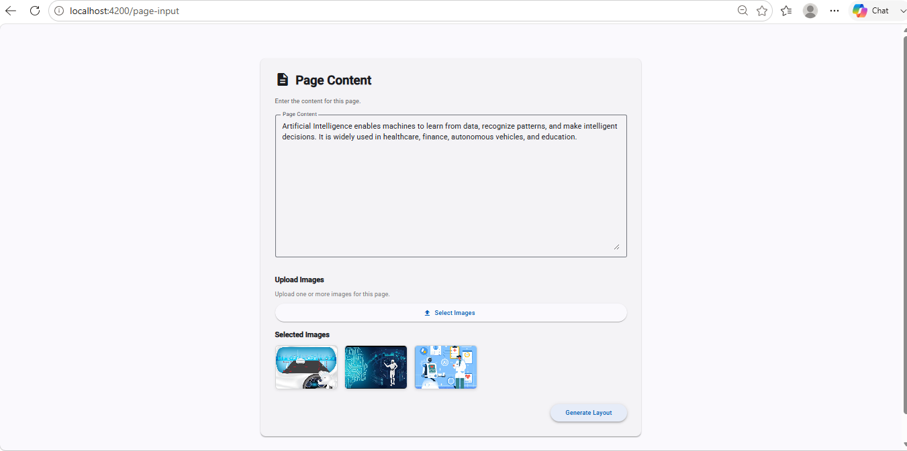
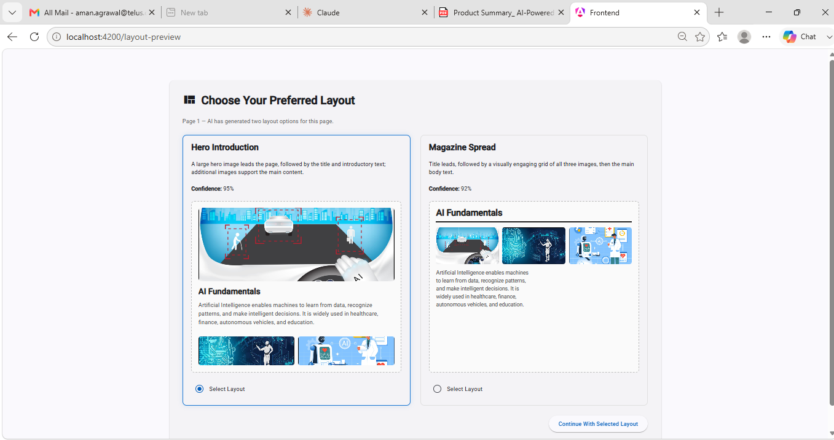
THE WORKING APPLICATION
Live Demo
Page content + images
Two AI layout options
Complete book draft
Demo flow: New Book → book details → add page → upload image → generate layout → two options → select → continue → final book.
Notes:
Switch to the live app here. Walk: New Book, add details, add a page, upload images, generate, show the two distinct options, select one, add another page, then finish to the complete book draft.

Slide 8
DEFENSIBLE CHOICES
Engineering Decisions
Page-level processing
Structured JSON output
FastAPI
Keeps each request within LLM context limits (~500-page books).
Validate-able, safe, deterministic — no free-form parsing.
Async, high-performance, first-class Pydantic validation.
Angular
No database (MVP)
No drag-and-drop (MVP)
Typed, component-driven SPA with Signals for clean state.
PRD non-goal; state is in-memory for a client-side prototype.
PRD non-goal; focus on AI layout intelligence first.
Notes:
Be ready to defend each: page-level processing for context limits; JSON output for safety and determinism; FastAPI for async + validation; Angular for a typed reactive UI; no DB and no drag-drop because both are explicit PRD non-goals for the MVP.

Slide 9
WHAT'S NEXT
Future Enhancements
1
2
3
4
Natural-language editing
Themes
Persistent storage
Multi-user collaboration
5
6
7
8
PDF export
Style consistency
Batch processing
Template library
Notes:
Roadmap: natural-language layout editing, themes and templates, persistent storage, multi-user collaboration, PDF export, cross-page style consistency, and batch processing — several straight from the PRD's future enhancements.

Slide 10
Thank You
Thank you for your time. I appreciate the opportunity to work on this assignment and I'm happy to discuss any architectural decision or implementation detail.
AA
Aman Agrawal aman.agrawal@telus.com linkedin.com/in/aman-agrawal007 · github.com/Aman007Agg/ai-powered-visual-book-generator
Notes:
Close: thank you for your time; I appreciate the opportunity and I'm happy to discuss any architectural decision or implementation detail. Invite questions.

