Slide 1
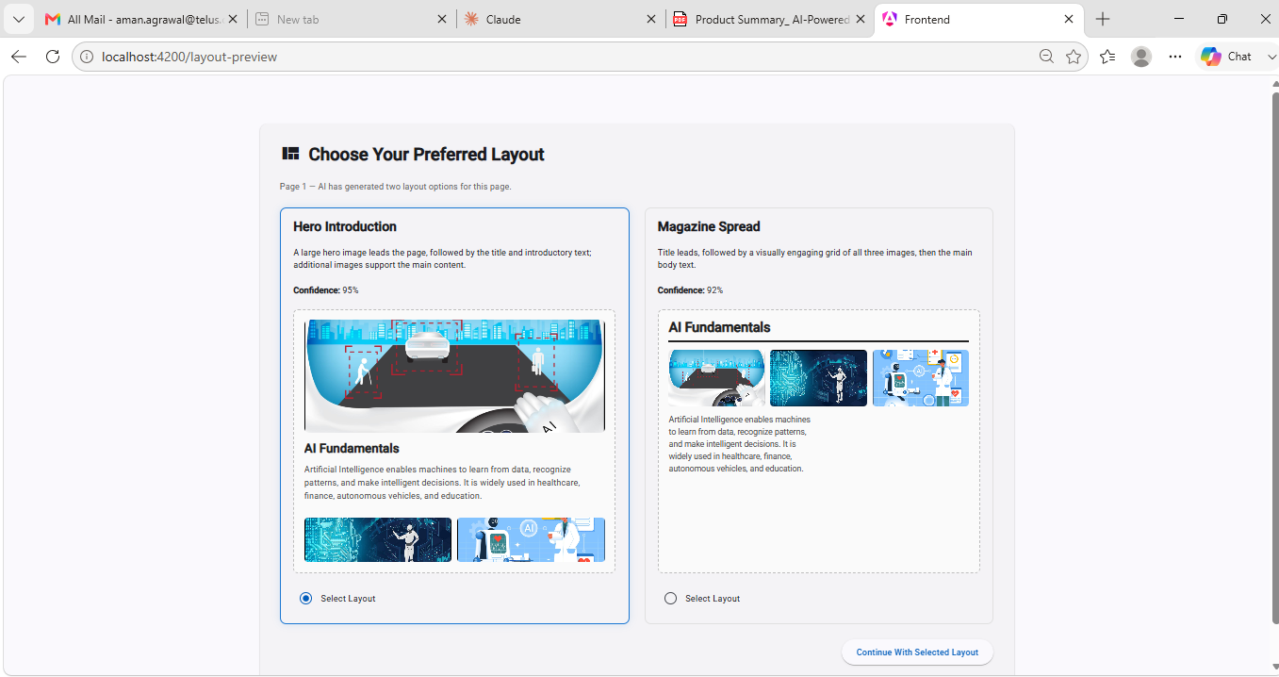
CODE WALKTHROUGH
AI-Powered
Visual Book Generator
A source-code deep dive: FastAPI, the LLM layout engine, and Angular rendering.
Aman Agrawal github.com/Aman007Agg/ai-powered-visual-book-generator

Slide 2
WHAT I'LL WALK THROUGH
Agenda
1
Folder structure
2
Tech choices
3
The contract
How the codebase is organised
Angular · FastAPI · OpenAI — and why
The JSON the LLM returns
4
Backend
5
The AI core
6
Frontend
FastAPI app, endpoint, schemas
Prompt + OpenAI service = why it's AI-powered
API, state, models, the layout renderer

Slide 3
REPOSITORY
Folder Structure
ai-powered-visual-book-generator
|-- backend
| |-- app
| | |-- api/ FastAPI routers (health, layout)
| | |-- core/ exceptions
| | |-- prompts/ system + user prompt builders
| | |-- schemas/ Pydantic request/response models
| | |-- services/ OpenAI service (orchestration + errors)
| | \-- main.py app + CORS + router registration
| |-- tests/ pytest (schemas, prompt, endpoint)
| \-- requirements.txt
|-- frontend
| \-- src/app
| |-- core/services/ http (ApiService) + state (BookState)
| |-- features/ routed screens
| \-- shared/
| |-- components/renderers/ LayoutRenderer + Hero/Split/Magazine
| |-- models/ typed contracts
| |-- pipes/ ImageRefPipe
| \-- utils/ groupSections()
\-- docs / README.md
What this does
Clear separation: backend (AI + API) vs frontend (UI + rendering).
Feature-first Angular structure; shared renderers, models, pipes, utils.
Backend split by responsibility: api, schemas, prompts, services.

Slide 4
CHOICES & RATIONALE
Why This Stack
Angular
FastAPI
OpenAI
Typed, component-driven SPA. Signals give simple, leak-free reactive state; owns all rendering.
Async, high-performance API. Pydantic validation makes the AI I/O a typed, safe contract.
Strong reasoning + JSON-object output we can validate and render deterministically.

Slide 5
THE CORE IDEA
What the LLM Returns (the contract)
{
"page_summary": "Short summary of the page",
"layout_options": [
{
"id": "layout_1",
"layout_type": "hero", // hero | split | magazine
"layout_name": "Hero Image",
"description": "Large hero image followed by text.",
"confidence": 95, // model self-rated 0-100
"sections": [
{ "type": "title", "text": "Artificial Intelligence" },
{ "type": "image", "image_reference": 0 },
{ "type": "paragraph", "text": "AI enables machines..." }
]
},
{ "id": "layout_2", "layout_type": "split", "sections": [ ... ] }
]
}
What this does
The LLM outputs SEMANTICS as JSON — never HTML/CSS.
Angular maps this JSON to a visual layout.
This clean contract = security, determinism, testability.

Slide 6
BACKEND · FASTAPI
App Setup (main.py)
app = FastAPI(
title="AI Powered Visual Book Generator API",
version="1.0.0",
)
# Allow the Angular app (localhost:4200) to call this API
app.add_middleware(
CORSMiddleware,
allow_origins=["http://localhost:4200"],
allow_credentials=True,
allow_methods=["*"],
allow_headers=["*"],
)
app.include_router(health_router) # GET /
app.include_router(layout_router) # POST /api/layout/generate
What this does
FastAPI is the bridge between Angular and OpenAI.
CORS lets the browser call the API cross-origin.
Routers register the endpoints; app stays stateless.

Slide 7
BACKEND · FASTAPI
The Endpoint (api/layout.py)
router = APIRouter(prefix="/api/layout", tags=["Layout"])
@router.post("/generate")
def generate_layout(request: GenerateLayoutRequest):
# FastAPI has ALREADY validated `request` against the
# Pydantic schema before this line runs.
return OpenAIService.generate_layout(request)
What this does
Thin router: it only receives a validated request and delegates.
Type hint = automatic request validation (422 on bad input).
All logic lives in OpenAIService — easy to test.

Slide 8
BACKEND · FASTAPI
Typed Contracts (Pydantic)
class GenerateLayoutRequest(BaseModel):
title: str | None = None # optional context
objective: str | None = None # optional context
page_text: str = Field(..., min_length=1) # required
images: list[PageImage] = Field(default_factory=list)
class LayoutSection(BaseModel):
type: SectionType # title | paragraph | image
text: str | None = None
image_reference: int | None = Field(default=None, ge=0)
class LayoutOption(BaseModel):
id: str
layout_type: str # hero | split | magazine
layout_name: str
description: str
confidence: int = Field(ge=0, le=100)
sections: list[LayoutSection]
class GenerateLayoutResponse(BaseModel):
page_summary: str
layout_options: list[LayoutOption]
What this does
One schema validates the request; one validates the AI response.
Bounds (min_length, ge/le) reject bad data automatically.
This is the safety net around a non-deterministic model.

Slide 9
BACKEND · THE AI CORE
The Prompt = the AI's Instructions (abridged)
SYSTEM_PROMPT = """
You are an expert editorial designer specializing in book layouts.
Generate EXACTLY TWO different layout recommendations.
Your task is NOT to generate HTML, CSS, or coordinates.
Decide ONLY: which layout, section order, which image per section.
CONSTRAINTS:
- "layout_type" MUST be one of: "hero", "split", "magazine".
- The TWO options MUST use TWO DIFFERENT layout_type values.
- "confidence" is an integer 0-100.
- "image_reference" is 0-based and < number of images.
Return ONLY valid JSON (no markdown, no explanations).
"""
What this does
Prompt engineering: role, goal, hard constraints, output schema.
Forces two DIFFERENT layouts so the choice is meaningful.
Explicitly forbids HTML/CSS — the model only reasons.

Slide 10
BACKEND · THE AI CORE
Dynamic User Prompt (build_user_prompt)
def build_user_prompt(title, objective, page_text,
image_count) -> str:
return f"""
Book Title: {title or "Not Provided"}
Book Objective: {objective or "Not Provided"}
Uploaded Images: {image_count}
Page Content:
{page_text}
Generate EXACTLY TWO layout options using two DIFFERENT
layout_type values. Never use an image_reference >= {image_count}.
"""
What this does
Injects this page's real content + context into the prompt.
Passes the image COUNT (vision is scoped for the MVP).
Repeats the key constraints right next to the data.

Slide 11
BACKEND · THE AI CORE
Where the LLM Works (openai_service.py)
response = client.chat.completions.create(
model=MODEL_NAME, # gpt-4.1
response_format={"type": "json_object"}, # force JSON
messages=[
{"role": "system", "content": SYSTEM_PROMPT},
{"role": "user", "content": user_prompt},
],
temperature=0.5,
)
data = json.loads(response.choices[0].message.content)
validated = GenerateLayoutResponse.model_validate(data) # Pydantic
return validated.model_dump()
# except AuthenticationError -> 401, RateLimitError -> 429,
# BadRequestError(context) -> 400, others -> 500 (typed errors)
What this does
THIS is the AI: GPT reasons about the page and returns a layout.
json_object mode + Pydantic = safe, structured output.
Typed error mapping turns OpenAI failures into clean HTTP codes.

Slide 12
FRONTEND · COMMUNICATION
Calling the API (ApiService)
@Injectable({ providedIn: 'root' })
export class ApiService {
private http = inject(HttpClient);
private apiUrl = environment.apiBaseUrl + '/layout/generate';
generateLayouts(req: GenerateLayoutRequest)
: Observable<GenerateLayoutResponse> {
return this.http
.post<GenerateLayoutResponse>(this.apiUrl, req)
.pipe(
retry({ count: 1, delay: 1000 }), // transient failures
catchError(err => throwError(() => err)),
);
}
}
What this does
The one place Angular talks to the backend (typed HttpClient).
RxJS is used here — the natural fit for an async HTTP call.
Retries once before surfacing an error to the UI.

Slide 13
FRONTEND · STATE
Single Source of Truth (BookStateService)
@Injectable({ providedIn: 'root' })
export class BookStateService {
private _pages = signal<BookPage[]>([]);
private _draftResponse =
signal<GenerateLayoutResponse | undefined>(undefined);
readonly pages = this._pages.asReadonly();
readonly pageCount = computed(() => this._pages().length);
commitCurrentPage(selectedLayoutId: string): void {
const res = this._draftResponse();
const layout = res?.layout_options
.find(o => o.id === selectedLayoutId);
if (!res || !layout) return;
this._pages.update(p => [...p, {
pageNumber: p.length + 1,
selectedLayout: layout,
/* + pageText, images, pageSummary */
}]);
}
}
What this does
Signals store: reactive, glitch-free, zoneless-friendly.
commitCurrentPage() turns the chosen option into a book page.
Private writable signals; public read-only — safe encapsulation.

Slide 14
FRONTEND · CONTRACT
Typed Models Angular Consumes
export type SectionType = 'title' | 'paragraph' | 'image';
export interface LayoutSection {
type: SectionType;
text?: string;
image_reference?: number;
}
export interface LayoutOption {
id: string;
layout_type: string; // hero | split | magazine
layout_name: string;
description: string;
confidence: number;
sections: LayoutSection[];
}
What this does
Front-end mirrors the backend JSON contract as TypeScript types.
Strong typing catches mistakes at compile time.
Same shape end-to-end: Pydantic <-> TypeScript interfaces.

Slide 15
FRONTEND · RENDERING
How Angular Renders the Layout (LayoutRenderer)
// layout-renderer.ts
export class LayoutRenderer {
readonly layout = input.required<LayoutOption>();
readonly images = input<PageImage[]>([]);
readonly layoutType = computed(() =>
(this.layout().layout_type ?? '').toLowerCase().trim());
}
// layout-renderer.html (Strategy pattern via @switch)
@switch (layoutType()) {
@case ('split') { <app-split-layout .../> }
@case ('magazine') { <app-magazine-layout .../> }
@default { <app-hero-layout .../> } // + fallback
}
What this does
Reads layout_type and picks a component at runtime (Strategy).
Adding a layout = new component + one branch (open/closed).
Unknown type falls back to Hero — the UI never breaks.

Slide 16
FRONTEND · RENDERING
JSON -> Pixels: helpers
// section-grouping.ts (simplified)
export function groupSections(sections) {
const g = { title:'', paragraphs:[], imageRefs:[] };
for (const s of sections ?? []) {
if (s.type==='title' && s.text) g.title ||= s.text;
if (s.type==='paragraph' && s.text) g.paragraphs.push(s.text);
if (s.type==='image' && s.image_reference!=null)
g.imageRefs.push(s.image_reference);
}
return g;
}
// image-ref.pipe.ts — resolve index -> base64
transform(ref, images) {
return (ref==null || !images) ? '' : images[ref]?.base64 ?? '';
}
What this does
Each layout groups sections by role, then arranges them its own way.
The pipe maps the AI's image_reference index to the real image.
HeroLayout/Split/Magazine reuse these — DRY + testable.

Slide 17
ENGINEERING
Real Problems Solved
Two options looked identical
Image preview lagged one click
Renderer ignored layout_type -> built a Strategy renderer + prompt forces two different types.
Zoneless change detection missed the async FileReader -> moved to Signals.
Hero image cropped / gaps
Single page -> full book
Tuned object-fit (cover vs contain) + sized images to their aspect.
Introduced a Signals BookStateService (Book / BookPage model).
Unsafe LLM output
'Vision' not wired
json_object + Pydantic validation; bad output fails, never reaches UI.
Caught in QA; scoped + documented with a one-line upgrade path.

Slide 18
End-to-End, in One Line
Angular sends text + images -> FastAPI validates & prompts -> OpenAI returns JSON -> Pydantic validates -> Angular renders the chosen layout.
Why it's an AI-powered book generator: the layout decisions themselves are made by the LLM reasoning over each page — not by fixed templates.
Aman Agrawal github.com/Aman007Agg/ai-powered-visual-book-generator

